Slide 1

DAEGU REAL ESTATE MARKET ANALYSIS: Investment & Accessibility Insights
A Comprehensive Analysis of Daegu's Property Market
Venkata Akhil Mettu
December 11, 2024

Slide 2
Business Context & Problem Statement
Background:
Real estate investments in Daegu require detailed market understanding.
Investors need data-driven insights for decision-making.
Complex interplay between location, accessibility, and property values.
Business Problems:
How do property values correlate with location and accessibility?
What factors drive investment potential in different areas?
How can we optimize property selection based on facilities and transit access?
Project Objectives:
Create comprehensive market analysis dashboard.
Develop location intelligence framework.
Provide actionable investment insights.

Slide 3
Methodology & Data Overview
Approach:
Dataset: 5,891 property records.
Tools: Microsoft Power BI.
Analysis Framework:
Investment Metrics.
Location Intelligence.
Accessibility Scoring.
Key Metrics Developed:
Price trends and growth patterns.
Transit accessibility scoring.
Facilities impact assessment.

Slide 4
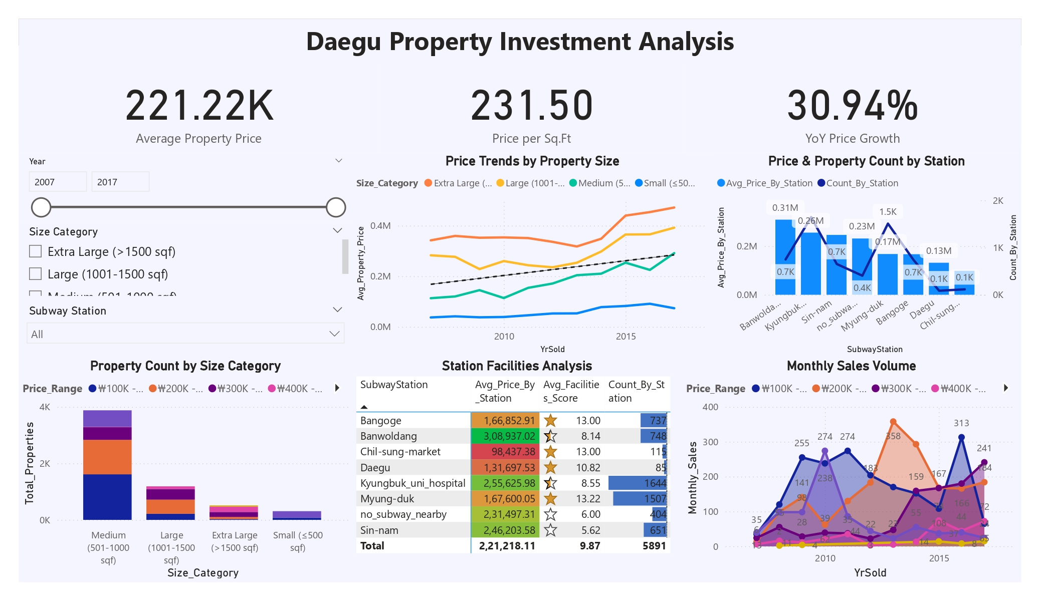
Dashboard 1 - Investment Analysis

Slide 5
Dashboard 1 - Investment Analysis
Key Components:
1. KPI Development:
Average Property Price: 221.22K
Price per Sq.Ft: 231.50
YoY Growth: 30.94%
2. Visualization Strategy:
Interactive filters.
Multi-dimensional analysis.
Trend monitoring.

Slide 6
Investment Insights
Key Findings:
Premium Locations:
Banwoldang: Highest avg. price (308,937).
Kyungbuk_uni_hospital: Highest volume (1,644 units).
Market Dynamics:
Size-based price variations.
Monthly sales patterns.
Growth corridors.

Slide 7
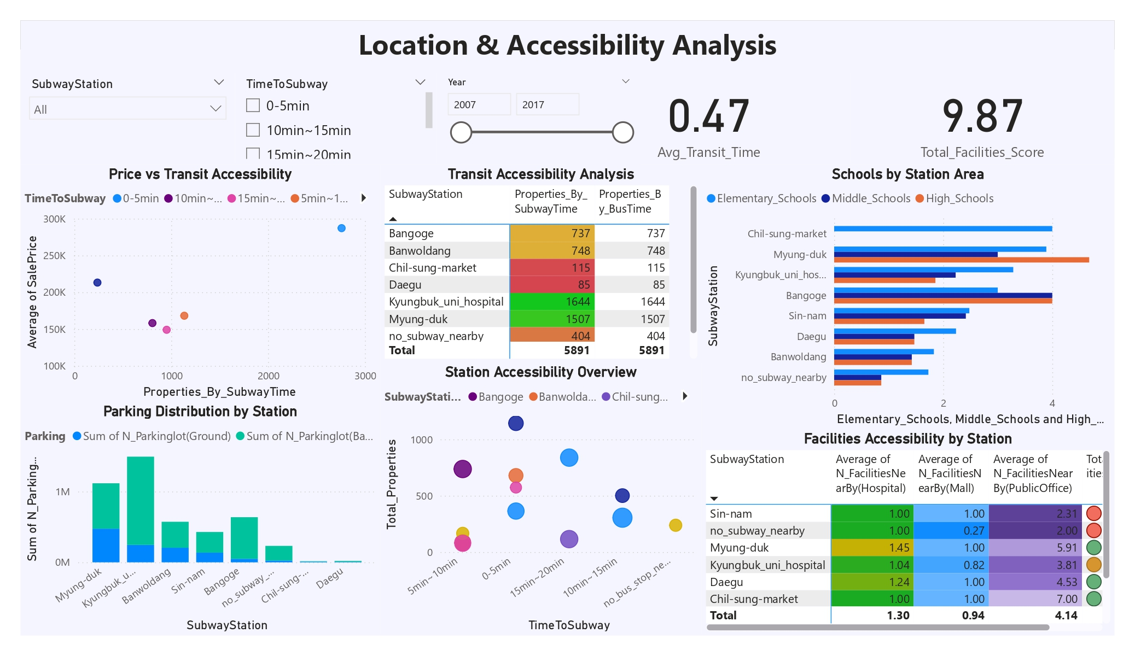
Dashboard 2 - Location Intelligence

Slide 8
Dashboard 2 - Location Intelligence
Framework Development:
Transit Scoring System.
Facilities Assessment.
Educational Institution Impact.
Key Metrics:
Transit Score: 0.47
Facilities Score: 9.87

Slide 9
Location Analysis Insights
Critical Findings:
Transit Impact:
Property value correlation
Accessibility patterns
Facility Distribution:
Educational hub influence.
Infrastructure value-add.

Slide 10
Technical Implementation
Development Process:
1. Data Modeling:
Relationship building.
DAX measure creation.
Visual optimization.
2. Dashboard Features:
Interactive filtering.
Cross-filtering.
Dynamic updates.

Slide 11
Challenges & Solutions
Challenges Faced:
1. Data Complexity:
Multiple facility types.
Transit time calculations.
Price normalization.
Solutions Implemented:
Custom DAX measures.
Advanced filtering.
Visual hierarchy.

Slide 12
Recommendations
Strategic Insights:
1. Investment Strategy:
Focus on medium-sized properties.
Target transit-oriented locations.
Leverage facility scores.
2. Value Optimization:
Educational proximity.
Transit accessibility.
Infrastructure development.

Slide 13
Business Impact & Learning
Project Outcomes:
1. Actionable Insights:
Market understanding.
Investment guidance.
Location optimization.
2. Technical Skills:
Power BI expertise.
DAX proficiency.
Data visualization.
Learning & Growth:
Data modeling complexity.
Business intelligence application.
Real estate market dynamics.

Slide 14
Thank You

