Slide 1
Air Quality Analytics: A Comprehensive Analysis Case Study
Data-Driven Environmental Monitoring & Decision Making
Venkata Akhil Mettu
December 13th, 2024

Slide 2
agenda
Business Context & Objectives 3
Project Scope & Approach 4
Primary Environmental Metrics 5
Advanced Compound Relations 7
Business Impact & Value Creation 10

Slide 3
Business Context & Objectives
Background:
Environmental monitoring agency tasked with analyzing air quality trends.
Need for comprehensive understanding of pollutant behaviors and correlations.
Goal to improve air quality monitoring and decision-making processes.
Key Challenges:
Complex relationships between different pollutants.
Seasonal and temporal variations in air quality.
Multiple pollutant types requiring synchronized monitoring.

Slide 4
Project Scope & Approach
Two-Phase Dashboard Implementation:
1. Primary Environmental Metrics
Core pollutant monitoring.
Environmental condition tracking.
Seasonal pattern analysis.
2. Advanced Compound Relations
Pollutant correlations.
Temporal pattern analysis.
Specialized compound monitoring.

Slide 5
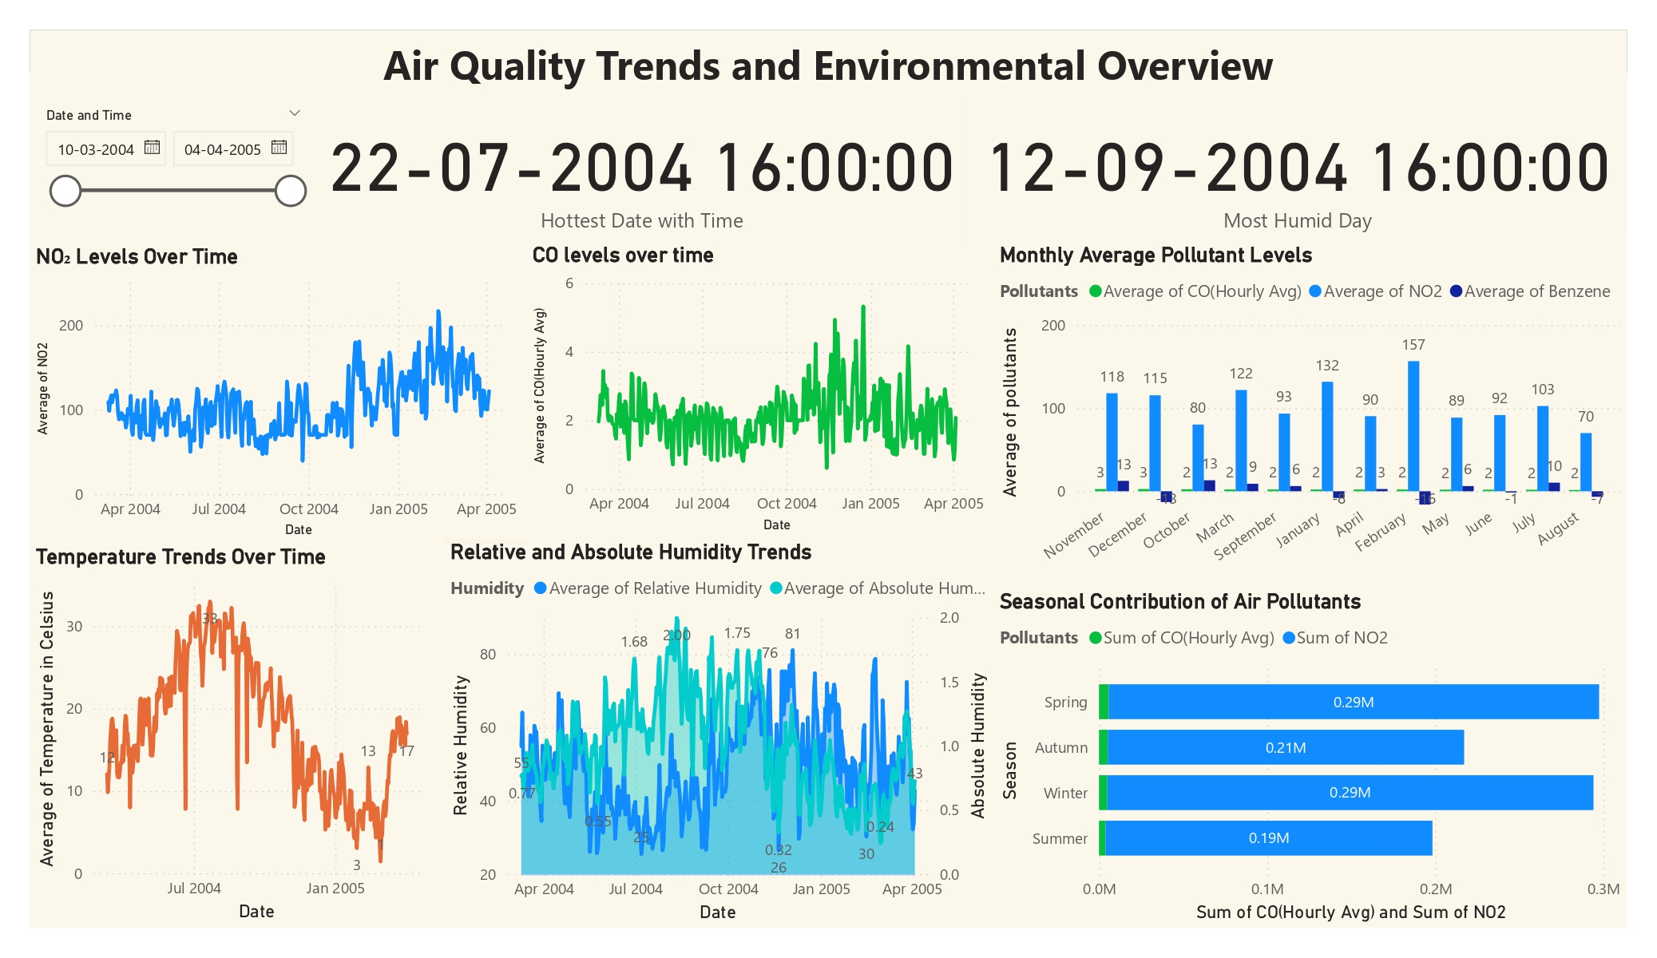
Primary Environmental Metrics - Key Findings

Slide 6
Primary Environmental Metrics - Key Findings
Key Insights:
Peak NO₂ levels observed in January 2005.
Strong seasonal variations in temperature (0-30°C).
Highest pollution levels in Spring/Winter (0.29M).

Slide 7
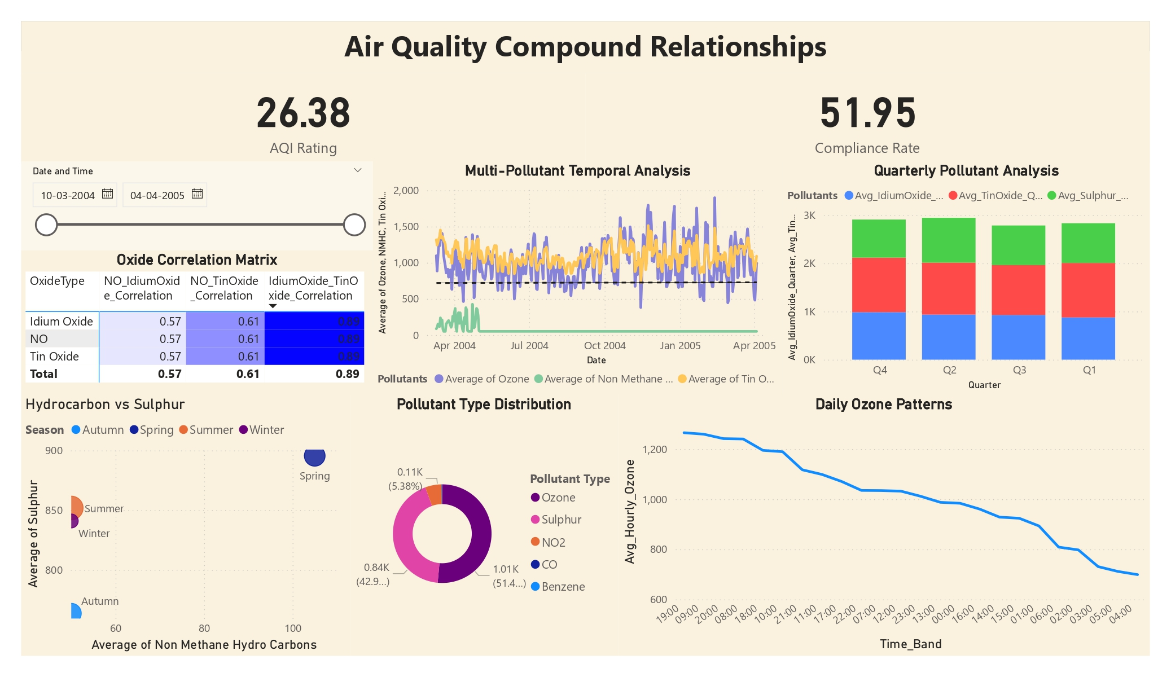
Advanced Compound Relations - Key Findings

Slide 8
Advanced Compound Relations - Key Findings
Key Insights:
Strong correlation between Idium Oxide and Tin Oxide (0.89).
Daily Ozone patterns showing peak concentrations.
Quarterly variations in pollutant levels.

Slide 9
Critical Insights & Patterns
Environmental Patterns:
Seasonal variations in pollutant levels.
Temperature impact on pollution concentration.
Humidity correlations with pollutant levels.
Pollutant Relationships:
Strong oxide correlations.
Temporal patterns in ozone levels.
Hydrocarbon-Sulphur relationships.

Slide 10
Business Impact & Value Creation
Operational Improvements:
Enhanced monitoring capabilities.
Better prediction of pollutant behaviors.
Improved decision-making framework.
Risk Management:
Early warning system for high pollution levels.
Better understanding of compound interactions.
Seasonal preparation strategies.

Slide 11
Thank You

