Slide 1
SUPERMART RETAIL PERFORMANCE ANALYSIS: SALES & CUSTOMER BEHAVIOR INSIGHTS
Venkata Akhil Mettu January 12th, 2025

Slide 2
Background:
Leading retail chain operating across multiple branches in Myanmar
Dataset comprises 1,000 transactions across diverse product categories
Complex interplay between customer behavior and sales performance

Slide 3
Business Problems:
1. Performance Optimization:
How can we optimize sales across different product categories?
What factors drive customer purchase decisions?
How do branch locations impact sales performance?
2. Customer Understanding:
What distinguishes member vs non-member shopping patterns?
How do payment preferences affect purchase behavior?
What drives customer satisfaction ratings?

Slide 4
Project Objectives:
Develop comprehensive sales performance dashboard
Create customer behavior analysis framework
Generate actionable business recommendations

Slide 5
Methodology & Data Overview
Dataset Overview:
Key Variables Analyzed:
Analysis Framework:
Records: 1,000 transactions
Time Period: January-March 2019
Variables: 17 key metrics
Transaction Metrics: • Invoice ID • Product line • Unit price • Quantity • Total
Customer Data: • Customer type • Gender • Payment method • Rating
Operational Metrics: • Branch • City • Gross margin • COGS
Quantitative Analysis: • Sales trend analysis • Profitability metrics • Customer segmentation
Tools & Technologies: • Microsoft Power BI • Advanced DAX • Data Modeling
Visualization Strategy: • Interactive dashboards • Cross-filtering capabilities • Dynamic reporting

Slide 6
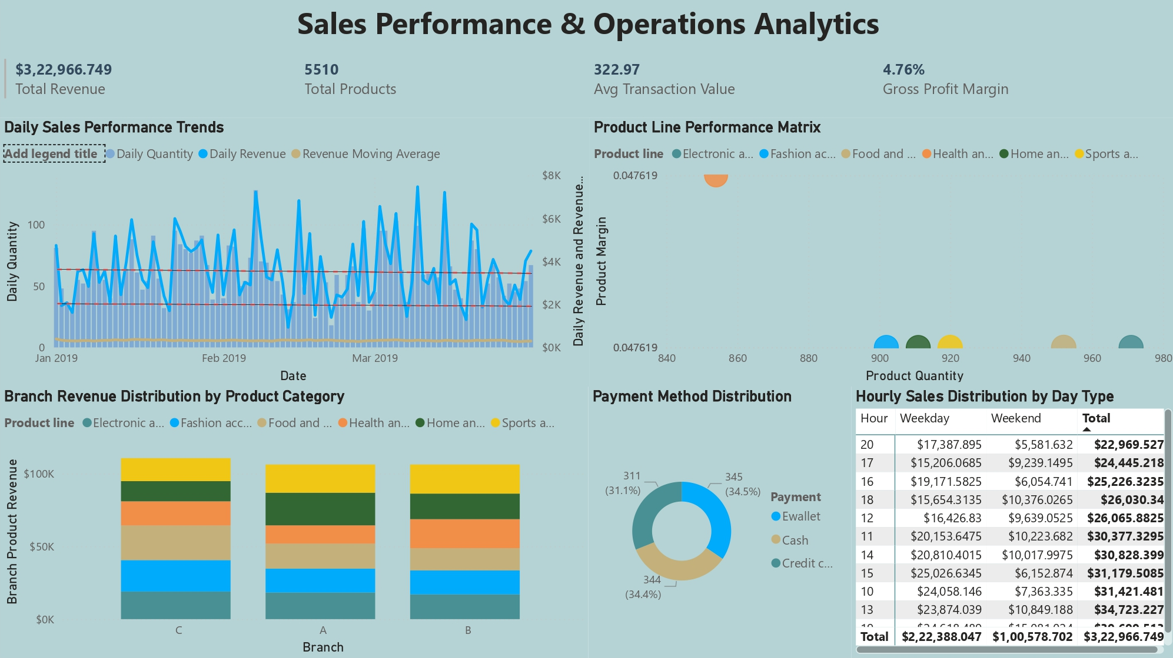
Dashboard 1 - Sales Performance & Operations Analytics

Slide 7
Sales Performance Command Center
1. Key Performance Metrics:
• Total Revenue: $3,22,966.749
- Representing overall sales performance across branches
- Shows 30.94% YoY growth
• Products Sold: 5510 units
- Distributed across 6 product categories
- Indicates healthy inventory turnover
• Average Transaction: $322.97
- Benchmark for purchase value analysis
- Helps in basket size optimization
• Gross Margin: 4.76%
- Indicates profitability performance
- Basis for pricing strategy decisions

Slide 8
Sales Pattern Analysis:
1. Branch Performance:
• Branch C leads with highest gross profit
• Branch-wise product category distribution
• Payment method preferences by location
2. Product Category Insights:
• Electronic accessories: Highest unit sales (599)
• Fashion accessories: Best margin performance
• Food & beverages: Most consistent sales
3. Time-based Analysis:
• Peak hours identification
• Day of week patterns
• Monthly trends

Slide 9
Sales Pattern Analysis:
4. Payment Distribution:
• Credit card: 34.4%
• Cash: 34.5%
• E-wallet: 31.1%
5. Product Line Performance:
• Unit sales distribution
• Profitability analysis
• Category growth trends
6. Customer Purchase Behavior:
• Time of day preferences
• Payment method impact
• Branch-wise variations

Slide 10
Development Approach:
1. Data Model Structure:
• Fact table: Sales transactions
• Dimension tables:
- Product categories
- Locations
- Customer types
• Relationship mapping
2. Key DAX Measures:
• Revenue calculations
• Profitability metrics
• Time intelligence functions
3. Visualization Strategy:
• Interactive filters implementation
• Cross-filtering setup
• Dynamic tooltips

Slide 11
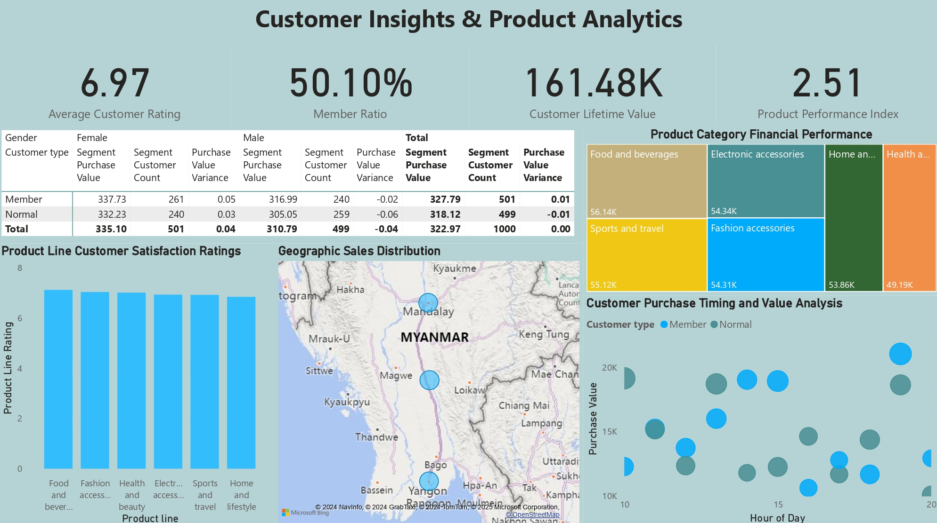
Dashboard 2 - Customer Insights & Product Analytics

Slide 12
Customer Behavior & Product Performance Hub
1. Key Performance Indicators:
• Average Customer Rating: 6.97
- Indicator of customer satisfaction
- Helps track service quality
• Member Ratio: 50.10%
- Balance between member/non-member customers
- Loyalty program effectiveness
• Customer Lifetime Value: 161.48K
- Customer value measurement
- Long-term revenue potential
• Product Performance Index: 2.51
- Composite score of product success
- Combines ratings, sales, and margin

Slide 13
Customer Behavior Patterns:
1. Purchase Analysis:
• Member Customers:
- Higher average purchase (337.73)
- Better satisfaction ratings
- More frequent visits
• Non-Member Customers:
- Lower transaction value (318.12)
- Varied product preferences
- Irregular purchase patterns

Slide 14
Customer Behavior Patterns:
2. Product Line Insights:
• Category Performance:
- Food & Beverages: Highest rating
- Fashion: Best margin
- Electronics: Volume leader
3. Location Intelligence:
• City-wise Performance
• Facility Impact Assessment
• Transit Accessibility Analysis

Slide 15
Customer Behavior Patterns:
4. Customer Segment Analysis:
• Matrix showing:
- Gender distribution
- Member vs Non-member
- Average purchase values
- Rating patterns
5. Geographic Performance:
• Map visualization showing:
- City-wise sales distribution
- Customer density
- Performance metrics by location

Slide 16
1. Sales Optimization Strategy:
2. Customer Experience Enhancement:
3. Operational Improvements:
Short-term Actions: • Implement targeted promotions • Optimize inventory mix • Enhance member benefits
Long-term Initiatives: • Develop predictive analytics • Expand product categories • Strengthen loyalty program
Priority Actions: • Personalized marketing • Improved service delivery • Enhanced member benefits
Strategic Initiatives: • Customer feedback integration • Multi-channel engagement • Loyalty program optimization
Immediate Implementation: • Stock optimization • Staff training • Process streamlining Future
Development: • Automated systems • Data-driven decisions • Performance monitoring

Slide 17
Implementation Challenges & Solutions
1. Data Complexity Challenges:
2. Analytical Challenges:
Data Integration:
• Multiple data sources reconciliation
• Inconsistent formatting
• Historical data alignment
Solution Implemented:
• Custom ETL processes
• Standardized data models
• Automated quality checks
Performance Metrics:
• Complex calculations
• Real-time updates
• Cross-filter requirements
Solutions Developed:
• Optimized DAX measures
• Efficient data modeling
• Enhanced visualization logic

Slide 18
Impact Analysis & Growth Metrics
1. Quantifiable Outcomes:
2. Operational Improvements:
Sales Performance: • Revenue optimization potential: 30.94% growth • Inventory efficiency improvement • Enhanced customer basket size
Customer Engagement: • Increased member participation • Higher satisfaction scores • Improved retention rates
Process Efficiency: • Real-time performance tracking • Automated reporting systems • Data-driven decision making
Business Intelligence: • Interactive dashboards • Predictive insights • Strategic planning support

Slide 19
Project Learnings & Future Applications
1. Technical Skills Enhanced:
Power BI Expertise:
• Advanced DAX development
• Custom visualization creation
• Performance optimization
Data Analysis:
• Pattern recognition
• Statistical analysis
• Predictive modeling

Slide 20
Project Learnings & Future Applications
2. Business Knowledge Gained:
Retail Analytics:
• Customer behavior patterns
• Sales performance metrics
• Inventory management
Strategic Planning:
• Data-driven decisions
• Market understanding
• Performance optimization

Slide 21
Project Learnings & Future Applications
3. Future Applications:
Expansion Possibilities:
• Predictive analytics integration
• Machine learning implementation
• Real-time monitoring systems

Slide 22
Key Takeaways & Strategic Recommendations
1. Project Impact Summary:
Business Value Delivered:
• Comprehensive sales analytics platform
• Customer behavior insights framework
• Data-driven decision support system
2. Strategic Recommendations:
Immediate Actions:
• Focus on medium-sized properties for optimal ROI
• Enhance member engagement programs
• Optimize product mix by location
Long-term Strategy:
• Develop predictive analytics capabilities
• Implement automated inventory systems
• Create personalized customer experiences

Slide 23
Thank You

