Slide 1
Rythu Mitra
Telugu–English Agricultural
Query Assistant
Natural Language Processing project
B.Tech CSE, SR University
Akhil Naragani and team
RYTHU MITRA / NLP PROJECT
01
Notes:
Opening: introduce the project as an NLP intent classifier with practical advisory workflows. The title uses the known presenter name and a team label because other names were not supplied. Replace that editable line with the final team names before presenting if desired. Sources: Project source: C:\Users\akhil\Desktop\NLP_PROJECT\index.html; Project source: C:\Users\akhil\Desktop\NLP_PROJECT\js\answers.js.

Slide 2
Problem statement
Farmers ask in Telugu, English and mixed spellings
“na potato chetu ki holes unnay em cheyali”
Language variation
An incomplete question
Romanized Telugu, Telugu script and spelling differences make keyword-only matching brittle.
The assistant still needs the affected part and visible symptoms before suggesting treatment.
RYTHU MITRA / NLP PROJECT
02
Notes:
Explain the language mismatch with the sample question, then separate the question's topic from the actual agronomic cause. Holes do not uniquely identify a pest. The system must recognize the crop and symptom and give useful next steps while seeking missing details. The quote is the user's actual test query, not a dataset claim. Sources: Project source: C:\Users\akhil\Desktop\NLP_PROJECT\js\practical.js; Project source: C:\Users\akhil\Desktop\NLP_PROJECT\tests\practical.cjs.

Slide 3
Objectives and scope
01
Understand the question
Recognize the farming topic across Telugu, English and mixed queries.
02
Extract useful details
Identify crop, symptoms, district and growth stage when the wording supplies them.
03
Provide a next step
Show sourced first actions, conditional calculations or the relevant official service.
04
Ask for missing details
Keep the original question attached when the farmer adds information.
RYTHU MITRA / NLP PROJECT
03
Notes:
Describe the objectives as working system capabilities. Recognition combines trained ML with explicit routing and entity rules. The website does not claim to answer every possible agricultural question. Weather and mandi rates require services, while private payment status and equipment availability remain on official external channels. Sources: Project source: C:\Users\akhil\Desktop\NLP_PROJECT\js\requests.js; Project source: C:\Users\akhil\Desktop\NLP_PROJECT\js\answers.js; Project source: C:\Users\akhil\Desktop\NLP_PROJECT\js\entities.js.

Slide 4
Dataset and label design
12,625 workbook rows
Expanded text examples
20 original intent labels
Training 36,443
Validation 4,101
Test 3,850
Telugu, English and code-mixed query columns
Seven farm topics + authored out_of_scope
16,206 synthetic examples
within training
Dataset provenance and templates limit claims about real farmer use
RYTHU MITRA / NLP PROJECT
04
Notes:
The supplied workbook contains 12,625 rows and 20 original intent labels, with Telugu, English and code-mixed query columns. The pipeline maps the labels to seven farm topics and adds an authored out_of_scope class. Query versions and wording groups stay together during splitting. The split counts refer to expanded text examples, not the original workbook rows. The training count of 36,443 includes 16,206 synthetic examples. Out_of_scope has no genuine workbook test rows. Provenance does not establish real farmer authorship. Sources: Project source: C:\Users\akhil\Desktop\NLP_PROJECT\reports\dataset_statistics.json; Project source: C:\Users\akhil\Desktop\NLP_PROJECT\ml\models\metrics.json; Project source: C:\Users\akhil\Desktop\NLP_PROJECT\ml\data.py; Project source: C:\Users\akhil\Desktop\NLP_PROJECT\reports\dataset_audit.md.

Slide 5
Methodology
1 Prepare text
Unicode normalization and selected spelling variants
2 Represent text
Word TF-IDF, character TF-IDF or their combination
3 Predict a topic
Naive Bayes, Logistic Regression or Linear SVM
4 Add context
Crop, symptom, location and focused question rules
5 Respond
Reviewed guidance, live lookup or a specific follow-up
RYTHU MITRA / NLP PROJECT
05
Notes:
Walk through the pipeline in order. NFC and Unicode L/M filtering retain Telugu letters and combining marks. Normalization removes punctuation, digits and URLs from classifier text and standardizes selected romanized spellings. It keeps stopwords. The implementation separately extracts quantities from the original query for calculations. TF-IDF word features use unigrams and bigrams; character features use char_wb n-grams of length 2 to 5. Classification predicts a topic, and entity/routing rules then guide the answer. Sources: Project source: C:\Users\akhil\Desktop\NLP_PROJECT\ml\preprocess.py; Project source: C:\Users\akhil\Desktop\NLP_PROJECT\ml\train.py; Project source: C:\Users\akhil\Desktop\NLP_PROJECT\ml\slots.py; Project source: C:\Users\akhil\Desktop\NLP_PROJECT\js\requests.js.

Slide 6
Experiments and model selection
Three classifiers
Three feature sets
Multinomial Naive Bayes
Logistic Regression
Linear SVM
Word unigrams and bigrams
Character n-grams, lengths 2–5
Combined word + character features
Five-fold grouped cross-validation
Validation macro-F1 selects Logistic Regression with word TF-IDF
The authored benchmark reports generalization after model selection
RYTHU MITRA / NLP PROJECT
06
Notes:
Explain why nine experiments exist: three classifiers times three feature families. Group-aware five-fold CV uses original training text with fold-local TF-IDF. Synthetic coverage enters final model fitting, so CV and validation use different training regimes. Validation macro-F1 selects the winner, with accuracy as a tie-break. The saved selection is Logistic Regression with word features. The 319-query challenge is for reporting and must not retrospectively choose a different model. The character and combined models improve challenge scores, which provides a future research direction. Source: Project source: C:\Users\akhil\Desktop\NLP_PROJECT\ml\train.py; Project source: C:\Users\akhil\Desktop\NLP_PROJECT\reports\model_comparison.md.

Slide 7
Results on the 319-query authored benchmark
Raw selected model: 79.00% accuracy and 80.02% macro-F1
RYTHU MITRA / NLP PROJECT
07
Notes:
Every value comes from robustness.raw_models in the saved metrics. Raw selected Logistic Regression/word accuracy is 79.00% and macro-F1 is 80.02%. Character and combined Logistic Regression both reach 88.09% accuracy on this challenge. The selected model remains fixed by validation selection. Macro-F1 is the unweighted mean of per-class F1. This authored challenge does not represent a farmer population survey. Exact machine-readable values remain embedded in the editable chart. Source: Project source: C:\Users\akhil\Desktop\NLP_PROJECT\ml\models\metrics.json, robustness.raw_models.

Slide 8
Generalization depends on the evaluation set
Evaluation | Queries | Accuracy | Macro-F1
Selected model: workbook | 3,850 | 100.00% | 100.00%
Selected model: original authored | 150 | 87.33% | 86.82%
Selected model: larger authored | 319 | 79.00% | 80.02%
Saved routing rules + selected ML | 319 | 83.39% | 83.88%
Cross-script: separate combined LR | 1,256 | 54.70% | 11.64%
Different sizes and difficulty prevent a direct ranking of these sets
Cross-script uses a different model/training protocol. Saved rules differ from the latest expansion.
RYTHU MITRA / NLP PROJECT
08
Notes:
Read the first three rows as evaluations of the selected word-feature model. The workbook held-out set has 3,850 examples and seven genuine workbook classes. The original authored benchmark has 150 queries and the larger challenge has 319. The fourth row applies the saved deployed guard and slot rules to the same 319 queries. The fifth row uses a separately fitted combined-feature Logistic Regression with C=2 and a different transfer-training protocol, so it is not the selected word model's cross-script score. All rows are stored evaluation snapshots and predate the latest advisory/question-rule expansion. Source: Project source: C:\Users\akhil\Desktop\NLP_PROJECT\ml\models\metrics.json; Project source: C:\Users\akhil\Desktop\NLP_PROJECT\ml\robustness.py.

Slide 9
Implementation
Browser interface
Local Python server
HTML, CSS and vanilla JavaScript
Language toggle and contextual follow-ups
Exported model for browser inference
Flask /predict and /prices endpoints
Saved scikit-learn estimator
Server-side price-service connection
Shared configuration keeps Python and browser extraction aligned
The answer layer combines reviewed guidance with service responses
RYTHU MITRA / NLP PROJECT
09
Notes:
The site uses HTML, CSS and vanilla JavaScript. app.py serves Flask prediction and price endpoints. The exported winning estimator supports browser inference as a fallback, rather than a different centroid substitute. Shared slot configuration drives Python and browser rules. The answer layer uses curated text and service adapters; there is no generative LLM answering arbitrary questions. The optional Windows price adapter uses the working PowerShell connection path. API credentials stay server-side and no key appears in this presentation. Sources: Project source: C:\Users\akhil\Desktop\NLP_PROJECT\app.py; Project source: C:\Users\akhil\Desktop\NLP_PROJECT\js\classifier.js; Project source: C:\Users\akhil\Desktop\NLP_PROJECT\js\entities.js; Project source: C:\Users\akhil\Desktop\NLP_PROJECT\js\answers.js; Project source: C:\Users\akhil\Desktop\NLP_PROJECT\js\requests.js; Project source: C:\Users\akhil\Desktop\NLP_PROJECT\ml\prices.py.

Slide 10
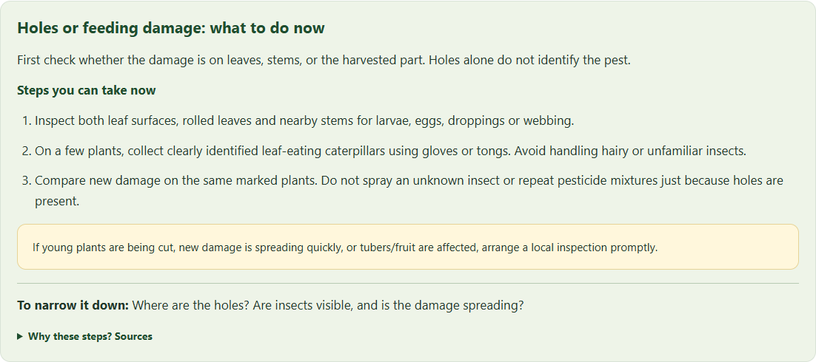
Practical guidance from a recognized symptom
Recognized context
Crop: Potato
Symptom: Holes
Next question
Leaves, stems
or tubers?
Actual website output. First actions support inspection and do not confirm the pest.
RYTHU MITRA / NLP PROJECT
10
Notes:
Demonstrate the exact query: na potato chetu ki holes unnay em cheyali. The real website recognizes potato and the holes symptom. It gives leaf-surface inspection, cautious physical collection of identified caterpillars on a few plants and monitoring, then offers affected-part follow-ups. It does not establish a diagnosis from the word holes. Clicking tubers changes the checks to tunnels near the eyes and separate storage handling, using TNAU guidance. The screenshot is an actual local offline rendering of current project files with no mocked API result. Sources: Project source: C:\Users\akhil\Desktop\NLP_PROJECT\js\practical.js; Project source: C:\Users\akhil\Desktop\NLP_PROJECT\tests\practical.cjs; https://ipm.ucanr.edu/home-and-landscape/leaf-feeding-caterpillars/ ; https://agritech.tnau.ac.in/crop_protection/potato/potato_2.html .

Slide 11
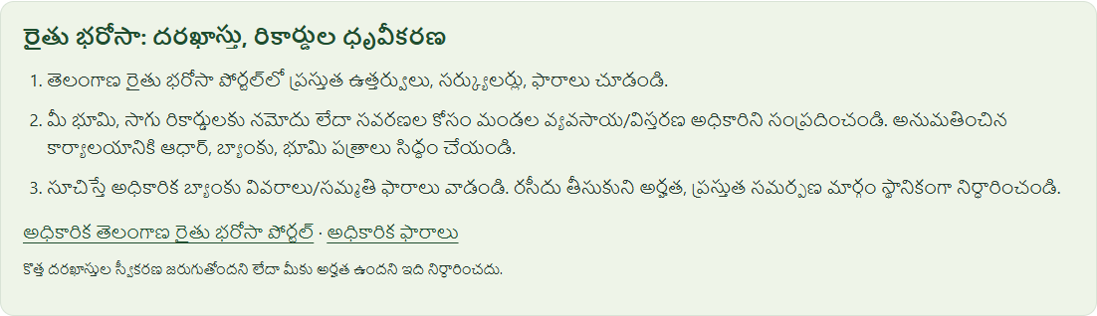
Telugu, English and mixed-language questions
“ఈరోజు వరంగల్ మార్కెట్‌లో
మిర్చి ధర ఎంత ఉంది?”
Chilli + Warangal + market price
“Hanamkonda దగ్గర soil testing
ఎక్కడ చేస్తారు?”
Soil Health Card + Hanumakonda
The user can switch the interface language without changing the query
RYTHU MITRA / NLP PROJECT
11
Notes:
These are authored functional regression examples, not a representative accuracy sample. Thirty variants cover the user's ten question types in Telugu, English and mixed forms. The shared configuration adds the Telugu chilli name and Telugu district aliases and recognizes soil testing, PM-KISAN, Rythu Bharosa and equipment rental requests. The Telugu screenshot is the real website's Rythu Bharosa guidance, rendered offline from current files. It does not show personal account data. Sources: Project source: C:\Users\akhil\Desktop\NLP_PROJECT\tests\question_cases.json; Project source: C:\Users\akhil\Desktop\NLP_PROJECT\tests\questions.cjs; Project source: C:\Users\akhil\Desktop\NLP_PROJECT\data\slots.json; Project source: C:\Users\akhil\Desktop\NLP_PROJECT\js\requests.js.

Slide 12
Weather, mandi prices and official services
Weather and prices
Official service routes
Dated forecasts for the selected location
Reported mandi rows with market and grade
Clear messages when services fail
Soil Health Card and local lab information
PM-KISAN status and Rythu Bharosa forms
FARMS equipment-hiring directory
Missing information leads to a focused follow-up
No invented weather, mandi prices, private status or rental availability
RYTHU MITRA / NLP PROJECT
12
Notes:
Weather uses Open-Meteo geocoding and the requested dated daily forecasts. Tomorrow uses the next day, and a three-day request uses three explicit dates including today. Missing location triggers a district selector. Mandi lookup uses the configured data.gov.in adapter and preserves commodity, market, reporting date and INR/quintal; older reports never become today's price. Unspecified chilli prompts dry/green clarification. Hanumakonda soil testing, PM-KISAN status, Rythu Bharosa forms and FARMS hiring use official public guidance and links. The assistant cannot inspect private payment status or confirm live equipment availability. External-service verification in regression tests uses explicit fixtures, not claims of observed current prices or weather. Sources: Project source: C:\Users\akhil\Desktop\NLP_PROJECT\js\requests.js; Project source: C:\Users\akhil\Desktop\NLP_PROJECT\ml\prices.py; https://open-meteo.com/en/docs ; https://www.pmkisan.gov.in/BeneficiaryStatus_New.aspx ; https://hanumakonda.telangana.gov.in/agriculture/ ; https://agrimachinery.nic.in/Index/farmsapp ; https://rythubharosa.telangana.gov.in/ .

Slide 13
Live demonstration and team participation
Suggested speaking areas
Demonstration sequence
1 Opening and dataset
Potato holes question
Affected-part follow-up
Telugu chilli price question
Tomorrow’s local forecast
2 NLP methodology and models
3 Implementation and demonstration
4 Results, limitations and conclusion
Every team member should explain a section and participate in questions
RYTHU MITRA / NLP PROJECT
13
Notes:
Suggested speaking allocation, not a claim about historical contributions: divide opening/data, NLP/modeling, implementation/demo, and results/conclusion among the actual team members. If the team size differs, split or combine these areas so everyone speaks. Demo in the local site: (1) enter the original potato holes query, (2) choose tubers and explain the contextual change, (3) ask the Telugu chilli/Warangal price query and choose dry/green, (4) ask about tomorrow's weather and select the district. Keep scheme and equipment examples as backup. Start the local server in advance. Internet is needed for weather and mandi services; if unavailable, show the honest service message and continue the crop-guidance demo. Sources: Project source: C:\Users\akhil\Desktop\NLP_PROJECT\tests\question_cases.json; Project source: C:\Users\akhil\Desktop\NLP_PROJECT\index.html.

Slide 14
Conclusion and future work
What the project demonstrates
What needs more evidence
A working NLP classifier connected to a multilingual website and practical farming workflows.
Real farmer data, broader expert-reviewed advice and stronger cross-script generalization.
79.00% raw accuracy on the 319-query challenge
Future work: field validation and stronger language-transfer models
RYTHU MITRA / NLP PROJECT
14
Notes:
Conclude that the project demonstrates a working classical NLP assistant for Telugu-English agricultural queries. The selected model's stored 319-query raw accuracy is 79.00%, and its macro-F1 is 80.02%. Saved routing rules improve that challenge accuracy to 83.39%, but the latest question-handling expansion has not been included in that stored metric. Cross-script transfer remains weak in macro-F1 and uses a separate combined-feature model. Workbook provenance and template effects limit external validity. Future work should collect consented real farmer questions, expand expert-reviewed local advice and validate transfer across scripts. Do not claim the system diagnoses diseases or answers every possible question. Sources: Project source: C:\Users\akhil\Desktop\NLP_PROJECT\ml\models\metrics.json; Project source: C:\Users\akhil\Desktop\NLP_PROJECT\reports\robustness.md; Project source: C:\Users\akhil\Desktop\NLP_PROJECT\js\practical.js.

Slide 15
Appendix: complete experiment results
Model | Features | Authored accuracy | Authored macro-F1 | Workbook accuracy | Workbook macro-F1
Naive Bayes | word | 72.73% | 71.90% | 98.91% | 98.19%
Logistic Regression | word | 79.00% | 80.02% | 100.00% | 100.00%
Linear SVM | word | 82.76% | 82.69% | 100.00% | 100.00%
Naive Bayes | char | 83.39% | 82.60% | 97.43% | 96.07%
Logistic Regression | char | 88.09% | 88.33% | 100.00% | 100.00%
Linear SVM | char | 86.21% | 85.78% | 100.00% | 100.00%
Naive Bayes | combined | 83.70% | 82.98% | 98.86% | 98.18%
Logistic Regression | combined | 88.09% | 88.48% | 100.00% | 100.00%
Linear SVM | combined | 87.46% | 87.11% | 100.00% | 100.00%
Authored: 319 queries. Workbook test: 3,850 expanded text examples. Percentages rounded to two decimals.
RYTHU MITRA / NLP PROJECT
15
Notes:
Percentages display two decimal places. The native table provides all nine model/feature experiments. Workbook test metrics and larger authored challenge metrics come from the same saved metrics file, but reflect different evaluation sets. Source: Project source: C:\Users\akhil\Desktop\NLP_PROJECT\ml\models\metrics.json, comparison and robustness.raw_models. Full-precision records: [{"experiment":"naive_bayes_word","accuracy":0.7272727272727273,"macro_f1":0.7189777226557835},{"experiment":"logistic_regression_word","accuracy":0.7899686520376176,"macro_f1":0.8002376862515979},{"experiment":"linear_svm_word","accuracy":0.8275862068965517,"macro_f1":0.8269297966220244},{"experiment":"naive_bayes_char","accuracy":0.8338557993730408,"macro_f1":0.8259626864617222},{"experiment":"logistic_regression_char","accuracy":0.8808777429467085,"macro_f1":0.8833491584082612},{"experiment":"linear_svm_char","accuracy":0.8620689655172413,"macro_f1":0.857769825628401},{"experiment":"naive_bayes_combined","accuracy":0.8369905956112853,"macro_f1":0.8298024761194243},{"experiment":"logistic_regression_combined","accuracy":0.8808777429467085,"macro_f1":0.8848497381525807},{"experiment":"linear_svm_combined","accuracy":0.8746081504702194,"macro_f1":0.8711268370764154}]

Slide 16
Appendix: verification and viva preparation
118 pytest checks
Viva topics
92 browser checks
Why TF-IDF?
Why macro-F1?
Why grouped splits?
ML versus routing rules
Why ask for clarification?
30 authored language variants
Zero reported JavaScript errors
Functional checks use explicit API fixtures. Field performance requires separate validation.
RYTHU MITRA / NLP PROJECT
16
Notes:
The current reports record 118 pytest checks, 43 question-flow browser checks, 28 practical-guidance browser checks and 21 remaining chart/browser checks. The browser sum is 92; these are functional checks with explicit external-service fixtures, not a field accuracy measure. For viva: TF-IDF measures term importance; word/character features address different spelling variation. Macro-F1 averages class-wise F1 equally. Validation selected the model; the authored challenge was not used to pick it. ML predicts intent while rules/entities supply context and the knowledge layer supplies reviewed advice. Sources: Project source: C:\Users\akhil\Desktop\NLP_PROJECT\reports\test_summary.json; Project source: C:\Users\akhil\Desktop\NLP_PROJECT\reports\questions_test_results.json; Project source: C:\Users\akhil\Desktop\NLP_PROJECT\reports\practical_test_results.json; Project source: C:\Users\akhil\Desktop\NLP_PROJECT\reports\charts_test_results.json; Project source: C:\Users\akhil\Desktop\NLP_PROJECT\ml\train.py.

