Slide 1


TCS
Technical Round

Slide 2
Intro about the company
Tata Consultancy Services Limited (TCS) is an Indian multinational information technology (IT) service, consulting and business solutions company Headquartered in Mumbai, Maharashtra.
It is a subsidiary of the Tata Group and operates in 46 countries.
TCS is now placed among the ‘Big 4’ most valuable IT services brands worldwide.
TCS is one of the largest private sector employers in India, and the fourth-largest employer among listed Indian companies (after Indian Railways, Indian Army and India Post).

Slide 3
TCS Technical round
There are two components of technical questions. MCQ's and Programming.
MCQ (or) Fill in the blanks
20 Minutes
10 Questions
Coding round
20 Minutes
One C program

Slide 4
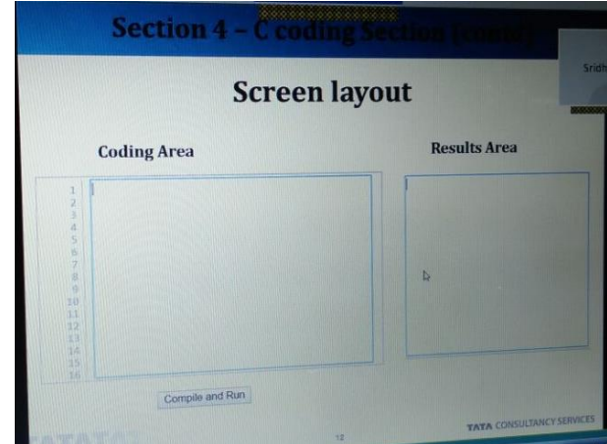
Coding platform

Slide 5
Coding platform - Instructions
There is only one question for 20 minutes.
It has 10 attempts(We can compile only 10 times).
We must start our code from the scratch.
The coding platform is divided into two, one for writing the code and other for output. We should write the whole program.
We can't use any input functions like scanf(), getch(), getchar().
The input to be provided should be read as command line arguments.

Slide 6
Coding platform - Instructions
We must only print exact output.
Output must not be re-framed by extra words.
If there is any error, the error will be shown in the output dialog box.
The errors are clearly mentioned.
If there are no errors, a message like "compiled successfully" will be printed.
Along with that they will mention four test cases are 'passed' or 'failed'. They are indicated like private and public test cases. They have not mentioned what is the test case, which is difficult to understand.
There is no time limit. But, when all the 10 attempts are over, a message like "attempts exhausted" will be shown.
To compile and run there is a button provided. To run the code, just click on that.

Slide 7
We can't use any input functions like scanf(), getch(), getchar(). The input to be provided should be read as command line arguments.

Slide 8
int main(int argc, char *argv[])
COMMAND LINE ARGUMENTS IN C:
main() function of a C program accepts arguments from command line or from other shell scripts by following commands.
They are argc and argv[]
where,
argc – Number of arguments in the command line including program name (integer). argv[] – This is carrying all the arguments including program name (pointer array ).

Slide 9
command line arguments
#include <stdio.h>
int main(int argc, char *argv[]) //command line arguments
{
printf("\n Program name : %s \n", argv[0]);
printf("1st arg : %s \n", argv[1]);
printf("2nd arg : %s \n", argv[2]);
return 0;
}

Slide 10
PROGRAMS
Program 1:
Factorial program in c using command line arguments.
Factorial of a non-negative integer n, denoted by n!, is the product of all positive integers less than or equal to n.
For example, The value of 5! is 5*4*3*2*1 = 120

Slide 11
#include<stdio.h>
int main(int a, char *b[]) //command line arguments
{
Int x,y,f=1;
x=atoi(b[1]);
for(i=1;i<=x;i++)
{
f=f*i;
}
printf("%d",f);
return 0;
}
//atoi function is to convert a character to integer

Slide 12
Program 2:
Write a c program, to find the area of a circle when the diameter is given, using command line arguments.
The input diameter is an integer and the output area should be a floating point variable with 2 point precision

Slide 13
#include<stdio.h>
#define PI 3.14
int main(int a, char *b[]) //command line arguments
{
int d;
float area =0;
d= atoi(argv[1]);
area =(float) PI*(d/2)*(d/2);
printf(“%0.2f", area);
return 0;
}
%0.2f is to print the answer with 2 values after decimal point.

Slide 14
Program 3:
Write a c program, to check whether the given year is a leap year or not using command line arguments.
A leap year is a calendar year containing one additional day (Feb 29th) added to keep the calendar year synchronized with the astronomical year.

Slide 15
#include<stdio.h>
int main(int a, char*b[])
{
Int year;
year=atoi(b[1]);
if(year%100==0){
if(year%400==0)
{ printf(“LEAP YEAR”); }
else{ printf(“NOT LEAP YEAR”); }
}
else if(year%4==0)
{ printf(“LEAP YEAR”); }
else{ printf(“NOT LEAP YEAR”); }
return 0;
}

Slide 16
Program 4:
Write a c program, to find the GCD of the given 2 numbers, using command line arguments.
The input is 2 integer and the output GCD also should be an integer value.

Slide 17
#include<stdio.h>
int main(int x, char *y[])
{
inta,b,small,i;
a=atoi(y[1]);
b=atoi(y[2]);
small=a>b?b:a;
for(i=small;i>=1;i--)
{
if((a%i==0)&&(b%i==0))
{
printf("%d",i);
break;
}
}
return 0;
}

Slide 18
PROGRAMS
Program 5: C Program to check whether a given number is a prime number or not?

Slide 19
#include<stdio.h>
int main(int a, char *b[]) //command line arguments
{
int i,f;
x=atoi(b[1]);
for(i=2;i<=x/2;i++)
{
f=1;
if(x%i==0)
{
f=0;
break;
}
}

Slide 20
if(f==1)
{
printf(“prime”);
}
else
{
printf(“not prime”);
}
return 0;
}
//atoi function is to convert a character to integer

Slide 21
PROGRAMS
Program 6: C Program to check whether a given number is a strong number or not?

Slide 22
#include<stdio.h>
int main(int a, char *b[]) //command line arguments
{
int n,temp,rex=0,f=1;
n=atoi(b[1]);
temp=n;
While(n!=0)
{
rem=n%10;
for(i=2; i<=r; i++)
{
f=f*i;
}

Slide 23
rex=rex+f;
n=n/10;
}
if(temp==rex)
{
Printf(“Yes”);
}
Else
{
Printf(“No”);
}
}

Slide 24
Write a C program which will convert a given decimal integer number N to its binary equivalent. The given number N, a positive integer, will be passed to the program using the first command line parameter. Print the equivalent binary number to stdout. Other than the binary number, no other extra information should be printed to stdout
Example:
Given input “19”, here N=19,expected out 10011

Slide 25
Write a c program that will find the sum of all prime numbers in a given range. The range will be specified as command line parameters. The first command line parameter, N1 which is a positive integer, will contain the lower bound of the range. The second command line parameter N2, which is also a positive integer will contain the upper bound of the range. The program should consider all the prime numbers within the range, excluding the upper bound and lower bound. Print the output in integer format to stdout. Other than the integer number, no other extra information should be printed to stdout.
Example
Given inputs “7” and “24” here N1= 7 and N2=34, expected output as 83

Slide 26
Write a C program which will check whether a given year YYYY is a leap year. A leap year is exactly divisible by 4 except for century years(years ending with 00). The century year is a leap year only if its perfectly divisible by 400. The given year YYYY will be passed to the program using the first command line parameter. If the given year YYYY is a leap year then print YES to stdout. If the given year is not a leap year, then print NO to stdout. Note that the words YES and NO have to be printed in UPPER CASE(capital letters) Other than the word YES or No,no other extra information should be printed to stdout.
Example:
Given input “1900”, here YYYY is 1900, expected output is No
Write your code here
#include<stdio.h>

Slide 27
Perfect Square
#include<stdio.h>
#include<stdlib.h>
int main(int a, char*b[])
{
int a, n;
n= atoi(b[1]);
for(a = 0; a <= n; a++)
{
if (n == a * a)
{
printf("YES");
return 0;
}
}
printf("NO");
return 0;
}

Slide 28
Armstrong
#include<stdio.h>
#include<stdlib.h>
#include<math.h>
int main(int a, char*b[])
{
int n;
n= atoi(b[1]);
int sum=0;
int temp=n;
int cnt=0;
while(n!=0)
{
int rem=n%10;
n=n/10;
cnt++;
}
n=temp;
while(n!=0)
{
int rem=n%10;
sum=sum+pow(rem,cnt);
n=n/10;
}
if(temp==sum)
{
printf("yes");
}
else
printf("no");
}

Slide 29
Palindrome
#include<stdio.h>
#include<stdlib.h>
int main(int a,int*b[])
{
int n,r,s=0;
int m=n;
n=atoi(b[1]);
while(n!=0)
{
r=n%10;
s=s*10+r;
n=n/10;
}
if(m==n)
printf(“palindrome”);
else
printf(“Not Palindrome”);
return 0;
}

Slide 30
Decimal to binary
#include<stdio.h>
#include<stdlib.h>
int main(int a, char* b[])
{
int n, cnt,i;
int b[32];
N=atoi(b[i]);
cnt=0;
while(n!=0)
{
b[int]=n%2;
n=n/2;
cn++;
}
for(i=(cnt-1);i>=0;i--)
Printf(“%d”,b[i]);
return 0;
}

Slide 31
Sum of prime numbers
#include<stdio.h>
#include<stdlib.h>
int main(int a, char*bc))
{
int m,n,j,c,i
int s=0;
m=atoi(b[1]);
n=atoi(b[2]);
for(i=m;i<=n;i++)
{
if(i%j==c)
c++;
}
if(c==2)
s=s+i;
}
printf(“%d”,s);
return 0;
}

Slide 32
Fibonacci Series up to n number of terms
#include<stdio.h>
#include<stdlib.h>
int main(int a, char* b[])
{
int i, n, t1 = 0, t2 = 1, nextTerm;
n=atoi(b[1]);
for (i = 1; i <= n; ++i)
{
printf("%d, ", t1);
nextTerm = t1 + t2;
t1 = t2;
t2 = nextTerm;
}
return 0;
}

Slide 33
Reverse a given number
#include<stdio.h>
#include<stdlib.h>
int main(int a, char *b[])
{
int n,r,s=0;
int m=n;
n=atoi(b[1]);
while(n!=0)
{
r=n%10;
s=s*10+r;
n=n/10;
}
printf("%d",s);
}

Slide 34
String palindrome
#include<stdio.h>
#include<string.h>
int my_pal(char*p);
int main(int argc,char* argv[])
{
int res= my_pal(argv[1]);
if(res )
{
printf(" given string is a palindrome\n");
}
else
{
printf(" %s is not a palindrome\n", argv[1]);
}
}
int my_pal(char *p1)
{
char* p2 = p1 + strlen(p2)-1;
while(p1 < p2)
{
if(*p1++ != *p2--)
return 0;
}
return 1;
}

Slide 35
Finding hypotenuse
#include<stdio.h>
#include<stdlib.h>
#include<math.h>
int main(int a, char*b[])
{
float hyp;
int opp=atoi(b[1]);
int adj=atoi(b[2]);
hyp=sqrt((opp*opp)+(adj*adj));
printf("%0.2f",hyp);
}

Slide 36
MCQ

Slide 37
1) How many times the below loop will be executed?
#include<stdio.h>
int main() {
int x, y;
for(x=5;x>=1;x--)
{
for(y=1;y<=x;y++)
printf("%d\n",y);
}
}
Notes:
Output:
1
2
3
4
5
1
2
3
4
1
2
3
1
2
1

Slide 38

Options
15
11
10
13

Slide 39
2) Where the local variables are stored?
Disk
Stack
Heap
13
Notes:
local variables can be stored either on the stack or in a data segment depending on whether they are auto or static. (if neither auto or static is explicitly specified, auto is assumed)

Slide 40
3) Select the missing statement?
#include<stdio.h>
long int fact(int n);
int main()
{
\\missing statement
}
long int fact(int n)
{
if(n>=1)
return n*fact(n-1);
else
return 1;
}

Slide 41
Options
printf(“%ll\n",fact(5));
printf("%u\n",fact(5));
printf("%d\n",fact(5));
printf("%ld\n",fact(5));

Slide 42
4) Which of the following indicate the end of the file?
Feof()
EOF
Both feof() and EOF
None of the mentioned
Notes:
EOF macro which expands to an integer constant expression, with type int and a negative value, that is returned by several functions to indicate end-of-file, that is, no more input from a stream.
The feof() function tests the end-of-file indicator for the stream pointed to by file pointer.

Slide 43
5) If a function’s return type is not explicitly defined then it’s default to ______ (In C).
int
float
void
Error
Notes:
If you do not specify a return type or parameter type, C will implicitly declare it as int.

Slide 44
6) For passing command line argument the main function should be like _______
int main(char *argv[], int argc)
int main(int argc)
int main(char *argv[])
int main( int argc, char *argv[])
Notes:
The full declaration of main looks like this:int main ( int argc, char *argv[] ) The integer, argc is the argument count. It is the number of arguments passed into the program from the command line, including the name of the program.

Slide 45
7) How many times the below loop will be executed?
#include<stdio.h>
int main()
{
int i;
for(i=0;i<5;i++)
{
printf("Hello\n");
}
}
Notes:
Output:
Hello
Hello
Hello
Hello
Hello

Slide 46
Options
5
1
0
3

Slide 47
8) Which of the following is a User-defined data type?
long int
double
unsigned long int
enum

Slide 48
9) Which has the highest precision?
float
double
unsigned long int
Long int

Slide 49
Floating point types
The following table provide the details of standard floating-point types with storage sizes and value ranges and their precision −
Type | Storage size | Value range | Precision
float | 4 byte | 1.2E-38 to 3.4E+38 | 6 decimal places
double | 8 byte | 2.3E-308 to 1.7E+308 | 15 decimal places
long double | 10 byte | 3.4E-4932 to 1.1E+4932 | 19 decimal places

Slide 50
10) What will be the output/error?(for input: 6, 9
#include<stdio.h>
int fg(int,int);
int main()
{
int n1,n2,g;
scanf("%d%d", &n1,&n2);
g=fg(n1,n2);
printf("%d",g);
}
int fg(int x,int y)
{
while(x!=y)
{
if(x>y)
return fg(x-y,y);
else
return fg(x,y-x);
}
return x;
}

Slide 51
Options
3
6
9
Error

Slide 52
11) What is dangling pointer?
Points to garbage value
Points to function
Both A and B
None of these

Slide 53
12) How to release the dynamically allocated memory?
free()
truncate()
delete()
release()

Slide 54
13) int main(int argc, char **argv) comment about: char **argv
Pointer to pointer
It is the file name and arguments passed
it is an array of character pointers
Compile time error

Slide 55
14) Predict the output
int main()
{
float x = 0.1;
If(x==0.1)
printf(“yes”);
else
printf(“no”);
return 0;
}
Yes
no

Slide 56
15) What is the similarity between enum and struct?
Can assign new values
Can create new data types
Nothing in common
They are same

Slide 57
16) What is recursion?
Looping
A function calls another function repeatedly
A function calls repeatedly
Function calls itself repeatedly

Slide 58
17. What is the purpose of ftell?
To get the current file name
To get the current file status
To get the current file attributes
To get the current file position

Slide 59
18. What is the similarity between a structure, union and enumeration?
a) All of them let you define new values
b)All of them let you define new datatypes
c)All of them let you define new pointers
d)All of them let you define new structures

Slide 60
19. Which of the following is not a fundamental datatype?
Enum
Unsigned long int
Long int
double

Slide 61
20. A memory leak happens when?
A program allocates memory in heap but forget to delete it.
A program allocates memory in stack.
When an unsigned pointer is freed using free function.
When realloc() is called on a pointer that is not allocated .

Slide 62
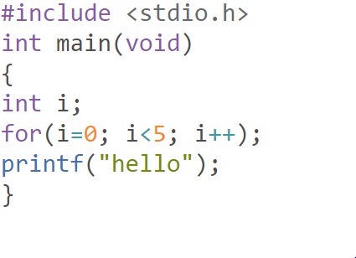
21. How many times hello will print?
Compilation error
1
4
Runtime error

Slide 63
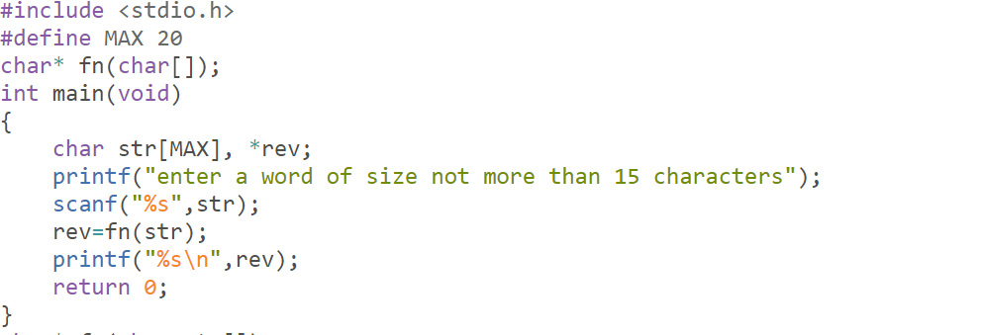
22. What is the output of the given program if user gives HELLO as input?

Slide 64
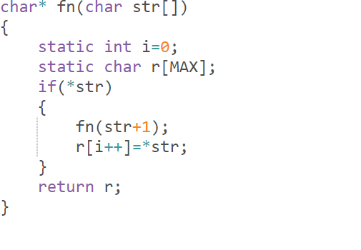
OLLEH
HELLO
LLO
ELLO

Slide 65
23. Which of the following is the correct order of evaluation for the below expression? z = x + y * z / 4 % 2 - 1
* / % + - =
= * / % + -
/ * % - + =
* % / - + =

Slide 66
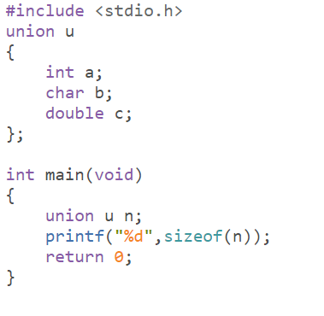
24. What is the output if size for char is 1, int is 4, double is 8?
8
4
1
error

Slide 67
25. Which of the following statements is true about the C language?
(void*)0 is different from a null pointer.
Null pointer is another name for un initialized pointer.
Calloc() can be used only for character pointer allocation.
Char *i=0 and char *i=NULL means the same.

Slide 68
NEW questions

Slide 69
Question 1
What will be the output of the below code:
#include<stdio.h>
int main()
{
float f = 0.1;
if( f==0.1)
printf(“NO\n”);
return 0;
}
NO
ERROR
NO output
Successfully complied but no output

Slide 70
Question 2
In the below code, what concept is used:
#include<stdio.h>
long int fact(int n);
int main()
{
int n;
Printf(“Enter a positive integer:”);
Scanf(“%d”,&n);
Printf(“ Factorial of %d=\ld’,n,fact(n));
return 0;
}
long int fact(int n)
{
If (n>=1)
return n*fact(n-1);
Else
return 1;
}

Slide 71
Function calls from one to other function
Repeatedly calls itself(recursive)
Conditional looping

Slide 72
Question 3
main(int argc,char** arg v)
In the above definition of main function, the variable argv denotes:
A) An array of character pointers each pointing to the command line parameters
B) An array of character pointers, the first array item pointing to the program name and the remaining pointing to the command line parameters
C)A pointer to character that points to command line parameters
D) A pointer to a pointer that points to the memory location where the program has been loaded into the memory

Slide 73
Question 4 *
What will be the output of the below code:
#include<stdio.h>
int main()
{
float f=0.1;
if(f==0.1)
Printf(“YES\n”);
Else
Printf(“No\n”);
Return 0;
}

Slide 74
ANSWER:
NO

Slide 75
Question 5
What does a default header file contain?
Prototypes
Declarations
Implementations
All of the above

Slide 76
Question 6
In the below code, the program expects the user to enter a word. If the user enters the word as ABRACADABRA , what is the output value printed:
#include<stdio.h>
#define MAX 20
char * fn(char());
int main()
{
char str[MAX], * rev;
Printf(“Enter a word size not more than 15 characters:”);
scanf(“%s”, str);
r=fn(str);

Slide 77
Printf(“\m\n”,r);
Return 0;
}
Char*fn(char str())
{
Static int 1=0;
Static char=r[MAX];
If(*str)
{
Fn(str+1);
R[i++]=*str;
}
Return r;
}

Slide 78
ABRACADABRA
ARBADACARBA
ERROR
NO OUTPUT

Slide 79
Question 7
Which of the below has the highest precision?
double
float
unsigned long int
long int

Slide 80
Question 8
atoi() function is used to
Gets index value of character in an array
Converts ASCII character to its integer value
converts an array of characters to array of equivalent integers
Convert a character string to its equivalent integer value.

Slide 81
Question 9
Which of the following statements is true about C language ?
There is a maximum limit to number of case instances inside a switch statement
B) A do while loop is used to ensure that the statements within the loop are executed atleast once
C) Two case constants within the same switch statement can have the same value
D) Continue keyword skips one iteration of loop

Slide 82
Question 10
While declaring parameters for main, the second parameter argv should be declared as
char**argv[]
char argv[]
char arg
Cant access

Slide 83
Question 11
Which of the below functions is NOT declared in string.h?
strcpr ()
strcpy ()
strlen()

Slide 84

Try more basic level programs using command line arguments

