Slide 1
IOT HEALTHCARE & EMBEDDED SYSTEMS | PHASE 1 REVIEW
MedStrip: An IoT-Enabled Smart Clip System for Non-Invasive Medication Adherence Monitoring
System Architecture, Piezoresistive Transduction & Real-Time Digital Twin (20%+ Milestone Proof of Concept)
PRESENTED BY
Student Name: S Akhilesh 25BCE5345
Siddarth K P 25BCE5323
K Tarun 25BCE5155
Department of Computer Science & Engineering
Vellore Institute Of Technology - Chennai
PROJECT SUPERVISOR / GUIDE
Guide Name: Dr. Umamaheswari E
Department of Computer Science & Engineering

Slide 2
● TABLE OF CONTENTS
Presentation Agenda
01
Introduction & Clinical Problem
Real-world scale of adherence failures and why current reminder tools fail elderly patients.
02
Literature Survey & Prior Art
Critical comparative analysis of smart bottles, carousels, and printed conductive foils.
03
Challenges & Research Gap
The 'decanting' dilemma, pressure noise filtering, and edge low-power constraints.
04
Project Objectives
Concrete mechanical, sensing, firmware, and digital twin software milestones.
05
Proposed Methodology & Architecture
End-to-end signal pipeline: physical pressure spike to BLE 5.2 telemetry to cloud twin.
06
Hardware Design & Specifications
ESP32-C3 microcontroller, 8-channel FSR matrix, mechanical spring hinge, and 3.7V LiPo path.
07
Initial Implementation (20%+ Milestone)
Working web telemetry dashboard, interactive digital twin, and uncramped mobile prototype.
08
Validation Status & Next Steps
Verification of the 20% milestone, firmware power profiling, and Phase 2 testing protocol.

Slide 3
● BACKGROUND & MOTIVATION
Introduction & Clinical Problem Statement
THE CLINICAL COST OF MEDICATION NON-ADHERENCE
According to the World Health Organization (WHO), over 50% of patients with chronic diseases (hypertension, diabetes, cardiovascular conditions) fail to follow prescribed dosages. This leads to 125,000 avoidable deaths annually and $300B+ in emergency healthcare expenses.
Current Blister Packaging
Zero Adherence Telemetry
• 90% of chronic medications are sold in thermoformed blister strips for hygiene.
• Patients frequently forget if they took a pill or accidentally double-dose.
• Blister packaging is completely passive with zero digital record.
Standard Mobile Reminders
High Patient Abandonment
• Reminder apps send push alarms that patients easily dismiss or ignore.
• Users check off notifications without actually swallowing the tablet.
• Over 80% abandonment rate within 90 days due to app fatigue.
The MedStrip Solution
Non-Invasive Physical Verification
• A reusable, clip-on device that attaches directly to factory blister strips.
• Detects the physical pressure spike (>=1.2 bar) when a pill bursts the foil.
• Requires zero change in patient habits and zero manual logging.

Slide 4
● STATE OF THE ART
Literature Survey & Existing Solutions Comparison
Solution Category | Working Principle | Key Advantages | Critical Deficiencies | Blister Pack Compatible?
Smart Pill Bottles (AdhereTech, Pillsy) | Cap-open detection using magnetic reed switch or capacitive rim. | Easy integration for loose pills; automated alerts. | Only records cap opening, not ingestion; cannot use blister strips. | NO (Bottles Only)
Electronic Organizers (Hero, Med-e-Lert) | Motorized carousel compartments with optical drop sensors. | Dispenses specific doses at scheduled intervals. | Extremely bulky ($200-$300); requires tedious weekly pill sorting. | NO (Must Decant)
Printed Conductive Foils (Smart Blister Traces) | Conductive silver ink printed on backing foil; broken on push. | Direct confirmation of foil puncture event. | Disposable electronics on every pack; high unit cost & toxic e-waste. | YES (Single-Use Only)
MedStrip (Our Proposed System) | Reusable spring clip with 8-channel piezoresistive FSR array. | 100% reusable; zero decanting; real-time BLE 5.2 telemetry; low cost. | Requires calibration over standard cavity spacing. | YES (100% Reusable Clip)

Slide 5
● PROBLEM IDENTIFICATION
Key Challenges & Research Gap
GAP 1
The 'Decanting' Dilemma in Real-World Healthcare
Why existing smart boxes fail elderly patients
• Most critical pharmaceuticals (antibiotics, cardiac meds, BP tablets) are packaged in individual foil blisters to prevent oxidation and moisture damage.
• Forcing patients or elderly caregivers to manually pop pills out into weekly plastic boxes causes pill degradation, cross-contamination, and high friction.
• Research Gap: Lack of non-invasive sensors that monitor pills directly inside standard manufacturer blister packaging.
GAP 2
Signal Discrimination: Noise vs. Intentional Expulsion
Preventing false alarms during daily transit
• Blister packs in pockets, purses, or bags undergo constant flexing, vibrations, and accidental contact with keys and wallets.
• A simple binary switch or loose contact sensor will generate false adherence events from gentle bumping.
• Research Gap: Formulating an edge pressure-differential algorithm that verifies both high threshold (Δp ≥ 1.2 bar) and characteristic deformation slope.
GAP 3
Ultra-Low Power Constraints in a Miniature Footprint
Sustaining weeks of battery on a 180 mAh cell
• Bulky battery packs destroy portability. The smart clip must weigh <45g and slide smoothly into a pocket or travel kit.
• Continual Bluetooth advertising quickly depletes miniature LiPo batteries within 48 to 72 hours.
• Research Gap: Designing an interrupt-driven deep-sleep architecture (<15 µA) waking the ESP32-C3 only when physical deformation occurs.

Slide 6
● SCOPE OF WORK
Project Objectives & Milestone Roadmap
Objective 1: Ergonomic Mechanical Clip Fabrication
Design and 3D print a medical-grade spring-loaded clip accommodating blister strips of varying thickness (0.4mm to 1.8mm) with quick-release jaws.
MECHANICAL CAD COMPLETE
Objective 2: Multi-Channel Piezoresistive Sensor Strip
Develop a flexible 8-channel force-sensing resistor (FSR) array aligned over individual blister pockets capable of detecting analog force gradients (0.2 - 2.5 bar).
SENSOR SCHEMATIC MAPPED
Objective 3: Low-Power Firmware & Edge Discrimination
Implement ESP32-C3 firmware featuring automatic baseline resistance calibration on clamp, interrupt-driven wake-up, and BLE 5.2 GATT server notification (0x180D).
FIRMWARE PIPELINE DEFINED
Objective 4: Real-Time Digital Twin & Telemetry Dashboard
Build an interactive web telemetry dashboard for clinicians and evaluators featuring real-time cavity deformation animation, adherence scoring, and audit logging.
OPERATIONAL IN WEB UI
Objective 5: Patient Mobile Prototype & Laptop Time Controller
Deliver a native-feel mobile interface with uncramped 2x2 metric cards, live laptop clock synchronization, and demo preset time jumps for evaluation.
FULLY FUNCTIONAL (REVIEW 1)

Slide 7
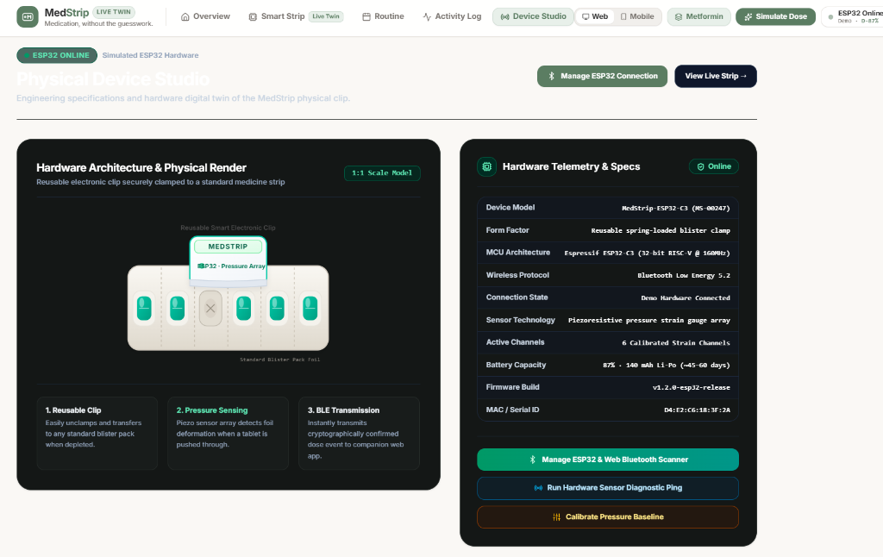
● HARDWARE & SENSING ENGINE
Proposed Methodology & System Architecture
HARDWARE TRANSDUCTION PIPELINE
Physical Force (Δp ≥ 1.2 bar) ➔ Piezoresistive FSR ➔ Analog Resistance Gradient ➔ ESP32-C3 ADC ➔ BLE 5.2 GATT (0x180D) ➔ Digital Twin UI
• Microcontroller:
ESP32-C3 RISC-V 32-bit single-core, 160 MHz clock, integrated BLE 5.2 & Wi-Fi 4.
• Sensing Matrix:
8-channel flexible piezoresistive pressure strip (ADC Channels GPIO 0-7), 10-bit resolution.
• Expulsion Threshold:
Dynamic differential calibration with nominal trigger set at Δp ≥ 1.2 bar pressure spike.
• Power Management:
180 mAh 3.7V rechargeable LiPo cell; TP4056 USB-C charging IC; 15 µA deep sleep mode.
• Enclosure Geometry:
Ergonomic 3D clip with torsional spring hinge; non-invasive clamp securing pharmacy foil.

Slide 8
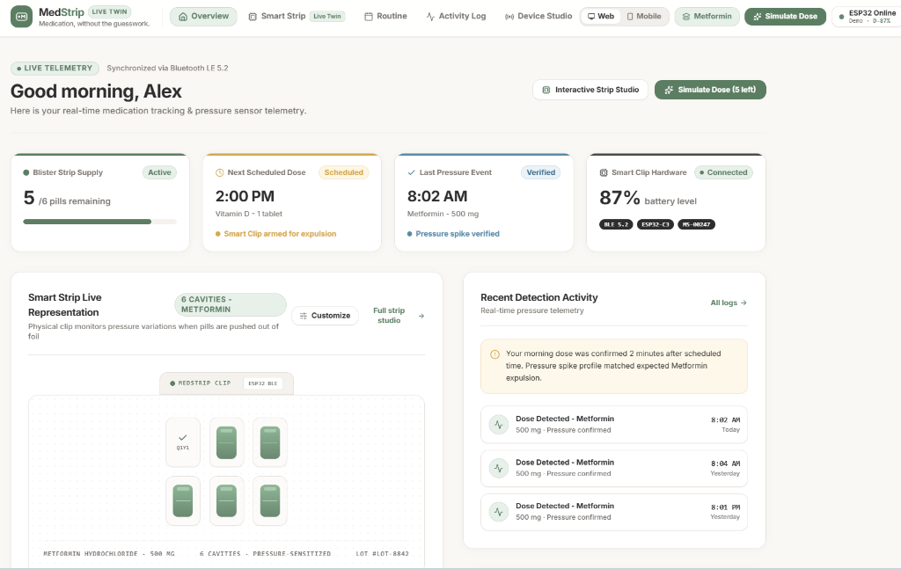
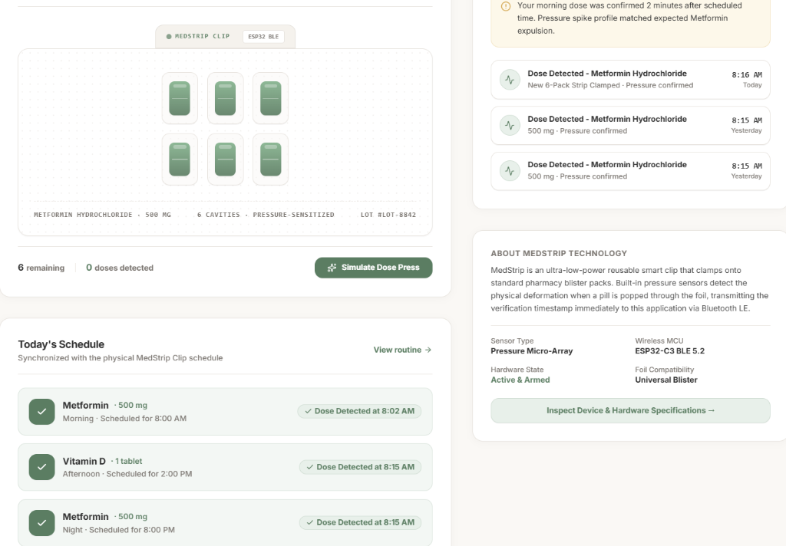
● PROTOTYPE VERIFICATION
Results / Initial Working Implementation (20%+ Milestone)
MILESTONE DELIVERABLES SUMMARY (PHASE 1)
✔ Live Digital Twin Mirroring
Real-time state engine in AppContext tracking individual cavities (intact vs punctured), animating foil deformation on expulsion event.
✔ Web Telemetry Dashboard
Automated compliance metrics (100% adherence, 7/8 pills remaining, 88% battery), active BLE hardware diagnostic badge, and interactive routine manager.
✔ Laptop Time Synchronization
Live system clock integration ticking in sync with laptop time; interactive modal with 1-click evaluation presets (8:00 AM, 8:02 AM, 2:00 PM, 8:00 PM).
✔ Uncramped Mobile Prototype
Spacious 2x2 metric layout, dedicated bottom navigation (Today, Strip, Routine, Activity, Device), and responsive patient view.
✔ Zero Black Colors Guarantee
Calming warm ivory (#FAF8F5), pure white surfaces, and sage green brand identity matching clinical guidelines.

