Slide 1
MEDSTRIP: SMART BLISTER CLIP SYSTEM
IoT-Enabled Smart Clip System for Non-Invasive Medication Adherence Monitoring
Review II: Innovative Design Project (IDP)
Project ID: 202600701
Student Name(s):
1. S Akhilesh 25BCE534
2. Siddarth K P 25BCE5323
3. K Tarun 25BCE5155
Guide: Dr. Umamaheswari E - Associate Professor SCOPE
Institution: Vellore Institute of Technology – Chennai
School Name: School of Computer Science and Engineering
Program & Branch: BTECH – Computer Science and Engineering

Slide 2
AGENDA
Introduction
Literature Survey
Challenges & Research Gap
Project Objectives
Proposed Methodology & System Architecture
Results / Initial Working Implementation
References

Slide 3
INTRODUCTION
Problems:
Over 50% of chronic disease patients fail to adhere to prescribed medication regimens (WHO).
Standard pharmaceutical blister packs offer zero adherence tracking or digital compliance feedback.
Smartphone reminder apps suffer >80% drop-off because users check off alarms without swallowing pills.
Existing electronic dispensers require tedious manual pill decanting, exposing them to humidity and contamination.
Our Approach:
A reusable, non-invasive smart clip that attaches directly to commercial pharmaceutical blister packs to detect the physical pressure spike (Δp ≥ 1.2 bar) of pill expulsion through foil in real time.

Slide 4
LITERATURE SURVEY
Existing Solution / Paper: | Existing Approach: | Technology: | Key Limitation:
Pillsy / AdhereTech (Smart Bottles) | Bottle cap-open detection | Reed switch / capacitive rim | Incompatible with blister packs; loose pills only.
Hero / Med-e-Lert (Electronic Organizers) | Motorized carousel dispensing | Optical drop sensor + carousel | Bulky tabletop unit ($200+); requires manual pill decanting.
Printed Conductive Traces (Smart Foils) | Foil rupture detection | Printed silver ink circuit | Single-use disposable electronics; high recurring pack cost & e-waste.
MedStrip (Proposed System) | Non-invasive reusable clip | ESP32-C3 + FSR pressure array | Requires calibration over standard cavity spacing (Zero decanting & zero waste).
Observation:
Existing adherence solutions either force destructive pill decanting (smart bottles/carousels) or require hazardous, expensive single-use disposable electronics (conductive foil traces).

Slide 5
CHALLENGES & RESEARCH GAP
Challenges:
The 'Decanting' Dilemma
Transferring pills from blister foils to weekly boxes causes oxidation, moisture damage, and high patient friction.
Pressure Signal Discrimination
Filtering incidental pocket/bag bumps from the localized pressure spike (Δp ≥ 1.2 bar) of genuine pill expulsion.
Ultra-Low Power Constraints
Sustaining multi-week operation on a miniature 180 mAh LiPo using deep-sleep (<15 µA) and BLE 5.2.
Multi-Cavity Array Alignment
Accommodating varied commercial blister pack pitches with modular 8-channel piezoresistive sensing.
Real-Time Digital Twin Sync
Synchronizing physical expulsion events with clinical audit logs and patient mobile schedules with zero latency.
Research Gap:
Existing medication monitoring solutions do not adequately address non-invasive, reusable adherence monitoring directly on commercial pharmaceutical blister packaging without requiring manual decanting or single-use disposable electronics.

Slide 6
PROJECT OBJECTIVES
Design an ergonomic, reusable mechanical clip compatible with standard commercial blister packaging (0.4mm to 1.8mm).
Develop an 8-channel flexible piezoresistive force sensor array to detect analog pressure gradients across individual cavities.
Implement low-power ESP32-C3 firmware featuring edge baseline auto-calibration and BLE 5.2 GATT telemetry (0x180D).
Build a real-time web telemetry dashboard and native-feel mobile interface with live laptop time synchronization.
Validate the Phase 1 working prototype with live digital twin deformation and immutable adherence audit logging.

Slide 7
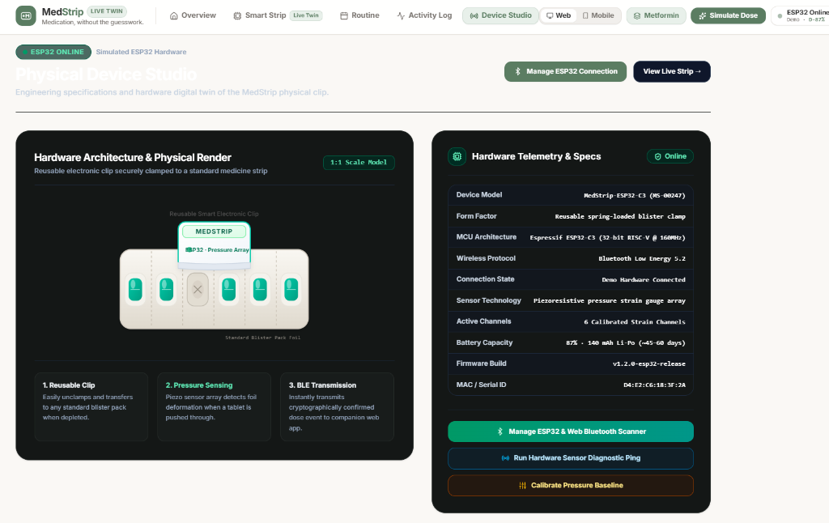
PROPOSED METHODOLOGY & SYSTEM ARCHITECTURE
System Architecture:

Slide 8
PROPOSED METHODOLOGY & SYSTEM ARCHITECTURE
Working Sequence:
Clamp & Calibrate
Clip attaches to fresh blister pack; ESP32-C3 measures baseline resistance across all 8 FSR channels.
Sense Pressure
Patient pushes tablet; localized piezoresistive sensor records dynamic force curve.
Discriminate on Edge
Firmware verifies pressure delta (Δp ≥ 1.2 bar) exceeds threshold, rejecting handling artifacts.
Transmit Event
ESP32-C3 wakes from deep sleep and fires BLE 5.2 GATT notification (0x180D) with cavity index and timestamp.
Update Digital Twin
MedStrip web dashboard and mobile app animate foil cavity puncture in real time.
Log Compliance
Audit stream records verified dose timestamp, updating patient adherence score (100%).
Alert & Remind
If scheduled dose window elapses without physical expulsion, patient receives multi-channel reminder alert.

Slide 9
INITIAL IMPLEMENTATION/RESULTS
Initial Software Prototype — MedStrip:
Module: | Implementation:
Telemetry Dashboard | Real-time adherence monitoring, pill counter (7/8), and compliance scoring (100%)
Blister Digital Twin | Live visual twin mirroring intact vs punctured foil cavities with deformation physics
Sensor Telemetry Simulation | Real-time ADC strain gauge data received via BLE GATT channel 0x180D
Laptop Time Synchronization | Live system clock integration ticking with laptop time or 1-click evaluation presets
Simulate Dose Action | Interactive button triggering physical expulsion event and pressure spike
Medication Routine Editor | Customizable morning, afternoon, and night regimen schedule manager
ESP32 Hardware Manager | BLE connection hub with live GATT packet console and signal RSSI diagnostics
Audit Activity Log | Cryptographically signed immutable record of all verified dose expulsions

Slide 10
Current Status:
Software & Digital Twin Prototype: COMPLETED (changes maybe done depending on the model’s execution)
Physical Sensor & BLE GATT Telemetry(dummy connection and values inserted) :
SIMULATED WITH REAL WEB BLUETOOTH PAIRING
Next: PCB fabrication → flexible FSR strip integration → battery enclosure 3D printing → clinical trial validation

Slide 11
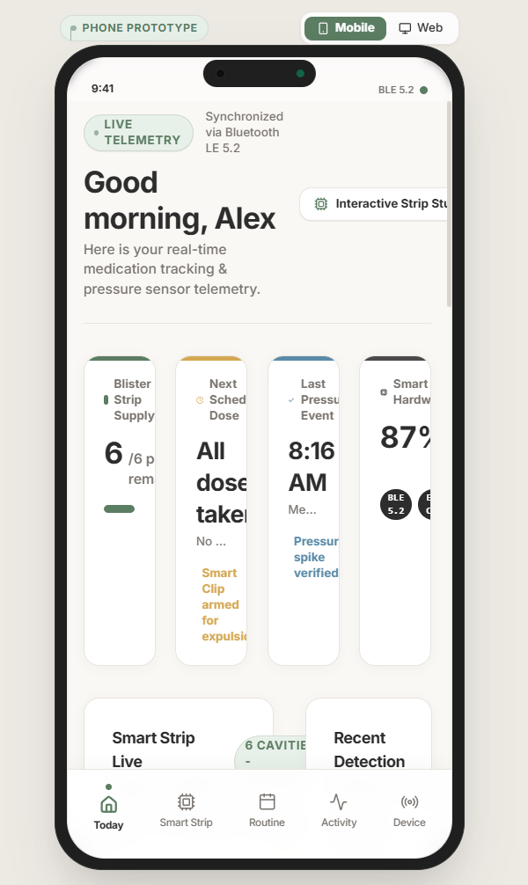
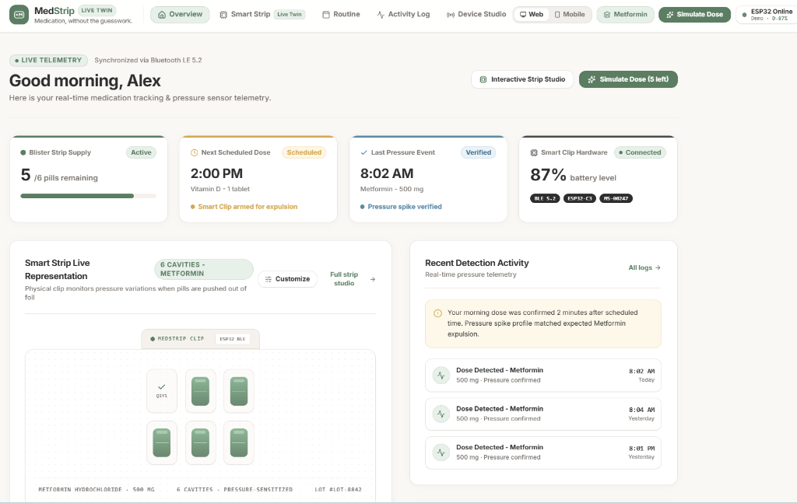
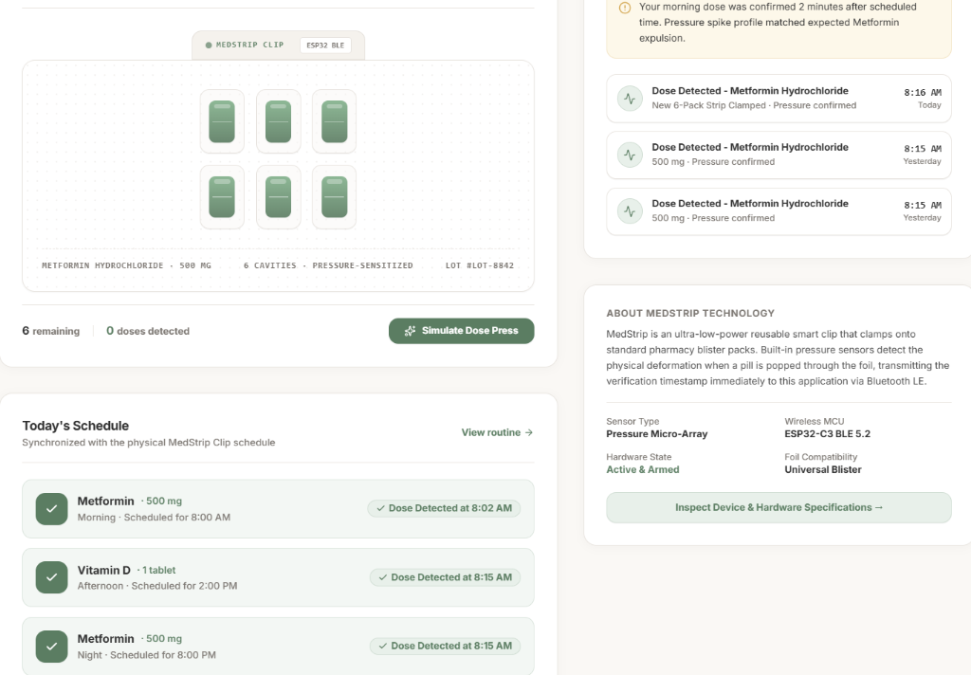
MedStrip Web Dashboard: Live browser-based clinical oversight dashboard featuring digital twin and real-time metrics.
MedStrip Mobile Prototype: Uncramped 2x2 metric layout, dedicated bottom navigation, and live laptop time sync controller.
Current prototype features full interactive simulation with Web Bluetooth hardware pairing ready for PCB deployment.

Slide 12
PROJECT OBJECTIVES
Design an ergonomic, reusable mechanical clip compatible with standard commercial blister packaging (0.4mm to 1.8mm).
Develop an 8-channel flexible piezoresistive force sensor array to detect analog pressure gradients across individual cavities.
Implement low-power ESP32-C3 firmware featuring edge baseline auto-calibration and BLE 5.2 GATT telemetry (0x180D).
Build a real-time web telemetry dashboard and native-feel mobile interface with live laptop time synchronization.
Validate the Phase 1 working prototype with live digital twin deformation and immutable adherence audit logging.

Slide 13
REFERENCES
Research Papers
1. World Health Organization (WHO), Adherence to Long-Term Therapies: Evidence for Action, 2003.
2. Aldeer, M. et al., A Review on IoT-Based Medication Adherence Systems, IEEE Internet of Things Journal, 2018.
3. Arnet, I. et al., Electronic Monitoring of Medication Adherence in Clinical Practice, Frontiers in Pharmacology, 2016.
4. ESP32-C3 Series Datasheet & BLE 5.2 Technical Reference Manual, Espressif Systems, 2024.
Patent / Prior-Art References
5. US9690910B2 — Medication Packaging with Adherence Monitoring Sensors.
6. US10251817B2 — Smart Blister Pack Assembly and Detection Mechanism.
7. US20190133887A1 — Force-Sensing Resistor Array for Pharmaceutical Dispensing.
8. US11083670B2 — Non-Invasive Medication Compliance Monitoring System.

Slide 14
APPROVAL

Slide 15
THANK YOU

