Slide 1
3D USER INTERFACE
Akhil R Nair (First year)
Jayanth Dadhich (First year)
Nithin K Shine (First year)
Sarath Krishna C (First year)
Sradha N (First year)
Domain : Open innovation

Slide 2

Problem statement
Inability of current user interface (UI) to keep up with the growing 3-d applications.
Novelty
We are designing an app/web application to display the current 3-D position. we are doing 3-d tracking in one particular area and the result can be obtained anywhere.it includes internet of things(iot)and it can be used very easily.
This Photo by Unknown author is licensed under CC BY-SA-NC.

Slide 3
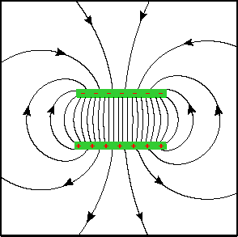
Methodology
Electric fields interact strongly with most materials, including the human body, due to dielectric polarization.
Intervening materials between or near the electrodes can absorb the energy due to coupling, in the case of humans possibly causing excessive electromagnetic field exposure.
The closer the hand move towards the capacitor, the more it gets discharged.
Hence it takes more time to get charged again

Slide 4
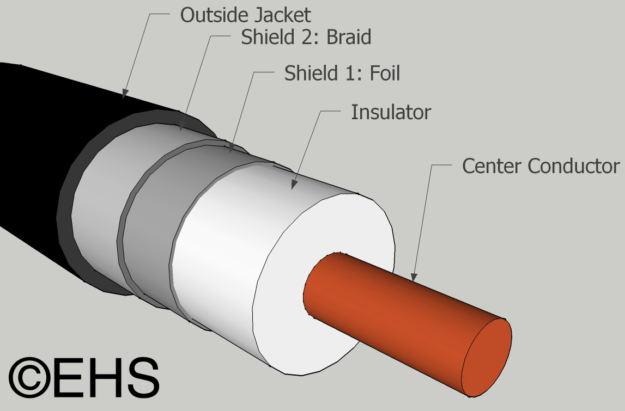
Shielded cable
The Shielded cable can be used to make a cylindrical capacitor.
By connecting the inner core to the positive terminal and the outer shield cable to the ground, or vice-versa

Slide 5
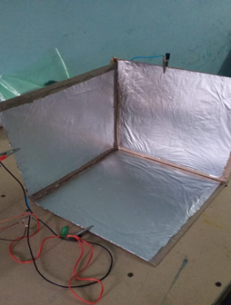
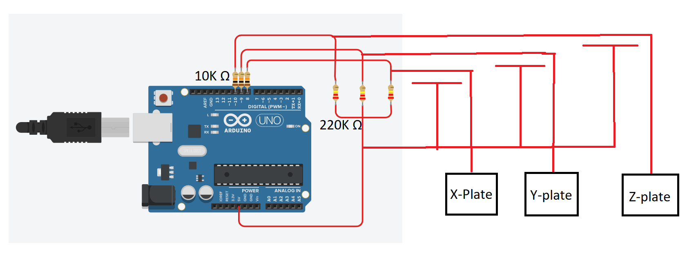
Circuit Diagram

Slide 6
Flow chart of process
Hard-ware implementation with Arduino
Running the software using Arduino IDE
Using the Processing software to simulate the virtual-cube

Slide 7
Implementation
Steps to be implemented: Spray the glue onto the cardboard and smooth the foil onto one side. Work slowly and try to leave a small gap around the edge of the foil. It is important that the foil plates do not touch each other when we tape the three sides together. In a pinch you can use a glue stick.
cut a small notch in the inside edge of the rightmost plate to make it easier to connect the alligator clips later on .
Using tape, assemble the plates to form one half of a cube. On the other non-alligator end of the cables, twist together the 3 shield wires and solder them. The shield will be connected to the 5V pin on the Arduino. This will minimize the antenna effect of the cable on the circuit.

Slide 8
The Arduino boards feature serial communications interfaces, including Universal Serial Bus (USB) , which are also used for loading programs. The microcontrollers can be programmed using the C and C++ programming languages, using a standard API which is also known as the "Arduino language". In addition to using traditional compiler toolchains, the Arduino project provides an integrated development environment (IDE) and a command line tool. Arduino IDE(1.8.13) is used in this project.
Software Implementation

Slide 9
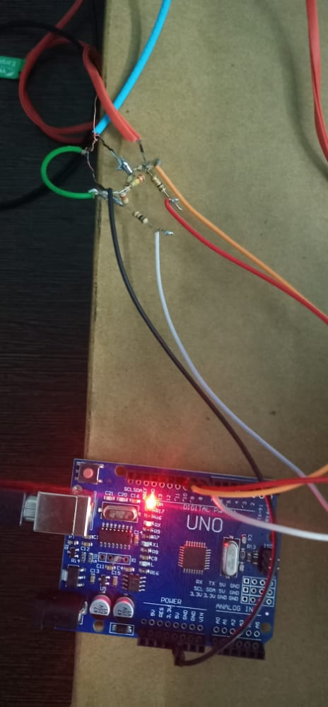
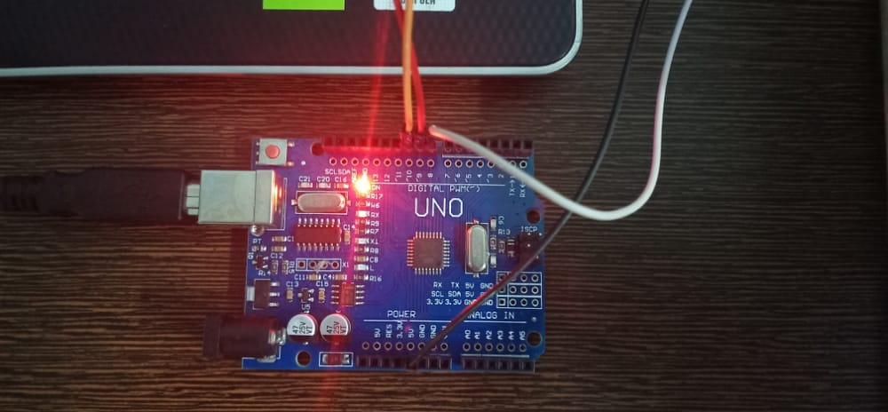
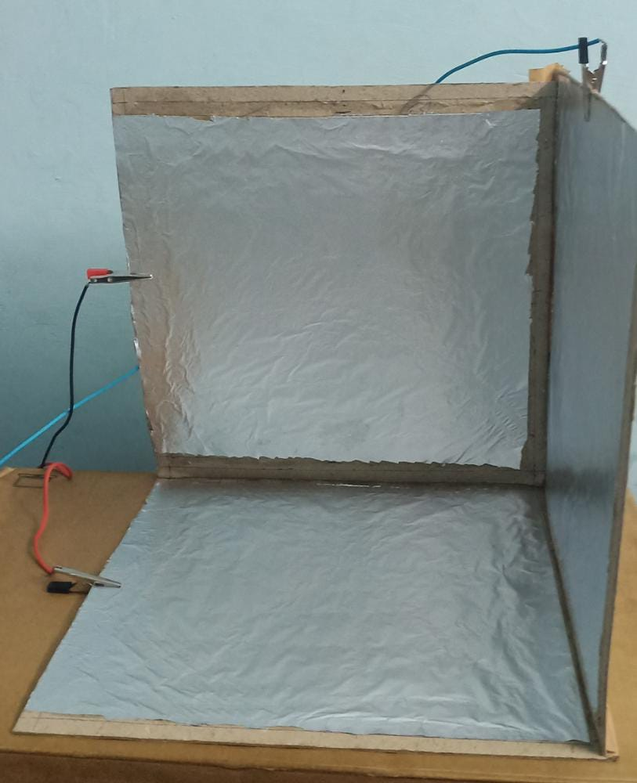
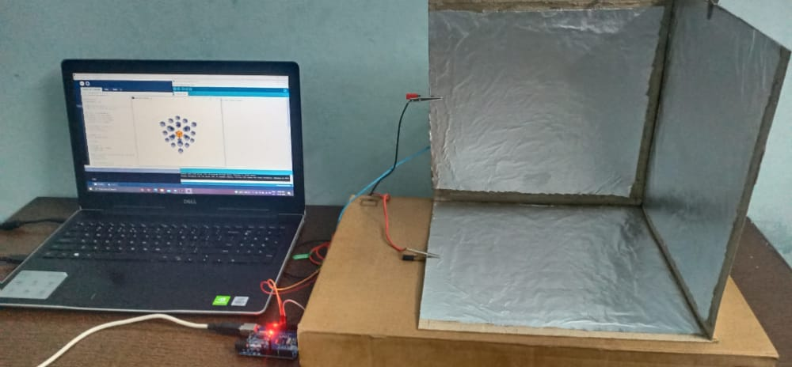
Result
The position of the hand inside the cube is tracked successfully and shown in the "Processing" app.

Slide 10
Discussion
There is a loss of energy when human body is brought near a capacitor
This leads to discharging of the capacitor, the extend of discharge is directly proportional to the distance of the hand from the plates.
After calibration we can plot the location of the hand inside the cube.
We used "Processing" to display the position.
It is a free graphical library and integrated development environment (IDE).
At first, we thought of getting the quadrant number from the
module using python-serial write connection to a web-site
After this we found a better way to simulate the 3*3*3
Grid .

Slide 11

BUISNESS SCOPE
There are 3 major areas of technology where the canny UI-3D designer is making major differences today and will be doing so for a good while into the future too. Video Games3D UI-3D have opened up a whole world of possibility in gaming; they can create the most compelling user experiences because they allow the gamer to become one with the action – rather than manipulating that action from a far. Very Large Displays Touch screens are a limited solution too. They’re OK when the user can reach the whole screen but that’s not likely to be very easy on a giant screen at a One Direction Concert. UI-3D which allows the user to interact with the screen in 3D – such as simple hand gestures; can make this problem much simpler to resolve. Mobile Applications Not all 3D UI-3D users are for the large screen; there’s as much a need for clever 3D UI-3D controls on the other end of things. Mobile devices are built for 3D complexity; they contain GPS, gyroscopes, accelerometers and dozens of other clever controls (such as cameras for accurate 3D positioning of a user or other individual near the equipment).

Slide 12

The increasing use of biometric equipment in the automobile, consumer electronics, commercial, and industrial sectors is expected to drive the growth of the touchless biometric equipment market. As biometric deployments begin to expand into markets and environments that are characterized by end-users who may possess less ideal skin conditions to use fingerprint technology, contactless biometric sensor technology is proving to be a viable solution. Fingerprint technology is not a one-size-fits-all solution due to its reliance on skin integrity and difficulty to function properly in certain environments and with various ethnicities. Contactless biometric sensors help in solving these problems and offer added features of being more hygienic, a problem that plagues biometric technology with sensors that require contact.
BY.

Slide 13
Thank you

