Slide 1
A RESEARCH IN PARTIAL FULFILMENT OF THE REQUIREMENT FOR THE AWARD OF BACHELOR DEGREE OF SCIENCS(B.Sc.) IN COMPUTER INFORMATION SYSTEM BY IDOWU AKINSOPE. E. 11/2378 MADUFOR JOSHUA 11/2402

Slide 2
INTRODUCTION
A computer network is a telecommunications network that allows computers to exchange data. In computer networks, networked computing devices pass data to each other along data connections BUT it should be noted that not only computing devices are associated with a network but we have other devices such as the phones and network hardware.
Bandwidth- This is the amount of information that may be transmitted at any given time or it is the amount of data that is used up each time data is exchanged and it is measured in megabits per second(mb/s).
Bandwidth Management- This is a means of allocating bandwidth resources to critical application on a network to ensure efficiency in bandwidth allocation and also assign priority to data to be transmitted to prevent network traffic. Network has three layers which are the:
Application software:
Network software
Network Hardware

Slide 3
PROBLEM ANALYSIS AND STATEMENT OF PROBLEM
Networks are capable of carrying many types of data services such as voice data, text data, images, and video. The following question form the basis for statement of problem:
How can we maximize the quality of service offered during periods of stress, as viewed by both the network operators and the network users?
How do we prevent congestion among users when there’s high traffic on the network, irrespective of the volume of bandwidth resource available on the network?
How do we assign bandwidth to each virtual path on the network, in order to optimize performance for all users?
These are the problems that we intend to proffer solutions to in the course of this research work.

Slide 4
APPLICATION OF BANDWIDTH MANAGEMENT
Corporate networks using intranets for information sharing and web navigation have an increased demand for bandwidth, but simply adding on more connection or larger connections (TI lines or larger) doesn’t address the bandwidth issue because availability is not guaranteed. Nearly all network links are shared by more than one user or application which means available bandwidth is shared between all users and all applications. Using bandwidth management to allocate bandwidth to applications or users during peak times can prevent traffic congestion on the network. Temporary network congestions can be improved by using BANDWIDTH MANAGEMENT; however if a network is continuously congested, improvement to the link that provide greater capacity is suggested. This project work is based on the use of simulated software models to confront the new challenging problems of easy flow of data transmission problems in network design as network evolves.

Slide 5
PROJECT OBJECTIVES
The main purpose of this project is to be able to do the following:
To research the rationale behind the need to make use of Network Bandwidth Management
Find out why it is necessary for them to use the above one
To develop software/system needed for the management and control of bandwidth in networks
To simulate the proposed technique in three above

Slide 6
SCOPE OF PROJECT
Considering the bandwidth management task, in which a file or message is to be sent from a computer to another computer as an important factor in computer networks, loop holes in sending the message and its destination quickly have necessitated periodic review of quick transmission of data with a review of bandwidth management control and improving on them. This research work focuses on an optimal bandwidth management and control scheme, which will keep at pace the level of prevalent inter-networks and reliable data communication between computers and network.

Slide 7
SIGNIFICANCE OF THE PROJECT
This project is aimed at providing convenience and flexibility and also viable solutions for controlling bandwidth on a network. The end result of the research work is expected to be beneficial to the following category of people:
Network designers
Network administrators
The Information Technology industry
Network users
Analysts and other researchers

Slide 8
FEASIBILITY AND PLAN OF THE PROJECT
The approach adopted in achieving the aims of this research includes:
Introducing the developed bandwidth control techniques.
A survey of the existing bandwidth management techniques
Simulation of the new technique.
Performance and comparison with the existing technique.

Slide 9
Methodology
Waterfall development methodology has been recognized as the best software development methodology for a successful implementation of Network Bandwidth Monitoring System. The waterfall model is sequential design process, often used in software development process in which progress is seen as flowing steadily downwards (like a waterfall) through the phases of Planning and selection, Requirement, Analysis and design, Coding, and Implementation of the system.

Slide 10
CHAPTER TWO LITERATURE REVIEW
The term bandwidth, also known as network bandwidth or data bandwidth or digital data bandwidth is referred to in computer science and networking as a bit rate measure of available or consumed data communication resources expressed in bits/second or multiples of it (kilobits/s, megabits/s, etc.). The term comes from the field of electrical engineering, where the bandwidth represents the total distance or range between the highest and the lowest signals on the communication channel(band).

Slide 11
Application Areas of Bandwidth Include
Network Bandwidth Capacity: In computer networking, bandwidth in bit/s may also refer to consumed bandwidth, corresponding to achieved throughput or goodput, i.e., the average rate of successful data transfer through a communication path.
Network Bandwidth Consumption
Multi-Media Bandwidth
ASYMPTOTIC BANDWIDTH
BANDWIDTH IN WEB HOSTING
Prospective users of bandwidth monitoring system may ask the following questions:
WHY IS BANDWITH IMPORTANT?
WHY IS BANDWIDTH CONTROL IMPORTANT?

Slide 12
REVIEW OF RELATED WORKS
SR-50 Sequence Reducer: This is a product of Peribit Networks that’s capable of compressing data by eliminating repetition using the Molecular Sequence Reduction (MSR) Technology. It has the capacity to spot repeated patterns and when it does, it replaces the data with labels; thus reducing the amount of traffic. (www.pcpro.co.uk/reviews).
NetEnforcer: This is a product of Allot Communications that employs the concept of bandwidth prioritization. It is capable of monitoring data traffic on the networks. It provides policy enforcement and traffic steering for a wide range of networks. (www.allot.com).

Slide 13
BANDWIDTH CONTROL AT THE ISP DEMARCATION POINT
THE SCENARIO:
An ISP is looking for a cost effective device that allow them to offer differentiated service plans to customers at various locations. Customers’ LANs are typically copper based, but single-mode fiber allows ISPs to achieve distance to up to 40 km. therefore, the ISP must find a way to convert copper to fiber and provide bandwidth in customer requested allotments.
THE SOLUTION: BANDWIDTH MANAGER
An ISP runs fiber from the central office to its demarcation point at the customer’s site. The challenge of converting copper to fiber and controlling bandwidth is easily overcome by placing IMC Network iMediaCenter/2 chassis at the edge of the customer’s network. In this one chassis, you can the fiber to copper with an iMcV-PIM media conversion module and then connect to the customers LAN with the copper based iMcV-Bandwidth Manager.

Slide 14
CHAPTER THREE SYSTEM DESIGN/DESIGN METHODOLODY
System analysis can be defined as the study of a business problem domain to recommend improvements and specify the business requirements and priorities for a new solution.
System design is the specification or construction of a technical, computer-based solution for the business requirements identified in system analysis. The system design phase develops the technical blueprints and specifications required to implement the final solution. t is a very crucial phase in the development of a new system. Normally, the design proceeds in two stages:
preliminary or general design
Structure or detailed design

Slide 15
DEVELOPMENT METHODOLOGY
To achieve our objective, we adopted the Evolutionary Prototyping method. Evolutionary Prototyping allows for the gradual development of a system in an environment where the system requirements may change over time.
Description of the System
The system simulates a simple wireless based intranet network environment. It calculates the size of any file that is to be sent over the network. If the file size exceeds the allotted bandwidth by the administrator, the transfer process is terminated. The system also enables an administrator to change the allowed network bandwidth based on preferences. Clients systems are allowed to share and transfer files as long as they are within the allowed bandwidth range.

Slide 16
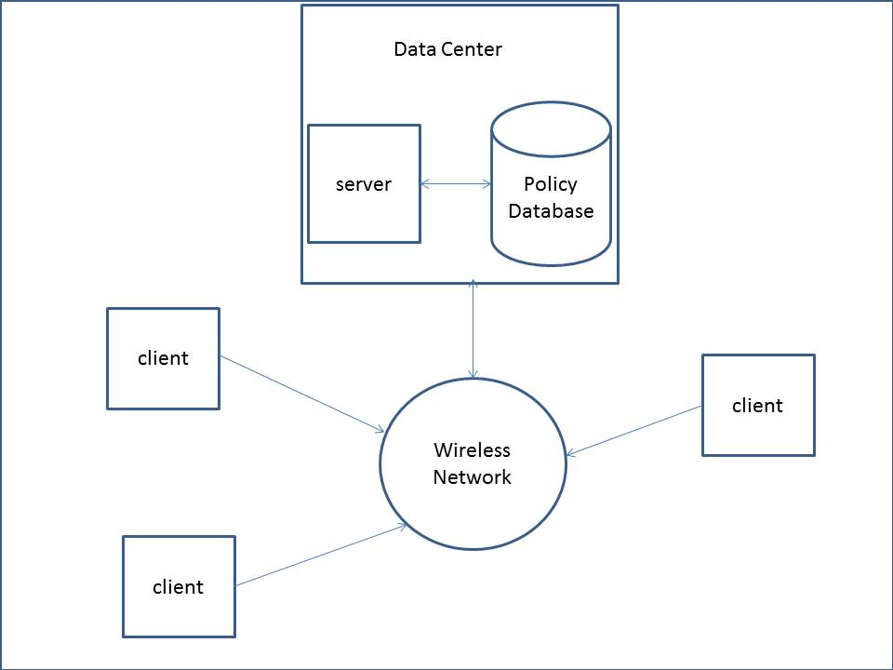
Network layout of the simulated environment

Slide 17
DATABASE DESIGN
A database model is a collection of logical construct used to represent the data structure and data relationships with a database. In the database for this application, we have 2 tables which are the Bandwidth Policy table and the Administrator table. Below are brief descriptions of each table.
Administrator Table: this table stores the details of the authorized users of the system who are responsible for setting bandwidth policies.

Slide 18
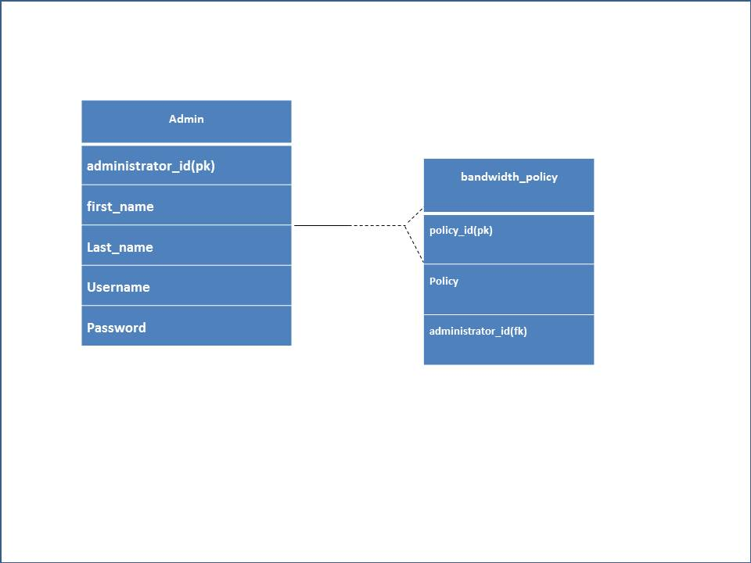
Fig 3.2 An Entity relationship diagram of the system table

Slide 19
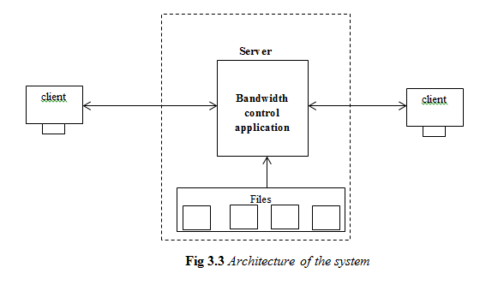

Slide 20
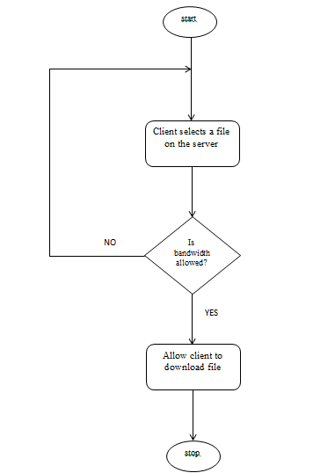
Fig 3.4 A flowchart of the system

Slide 21
REFERENCES
Behrouz A. Forouzan, Data communications and networking, McGraw-Hill, 2007
Catherine Allen, “Bandwidth control: the global journal of advanced management technology, ed. Robin Townsend (London: Global projects Group, 1995). pgs. 193-194 vol. 2
Devajit, M. Majidul, A. Utpal, J. A Study Of Bandwidth Management in Computer Networks. Volume 2. Issue 2.
Enemu, B., Bekisu, A., Ebunoluwa, G. Management & Control of Bandwidth in Computer Networks. Babcock University, Nigeria.

Slide 22

Our purpose Everyday we connect to people, improving their lives.
We strive to make you happy and satisfied
THANKS FOR PAYING ATTENTION!!!

