Slide 1
Inferential statistics and hypothesis testing

Slide 2
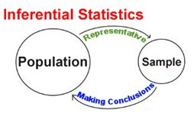
Inferential Statistics
Inferential statistics is used to draw inference from the sample of the huge data.
In this session we are going to talk about the following topics
t-Tests
Correlation Coefficients
Chi-Square

Slide 3
Hypothesis testing
Hypothesis testing is a statistical method that is used in making statistical decisions using experimental data.
Hypothesis Testing is basically an assumption that we make about the population parameter.
A hypothesis test evaluates two mutually exclusive statements about a population to determine which statement is best supported by the sample data.
When we say that a finding is statistically significant, it’s thanks to a hypothesis test.

Slide 4
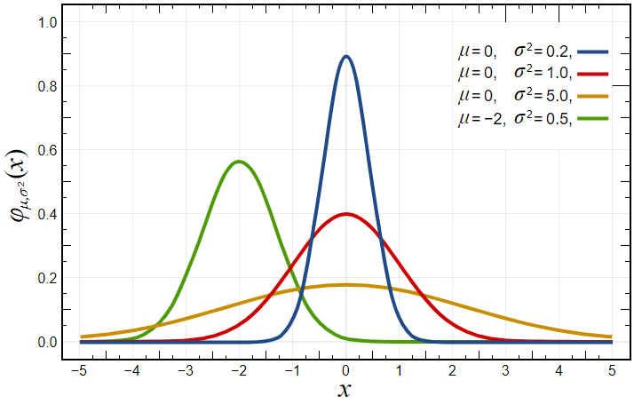
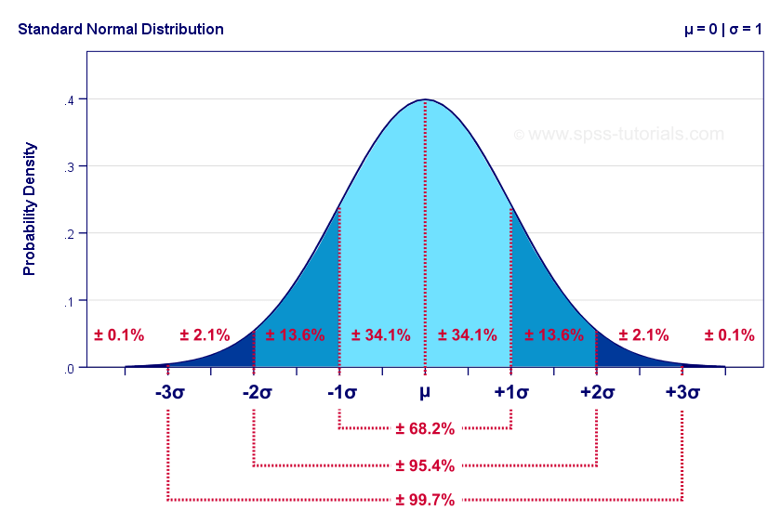
Basics of hypothesis testing
The basic of hypothesis is “Normalization” and “Standard Normalization”.

Slide 5
Parameters of hypothesis testing
Null Hypothesis:- In inferential statistics, the null hypothesis is a general statement or default position that there is no relationship between two measured phenomena, or no association among groups.
Alternative Hypothesis:- The alternative hypothesis is the hypothesis used in hypothesis testing that is contrary to the null hypothesis. It is usually taken to be that the observations are the result of a real effect.
Errors:- There are two types of errors Type-I and type-II.

Slide 6
Python library
Numpy
Pandas
Scipy
Matplotlib

Slide 7
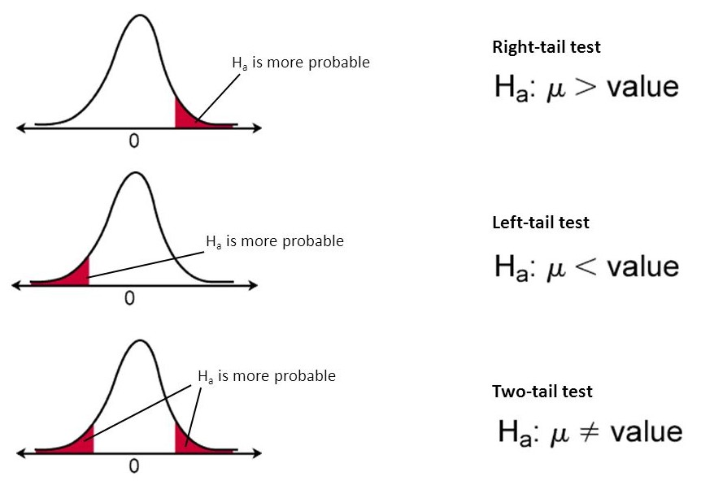
t-test
t-Test is used to see whether two groups are similar or not.
Two-sided one-sample t-test
Independent t-test
Paired t-test

Slide 8
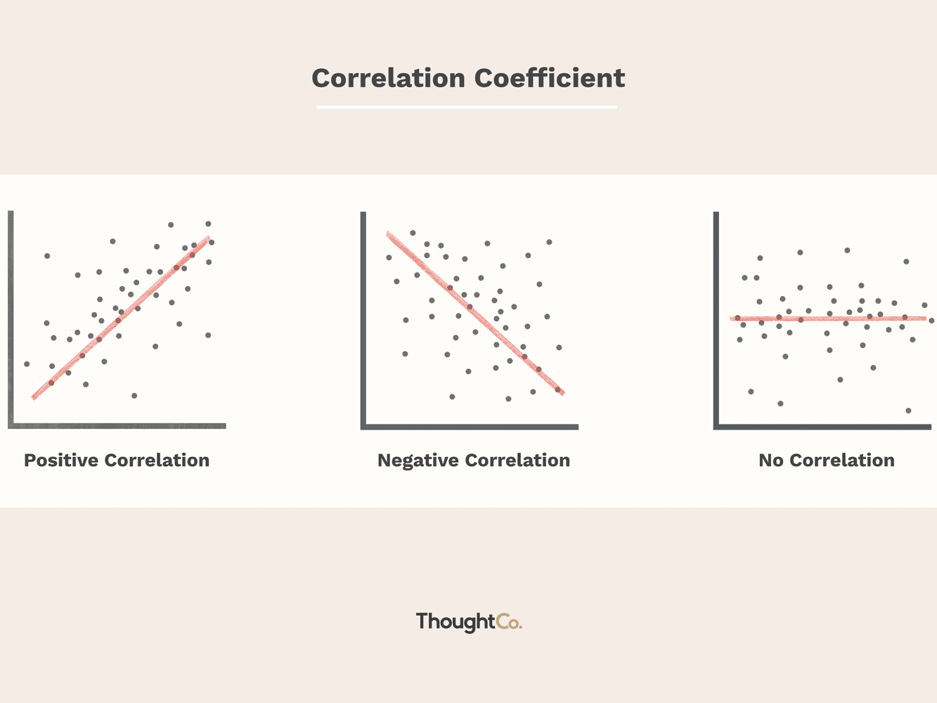
Correlation coefficient
The correlation coefficient is a statistical measure of the strength of the relationship between the relative movements of two variables.
Three relations can be established depending upon the value of the correlation coefficient
Positive
Negative
Neutral

Slide 9
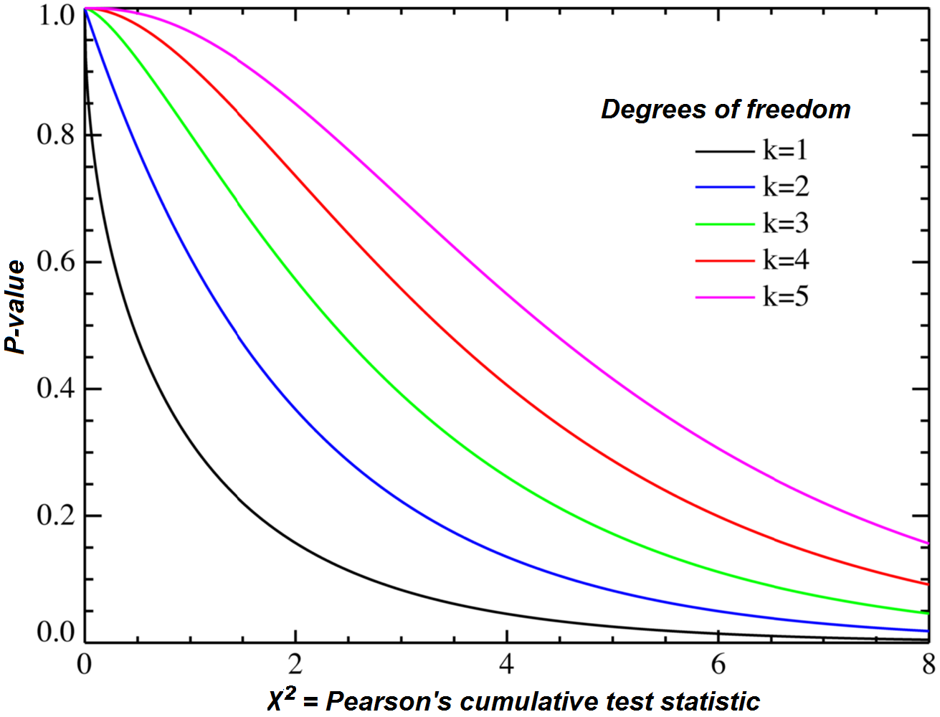
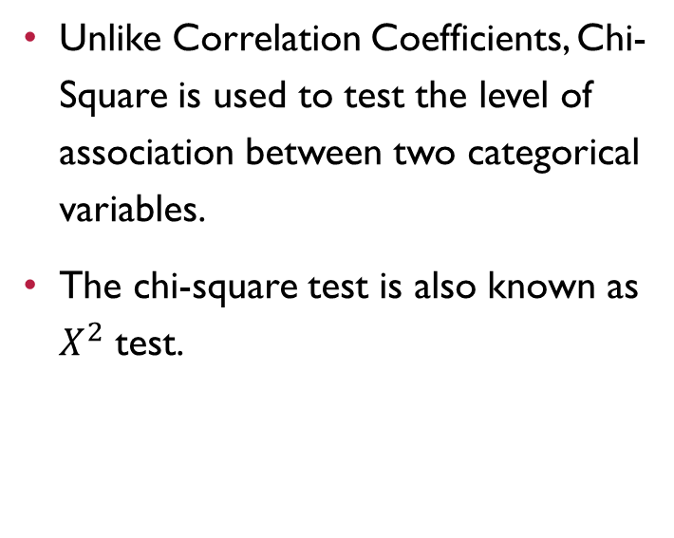
Chi-square test
Unlike Correlation Coefficients, Chi-Square is used to test the level of association between two categorical variables.
The chi-square test is also known as $X^{2}$ test.

Slide 10
Thank you

