Slide 1
Random forest

Slide 2
Ensemble learning(1/3)
Random forest is a version of ensemble learning.
Ensemble leaning is where we take multiple algorithms or a single algorithm multiple time and put them together to get a more powerful algorithm to produce a prediction.
For Example:
We typically ask the opinions of several doctors before agreeing to a medical procedure.
We read user reviews before purchasing an item.
We evaluate future employees by checking their references.

Slide 3
Contd.(2/3)
STEP 1: Pick at random K data points from the training set.
STEP 2: Build the decision tree associated to these K data points.
STEP 3: Choose the number Ntress you want to build and repeat STEPS 1 & 2.
STEP 4: For a new data point, make each one of your Ntree trees predict the value of Y for the data point in question and assign the new data point the average across all the predicted Y values.

Slide 4

Contd.(3/3)

Slide 5

Random forest intuition

Slide 6

Steps involved
Importing the basic libraries

Slide 7
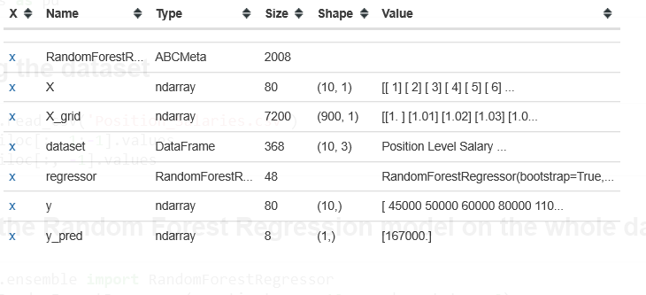
Importing data and splitting the X and Y variables

Slide 8
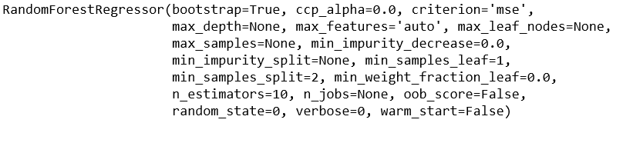
Fitting the decision tree model

Slide 9
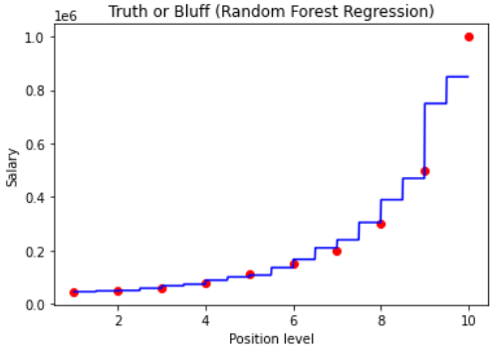
Predicting and representing data

Slide 10
Thank you

