Slide 1
Reinforcement learning - UCB

Slide 2
Reinforcement learning
Reinforcement learning is one of three basic machine learning paradigms, alongside supervised learning and unsupervised learning.
Reinforcement learning differs from supervised learning in not needing labelled input/output pairs be presented.
Reinforcement learning is the training of machine learning models to make a sequence of decisions. The agent learns to achieve a goal in an uncertain, potentially complex environment.

Slide 3
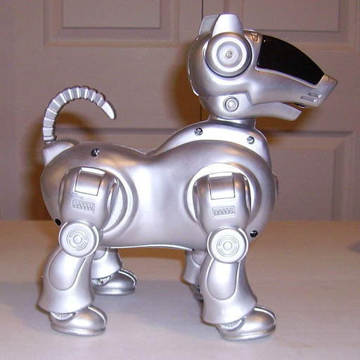
Contd.(3/3)

Slide 4
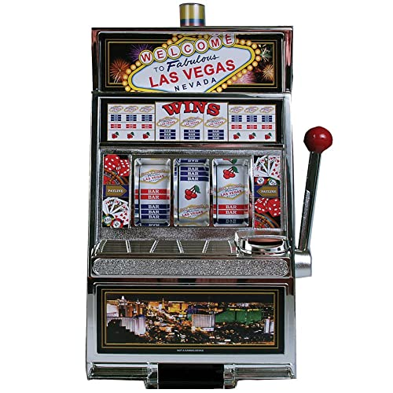
Multi-armed bandit problem(1/2)

Slide 5
Contd.(2/3)
D1
D2
D3
D4
D5

Slide 6
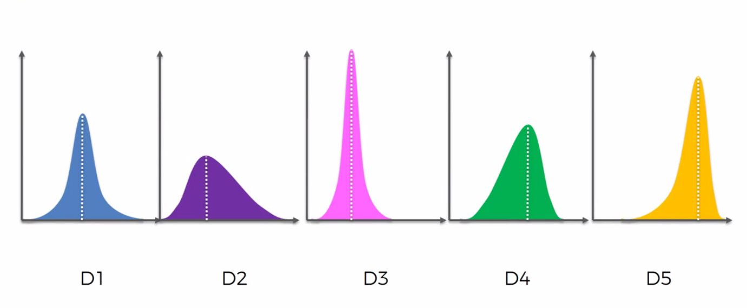
Contd.(3/3)

Slide 7




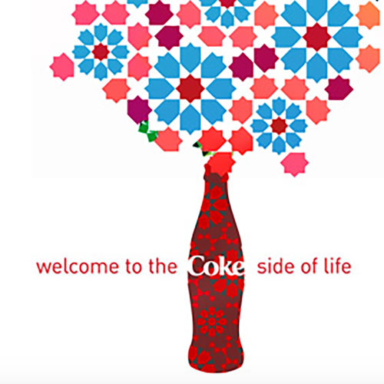
Modern approach
D1
D2
D3
D4
D5

Slide 8
Upper confidence bound(Ucb)

Slide 9
The multi-armed bandit problem
D1
D2
D3
D4
D5

Slide 10
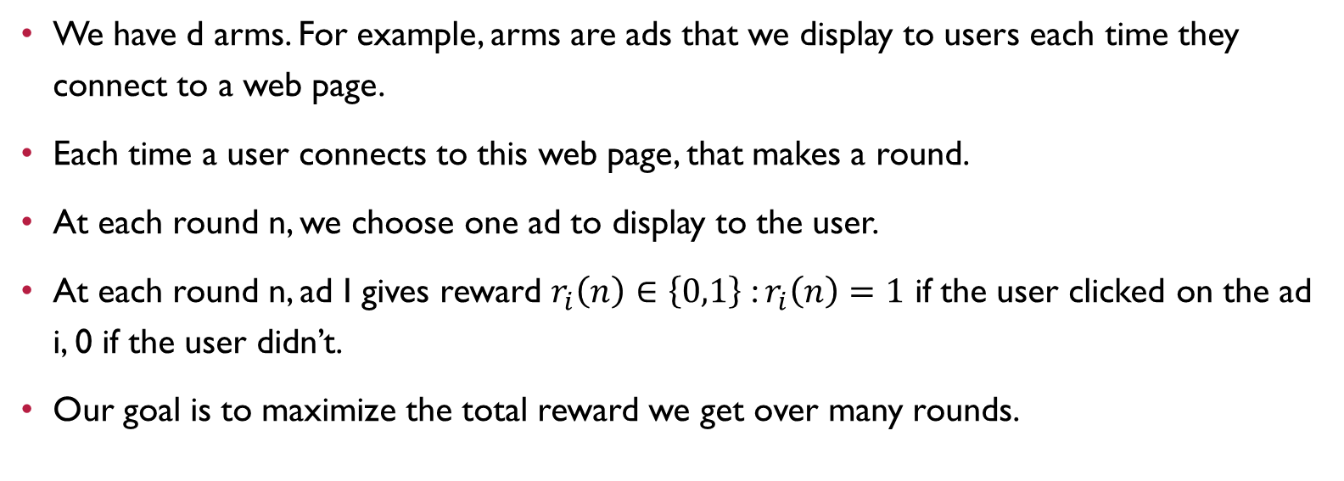
Quick summary
We have d arms. For example, arms are ads that we display to users each time they connect to a web page.
Each time a user connects to this web page, that makes a round.
At each round n, we choose one ad to display to the user.
At each round n, ad I gives reward $r_{i}\left(n\right)∈\left\{0,1\right\}$ : $r_{i}\left(n\right)=1$ if the user clicked on the ad i, 0 if the user didn’t.
Our goal is to maximize the total reward we get over many rounds.

Slide 11
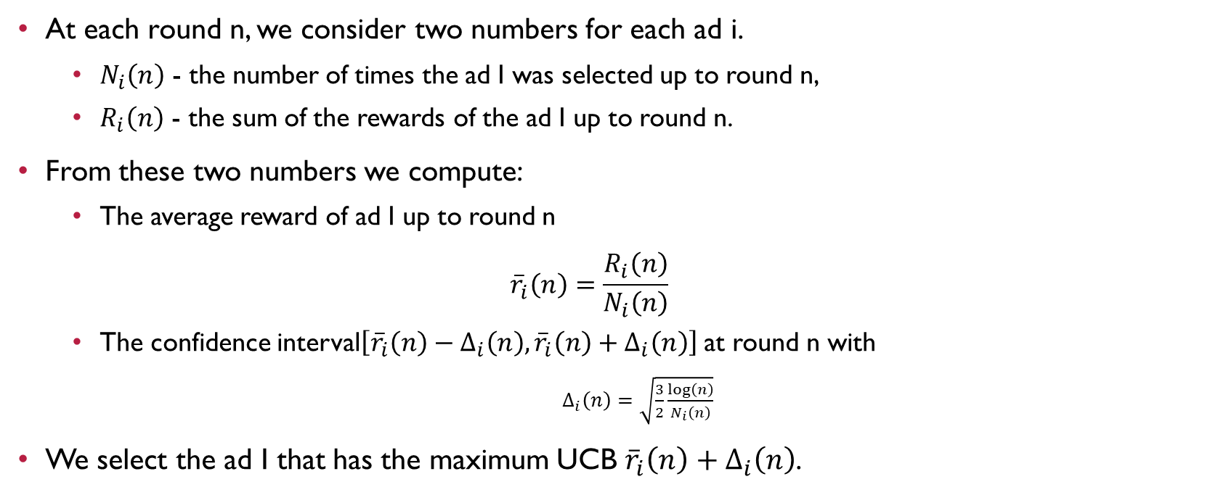
Ucb algorithm
At each round n, we consider two numbers for each ad i.
$N_{i}\left(n\right)$ - the number of times the ad I was selected up to round n,
$R_{i}\left(n\right)$ - the sum of the rewards of the ad I up to round n.
From these two numbers we compute:
The average reward of ad I up to round n
$${\overline{r}}_{i}\left(n\right)=\frac{R_{i}\left(n\right)}{N_{i}\left(n\right)}$$
The confidence interval$\left[{\overline{r}}_{i}\left(n\right)−Δ_{i}\left(n\right),{\overline{r}}_{i}\left(n\right)+Δ_{i}\left(n\right)\right]$ at round n with
$Δ_{i}\left(n\right)=\sqrt{\frac{3}{2}\frac{\log\left(n\right)}{N_{i}\left(n\right)}}$
We select the ad I that has the maximum UCB ${\overline{r}}_{i}\left(n\right)+Δ_{i}\left(n\right)$.

Slide 12
Upper confidence bound algorithm
D1
D2
D3
D4
D5

Slide 13
UCB

Slide 14
UCB
D1
D2
D3
D4
D5

Slide 15
UCB
D1
D2
D3
D4
D5

Slide 16
UCB
D1
D2
D3
D4
D5

Slide 17
UCB
D1
D2
D3
D4
D5

Slide 18
UCB
D1
D2
D3
D4
D5

Slide 19
UCB
D1
D2
D3
D4
D5

Slide 20
UCB
D1
D2
D3
D4
D5

Slide 21
UCB
D1
D2
D3
D4
D5

Slide 22
UCB
D1
D2
D3
D4
D5

Slide 23
UCB
D1
D2
D3
D4
D5

Slide 24
UCB
D1
D2
D3
D4
D5

Slide 25
UCB
D1
D2
D3
D4
D5

Slide 26
UCB
D1
D2
D3
D4
D5

Slide 27
Thank you

