Slide 1
Classification and SVM

Slide 2
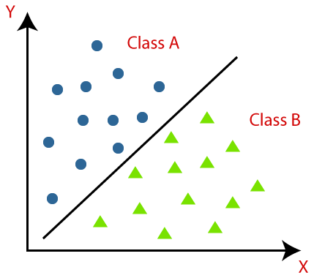
Classification(1/2)
Unlike regression where we predict a continuous number, we use classification to predict a category.
Example:
To identify customer segment
To identify if a kid will pass or fail in examination

Slide 3
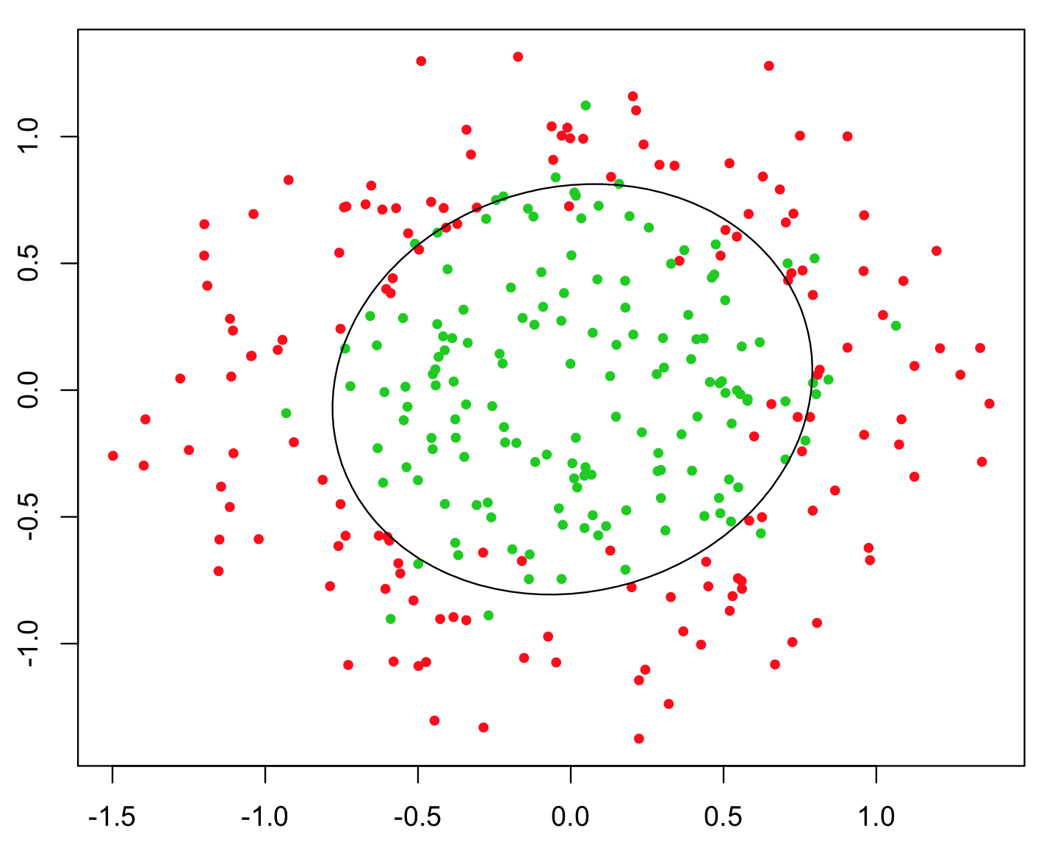
Contd.(2/2)
Types of classification algorithms:
Linear models
Logistics Regression
Support Vector machines
Non-linear Models
K-nearest Neighbors(KNN)
Kernel SVM
Naïve Bayes

Slide 4
SVM definition
A support vector machine (SVM) is a supervised machine learning model that uses classification algorithms for two-group classification problems.
After giving an SVM model sets of labeled training data for each category, they’re able to categorize new text.
Applications:
Face detection – SVM classify parts of the image as a face and non-face and create a square boundary around the face.
Handwriting recognition – We use SVM to recognize handwritten characters used widely.

Slide 5
Support Vector machines(1/3)

Slide 6
Svm(2/3)

Slide 7
Svm(3/3)
Maximum margin
Positive Hyperplane
Maximum margin hyperplane
(maximum margin classifier)
Support Vectors
Negative Hyperplane

Slide 8
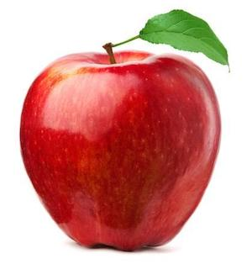
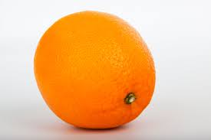
SVM intuition

Slide 9
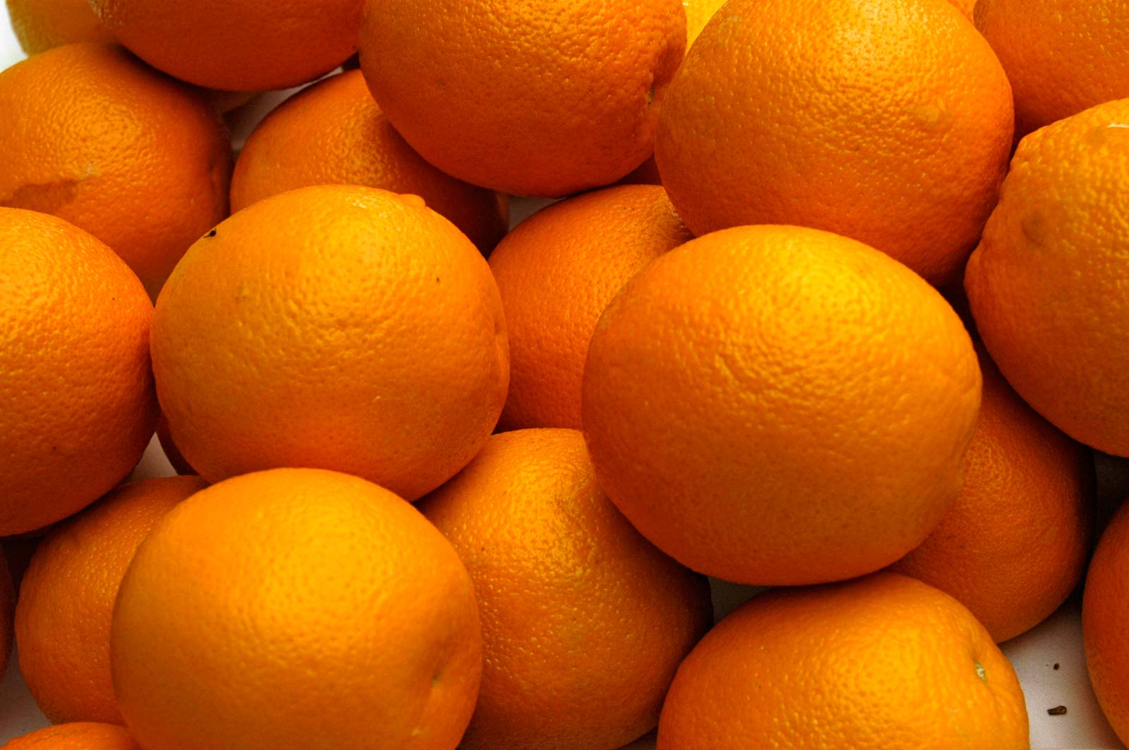
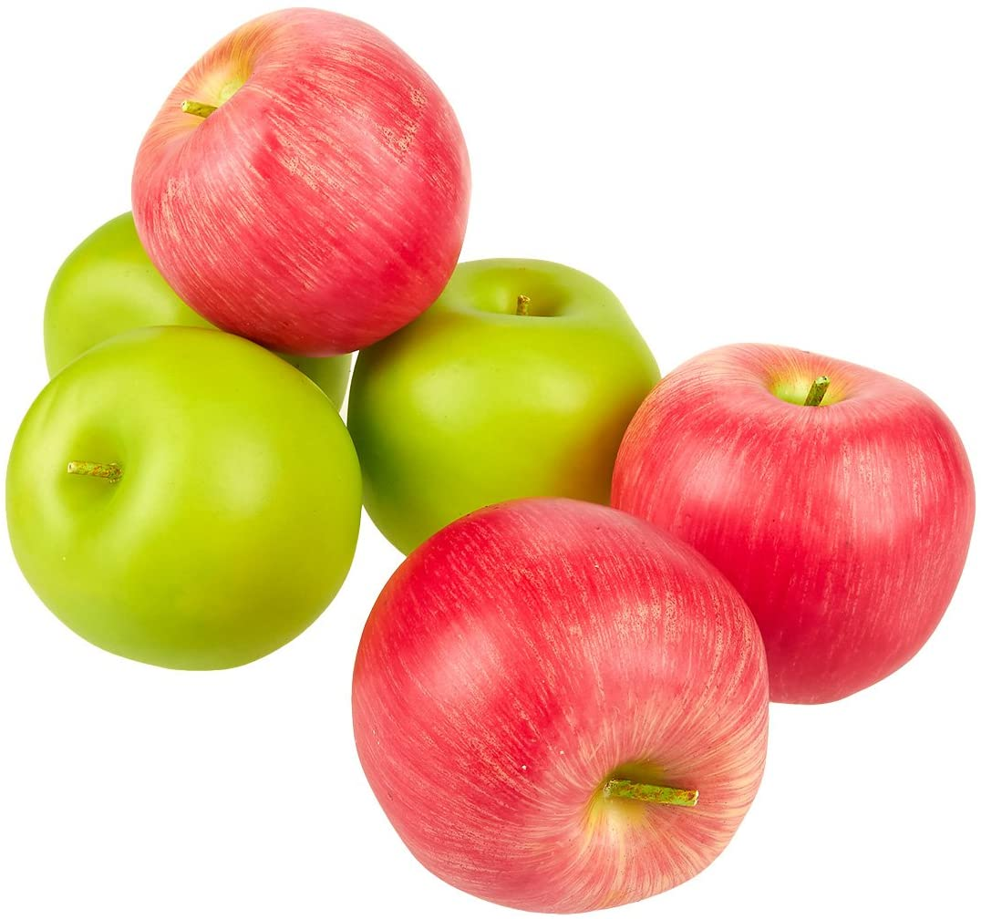
Svm intuition

Slide 10
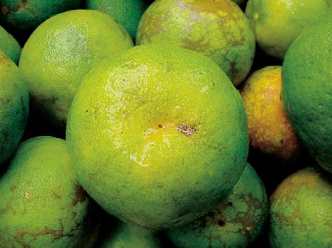
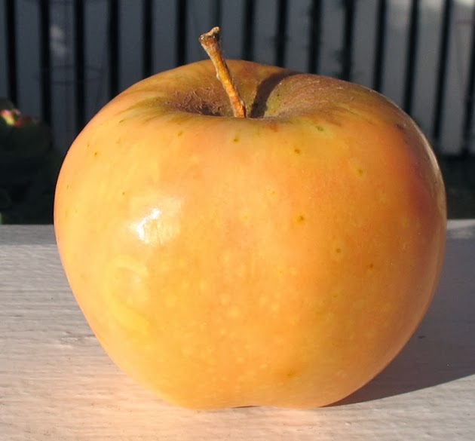
Svm intuition

Slide 11
Thank you

