Slide 1
Clustering and K-means

Slide 2
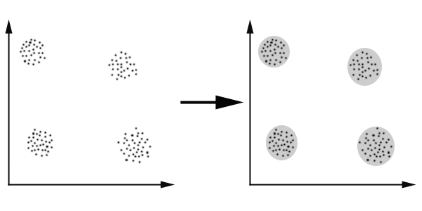
Clustering
Unlike the previous algorithms clustering falls into the category of un-supervised learning.
Clustering is the task of dividing the population or data points into a number of groups such that data points in the same groups are more similar to other data points in the same group and dissimilar to the data points in other groups.

Slide 3
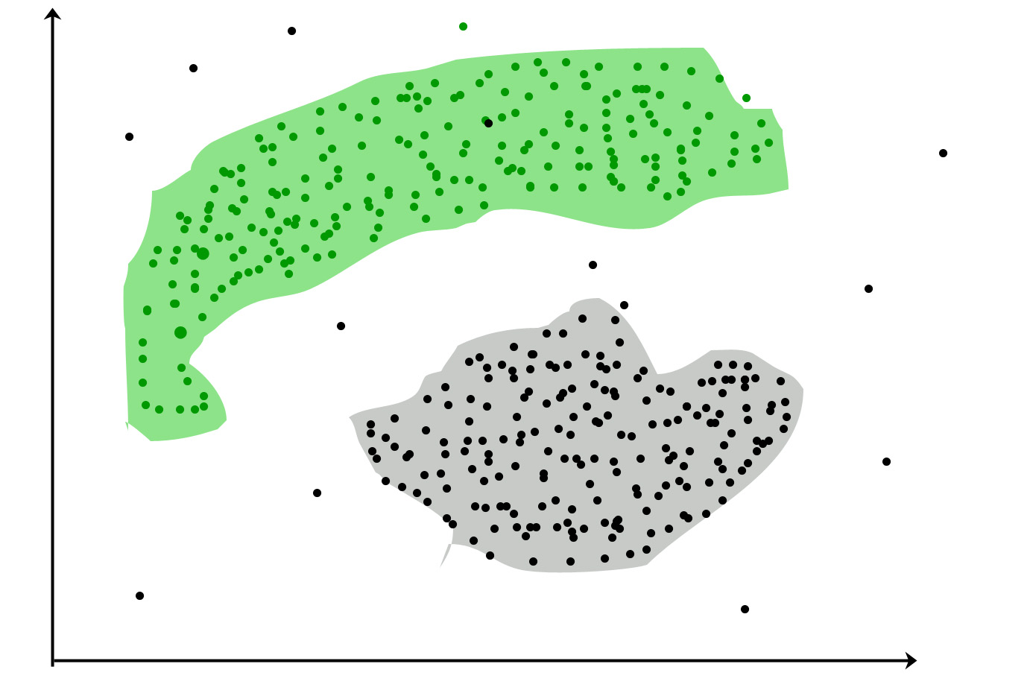
applications
Marketing : It can be used to characterize & discover customer segments for marketing purposes.
Biology : It can be used for classification among different species of plants and animals.
Libraries : It is used in clustering different books on the basis of topics and information.
Insurance : It is used to acknowledge the customers, their policies and identifying the frauds.

Slide 4
K-means clustering

Slide 5




What K-means do for you
Before K-Means
After K-Means
$$x_{2}$$
$$x_{2}$$
K-Means
$$x_{1}$$
$$x_{1}$$

Slide 6
How does it works?
STEP 1: Choose the number K clusters.
STEP 2: Select at random K points, the centroids(not necessarily from your dataset).
STEP 3: Assign each data point to the closest centroid – That forms K clusters.
STEP 4: Compute and place the new centroid of each cluster.
STEP 5: Reassign each data point to the new closet centroid.
If reassignment took place, go to step 4, otherwise go to FIN.(Model Created)

Slide 7
Step 1: choose the number K of clusters: k=2

Slide 8
Step 2: select at random k points, the centroid (not necessarily from your dataset)

Slide 9
Step 3: Assign each data point to the closest centroid – that forms K clusters

Slide 10
Step 4: Compute and place the new centroid of each cluster

Slide 11
Step 5: reassign each data point to the new closest centroid. If an reassignment took place go to step 4, otherwise go to fin.

Slide 12
Finished model

Slide 13


Random Initialization trap
$$x_{2}$$
$$x_{1}$$
$$x_{1}$$

Slide 14
Random Initialization trap
But what would happen if we choose a bad random initialization?

Slide 15



Random Initialization trap
$$x_{2}$$
$$x_{1}$$
$$x_{1}$$

Slide 16
Avoiding the trap
Solution
K-Means++

Slide 17


Choosing the right number of clusters
$$x_{2}$$
$$x_{2}$$
$$x_{1}$$
$$x_{1}$$
$$x_{1}$$

Slide 18



Within clusters sum of squares
WCSS$=Σ distance(P_{i},C_{1})^{2}+Σ distance(P_{i},C_{2})^{2}$ + $Σ distance(P_{i},C_{3})^{2}$
$$P_{i }in cluster 1$$
$$P_{i }in cluster 2$$
$$P_{i }in cluster 3$$

Slide 19




Contd..
$$x_{2}$$
$$x_{1}$$
$$x_{1}$$
WCSS$=Σ distance(P_{i},C_{1})^{2}+Σ distance(P_{i},C_{2})^{2}$ + $Σ distance(P_{i},C_{3})^{2}$
$$P_{i }in cluster 1$$
$$P_{i }in cluster 2$$
$$P_{i }in cluster 3$$

Slide 20
Rewind..

Slide 21
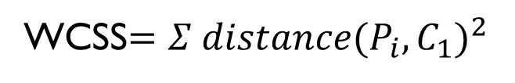
$$x_{2}$$
$$x_{1}$$
$$x_{1}$$
WCSS$=Σ distance(P_{i},C_{1})^{2}$
$$P_{i }in cluster 1$$

Slide 22
$$x_{2}$$
$$x_{1}$$
$$x_{1}$$
WCSS$=Σ distance(P_{i},C_{1})^{2}+Σ distance(P_{i},C_{2})^{2}$
$$P_{i }in cluster 1$$
$$P_{i }in cluster 2$$

Slide 23
$$x_{2}$$
$$x_{1}$$
$$x_{1}$$
WCSS$=Σ distance(P_{i},C_{1})^{2}+Σ distance(P_{i},C_{2})^{2}$ + $Σ distance(P_{i},C_{3})^{2}$
$$P_{i }in cluster 1$$
$$P_{i }in cluster 2$$
$$P_{i }in cluster 3$$

Slide 24
The Elbow Method

Slide 25
Thank you

