Slide 1

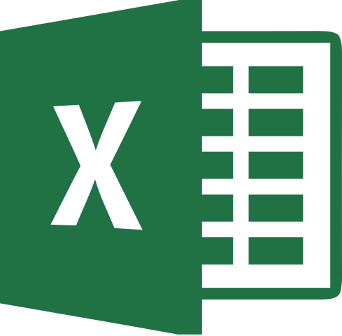

2
Business Analytics
MentorrBuddy.com

Slide 2


2
DATA TYPES AND STATEMENTS IN R
Lesson 8.1
Data Types in R
Business Analytics
MentorrBuddy.com

Slide 3
Basic Data Types in R
R has 5 types of basic data types:
Numeric type – 3, 45, -23, 33.4
Integer type – 3L, 45L (where L tells R to store data as integer)
Character type – “a”, “V”, “sky”
Logical type – TRUE or FALSE
Complex type – 1+4i, 45-3i
Business Analytics
MentorrBuddy.com

Slide 4
Basic Data Structures in R
The data structures in R are created by combining the basic data types.
Some of the data structures are mentioned below:
Vector
Matrices
Lists
Data frame
Factors
Business Analytics
MentorrBuddy.com

Slide 5
Operators In R(1/2)
Business Analytics
MentorrBuddy.com

Slide 6
Contd.(2/2)
Business Analytics
MentorrBuddy.com

Slide 7
In-Built Functions in R (1/2)
print() – to print the values on the screen
Sort() – to sort the values in a vector
dim() – to print the dimensions of an matrix
cbind() – to add a new column in an existing matrix
rbind() – to add a new row in a matrix/data frame
Business Analytics
MentorrBuddy.com

Slide 8
Contd.(2/2)
str() – to find the structural details of a data frame
summary() – to get the statistical details of a data frame
subset() – to select a range of data as per our condition from a data frame.
Business Analytics
MentorrBuddy.com

Slide 9
Input/Importing in R(1/2)
In R we can take input from the user by as well as importing different types of file like .csv, excel sheet or download from github.
To take the input from the user we use “readline()” function.
ex. Variable = readline(prompt = “message”)
To import the csv file from your file locations into R Studio we use “read,csv()” function.
ex. Variable = read.csv(“file name with location.csv”, header = TRUE)
Business Analytics
MentorrBuddy.com

Slide 10
Input/Importing in R(2/2)
To import the excel sheet into R Studio we use “read_excel()” function after using “readxl” library.
ex. library(“readxl”)
read_excel(“path location//filename.xlsx”)
Business Analytics
MentorrBuddy.com

Slide 11
Exporting files in R
To export any file from R Studio we use “write” function
ex. write.csv(data variable name, file = “file name.csv”)
library(“xlsx”)
write.xlsx(data variable, file = “file name.xlsx”, sheetName = “sheet Name”, append = FALSE)
Business Analytics
MentorrBuddy.com

Slide 12
Thank you
Business Analytics
MentorrBuddy.com

