Slide 1




2
Data Science
MentorrBuddy.com

Slide 2


2
Solver in Excel
Lesson 9
Solver in Excel
Data Science
MentorrBuddy.com

Slide 3
2
Solver Tool
Excel Solver belongs to a special set of commands often referred to as What-if Analysis Tools. It is primarily purposed for simulation and optimization of various business and engineering models.
The Excel Solver add-in is especially useful for solving linear programming problems, aka linear optimization problems, and therefore is sometimes called a linear programming solver. Apart from that, it can handle smooth nonlinear and non-smooth problems.
While Solver can't crack every possible problem, it is really helpful when dealing with all kinds of optimization problems where you need to make the best decision. For example, it can help you maximize the return of investment, choose the optimal budget for your advertising campaign, make the best work schedule for your employees, minimize the delivery costs, and so on.
Data Science
MentorrBuddy.com

Slide 4
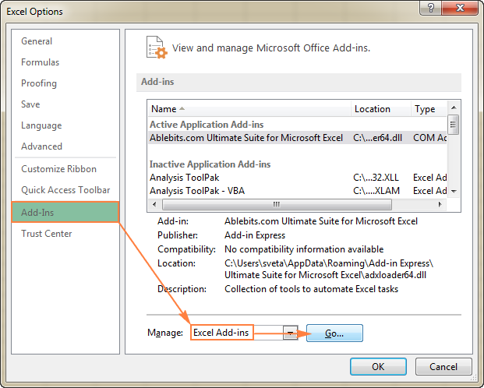
How to add Solver to Excel
To add Solver to your Excel, perform the following steps:
In Excel 2010, Excel 2013, Excel 2016, and Excel 2019, click File > Options.
In the Excel Options dialog, click Add-Ins on the left sidebar, make sure Excel Add-ins is selected in the Manage box at the bottom of the window, and click Go.
Data Science
MentorrBuddy.com

Slide 5
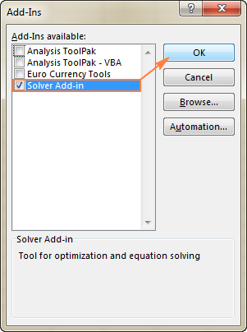
How to add Solver to Excel
In the Add-Ins dialog box, check the Solver Add-in box, and click OK:
Data Science
MentorrBuddy.com

Slide 6
Thank you
Data Science
MentorrBuddy.com

