Slide 1

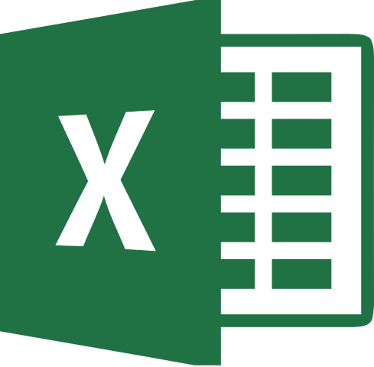


2
Data Science
MentorrBuddy.com

Slide 2


2
Data Analysis
Lesson 7
Data Analysis
Data Science
MentorrBuddy.com

Slide 3
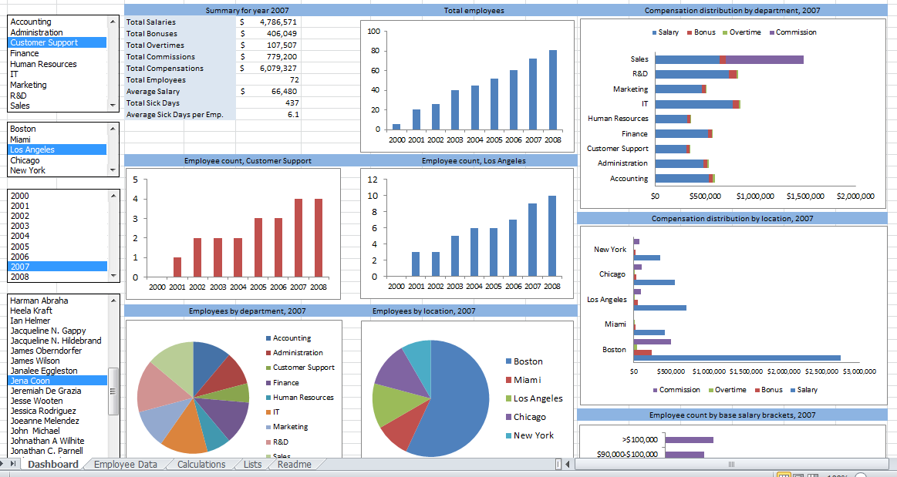
2
Data Analysis
Data analysis is a process of inspecting, cleansing, transforming and modelling data with the goal of discovering useful information, informing conclusion and supporting decision-making. Data analysis has multiple facets and approaches, encompassing diverse techniques under a variety of names, and is used in different business, science, and social science domains. In today's business world, data analysis plays a role in making decisions more scientific and helping businesses operate more effectively.
Data Science
MentorrBuddy.com

Slide 4
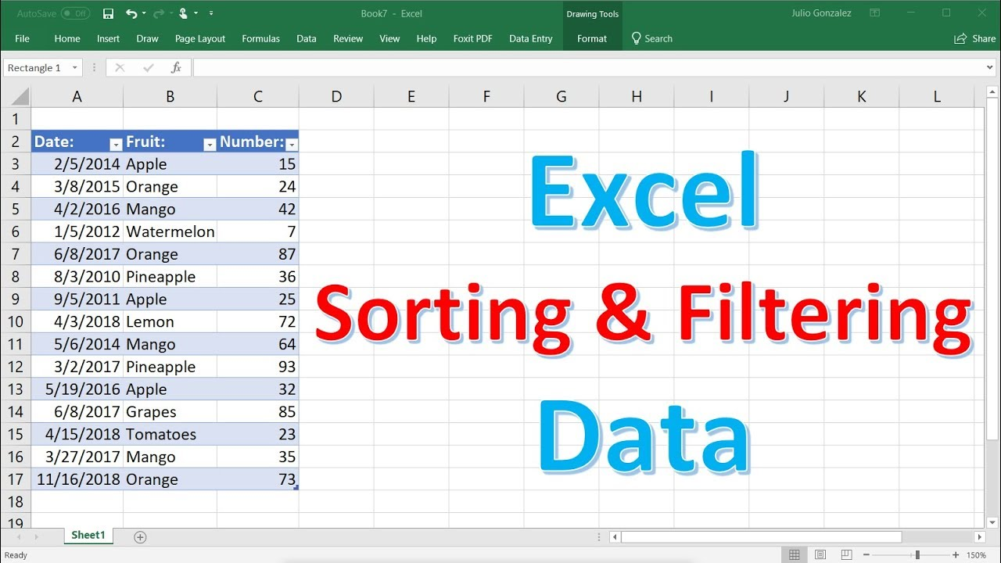
Data Analysis
Sort: You can sort your Excel data on one column or multiple columns. You can sort in ascending or descending order. To arrange your data in a particular order. E.g. Arranging a list on the alphabetical order, arranging your data on in increasing or decreasing order of numeric values
Filter: Filter your Excel data if you only want to display records that meet certain criteria.
Data Science
MentorrBuddy.com

Slide 5
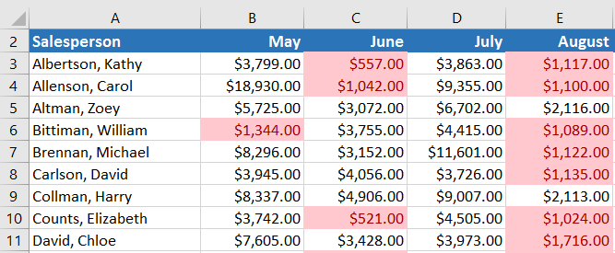
Conditional formatting
Conditional formatting allows you to automatically apply formatting—such as colors, icons, and data bars—to one or more cells based on the cell value. To do this, you'll need to create a conditional formatting rule.
For example, a conditional formatting rule might be: If the value is less than $2000, color the cell red. By applying this rule, you'd be able to quickly see which cells contain values less than $2000.
Data Science
MentorrBuddy.com

Slide 6
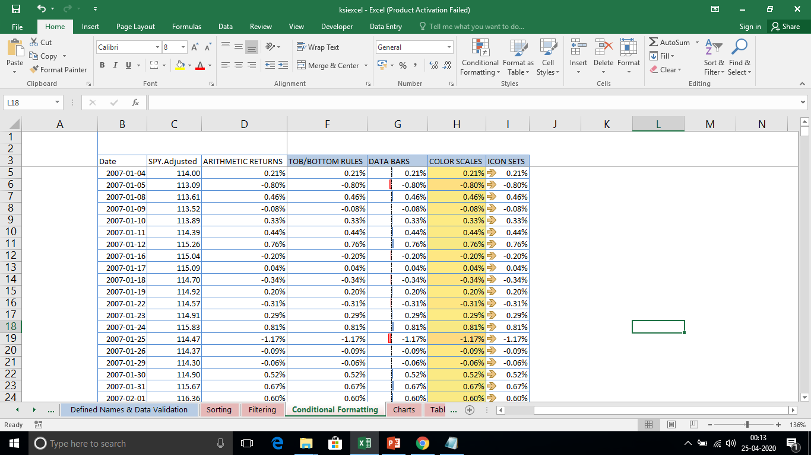
Conditional formatting
Conditional formatting Rules:-
Highlight cell rules
Top/bottom rules
Data bar rules
Color scales rules
Icon sets rules
Data Science
MentorrBuddy.com

Slide 7
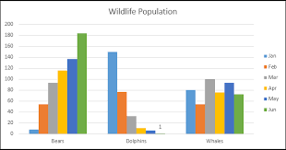
Charts
A chart is a visual representative of data in both columns and rows. Charts are usually used to analyse trends and patterns in data sets.
Column Chart:-
A Column Chart typically displays the categories along the horizontal (category) axis and values along the vertical (value) axis.
Line Chart
Line charts can show continuous data over time on an evenly scaled Axis. Therefore, they are ideal for showing trends in data at equal intervals, such as months, quarters or years.
Data Science
MentorrBuddy.com

Slide 8
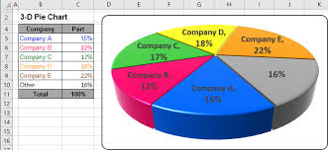
Charts
Bar Chart
Bar Charts illustrate comparisons among individual items. In a Bar Chart, the categories are organized along the vertical axis and the values are organized along the horizontal axis.
Pie Chart
Pie charts show the size of items in one data series, proportional to the sum of the items. The data points in a pie chart are shown as a percentage of the whole pie.
Data Science
MentorrBuddy.com

Slide 9
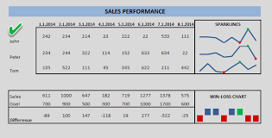
Charts
XY (Scatter) Chart
XY (Scatter) charts are typically used for showing and comparing numeric values, like scientific, statistical, and engineering data.
Sparkline
A sparklines is a tiny chart in a worksheet cell that provides a visual representation of data. Use sparklines to show trends in a series of values, such as seasonal increases or decreases, economic cycles, or to highlight maximum and minimum values.
Data Science
MentorrBuddy.com

Slide 10
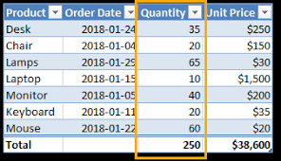
Tables and Pivot Tables
Tables:-
Tables allow you to analyse your data in Excel quickly and easily. Learn how to insert, sort and filter a table, and how to display a total row at the end of a table.
Data Science
MentorrBuddy.com

Slide 11
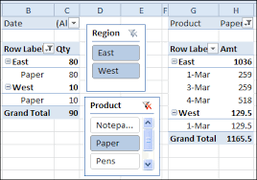
Tables and Pivot Tables
Pivot tables:-
Featured snippet from the web
A pivot table is a summary of your data, packaged in a chart that lets you report on and explore trends based on your information. Pivot tables are particularly useful if you have long rows or columns that hold values you need to track the sums of and easily compare to one another.
Data Science
MentorrBuddy.com

Slide 12
Thank you
Data Science
MentorrBuddy.com

