Slide 1

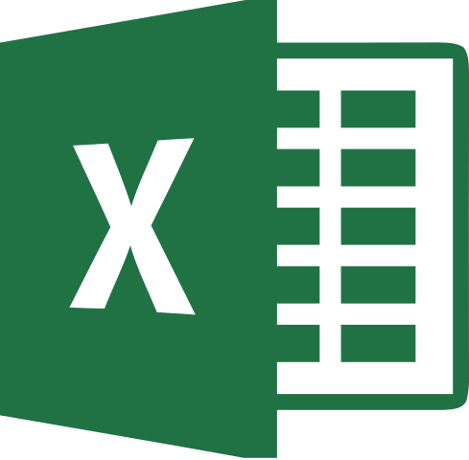


2
Data Science
MentorrBuddy.com

Slide 2


2
Data Analysis Tools
Lesson 8
Data Analysis Tools
Data Science
MentorrBuddy.com

Slide 3
2
Data Analysis Tools
If you need to develop complex statistical or engineering analyses, you can save steps and time by using the Analysis ToolPack. You provide the data and parameters for each analysis, and the tool uses the appropriate statistical or engineering macro functions to calculate and display the results in an output table. Some tools generate charts in addition to output tables.
The data analysis functions can be used on only one worksheet at a time. When you perform data analysis on grouped worksheets, results will appear on the first worksheet and empty formatted tables will appear on the remaining worksheets. To perform data analysis on the remainder of the worksheets, recalculate the analysis tool for each worksheet.
Data Science
MentorrBuddy.com

Slide 4
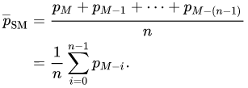
Moving Average
Generally speaking, moving average (also referred to as rolling average, running average or moving mean) can be defined as a series of averages for different subsets of the same data set.
It is frequently used in statistics, seasonally-adjusted economic and weather forecasting to understand underlying trends. In stock trading, moving average is an indicator that shows the average value of a security over a given period of time. In business, it's a common practice to calculate a moving average of sales for the last 3 months to determine the recent trend.
Data Science
MentorrBuddy.com

Slide 5
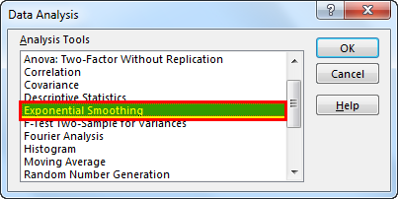
Exponential Smoothing
Exponential Smoothing is done on the observations of data and by formulas, it is a tedious task to do so but excel has provided us with an inbuilt tool to use this technique, after selecting the data we need to go to the Data tab and then in data analysis where we will find exponential smoothing technique.
“Exponential Smoothing is used for predicting Demand”
Data Science
MentorrBuddy.com

Slide 6
Descriptive Statistics and Histogram
Descriptive Statistics Analysis Tools:-
Descriptive statistics are one of the fundamental “must knows” with any set of data. It gives you a general idea of trends in your data including:
The mean, mode, median and range.
Variance and standard deviation.
Skewness.
Count, maximum and minimum.
Descriptive statistics is useful because it allows you to take a large amount of data and summarize it. For example, let’s say you had data on the incomes of one million people. No one is going to want to read a million pieces of data; if they did, they wouldn’t be able to glean any useful information from it. On the other hand, if you summarize it, it becomes useful: an average wage, or a median income, is much easier to understand than reams of data.
Data Science
MentorrBuddy.com

Slide 7
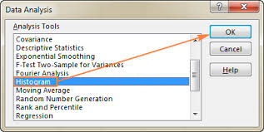
Descriptive Statistics and Histogram
the Histogram Data Analysis tool to create a frequency distribution and, optionally, a histogram chart. A frequency distribution shows just how values in a data set are distributed across categories. A histogram shows the same information in a cute little column chart.
Data Science
MentorrBuddy.com

Slide 8
Correlation and Regression
Correlation:-
Correlation is a statistical measure which determines co-relationship or association of two variables.
To represent linear relationship between two variables.
Correlation coefficient indicates the extent to which two variables move together.
To find a numerical value expressing the relationship between variables.
Regression:-
Regression describes how an independent variable is numerically related to the dependent variable.
To fit a best line and estimate one variable on the basis of another variable.
Regression indicates the impact of a unit change in the known variable (x) on the estimated variable (y).
To estimate values of random variable on the basis of the values of fixed variable.
Data Science
MentorrBuddy.com

Slide 9
What-If Analysis
What-If Analysis is the process of changing the values in cells to see how those changes will affect the outcome of formulas on the worksheet. Three kinds of What-If Analysis tools come with Excel: Scenarios, Goal Seek, and Data Tables. Scenarios and Data tables take sets of input values and determine possible results.
By using What-If Analysis tools in Excel, you can use several different sets of values in one or more formulas to explore all the various results.
For example, you can do What-If Analysis to build two budgets that each assumes a certain level of revenue. Or, you can specify a result that you want a formula to produce, and then determine what sets of values will produce that result. Excel provides several different tools to help you perform the type of analysis that fits your needs.
Data Science
MentorrBuddy.com

Slide 10
Goal Seek
The Goal Seek Excel function (often referred to as What-if-Analysis) is a method of solving for a desired output by changing an assumption that drives it. The function essentially uses a trial and error approach to back-solving the problem by plugging in guesses until it arrives at the answer. For example, if the formula for revenue is equal to the number of units sold multiplied by the selling price, Goal Seek can determine how many units have to be sold to reach $1 million of revenue, if the selling price is known. The function is extremely useful for performing sensitivity analysis in financial modelling.
Data Science
MentorrBuddy.com

Slide 11
Thank you
Data Science
MentorrBuddy.com

