Slide 1

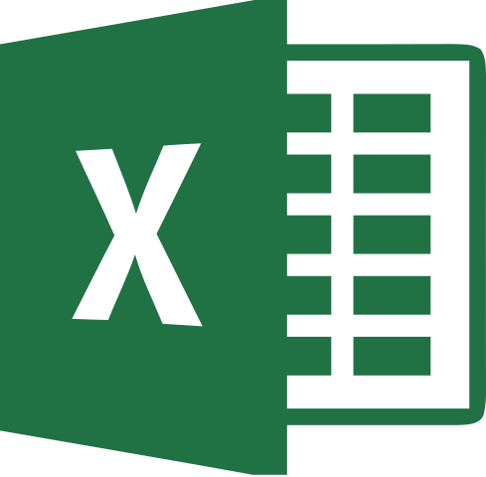


2
Data Science
MentorrBuddy.com

Slide 2


2
INTRODUCTION TO
EXCEL
Lesson 2
Introduction to Excel
Data Science
MentorrBuddy.com

Slide 3
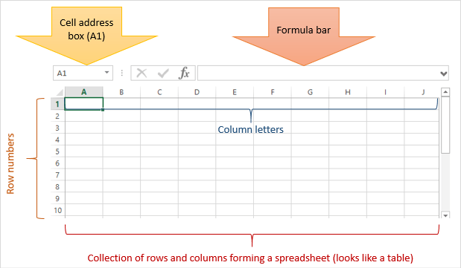
2
What is Microsoft Excel?
Microsoft Excel is a spreadsheet program that is used to record and analyse numerical data. Think of a spreadsheet as a collection of columns and rows that form a table. Alphabetical letters are usually assigned to columns and numbers are usually assigned to rows. The point where a column and a row meet is called a cell. The address of a cell is given by the letter representing the column and the number representing a row.
Data Science
MentorrBuddy.com

Slide 4
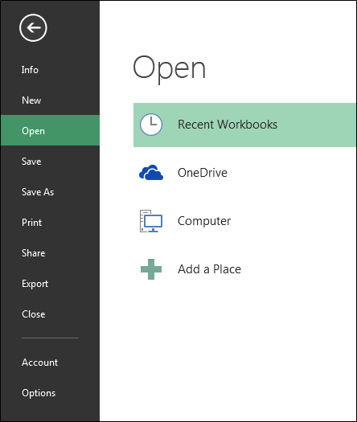
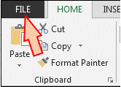
File Option in Excel
File tab contains the basic required options such as New, Open, Save, Save as, Print, Share, Export, and Close options. Other than the aforementioned options, we can find account and Excel options tab, too.
Data Science
MentorrBuddy.com

Slide 5
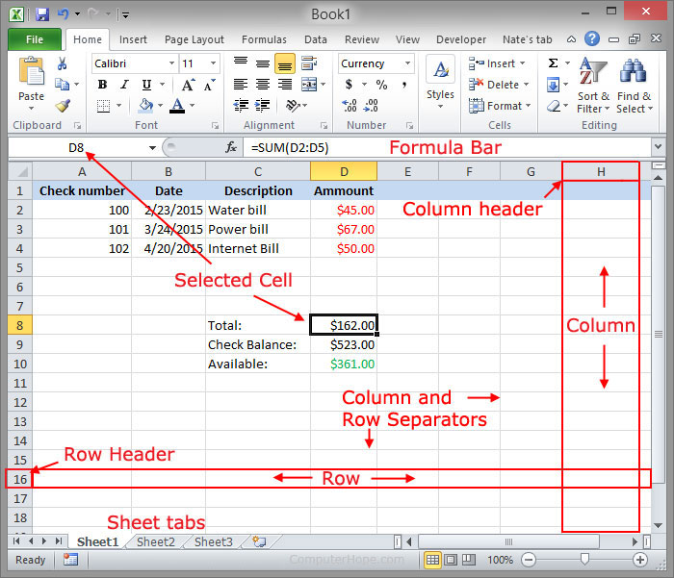
2
Workbook
In Microsoft Excel, a workbook is a collection of one or more spreadsheets, also called worksheets, in a single file. Below is an example of a spreadsheet called "Sheet1" in an Excel workbook file called "Book1." Our example also has the "Sheet2" and "Sheet3" sheet tabs, which are also part of the same workbook.
Data Science
MentorrBuddy.com

Slide 6
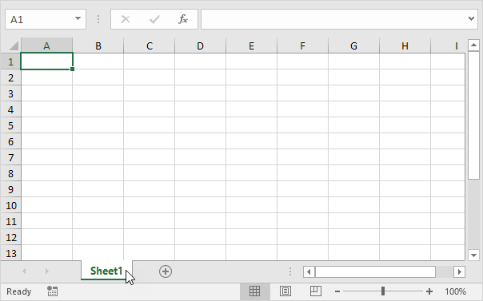
2
Worksheet
A worksheet is a collection of cells where you keep and manipulate the data. Each Excel workbook can contain multiple worksheets.
When you open an Excel workbook, Excel automatically selects Sheet1 for you. The name of the worksheet appears on its sheet tab at the bottom of the document window.
Data Science
MentorrBuddy.com

Slide 7
2
Cells
A cell is the intersection between a row and a column on a spreadsheet that starts with cell A1. In the following example, a highlighted cell is shown in a Microsoft Excel spreadsheet. D8 (column D, row 8) is the highlighted cell. Any modifications made while this cell is highlighted will be limited to this item in the spreadsheet.
Each cell in a spreadsheet can contain any value that can be called using a relative cell reference or called upon using a formula.
Data Science
MentorrBuddy.com

Slide 8
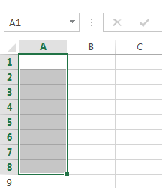
2
Ranges
In a spreadsheet a cell range is a collection of selected cells. This cell range is usually symmetrical (square), but can exist of separate cells just the same. A cell range can be referred to in a formula.
In a spreadsheet, a cell range is defined by the reference of the upper left cell (minimum value) of the range and the reference of the lower right cell (maximum value) of the range. Eventually separate cells can be added to this selection, then the range is called an irregular cell range. In Excel, the minimum and maximum value are included. That’s different from a mathematical range, in which it is a collection of values between a maximum and a minimum value.
Cell Range A1:A8
Data Science
MentorrBuddy.com

Slide 9
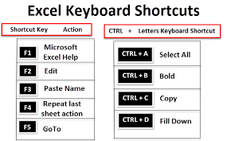
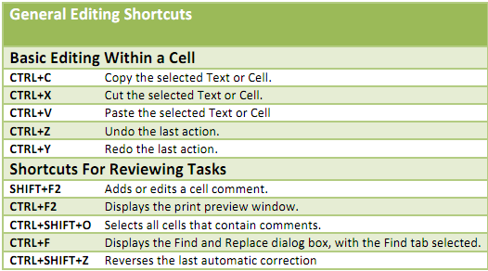
2
Keyboard Shortcuts
Data Science
MentorrBuddy.com

Slide 10
Thank you
Data Science
MentorrBuddy.com

