Slide 1




2
Data Science
MentorrBuddy.com

Slide 2


2
Formula and Function-1
Lesson 3
Formula and Function-1
Data Science
MentorrBuddy.com

Slide 3
2
Formula and Functions
Mastering the basic Excel formulas is critical for beginners to become highly proficient in financial analysis. Microsoft Excel is considered the industry standard piece of software in data analysis. Microsoft’s spreadsheet program also happens to be one of the most preferred software by investment bankers and financial analysts in data processing, financial modelling, and presentation.
There are two basic ways to perform calculations in Excel: Formulas and Functions.
1. Formulas
In Excel, a formula is an expression that operates on values in a range of cells or a cell. For example, =A1+A2+A3, which finds the sum of the range of values from cell A1 to cell A3.
2. Functions
Functions are predefined formulas in Excel. They eliminate laborious manual entry of formulas while giving them human-friendly names. For example: =SUM(A1:A3). The function sums all the values from A1 to A3.
Data Science
MentorrBuddy.com

Slide 4
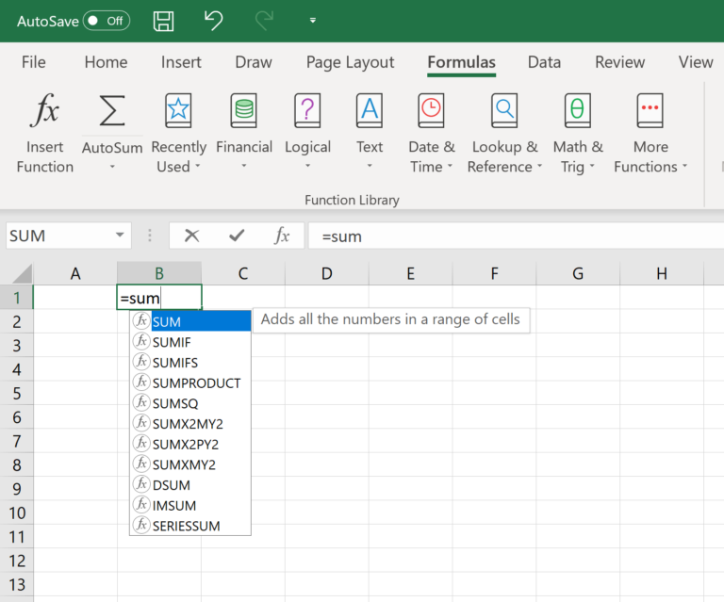
Formulas
Typing a formula in a cell or the formula bar is the most straightforward method of inserting basic Excel formulas. The process usually starts by typing an equal sign, followed by the name of an Excel function.
Excel is quite intelligent in that when you start typing the name of the function, a pop-up function hint will show. It’s from this list you’ll select your preference. However, don’t press the Enter key. Instead, press the Tab key so that you can continue to insert other options. Otherwise, you may find yourself with an invalid name error, often as ‘#NAME?’. To fix it, just re-select the cell, and go to the formula bar to complete your function.
Data Science
MentorrBuddy.com

Slide 5
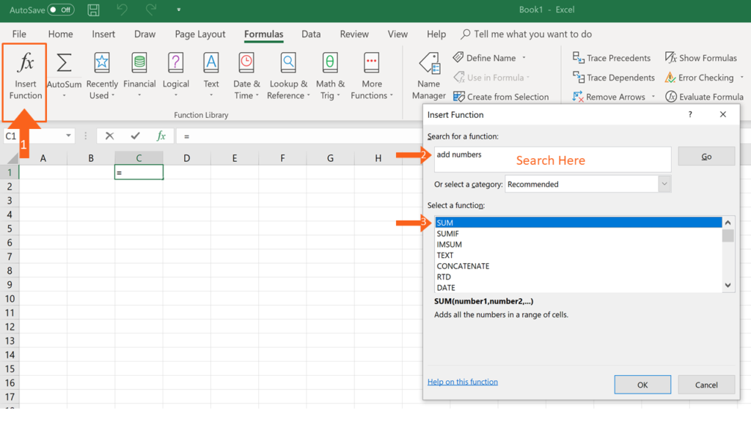
2
Insert Function Option from Formulas Tab
If you want full control of your functions insertion, using the Excel Insert Function dialogue box is all you ever need. To achieve this, go to the Formulas tab and select the first menu labelled Insert Function. The dialogue box will contain all the functions you need to complete your financial analysis.
Data Science
MentorrBuddy.com

Slide 6
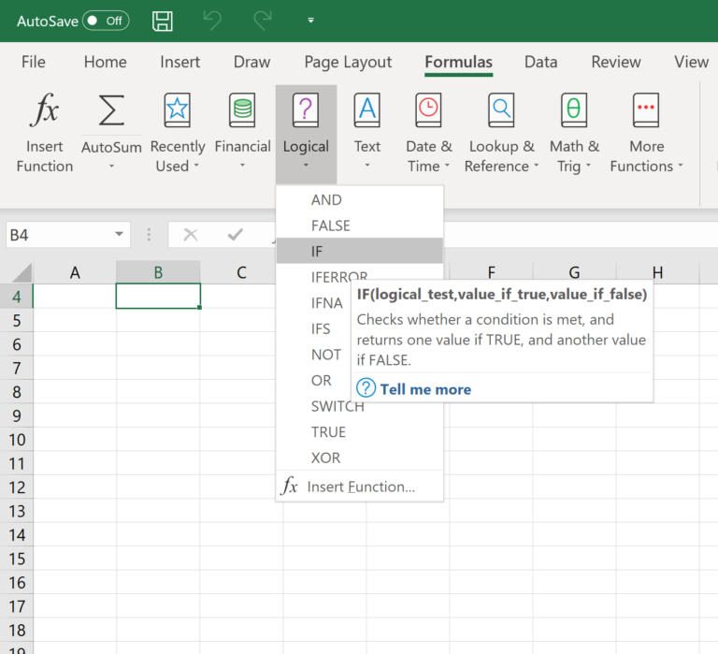
2
Groups in Formula Tab
This option is for those who want to delve into their favorite functions quickly. To find this menu, navigate to the Formulas tab and select your preferred group. Click to show a sub-menu filled with a list of functions. From there, you can select your preference. However, if you find your preferred group is not on the tab, click on the More Functions option – it’s probably just hidden there.
Data Science
MentorrBuddy.com

Slide 7
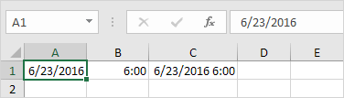
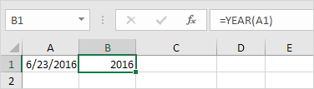
2
Date & Time Functions
To enter a date in Excel, use the "/" or "-" characters. To enter a time, use the ":" (colon). You can also enter a date and a time in one cell.
Dates are in US Format. Months first, Days second. This type of format depends on your windows regional settings
To get the year of a date, use the YEAR function.
Data Science
MentorrBuddy.com

Slide 8
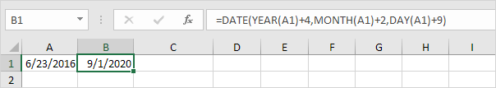
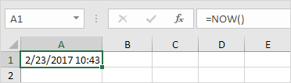
To add a number of years, months and/or days, use the DATE function.
To get the current date and time, use the NOW function.
Data Science
MentorrBuddy.com

Slide 9
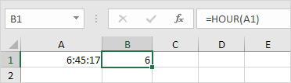
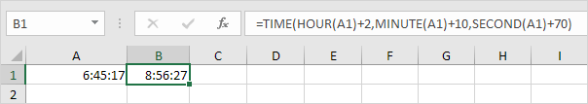
2
To return the hour, use the HOUR function. use the MINUTE and SECOND function to return the minute and second.
To add a number of hours, minutes and/or seconds, use the TIME function.
Data Science
MentorrBuddy.com

Slide 10
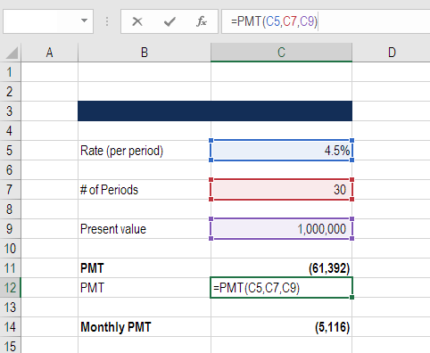
2
Financial Functions
PMT:-
Formula: =PMT(rate, number of periods, present value)
This is a very common function in Excel for finance professionals working with real estate financial modelling. The formula is most easily thought of as a mortgage payment calculator.
Given an interest rate, and a number of time periods (years, months, etc.) and the total value of the loan (e.g., mortgage) you can easily figure out how much the payments will be.
Remember this produces the total payment, which includes both principal and interest.
Data Science
MentorrBuddy.com

Slide 11
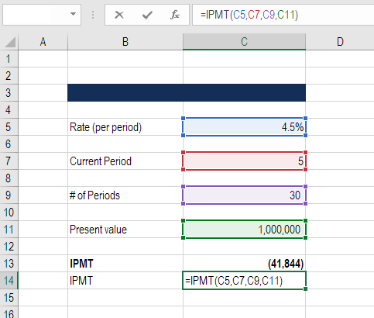
2
Financial Functions
IPMT:-
Formula: = IPMT(rate, current period #, total # of periods, present value)
IPMT calculates the interest portion of a fixed debt payment. This Excel function works very well in conjunction with the PMT function above. By separating out the interest payments in each period, we can then arrive at the principal payments in each period by taking the difference of PMT and IMPT.
Data Science
MentorrBuddy.com

Slide 12
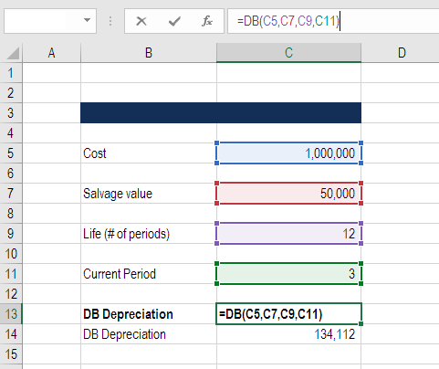
2
Financial Functions
DB:-
Formula: =DB(cost, salvage value, life/# of periods, current period)
This is a great Excel function for accountants and finance professionals. If you want to avoid building a large Declining Balance (DB) depreciation schedule, Excel can calculate your depreciation expense in each period with this formula.
Data Science
MentorrBuddy.com

Slide 13
2
Financial Functions
PPMT:-
The Excel PPMT function is used to calculate the principal portion of a given loan payment. For example, you can use PPMT to get the principal amount of a payment for the first period, the last period, or any period in between.
PV:-
Get the present value of an investment. present value. =PV (rate, nper, pmt, [fv], [type]) rate - The interest rate per period. The PV function returns the value in today's dollars of a series of future payments, assuming periodic, constant payments and a constant interest rate.
RRI:-
Excel RRI Function. RRI is an Excel function that calculates the periodic equivalent interest on a loan or investment over a period given its present value, future value and total number of periods. RRI return a rate for the same time unit in which we specify the number of periods
SLN:-
The Excel SLN function returns the depreciation of an asset for one period, calculated with a straight-line method. The calculated depreciation is based on initial asset cost, salvage value, and the number of periods over which the asset is depreciated.
SYD:-
The Excel SYD function returns the "sum-of-years" depreciation for an asset in a given period. The calculated depreciation is based on initial asset cost, salvage value, and the number of periods over which the asset is depreciated.
Data Science
MentorrBuddy.com

Slide 14
Thank you
Data Science
MentorrBuddy.com

