Slide 1
Multiple Linear regression

Slide 2

Simple linear regression
Co-efficient
Multiple
Linear
Regression
$$y=a_{1}x_{1}+a_{2}x_{2}+…b$$
Constant
Dependent variable
Independent variables

Slide 3
Assumptions of linear regression
Linearity
Homoscedasticity
Multivariate normality
Independence of error
Lack of multicollinearity

Slide 4

Dummy variable
Dummy Variable
Profit | R&D | Admin | Marketing | State
192261.8 | 165349.2 | 136897.8 | 471784.1 | New York
191792.1 | 162597.7 | 151377.6 | 443898.5 | California
191050.4 | 153441.5 | 101145.6 | 407934.5 | New York
182902 | 144372.4 | 118671.9 | 383199.6 | New York
166187.9 | 142107.3 | 91391.77 | 366168.4 | California
New York | California
1 | 0
0 | 1
1 | 0
1 | 0
0 | 1
$$y = b + a_{1}x_{1} + a_{2}x_{2} +{ a}_{3}κ_{3}$$
+ ???
$$+a_{4}x_{4}$$

Slide 5






Build a model(1/3)
$$x_{3}$$
$$x_{4}$$
$$x_{2}$$
$$x_{5}$$
$$x_{1}$$
y
$$x_{6}$$

Slide 6
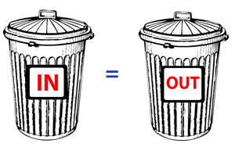
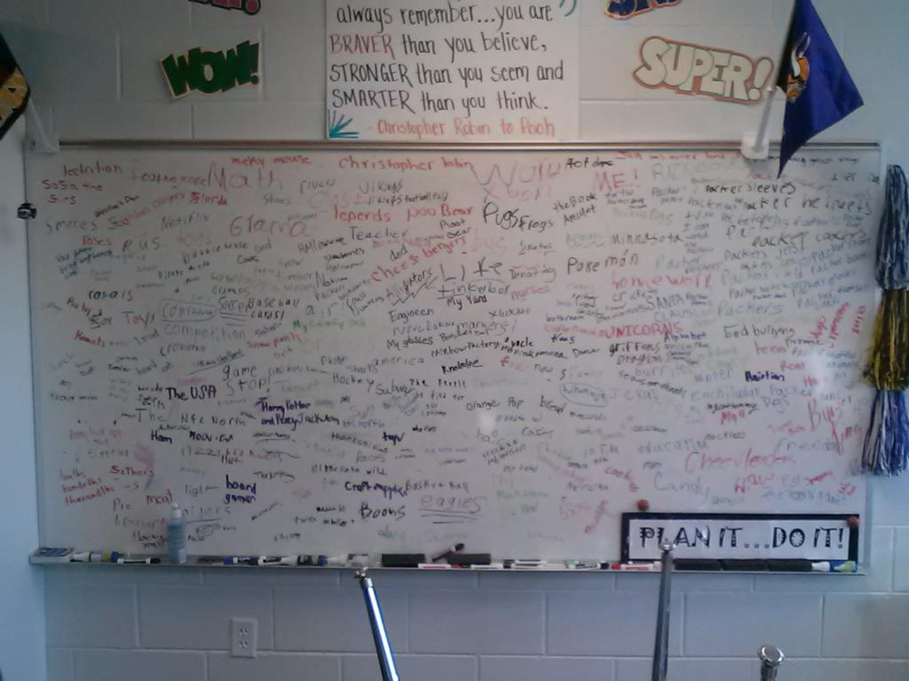
Contd.(2/3)
1).
2).

Slide 7
Contd.(3/3)
There are 5 methods to build the model:
All-in
Backward Elimination
Forward Selection
Bi-directional Elimination
Score Comparison

Slide 8

All-in Method
Prior Knowledge
You have to
Preparing for backward elimination

Slide 9

Backward elimination method
Select a significance level to stay in the model ( e.g. SL = 0.05)
Fit the full model with all possible predictors
Consider the predictor with the highest P-value. If P > SL , go to step 4 otherwise Finish.
Remove the predictor
Fit the model without the variable.

Slide 10

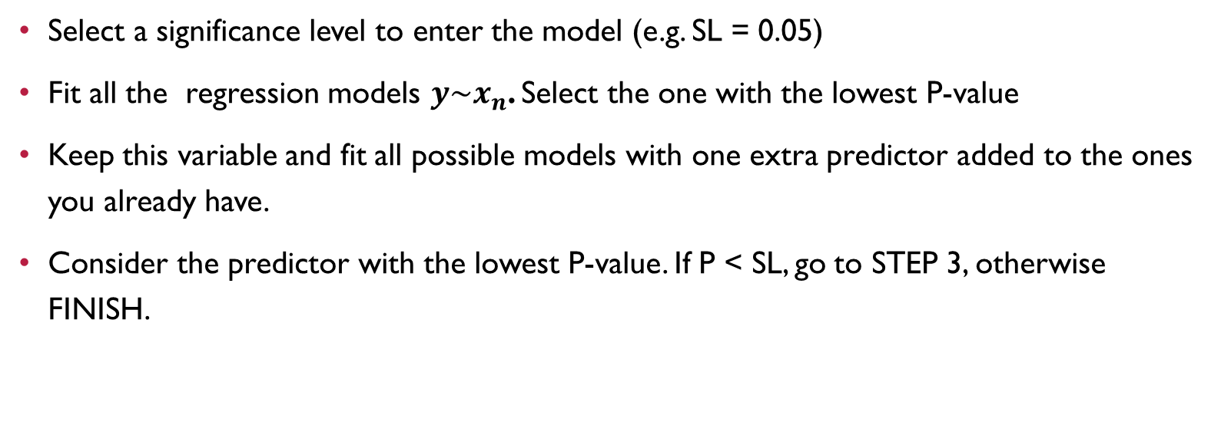
Forward selection method
Select a significance level to enter the model (e.g. SL = 0.05)
Fit all the regression models $y\sim x_{n}$. Select the one with the lowest P-value
Keep this variable and fit all possible models with one extra predictor added to the ones you already have.
Consider the predictor with the lowest P-value. If P < SL, go to STEP 3, otherwise FINISH.

Slide 11
Bidirectional Elimination
Select a significance level to enter and to stay in the model. ( e.g. SLENTER = 0.05, SLSTAY = 0.05)
Perform the next step of the Forward Selection (new variable must have: P < SLENTER to enter)
Perform all the steps of Backward Elimination method (old variable must have P < SLSTAY to stay)
No new variables can enter and no old variable can exit.
Finish your model.

Slide 12
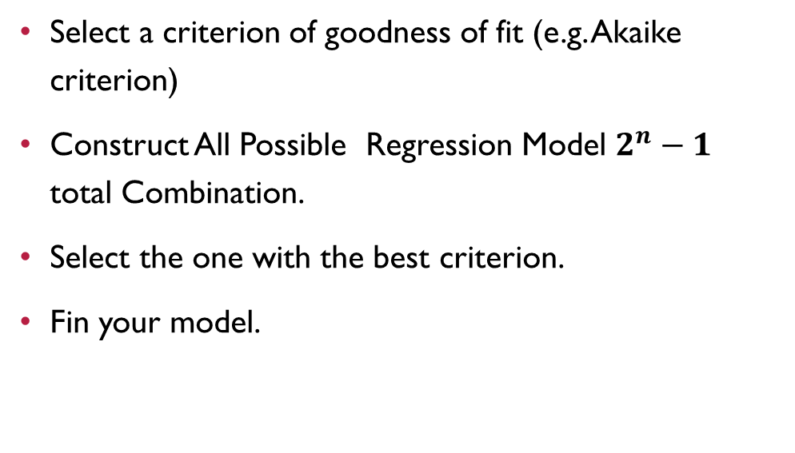
All possible model
Select a criterion of goodness of fit (e.g. Akaike criterion)
Construct All Possible Regression Model $2^{n}−1$ total Combination.
Select the one with the best criterion.
Fin your model.

Slide 13
Thank you

