Slide 1
Sales Performance Dashboard
Business Intelligence & Predictive Analytics

Slide 2
Abstract
The Sales Performance Dashboard provides interactive analytics and visualization for automobile sales data using Power BI. It enables real-time monitoring, regional analysis, product performance evaluation, and predictive forecasting.

Slide 3
Introduction
The automobile industry generates large volumes of sales data. Traditional reporting methods fail to provide timely insights. BI dashboards transform raw data into actionable insights.

Slide 4
Project Objective
• Centralized sales monitoring
• Interactive visualization
• Regional & product analysis
• Predictive sales forecasting

Slide 5
Literature Survey – BI Systems
Studies show BI tools improve decision-making efficiency. Power BI offers self-service analytics and AI-powered insights.

Slide 6
Literature Survey – Forecasting
Time series models such as ARIMA and Prophet are widely used for sales forecasting. Prophet handles seasonality and missing data effectively.

Slide 7
System Modules
• Trend Analysis
• Regional Sales
• Body Style Distribution
• Model Performance
• Forecasting
• Q&A Module

Slide 8
Algorithms Used
• Prophet Time Series Forecasting
• DAX Aggregations
• Power Query ETL

Slide 9
Architecture
Three-layer architecture:
• Data Layer
• Analytics Layer
• Presentation Layer

Slide 10
Data Flow Diagram
Sales data flows from dealer systems → ETL → Data Model → Visualization → Users

Slide 11
Existing System
• Excel-based reporting
• Manual data processing
• Static reports
• Delayed insights

Slide 12
Limitations of Existing System
• Data latency
• No forecasting
• Poor scalability
• High manual effort

Slide 13
Proposed System
• Automated ETL
• Interactive Power BI dashboard
• Real-time insights
• Predictive analytics

Slide 14
Proposed System Advantages
• Faster reporting
• Accurate decisions
• Better scalability
• Single source of truth

Slide 15
Results – Sales Trends
Analysis shows declining sales trends in recent periods with regional variations.

Slide 16
Results – Regional Analysis
Austin and Janesville are top-performing regions, contributing maximum revenue.

Slide 17
Results – Product Performance
SUVs dominate sales. BMW and Toyota models contribute the highest revenue.

Slide 18
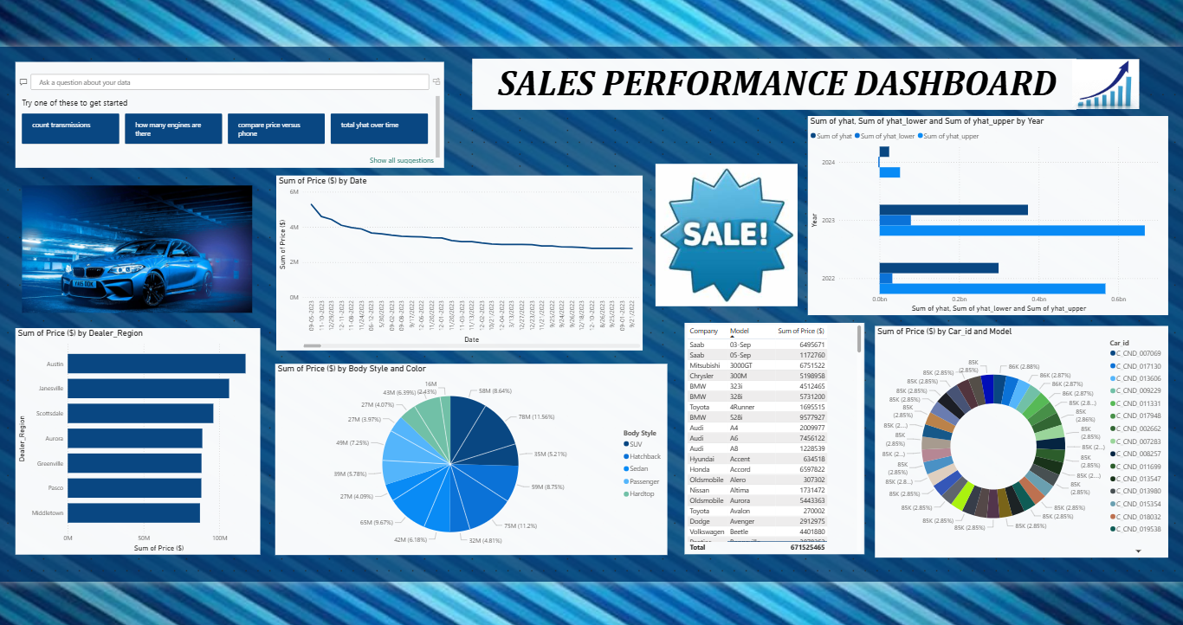

Slide 19
Forecasting Results
Prophet forecasts indicate fluctuating future sales with uncertainty intervals.

Slide 20
Conclusion
The dashboard improves visibility, reduces reporting time, and enhances data-driven decision-making.

Slide 21
Future Scope
• Real-time data integration
• Advanced ML models
• Customer analytics
• Mobile optimization

Slide 22
References
• Microsoft Power BI Documentation
• Taylor & Letham (2018) – Prophet
• Gartner BI Reports

