Slide 1
Linear Time Algorithm to Compute the Impact of all the Articulation Points

Slide 2
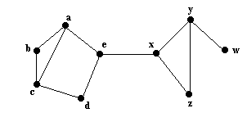
What is an Articulation Point?

Slide 3
Relevance of Articulation Points
Node
Node
Node
Node
Node
DC
DC
DC
DC

Slide 4
Impact Factor
0
0
0
4
0
2
0
1
0

Slide 5
Depth-First Search
3
2
9
4
5
6
1
8
7

Slide 6
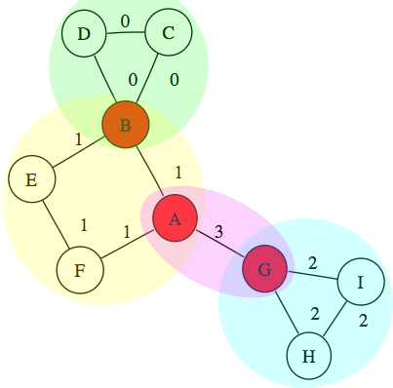
Block Structure

Slide 7
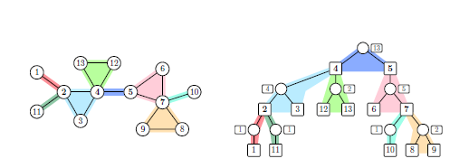
Procedure

