Slide 1
Mitigating the Impact of Data Movement in Contemporary Applications
Aditya K Kamath
Generals Examination
May 27th, 2025

Slide 2
Outline
The growing problem of data movement
Highlighting mitigation techniques
Avoiding: Lazy Memcopy for IPC and Databases
Hiding: Operation Overlap for LLM Inference
Reducing: Lossless Compression for ML
Timeline and future work

Slide 3
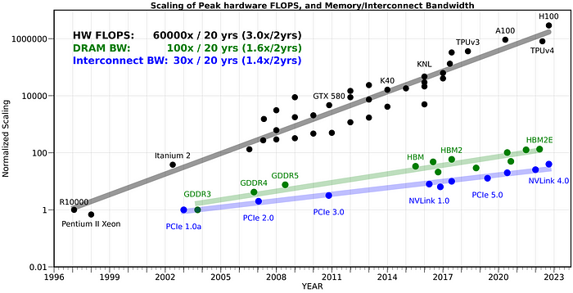
Data movement disparities

Slide 4
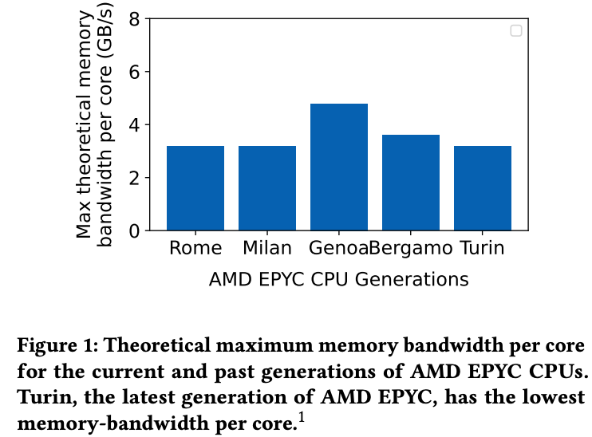
Data movement disparities

Slide 5

Data movement is a growing problem
Causes latency spikes, throughput limitations and processing bottlenecks.
Data
Movement
Processor

Slide 6

Mitigation techniques
1) Avoid
2) Hide
3) Reduce
(MC)²
POD-Attention
Invariant Bit Packing
POD-Attention
(MC)²
Invariant Bit Packing
Invariant Bit Packing

Slide 7
Avoiding: Lazy MemCopy for IPC and Databases
Published as:
(MC)²: Lazy MemCopy at the Memory Controller, ISCA 2024

Slide 8
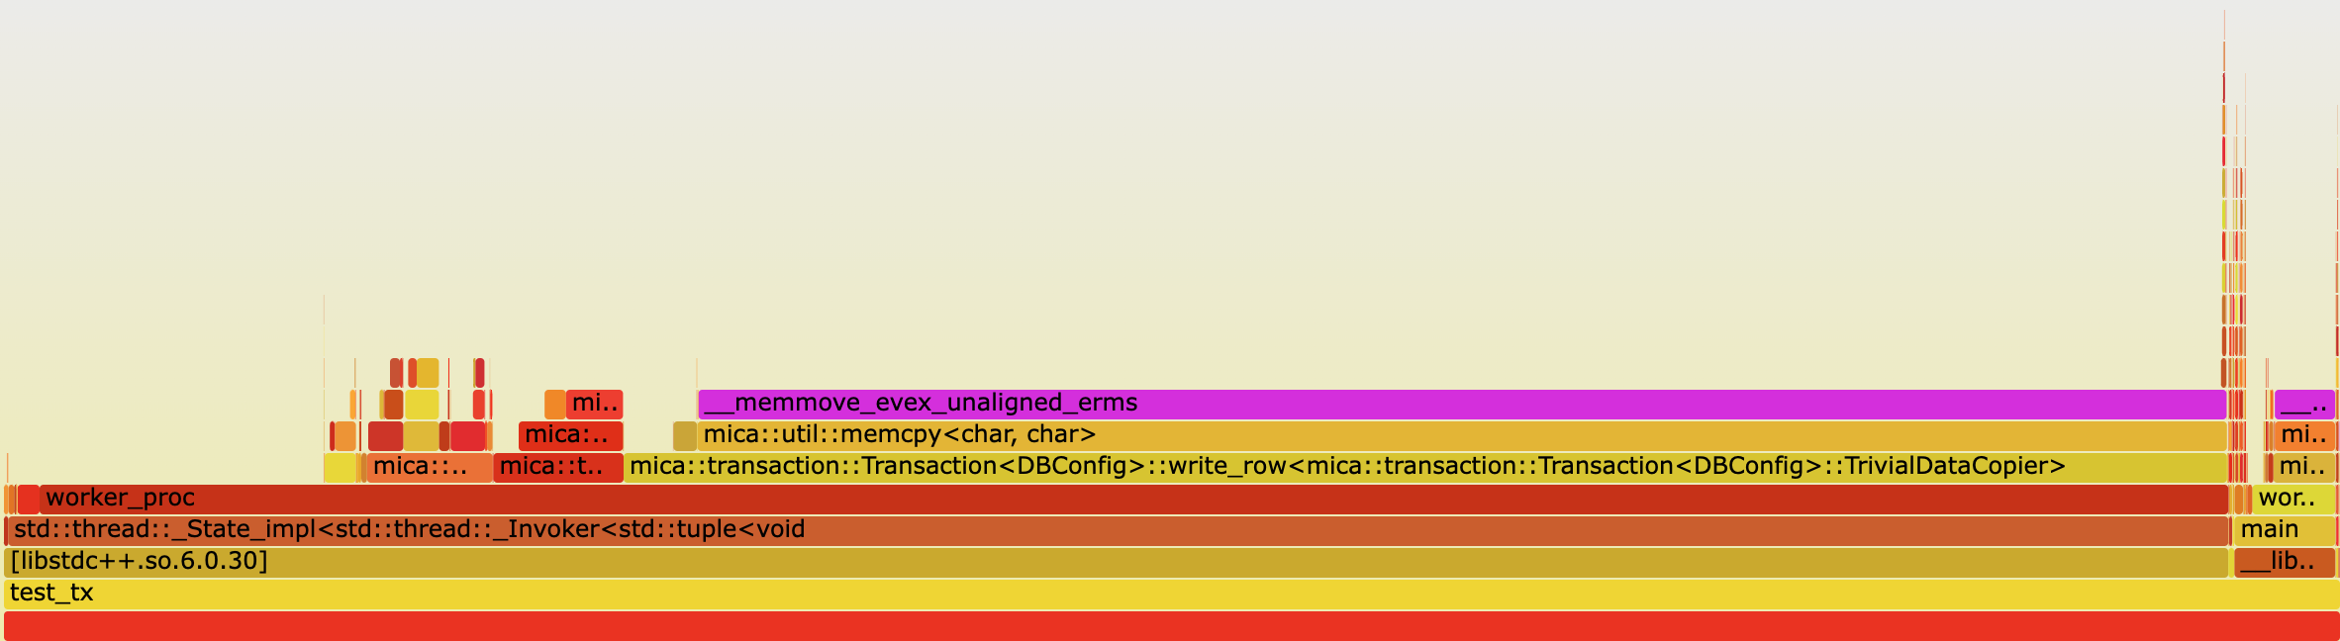
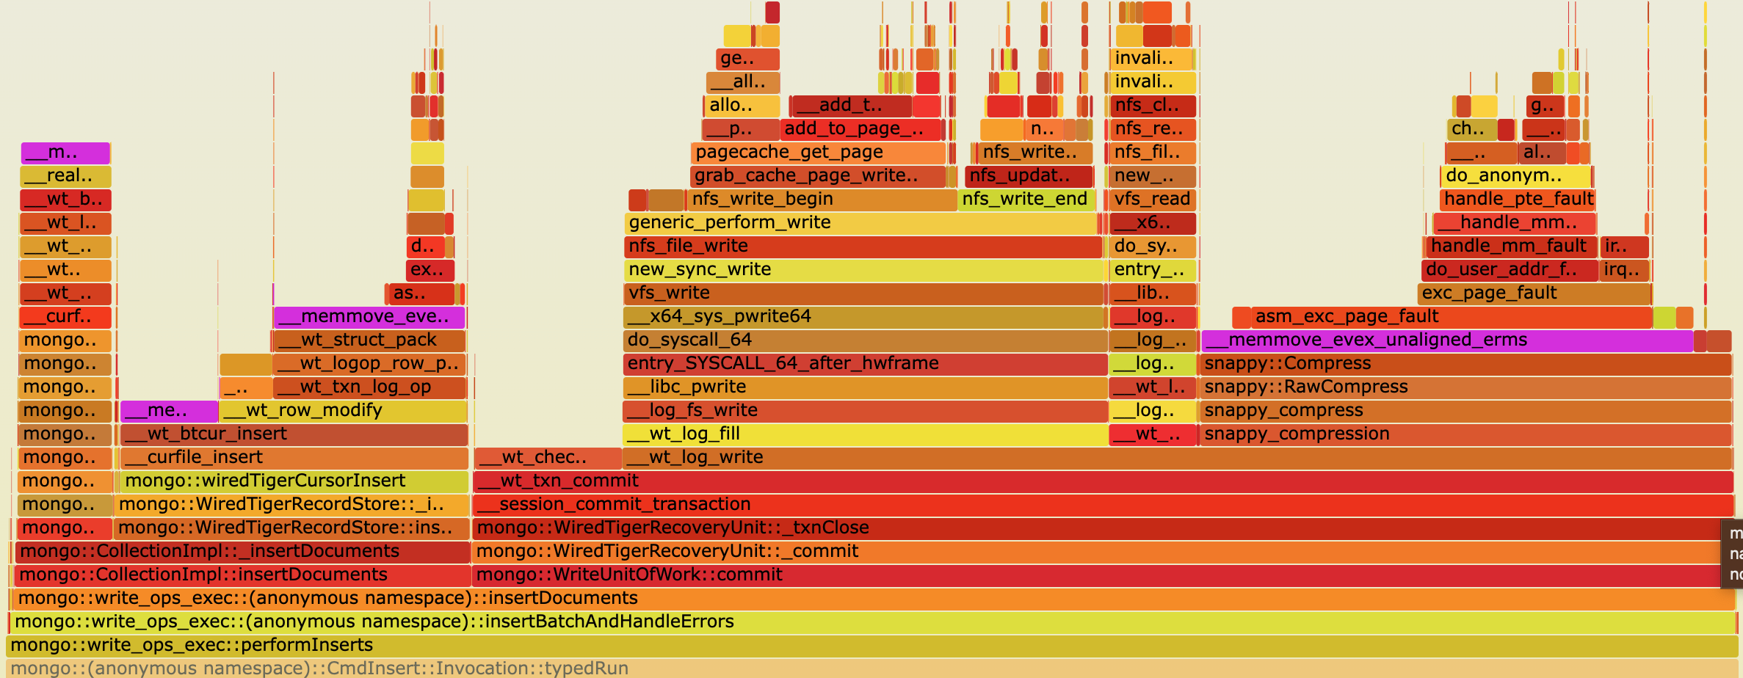
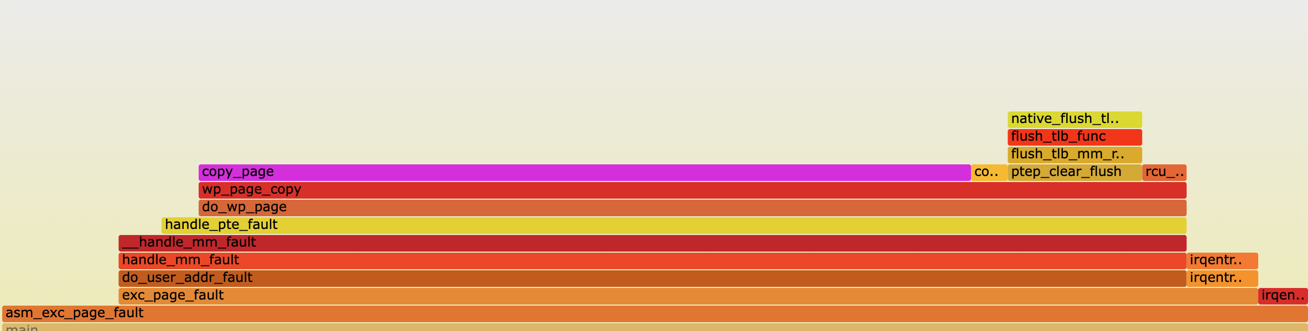
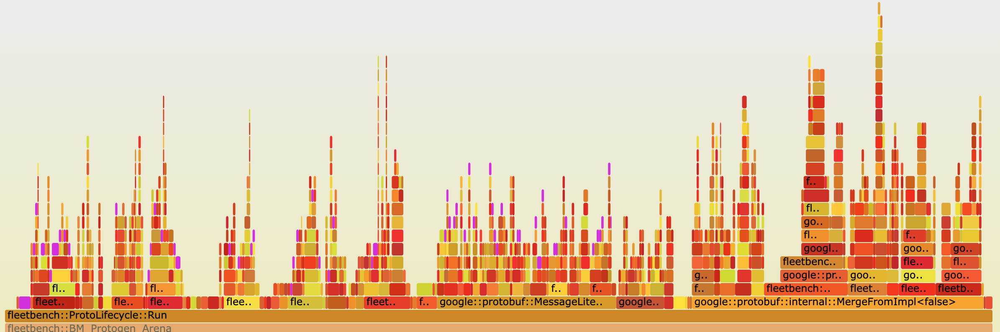
Operations with high copy overhead
Cicada [1] writes: 68.0%
MongoDB [2] inserts: 42.3%
Fork + COW fault: 60.0%
Protobuf (Serialize/Merge) [3]: 29.2%
[1] H. Lim et al., SIGMOD ’17 [2] github.com/mongodb/mongodb [3] github.com/google/fleetbench
Notes:
We ourselves conducted a study on several operations across different application domains that exhibited a high copy overhead.
We plotted flamegraphs showing the amount of time spent in various functions of these operation, including memory copy times.
The top two graphs depict writes and insertions for an OLTP and NoSQL database respectively.
While the bottom left graph shows OS copy-on-write faults, and the bottom right shows common Protobuf operations.
The bars highlighted in purple show the time spent copying, which can be up to 68% for these operations.

Slide 9
Insights from studying use-cases
Apps often use memory copies to fill temporary buffers
Copies may be excessive/redundant if full copy isn’t accessed
Killer microseconds: difficult for CPU to hide copy overhead
Notes:
Our insights from looking at these applications are that they typically use memcpy to fill temporary buffers. This can lead to excessive or redundant copying.
When copying happens in the critical path of the application processing, it becomes difficult for the CPU to hide its overhead, leading to ”killer microseconds” of copy execution

Slide 10
Use case: Multi-Version Concurrency Control
Writer
Write X
Write Y
Commit
Read Y
Read X
Commit
Reader
Copy
Database
Copy used for isolation
Notes:
To see how copies are used in modern applications, let’s look at a typical use case: read-copy-updates in multi-version concurrency control databases.
MVCC databases copy rows or tuples being modified to local buffers to preserve isolation guarantees. In this example, we see two threads performing transactions on the database concurrently, with one writer and one reader.
Before performing the modifications, the writer creates a copy of the row that it wishes to modify.
The writer then performs its required modification to its local copy.
This allows the reader to read the unmodified data from the original database and avoid inconsistencies in operations.
When the writer commits the transaction it merges its row back into the main database. The entire row may not end up modified, in which case the writer copied more data than it actually needed to.
In addition, there’s potential for copy overheads to be hidden in the background while other DB operations are ongoing.

Slide 11
Current systems: Eager copying
Copy Src to Dest
Read
Dest[1]
Dest[1]
Dest
Src
Notes:
Currently, applications make use of what we refer to as “eager copying” where a copy operation causes data to be moved.
Then on access, the required data is obtained.
For the applications we previously saw, we find that this is not the best approach for data movement.

Slide 12
Our proposal: Perform movement lazily
Copy Src to Dest
Read
[Don’t copy]
Dest[1]
Dest[1]
Dest
Src
Notes:
We instead propose performing data movement lazily.
On a copy operation, we don’t do anything.
When the data is accessed, we reroute the request to the appropriate location performing the data copy.
This method only copies data that is accessed from memory. Furthermore, it allows the hardware prefetcher to trigger copies before data is accessed to hide copy latencies.

Slide 13
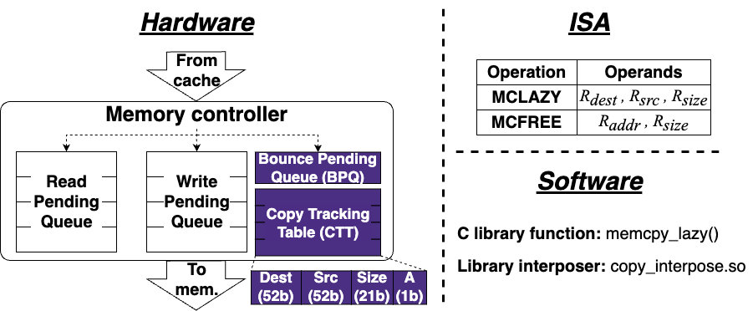
(MC)² : Lazy MemCopy at the Memory Controller
Notes:
To support this operation, we propose MC^2, performing lazy memcopy at the memory controller.
We find that the memory controller is the ideal place to handle this as all memory accesses must pass through it, and it frees up responsibilities from the CPU, providing opportunities for copy hiding.
This system consists of three main components. Hardware modifications to the memory controller, new instructions, and a software wrapper.
We’ll now look at each of these in-depth.

Slide 14
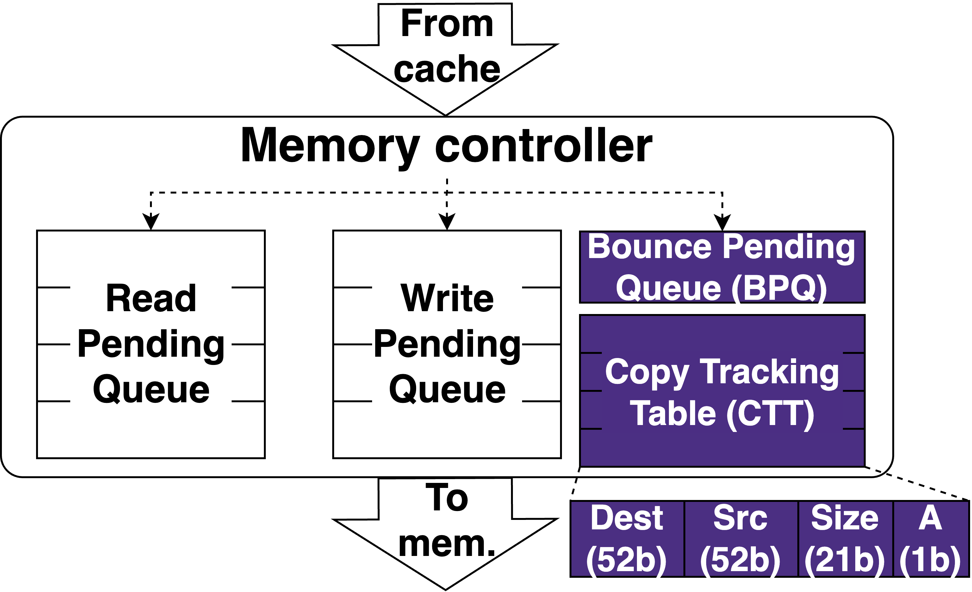
(MC)² hardware
Notes:
We add a copy tracking table or CTT, which tracks all the prospective copies.
Each entry in this table contains a 52-bit destination address, a 52-bit source address, and 21-bit size of executed copies, along with an active bit to check whether the entry is in use. We use 52 bits for addresses since this is typically the size of physical addresses in systems today. The 21-bit size allows each entry to track a prospective copy of up to 2 MB in size or the size of a large page. The entries in the CTT are kept coherent across memory controller, and the CTT is looked up in parallel with memory accesses, hiding its access latency in the critical path.
We also maintain a bounce pending queue that temporarily holds writes to source buffers for consistency. The importance of the BPQ is explained in detail in our paper.

Slide 15
(MC)² ISA
memcpy_lazy: C wrapper function with
semantics identical to memcpy
Operation | Operands
MCLAZY | R_{dest} , R_{src} , R_{size}
MCFREE | R_{addr} , R_{size}
Must be physically contiguous,
i.e., within a single page for user apps
Multiple of cacheline size
Destination:
Cacheline-aligned
Notes:
We provide two new instructions to take advantage of Mcsquare. The first is MCLAZY which initiates the lazy memcpy operation. It accepts 3 registers, the destination virtual address, the source virtual address and the copy size. The second instruction is MCFREE which is a hint that informs the system that the address provided is no longer in use and does not need to be tracked anymore.
MCLazy has a few alignment restrictions to simplify hardware. We provide software wrappers that hide these low-level constraints from the programmer. The first is that the destination buffer address must be cacheline-aligned. This is because memory accesses occur at cacheline granularity, and lazy copies on partial cachelines would make the hardware overly complex.
The second restriction is that the copy size must be a multiple of the cacheline size, for the same reason of avoiding partial cacheline copies.
The final restriction is that the destination and source buffers must be contiguous in physical memory. For userspace applications this means they must each lie within a single page. For copies spanning multiple pages, MCLAZY should be called on each page.
We provide a C wrapper around MCLAZY that exposes a lazy memcpy with identical semantics to libc memcpy for programmer convenience. Full details on how this is done are in the paper.

Slide 16
(MC)² operation: Lazy copy
Core
Core
MCLAZY
DEST, SRC, SIZE
Core
MCLAZY
DEST, SRC, SIZE
MCLAZY
DEST, SRC, SIZE
Last-level $
SRC
DEST
SRC
Interconnect
BPQ
Copy Tracking Table
Copy Tracking Table
BPQ
DEST
SRC
SIZE
A
Memory controller
Memory controller
DEST
SRC
SIZE
A
Memory
Memory
SRC
DEST
Notes:
We’ll now look at how the lazy copy operation is performed, and what happens on memory accesses.
Let’s assume the CPU core executes an MCLAZY operation on a destination and source cacheline. The CPU creates a packet for this operation and sends it towards the caches.
At the caches, the operation triggers an effect where the destination cacheline is invalidated, and the source cacheline is written back. This ensures that further accesses to the destination reach the memory and that the memory has the up-to-date values of src that were copied to dest.
The packet is then broadcasted to all the memory controllers where the operation is added to the Copy Tracking Table.
We’ll now see how reads to the destination buffer are impacted by this operation.

Slide 17
(MC)² operation: Read destination
Core
Core
Core
READ DEST
Last-level $
Interconnect
BPQ
Copy Tracking Table
Copy Tracking Table
BPQ
DEST
SRC
SIZE
A
Memory controller
Memory controller
DEST
SRC
SIZE
A
DEST
Memory
Memory
SRC
DEST
Notes:
When the CPU reads the destination, we need to obtain the data from the source instead, since the data wasn’t actually copied.
The access proceeds as normal initially.
At the memory controller, we consult the CTT and realize that this was the destination of a prospective copy.
This causes the request to be bounced to the memory controller containing the source cacheline.
The source cacheline is read from memory and sent the CPU core as if it was read from the destination memory location. Reads to the destination incur an additional latency due to the CTT lookup and bounce operations.
In our paper we also detail out how reads to the source and writes to the source or destination buffer is performed.

Slide 18
Evaluation questions
How much lower is (MC)²’s copy overhead?
What is the impact of lazily copying data on access time?
What benefit could (MC)² provide real workloads?
What are the sources of overhead for (MC)²?
How do (MC)²’s various parameters impact performance?
Notes:
We now have a few questions that we shall quantify in our evaluation.
How much lower is MC^2’s copy overhead? What impact does it have on access times? and what benefit could (MC)^2 provide real workloads?
In our full paper we answer a few more questions that we wont be able to cover here.

Slide 19
Evaluation: GEM5 configuration
Hardware
CPUs | 8 | 8 | Clock speed | 4 GHz
Private L1 cache | 64 KB/CPU, stride prefetcher | 64 KB/CPU, stride prefetcher | Shared L2 cache | 2 MB, stride prefetcher
DRAM size | 3 GB | 3 GB | DRAM channels | 2
DRAM config. | DDR4 | DDR4 | BPQ size | 8 entries
CTT entries | 2048 | 64K | CTT latency | 0.79 ns
Software
OS kernel |  | Linux 5.7.0 | Distribution | Ubuntu 20.04
Notes:
To answer these questions, we make use of gem5, a cycle-accurate CPU simulator.
Our configuration models a scaled-down server node with 8 CPUs.

Slide 20
Evaluation: Prior work comparison
Prior work: zIO [1], OS-based COA | Our proposal: (MC)², lazy copy
Software-based | Hardware-based
Page-granularity | Cacheline-granularity
Requires TLB shootdowns | No shootdowns required
High access penalties | Minimal access penalties
[1] T. Stamler et. al., ODSI ‘22
Notes:
Wherever possible, we compare against zIO an OS-based copy-on-access mechanism that makes use of OS-managed page tables to elide copies.
zIO is essentially the OS-based approach to lazy copying, which requires expensive page table management operations on accessing lazily copied pages, giving it high access penalties.

Slide 21
Evaluation: Copy performance
11x
faster!
Faster
Notes:
To evaluate the latency of copying, we performed an experiment where different sized source buffers were copied to destination buffers. Note the y-axis is in log scale.
We evaluate against memcpy in two scenarios. The first is where none of the data is cached referred to as just Memcpy, the second is where the source and destination buffers have been accessed just before the copy allowing them to be cached. These are essentially the best- and worst-case performance for memcpy. Copies with high overheads due to high memory access latencies behave closer to the uncached memcpy performance.
(MC)^2 provides speedups for copies at and above 1 KB, performing similar to copying cached data at 64 KB and above, and is up to 11 times faster than uncached memcpy.
Since zIO relies on page table manipulation, it only ran for copies at and above a 16KB size. It has a high initial overhead due to page table manipulation and TLB shootdowns. Below 256KB, MCSquare outperforms zIO. Above this, zIO outperforms (MC)^2 as (MC)^2 relies on cacheline flushing which has its own overhead. Despite this, we shall see how (MC)^2 still provides benefits at these sizes.

Slide 22
Evaluation: Copy + access runtime
Faster
Notes:
To analyze the impact of lazily copying on access latencies, we ran a microbenchmark where a 4 MB source buffer is copied to a destination buffer. The destination is then accessed sequentially.
We intentionally misaligned the source and destination, as in the applications we examine, the source and destination buffers are typically not cacheline-aligned with each other.
For our system this causes additional access latencies to fetch data (full details in the paper).
The runtime of each system is normalized to the time taken by memcpy, with higher meaning slower. We analyze the runtime when different percentages of the 4 MB destination buffer are accessed.
As we previously saw, zIO outperforms (MC)^2 when the dataset isn’t accessed. However, once we start accessing the destination, zIO starts seeing page faults triggering copies. When more than 25% of the dataset is accessed it starts performing worse than memcpy.
On the other hand, (MC)^2 is able to retain low latency penalties.
Surprisingly, even when the entire dataset is accessed, MC^2 outperforms memcpy. We find that this is because the cache prefetcher hides some of the extra access latencies. When we turn off the prefetcher, we see that it slows down compared to memcpy, showing the impact of copy latency hiding.
When the source and destination are aligned, we see even better performance.

Slide 23
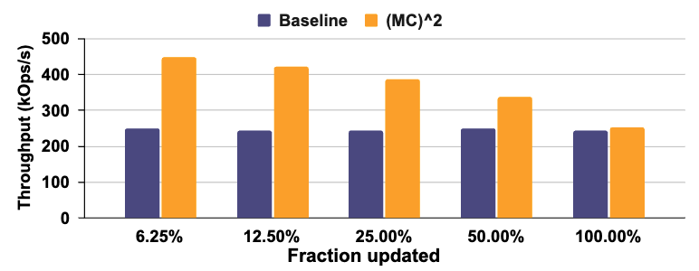
Evaluation: Cicada transaction throughput
Faster
Notes:
Moving on to the performance of applications with MCSquare, we see that many database transactions involve updating only small portions of a tuple. For example, in TPCC, decrementing the quantity of stock of an item being sold in a store may only update 1 – 2 % of the total tuple size. As we previously saw, this leads to excessive data being copied for the read-copy-update performed by MVCC databases.
With (MC)^2, we can pay only the copy overhead for the portion of the tuple updated.
To evaluate this, we enhanced the Cicada database with (MC)^2 and performed repeated operations on a table with 8KB sized rows modifying different fractions of the tuple and measuring throughput. These operations are split 50:50 between reads and updates typical of write-intensive DB workloads. We used 8 threads saturating the cores on our system.
(MC)^2 is able to provide up to 78% higher throughput, since it reduces the memory bandwidth consumed for smaller update fractions.
Our paper contains more evaluation for workloads including huge page COW faults, and kernel buffer copying.

Slide 24
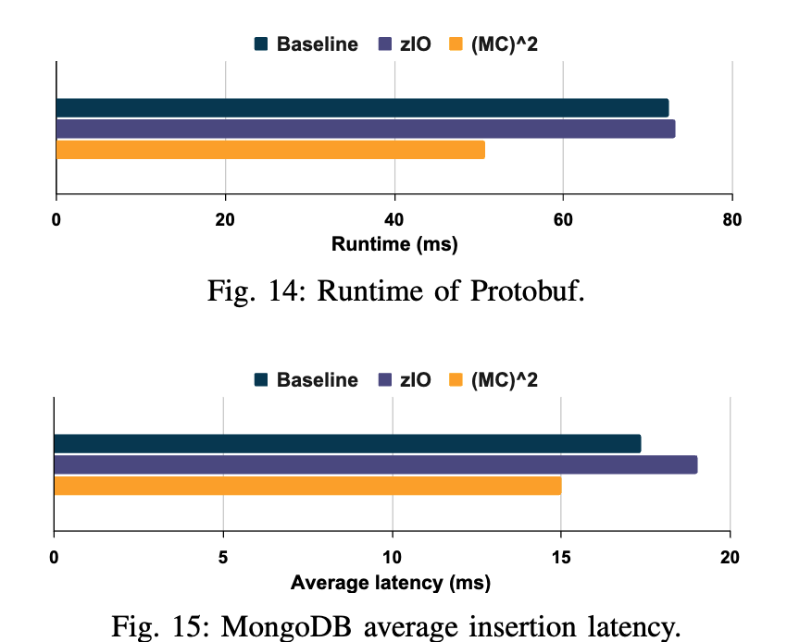
Evaluation: Protobuf and MongoDB
Faster
Faster
43% lower
15% lower
Notes:
We analyze (MC)^2 with a protobuf workload provided in Google’s Fleetbench benchmark suite. Fleetbench contains workloads dedicated to common hot library functions, constructed using traces from production servers. We find that (MC)^2 has 43% lower runtime compared to memcpy. zIO is unable to generate any performance benefit since all the copies in this benchmark were smaller than the 4 KB page size it requires to elide copies.
We also replicated an experiment from the zIO paper, where MongoDB insertions are performed using 100KB fields and 10 fields per insertion. (MC)^2 provides on average 15% lower latency for insertion, while zIO slows down by 9%. This is because copied data is later accessed, triggering page faults for zIO which (MC)^2 avoids.

Slide 25
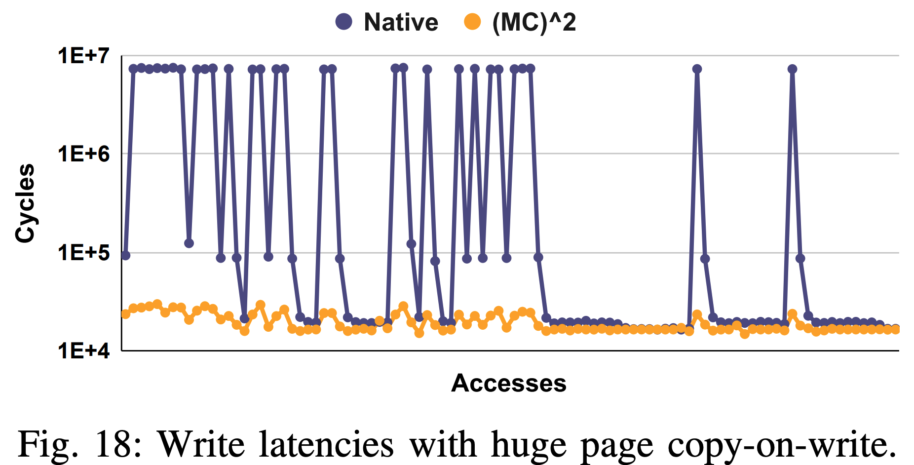
Evaluation: Huge page COW faults
Faster
Notes:
We analyze (MC)^2 with a protobuf workload provided in Google’s Fleetbench benchmark suite. Fleetbench contains workloads dedicated to common hot library functions, constructed using traces from production servers. We find that (MC)^2 has 43% lower runtime compared to memcpy. zIO is unable to generate any performance benefit since all the copies in this benchmark were smaller than the 4 KB page size it requires to elide copies.
We also replicated an experiment from the zIO paper, where MongoDB insertions are performed using 100KB fields and 10 fields per insertion. (MC)^2 provides on average 15% lower latency for insertion, while zIO slows down by 9%. This is because copied data is later accessed, triggering page faults for zIO which (MC)^2 avoids.

Slide 26

Hiding: Operation Overlap for LLM Inference
Published as:
POD-Attention: Unlocking Full Prefill-Decode Overlap for Faster LLM Inference, ASPLOS 2025

Slide 27

LLM prefill
Time-To-First-Token (TTFT)
Time taken by this iteration
decode
Feed-Forward Network
Prefill
Large input size
N Layers ⨉
Self-Attention
This
Is
A
Prefill
Large Language Model (LLM)
User
Notes:
Large Language models or LLMs are extremely popular today. (click) The fundamental unit of LLM architecture is the transformer block which consists of Self Attention and the Feed Forward Network. This block repeating N times makes a large language model. (click) When a user submits a prompt, the LLM processes it to produce the first token. This is called prefill. (click) The time that this takes is called the Time to first token, which is an important latency metric that modern LLM serving systems try to optimize.

Slide 28
LLM decode
Time-Between-Token (TBT)
Time between two decodes
decode
is
happening!
Feed-Forward Network
Decode
Single token input/output size.
N Layers ⨉
Self-Attention
This
Is
A
Prefill
decode
is
Large Language Model (LLM)
User
Notes:
After the first iteration, the output is passed back into the LLM to generate the next token. This is called a decode. (click) It is characterized by its relatively smaller input and output size. (click) This process of passing new tokens back to the LLM continues until it stops generating tokens for the request. (click) The time between two decodes is called Time between token or TBT, which is another important latency metric that serving systems optimize for.

Slide 29


LLM hybrid batching [Sarathi-Serve, OSDI’24]
Prefill
Prefill
LLMs
Decode
Decode
Prefill and decode inputs of multiple requests are combined as a single input
Improves throughput by reusing model weights and reducing latencies.
Notes:
Hybrid batching has emerged as the state-of-the-art method of balancing these latencies. [Click] In hybrid batching, multiple requests’ prefill and decode are combined and operated on by the same model weights. This improves overall throughput by reusing model weights and reduces latencies.

Slide 30
LLM hybrid batching: A closer look
Layer norm
Pre-projection
Post-projection
Layer norm
FFN
Prefill
Prefill
Attention
Decode Attention
Decode
Notes:
When we take a closer look at how hybrid batching is implemented in frameworks, we see that the reuse of model weights does happen for operations like Pre projection.

Slide 31
LLM hybrid batching: A closer look
Prefill
Prefill
Layer norm
Pre-projection
Decode
Post-projection
Layer norm
FFN
Decode
Prefill
Attention
Decode Attention
Prefill
Decode
Attention operates on discrete data items (no data reuse across input requests).
Kernels optimized independently for prefill or decode.
Notes:
Unfortunately, for Attention operations, each input is operated on by a separate data item called a KV-Cache which isn’t shared across the requests. GPU attention kernels are independently optimized for either prefill’s large size or decode’s small size. [Click] This means that the inputs are separated and the attention for each is performed independently, following which they are again recombined for the rest of the LLM layer.

Slide 32
Our goal with POD-Attention
Layer norm
Pre-projection
Post-projection
Layer norm
FFN
Can we optimize this part?
Prefill
Attention
Decode Attention
Notes:
Our work tries to reduce the overhead of the attention operations to improve overall LLM serving performance.

Slide 33
Why optimize attention?
60% of overall time
Model: Llama-3-8B, Hardware A100 x 2, Decode Batch Size: 60
Attention is the biggest bottleneck at large context lengths.
Notes:
Our motivation lies in the fact that for larger input context lengths or number of input tokens, the attention operations end up being the biggest bottleneck, taking up to 60% of execution time - as shown in the plot here. As context lengths are ever-increasing, this problem will only increase in magnitude. For the rest of this talk we’ll focus only on Attention. We now look at the opportunities present for improving this situation.

Slide 34
Opportunity: Resource (under)utilization
Model: Llama-3-8B, Hardware: 2 A100
Prefill saturates compute but has low memory bandwidth utilization.
Decode saturates memory bandwidth but has low compute utilization.
Notes:
We profiled the prefill and decode attention kernels to identify the compute and memory bandwidth utilization shown in the y-axis. As prefill attention operates on a large number of tokens seen in the x-axis, prefill attention kernels are optimized for large matrix multiplications which are compute-bound. For decode attention, typically 10 to 100 requests are batched together and operated on, which have a small number of tokens compared to prefill. The decode kernels are optimized for smaller matrix multiplications which are memory-bound.
[click] We notice that the utilization of memory bandwidth for prefill was below 5% and compute for decode was below 10% which is very low. From this we ask, is it possible to saturate both the compute and memory bandwidth by performing these operations together?
To answer this question, we must first look at how the GPU processes operations.

Slide 35
GPU execution: CTA scheduling
CTA
Launched Kernel
Stream
queue
CTA
CTA
CTA
CTA
CTA
CTA scheduler
SM
SM
SM
CTA
CTA
CTA
L1 $ / Shared mem
L1 $ / Shared mem
L1 $ / Shared mem
GPU
L2 $
DRAM
CTA scheduler in hardware assigns queued CTAs to SMs for execution.
Notes:
When a programmer launches a GPU kernel, they specify groups of a hundred to a thousand threads called Cooperative Thread Arrays or CTAs. The work to be done by the kernel is split among these different CTAs. For example, in tiled matrix multiplication, each CTA can handle a different matrix tile. [click] These wait in a stream queue until a CTA scheduler assigns these CTAs to the Streaming Multiprocessors or SMs within the GPU where execution occurs. The SM is analogous to a CPU processor. In modern GPUs, each SM holds around 1 to 8 CTAs. For the attention kernels we analyzed, each SM had up to 2 CTAs.

Slide 36
GPU execution: Warp scheduling
SM
CTA
CTA
Warp
Warp
Warp
Warp
Warp
Warp
Green = Prefill Warp
Orange = Decode Warp
Warp scheduler
Compute core
Compute core
Ld/st unit
Ld/st unit
L1 $ / Shared mem
Warp scheduler assigns queued warps to free resources attempting to saturate all GPU resources.
Notes:
Inside the SM, these CTAs are divided into warps, [click] which are groups of 32 threads which execute in lockstep. In the figure, we look at the warps of a decode kernel which are memory-bound, depicted with an orange color. A warp scheduler assigns queued warps to free resources every clock cycle. If possible, it attempts to saturate all the available resources. [click] For the decode attention shown, these warps are all reliant on the load/store unit to perform memory accesses. [click] As all the warps are contending for the same resource, the warp scheduler has limited opportunity to overlap execution between the warps. Conversely, prefill warps are compute bound and contend for the compute cores.
[click] If instead, we had prefill warps co-located with these decode warps within the same SM, the warp scheduler could attempt to service them all in parallel as depicted, thus improving overall throughput.

Slide 37
Fusing prefill and decode
Goal: Overlap compute-heavy prefill with memory-bandwidth-heavy decode to fully utilize GPU resources.
Sub Goal: Co locate prefill and decode CTAs within the same SM
Notes:
Thus, to achieve the best performance and reach our goal of overlapping compute-heavy prefill with memory-bandwidth-heavy decode. We establish a new goal of co-locating the prefill and decode CTAs within the same SM so that the warp scheduler can overlap them.

Slide 38
Known methods of kernel fusion
Naïve fusion (CTA-parallel): Combined kernel for both prefill and decode.
Kernel-parallel: Launch kernels in separate CUDA Streams.
Warp-parallel: Divide warps in the CTA among ops [HFuse, CGO ‘22].
Intra-thread: Every thread performs both operations.
Cannot guarantee operation co-location within SM.
Exhibits bad load balancing within the GPU.
Excessive synchronization overhead.
Notes:
For this, we go over existing methods of kernel fusion and find that they all have limitations. (click) Naïve fusion and kernel parallel cannot guarantee operation co-location within an SM, and we shall shortly see why. Warp-parallel execution exhibits bad load balancing within the GPU. Intra-thread fusion requires excessive synchronization overheads for correctness.

Slide 39
Naïve kernel fusion (CTA-parallel)
CTA
CTA
CTA
CTA
Stream
queue
CTA
CTA
Green = Prefill CTA
Orange = Decode CTA
CTA
CTA
CTA
CTA
CTA scheduler
SM
SM
SM
CTA
CTA
CTA
CTA
CTA
CTA
L1 $ / Shared mem
L1 $ / Shared mem
L1 $ / Shared mem
Cannot guarantee SM co-location, limiting speedup.
Notes:
The traditional method of kernel fusion involves combining the two kernels into one kernel, assigning the different CTAs to different operations. In the figure the green CTAs perform prefill and the orange decode. (click) The problem with this approach is that since the CTA scheduler is handled by hardware, there is no control over which CTAs get scheduled on which SMs greatly limiting the speedup. Kernel-parallel execution suffers from the same problem for the exact same reason.

Slide 40
How can we address this?
Goal: Overlap compute-heavy prefill with memory-bandwidth-heavy decode to fully utilize GPU resources.
Problem: CTA scheduler is handled by GPU driver/hardware.
Notes:
We see that a major problem of fusion is that the assignment of CTAs to GPU SMs is hidden from the programmer as it is handled by the GPU driver and hardware.

Slide 41
Introducing POD-Attention!
POD-Attention: Combines prefills and decodes into a single kernel with guaranteed SM co-location.
Key idea: SM-aware CTA scheduling
Guarantees each SM runs prefill and decode CTAs in parallel.
Enables the CTA scheduler to overlap the two operations.
Utilizes compute and memory bandwidth simultaneously.
Notes:
To address this, we introduce POD-Attention, which efficiently combines prefill and decode operations into a single kernel while guaranteeing SM co-location. POD-Attention uses SM-aware CTA scheduling to guarantee co-location of prefill and decode within each SM. This allows the warp scheduler to overlap the operations and properly utilize both the compute and memory bandwidth of the GPU. Unlike other approaches, we can guarantee SM co-location as well as good load balancing.

Slide 42
POD-Attention: Fused kernels
CTA
CTA
POD-Attention
stream
Green = Prefill CTA
Orange = Decode CTA
CTA
CTA
Prefill
stream
Decode
stream
CTA
CTA
CTA
CTA
CTA
CTA
CTA scheduler
SM
SM
SM
L1 $ / Shared mem
L1 $ / Shared mem
L1 $ / Shared mem
We create a new kernel with enough CTAs for both prefill and decode kernels.
Notes:
Previously, we would launch two kernels, one for prefill and one for decode, each with a certain number of CTAs depending on the inputs. (click) With POD-Attention, we instead have a new kernel which is launched with enough CTAs for both prefill and decode combined.

Slide 43
POD-Attention: SM-aware CTA scheduling
CTA
CTA
POD-Attention
stream
CTA
Green = Prefill CTA
Orange = Decode CTA
CTA
CTA
CTA scheduler
SM 0
SM 1
SM 2
CTA
CTA
CTA
CTA
CTA
L1 $ / Shared mem
L1 $ / Shared mem
L1 $ / Shared mem
2
1
2
3
2
SM counter array
Prefill counter
Decode counter
Notes:
Instead of having dedicated prefill and decode CTAs, we treat all of the CTAs the same before execution begins. Inside the kernel, we maintain three global variables shared by all the CTAs, namely (click) the SM counter array, (click) the prefill counter, and the decode counter. The SM counter array keeps track of how many CTAs have launched on each SM so far. In the figure we see that the counter array has 2, 1, and 2 which means 2 CTAs have run on SM 0, 1 on SM 1, and 2 on SM 2. The prefill and decode counters keep track of how many CTAs have executed prefill and decode respectively. In the figure we see the prefill counter contains 3, indicating 3 prefills have executed, while the decode counter has 2 matching the 2 decode CTAs. We shall now look at how these allow us to co-locate prefill and decode operations despite having no control over the hardware CTA scheduler.

Slide 44
POD-Attention: SM-aware CTA scheduling
CTA
Read SM ID hardware register
Atomically increment SM counter to find which op to perform
Atomically increment op counter to get CTA_ID
Begin operation
CTA
POD-Attention
stream
CTA
CTA
CTA
CTA scheduler
SM 0
SM 1
SM 2
CTA
CTA
CTA
CTA
CTA
CTA
CTA
L1 $ / Shared mem
L1 $ / Shared mem
L1 $ / Shared mem
1
2
2
2
3
3
2
SM counter array
Prefill counter
Decode counter
Notes:
Once a CTA is launched by the CTA scheduler onto an SM, it first determines the SM it was launched on by reading an SM ID hardware register contained within every SM. In the shown case, the newly launched CTA reads the SM ID 1. [click] It then increments the SM counter array for the respective SM, getting the value 1 from the counter array, and replacing it with 2. This informs the new CTA that it is the second CTA to launch on that SM, with an ID value of 1. We now apply a policy to decide what operation this newly launched CTA should run based on this value, for example, even numbered CTAs perform prefill, odd CTAs perform decode. [click] In the shown case, since it has a value of 1, it performs decode. [click] The CTA then atomically increments the operator counter and executes it. This allows us to ensure that we don’t run more operations that necessary. For example, if we want only 4 decode CTAs and the counter has the value 4, we can perform prefill instead. Since each CTA determines its operations based on previously launched CTAs within each SM, we guarantee co-location of the different operations. Since each SM can hold two CTAs, load balancing is not an issue as completion of an operation allows another to get scheduled on the SM.

Slide 45
Attention-specific optimizations
Decode tiling
Smaller tiles minimize compute utilization of decode CTAs
Varying number of CTAs per SM
Enables fine-grained overlap of prefill and decode CTAs
Limited prefill splitting
Reduces memory bandwidth usage of prefill CTAs
Notes:
Our paper covers various optimizations that we perform to minimize interference between the prefill and decode operations and maximize performance. For example, we use smaller decode tiles to minimize decode CTA compute utilization. We vary the CTAs per SM to allow more fine-grained overlap, and we reduce prefill splitting which reduces the bandwidth pressure caused by prefill CTAs.

Slide 46
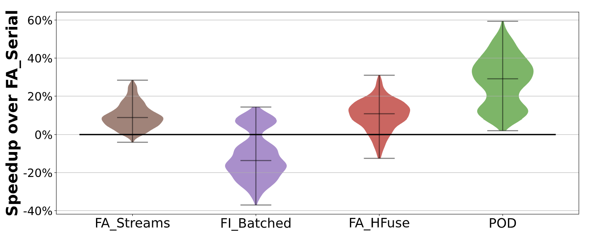
POD-Attention performance
Streams
Batched
HFuse
POD beats all existing alternatives, with up to 61% speedup (33% average).
Notes:
To investigate POD-Attention’s performance, we ran the attention kernels sweeping over a thousand practical input configurations, varying input sizes and LLM model configurations. We compare against FlashAttention kernels, as well as state-of-the-art FlashInfer kernels. FA_Serial, our baseline, executes the two operations in serial, similar to how existing hybrid-batch frameworks run these kernels. Streams executes prefill and decode in separate CUDA streams, as we previously saw. This provides some limited speedup, as early completion of some prefill operations allows decode to start utilizing the GPU. Batched combines both prefill and decode input and runs a single prefill kernel. This ends up usually performing worse, as kernel execution is optimized for one set of inputs (in this case prefill), and adding other inputs leads to subpar execution choices, like excessively large matrix multiplication tile sizes. Hfuse is a state-of-the-art GPU kernel fusion tool that merges the warps of different kernel’s CTAs. Finally, POD performs 29% - 33% better on average, with a speedup of up to 59%.

Slide 47
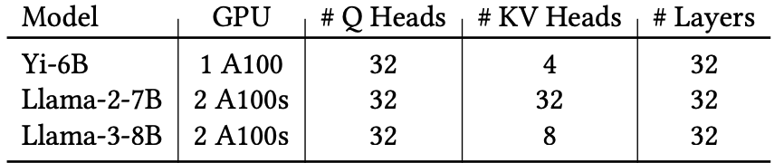
LLM evaluation: Baselines and workloads
Inference frameworks
Framework | Description
vLLM [SOSP ‘23] | Popular framework that prioritizes prefill latency (TTFT).
Sarathi [OSDI ‘24] | Uses hybrid-batching to improve decode latency (TBT).
Sarathi + POD | Sarathi enhanced with POD-Attention.
Models and hardware
Notes:
We also evaluate POD-Attention’s benefit on end-to-end LLM execution. We compare against state-of-the-art schedulers vLLM and Sarathi. vLLM uses prefill prioritizing scheduling which stalls ongoing decodes whenever a new prefill request arrives. Sarathi instead uses hybrid batching which combines prefills and decodes into a batch avoiding these stalls. Finally, we look at Sarathi enhanced by POD to overlap the prefill and decode attention. We evaluate on a few different models on A100 GPUs.

Slide 48
Online inference performance
Llama 3 8B, arXiv-Summarization, QPS = 0.95
Lower is
better
vLLM provides low TTFT but high TBT, stalling nearly all requests
Sarathi provides low TBT, but high TTFT
Sarathi + POD reduces TBT stalls with TTFT closer to vLLM
Notes:
vLLM prioritizes prefills, providing low TTFT at the expense of high TBT. Sarathi’s hybrid batching suffers from high TTFT latency as prefills and decodes are combined in a batch causing decode’s attention latency to have an impact on TTFT. POD allows both to overlap achieving an acceptable latency in comparison.

Slide 49
Reducing: Lossless Compression for ML
Under Review

Slide 50
Data movement for large-scale ML
GPU
SM
SM
SM
Memory
Data
Notes:
GPUs have become the processor of choice for most machine learning computation. [click] Unfortunately, for many cases of machine learning, the data being processed can exceed the size of the GPU memory.

Slide 51
Data movement for large-scale ML
CPU
GPU
Memory
SM
SM
SM
Data
PCIe
Memory
Notes:
To resolve this, systems place the data in the CPU memory instead, which is significantly larger than the GPU memory. Data is transferred on-demand to the GPU across the PCIe. [click] This data is then processed on the GPU as before. Due to this requirement for transferring data before processing, the PCIe ends up forming the bottleneck in these computations.

Slide 52
GNN data movement overhead
Notes:
To demonstrate this, we evaluated 3 publicly available GNN datasets using a state-of-the-art GNN training framework called Legion on an A100 GPU. As we can see, the overhead of PCIe data movement can be more than 60% of the execution time during training.

Slide 53
Warp execution in GPUs
Warp
Data
All threads in a warp execute the same instruction in lockstep.
Contiguous data accesses provide the best performance.

Slide 54
Proposal: Lossless compression
Data is preprocessed and compressed in CPU memory.
GPU fetches and decompresses data in-flight.
Compression is lossless, no accuracy tradeoffs for the model.

Slide 55
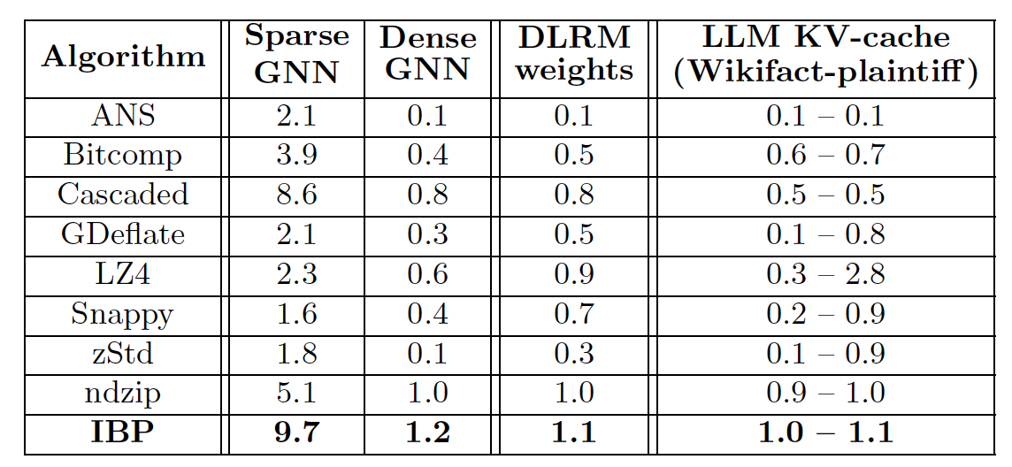
Problem: Current lossless algorithms are too slow
Average speedup of transferring ML data across PCIe with compression.

Slide 56
Our goal
A low-overhead lossless compression algorithm.
Easily parallelizable to exploit the GPU.
Minimize memory accesses for decompression.
Applicable to a wide variety of data types.

Slide 57
Proposal: Invariant Bit Packing (IBP)
Identify invariant bits across tensors.
Eliminate them, packing the remaining bits into a smaller space.
Keep one set of metadata in GPU memory (order of KBs).

Slide 58
Classical bit packing
0 0 0
0 0 0
0 0 0
0 0 0
0 0 0
1 0 0 0 0 1 1 0 1
0 0 0 0 1 1 1 0 0
0 0 0 1 1 0 1 0 0
1 1 0 0 0 0 1 0 1
0 0 1 0 0 1 1 0 0
Tensors
Compressed data

Slide 59
Invariant bit packing (IBP)
Compressed data (In CPU)
Participation
bits
0 0 0
0 0 0
0 0 0
0 0 0
0 0 0
1 0 0 0 0 1 1 0 1
0 0 0 0 1 1 1 0 0
0 0 0 1 1 0 1 0 0
1 1 0 0 0 0 1 0 1
0 0 1 0 0 1 1 0 0
1 1
1 1
1 0
0 1
1 0 1 1
0 1 1 0
0 1 1 0 1 0 0
0 0 0 1 1 0 0 0 1
Tensors
0 0 0 0 0 1 0 0 1 1 0 0
Bitval
0 0 0 * 0 0 0 * * 1 0 *
Mask
1 1 1 0 1 1 1 0 0 1 1 0
In GPU

Slide 60
Problem: Oddly-sized compressed data
1 1
1 1
1 0
0 1
1 0 1 1
0 1 1 0
0 1 1 0 1 0 0
0 0 0 1 1 0 0 0 1
0 0 0 0 0 1 0 0 1 1 0 0
Hinders parallelism opportunities

Slide 61
Warp-parallel iterative decompression
CPU memory
Compressed data
Region
Region
…
GPU
Region
Mask
1 1 1 0 1 1 1 0 0 1 1 0 0 1 1 0 0 1

Slide 62
Warp-parallel iterative decompression
CPU memory
Region
…
GPU
Region
1
4
7
1
3
3
Mask
1 1 1 0 1 1 1 0 0 1 1 0 0 1 1 0 0 1

Slide 63
Warp-parallel iterative decompression
CPU memory
Region
…
GPU
Region
Decompressed
1
4
7
1
3
3
Mask
1 1 1 0 1 1 1 0 0 1 1 0 0 1 1 0 0 1

Slide 64
Integrating compression into ML
GPU
CPU memory
ID
Tensor 0
Tensor 0
Padding
Tensor 1
1
0
1
1
Pad
Tensor 2
Tensor 2
Bitmask
(Compressed or not?)
Pad
Tensor 3
Tensor 3

Slide 65
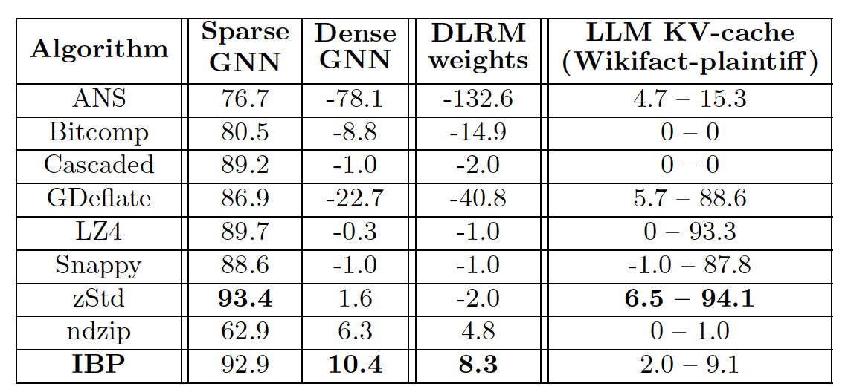
Compression performance
Table 1. Normalized throughput
Table 2. Space saved %

Slide 66
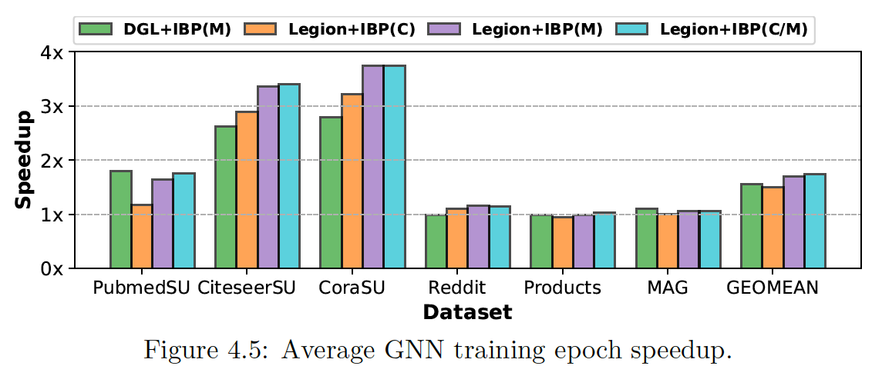
GNN compression performance

Slide 67
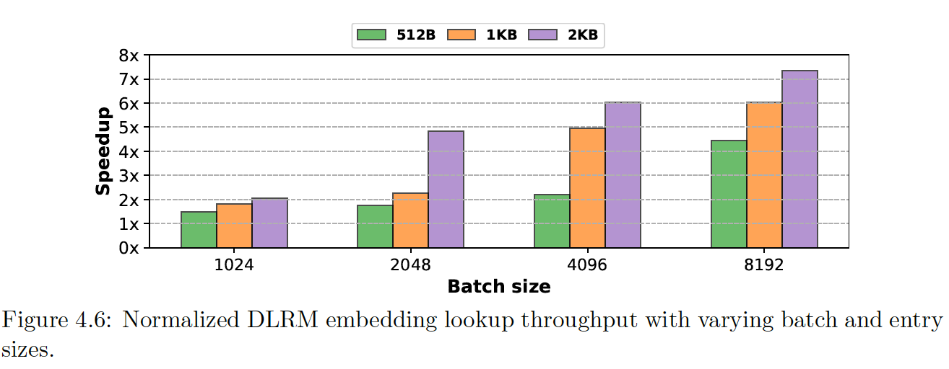
DLRM embedding transfers

Slide 68
Future Work and Timeline
Extend IBP to LLMs [Work in progress]
KV-cache offloading involves maintaining LLM KV-cache in CPU memory for million-token-scale inference.
Target a graduation of summer 2026.

Slide 69
Summary
Data movement is a growing issue.
Three principles to mitigate its impact:
Avoid! [via (MC)²]
Hide! [via POD-Attention]
Reduce! [via Invariant Bit Packing]
Thank you for attending.

Slide 70
Integrating IBP into ML: Caching
ID
Compressed?
0 / 1
Hashmap
64-bit pointer
40-bit offset
Cache

