Slide 1

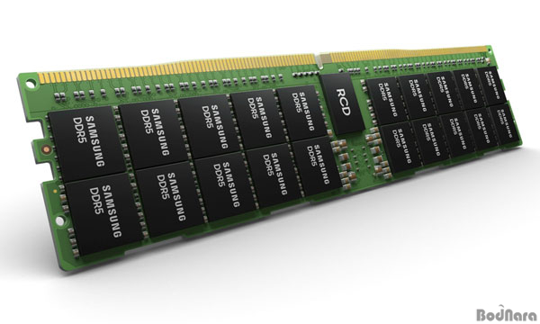
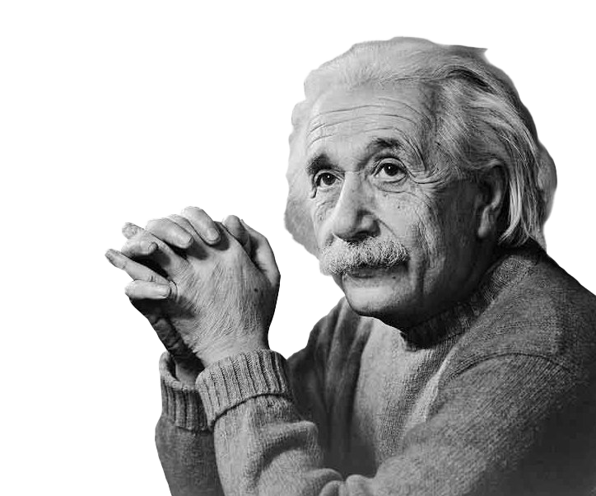
(MC)²: Lazy MemCopy at the Memory Controller
Aditya K Kamath, Simon Peter
ISCA ‘24
Notes:
Hi everyone, my name is Aditya K Kamath. Today I’m presenting (MC)^2 lazy memcopy at the memory controller.

Slide 2
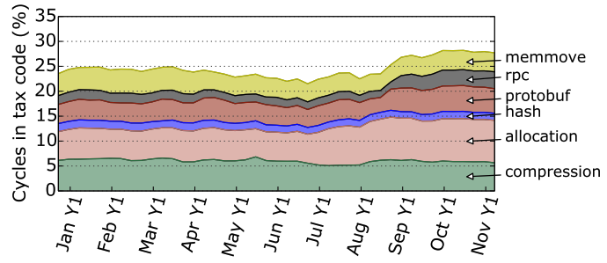
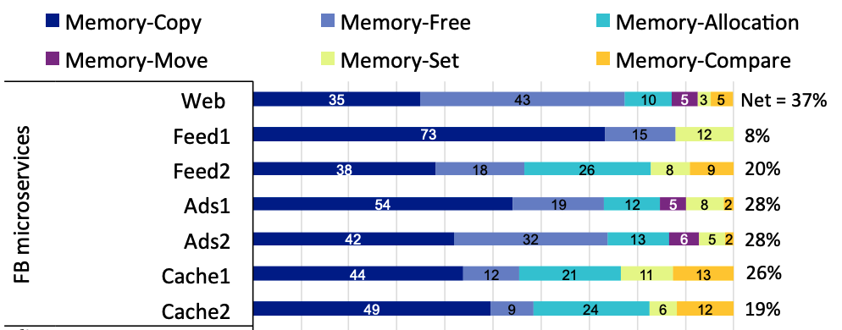
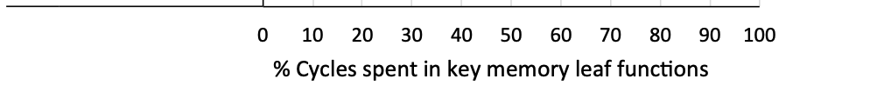
High overhead of memory copies
Google datacenter profiling
[S. Kanev et. al., ISCA ‘15]
Meta microservice profiling
[A. Sriraman et. al., ASPLOS ‘20]
Notes:
Prior work has shown that memory movement consumes a high amount of overhead across many processes.
A 2015 paper profiled the behaviour of applications in Google’s datacenters and found that up to 7% of all CPU cycles were consumed by memory movement.
In addition, RPC calls and protobuf also had high copy overheads.
Another paper profiling Meta’s most popular microservices in 2020 saw similar trends with copy overheads of up to 14%.

Slide 3
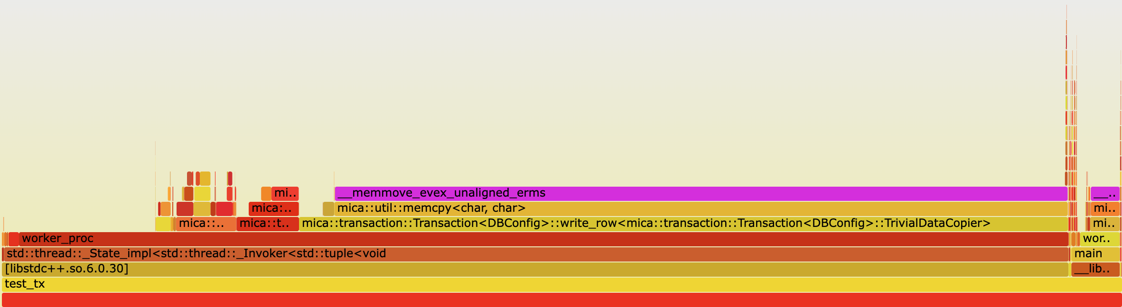
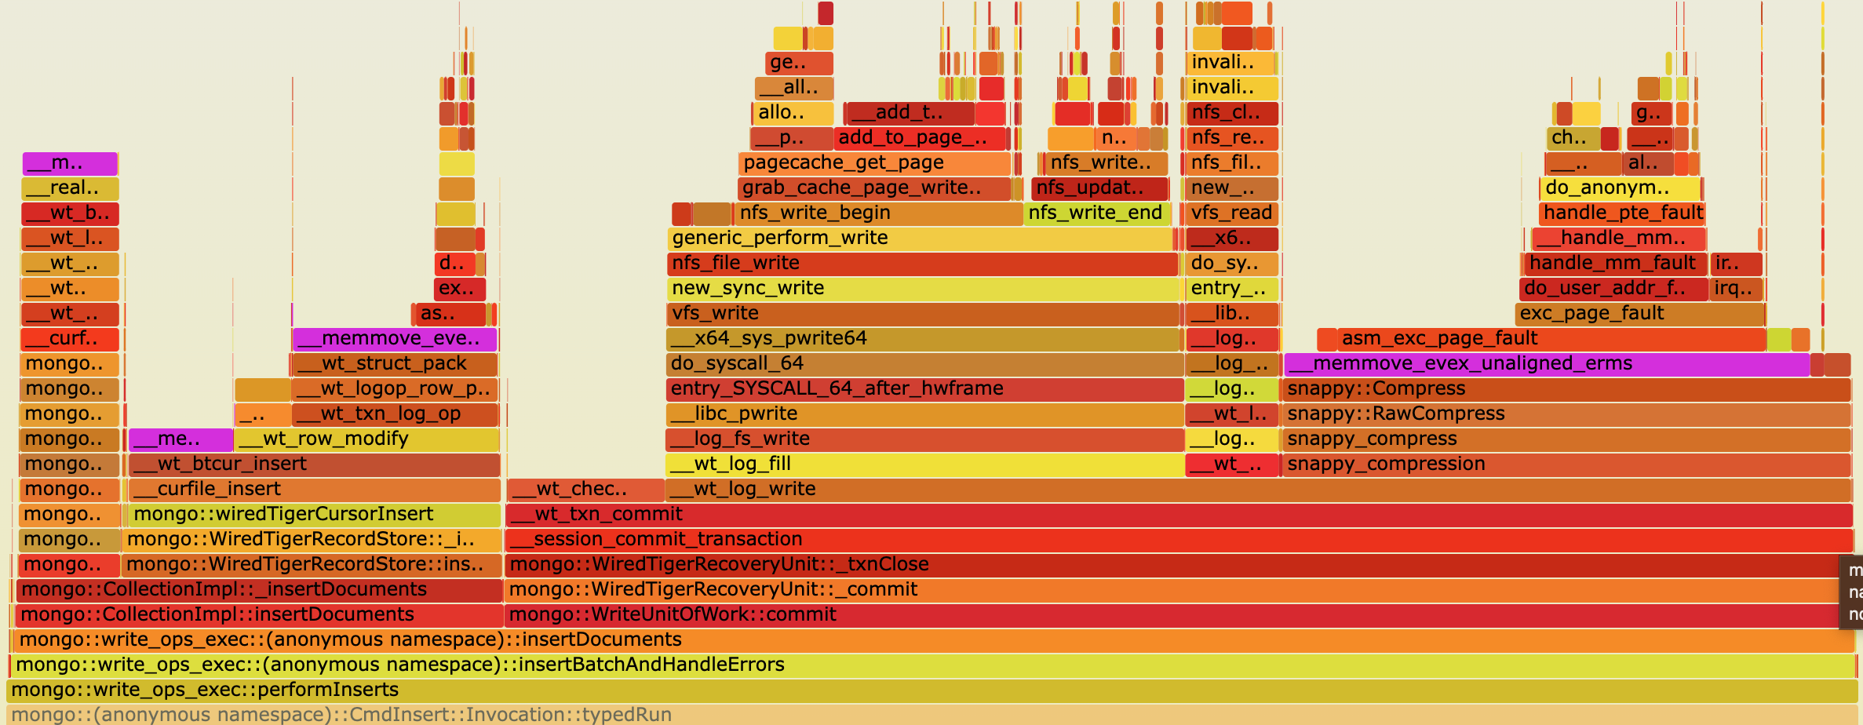
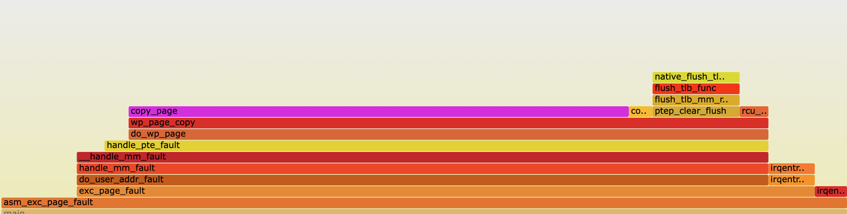
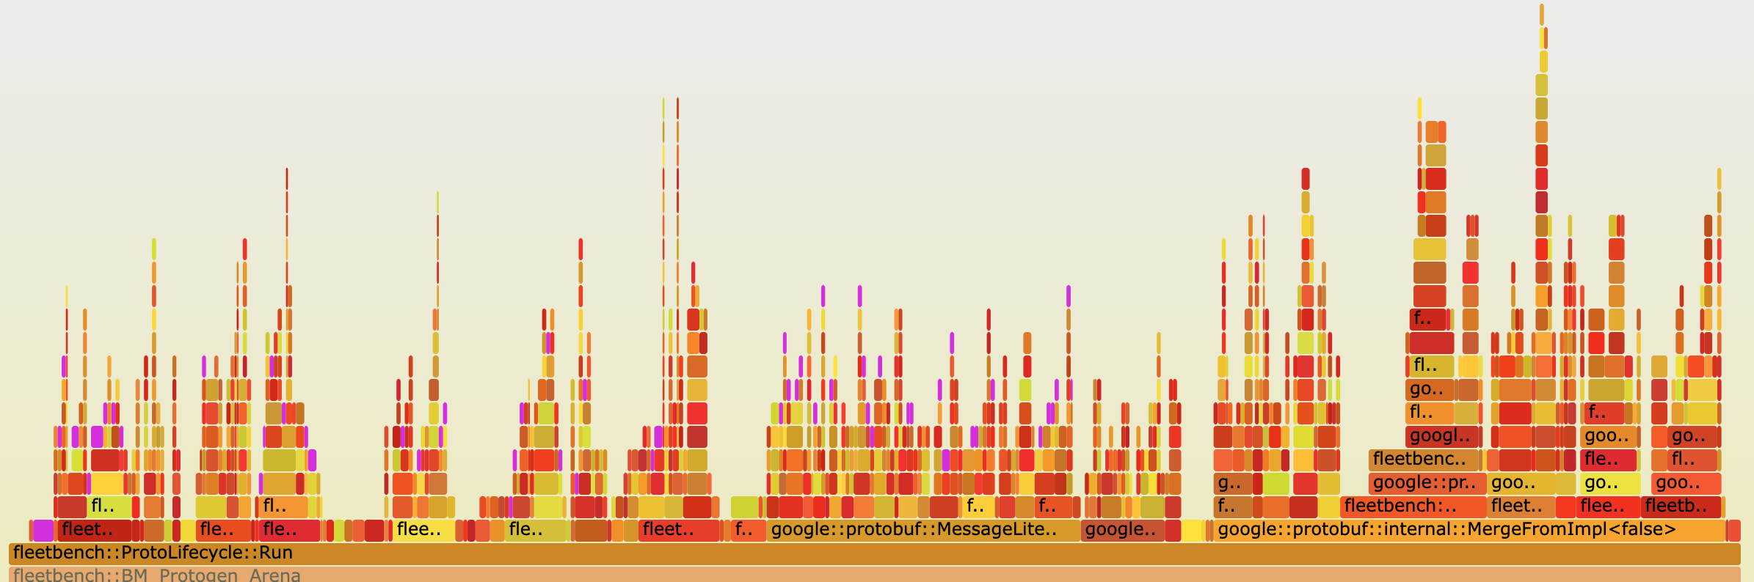
Operations with high copy overhead
Cicada [1] writes: 68.0%
MongoDB [2] inserts: 42.3%
Fork + COW fault: 60.0%
Protobuf (Serialize/Merge) [3]: 29.2%
[1] H. Lim et al., SIGMOD ’17 [2] github.com/mongodb/mongodb [3] github.com/google/fleetbench
Notes:
We ourselves conducted a study on several operations across different application domains that exhibited a high copy overhead.
We plot flamegraphs showing the amount of time spent in various functions of these operation, including memory copy times.
The top two graphs depict writes and insertions for an OLTP and NoSQL database respectively.
The bottom left graph shows OS copy-on-write faults, while the bottom right shows common Protobuf operations.
The bars highlighted in purple show the time spent copying, which can be up to 68% for these operations.

Slide 4
Insights from studying use-cases
Apps often use memory copies to fill temporary buffers
Copies may be excessive/redundant if full copy isn’t accessed
Killer microseconds: difficult for CPU to hide copy overhead
Notes:
Our insights from looking at these applications are that apps typically use memcpy to fill temporary buffers. This can lead to excessive or redundant copies.
When copying happens in the critical path of the application processing, it becomes difficult for the CPU to hide its overhead, leading to ”killer microseconds” of copy execution

Slide 5
Use case: Read-Copy-Update in MVCC databases
Writer
Write X
Write Y
Commit
Read Y
Read X
Commit
Reader
Copy
Database
Copy used for isolation
Notes:
To see how copies are used in modern applications, let’s look at a typical use case: read-copy-updates in multi-version concurrency control databases.
MVCC databases copy rows or tuples being modified to local buffers to preserve isolation guarantees.
In this example, we see two threads performing transactions on the database concurrently, with one writer and one reader.
Before performing the modifications, the writer creates a copy of the row that it wishes to modify.
The writer then performs its required modification to its local copy.
This allows the reader to read the unmodified data from the original database and avoid inconsistencies in operations.
When the writer commits the transaction it merges its row back into the main database.
The entire row may not end up modified, in which case the writer copied more data than it actually needed to.
In addition, there’s potential for copy overheads to be hidden in the background while other DB operations are ongoing.

Slide 6
Current systems: Eager copying
Copy Src to Dest
Read
Dest[1]
Dest[1]
Dest
Src
Notes:
Currently, applications make use of what we refer to as “eager copying” where a copy operation causes data to be moved.
Then on access, the required data is obtained.
For the applications we previously saw, we find that this is not the best approach for data movement.

Slide 7
Our proposal: Perform movement lazily
Copy Src to Dest
Read
[Don’t copy]
Dest[1]
Dest[1]
Dest
Src
Notes:
We instead propose performing data movement lazily.
On a copy operation, we don’t do anything.
When the data is accessed, we reroute the request to the appropriate location performing the data copy.
This method only copies data that is accessed from memory. Furthermore, this allows the hardware prefetcher to trigger copies before data is accessed hiding copy latencies.

Slide 8
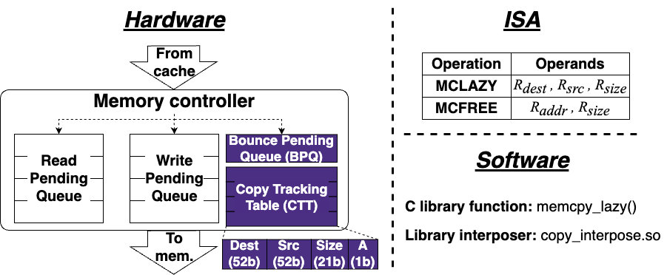
(MC)² : Lazy MemCopy at the Memory Controller
Notes:
To support this operation, we propose MC^2, performing lazy memcopy at the memory controller.
We find that the memory controller is the ideal place to handle this as all memory accesses must pass through it, and it frees up responsibilities from the CPU, providing opportunities for copy hiding.
This system consists of three main components. Hardware modifications to the memory controller, new instructions, and a software wrapper.
We’ll now look at each of these in-depth.

Slide 9
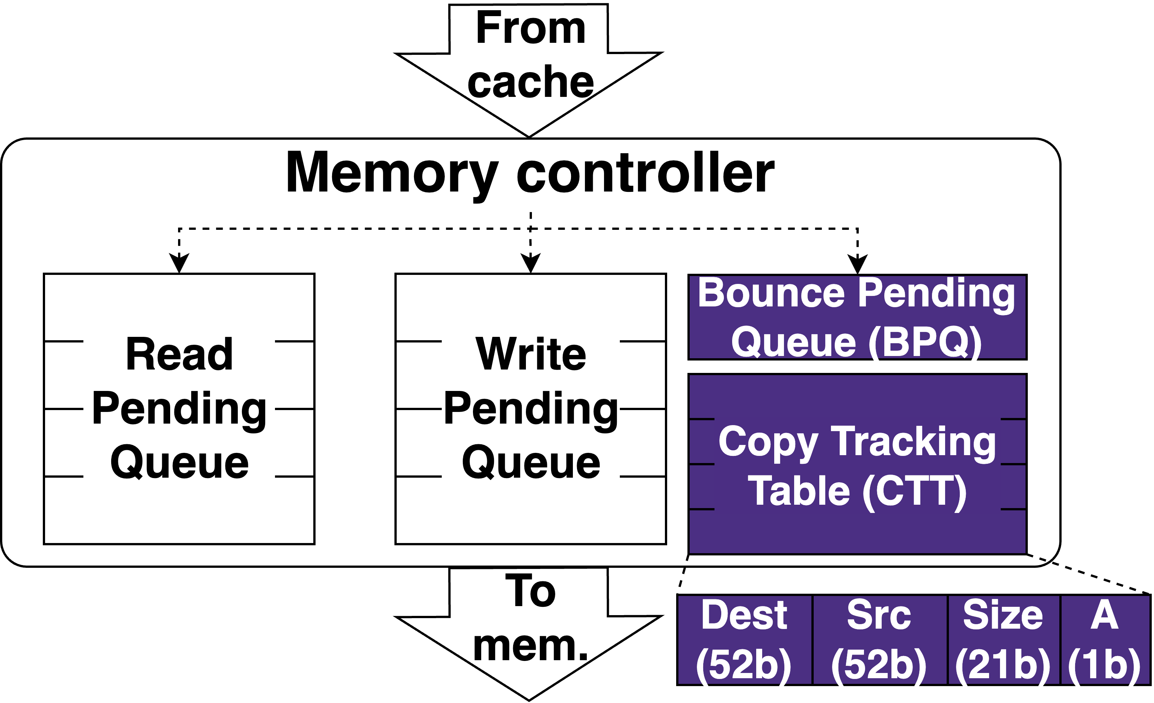
(MC)² Hardware
Notes:
We add a copy tracking table or CTT, which tracks all the prospective copies.
Each entry in this table contains a 52-bit destination address, a 52-bit source address, and 21-bit size of executed copies, along with an active bit to check whether the entry is in use. We use 52 bits for addresses since this is typically the size of physical addresses in systems today. The 21-bit size allows each entry to track a prospective copy of up to 2 MB in size or the size of a large page. The entries in the CTT are kept coherent across memory controllers. The CTT is looked up in parallel with memory accesses, hiding its access latency in the critical path.
We also maintain a bounce pending queue, that temporarily holds writes to source buffers for consistency. The importance of the BPQ is explained in detail in our paper.

Slide 10
(MC)² ISA
memcpy_lazy: C wrapper function with
semantics identical to memcpy
Operation | Operands
MCLAZY | R_{dest} , R_{src} , R_{size}
MCFREE | R_{addr} , R_{size}
Must be physically contiguous,
i.e., within a single page for user apps
Multiple of cacheline size
Destination:
Cacheline-aligned
Notes:
We provide two new instructions to take advantage of Mcsquare. The first is MCLAZY which initiates the lazy memcpy operation. It accepts 3 registers, the destination virtual address, the source virtual address and the copy size. The second instruction is MCFREE which is a hint that informs the system that the address provided is no longer in use and does not need to be tracked anymore.
MCLazy has a few alignment restrictions to simplify hardware. We provide software wrappers that hide these low-level constraints from the programmer. The first is that the destination buffer address must be cacheline-aligned. This is because memory accesses occur at cacheline granularity, and lazy copies on partial cachelines would make the hardware overly complex.
The second restriction is that the copy size must be a multiple of the cacheline size, for the same reason of avoiding partial cacheline copies.
The final restriction is that the destination and source buffers must be contiguous in physical memory. For userspace applications this means they must each lie within a single page. For copies spanning multiple pages, MCLAZY should be called on each page.
As previously mentioned, we provide a C wrapper around MCLAZY that exposes a lazy memcpy with identical semantics to libc memcpy for programmer convenience. Full details on how this is done are in the paper.

Slide 11
(MC)² operation: Lazy copy
Core
Core
MCLAZY
DEST, SRC, SIZE
Core
MCLAZY
DEST, SRC, SIZE
MCLAZY
DEST, SRC, SIZE
Last-level $
SRC
DEST
SRC
Interconnect
BPQ
Copy Tracking Table
Copy Tracking Table
BPQ
DEST
SRC
SIZE
A
Memory controller
Memory controller
DEST
SRC
SIZE
A
Memory
Memory
SRC
DEST
Notes:
We’ll now look at how the lazy copy operation is performed, and what happens on memory accesses.
Let’s assume the CPU core executes an MCLAZY operation on a destination and source cacheline. The CPU creates a packet for this operation and sends it towards the caches.
At the caches, the operation triggers an effect where the destination cacheline is invalidated, and the source cacheline is written back. This ensures that further accesses to the destination reach the memory and that the memory has the up-to-date values of src that were copied to dest.
The packet is then broadcasted to all the memory controllers where the operation is added to the Copy Tracking Table.
We’ll now see how reads to the destination buffer are impacted by this operation.

Slide 12
(MC)² operation: Read destination
Core
Core
Core
READ DEST
Last-level $
Interconnect
BPQ
Copy Tracking Table
Copy Tracking Table
BPQ
DEST
SRC
SIZE
A
Memory controller
Memory controller
DEST
SRC
SIZE
A
DEST
Memory
Memory
SRC
DEST
Notes:
When the CPU reads the destination, we need to obtain the data from the source instead, since the data wasn’t actually copied.
The access proceeds as normal initially.
At the memory controller, we consult the CTT and realize that this was the destination of a prospective copy.
This causes the request to be bounced to the memory controller containing the source cacheline.
The source cacheline is read from memory and sent the CPU core as if it was read from the destination memory location. Reads to the destination incur an additional latency due to the CTT lookup and bounce operations.
In our paper we also detail out how reads to the source and writes to the source or destination buffer is performed.

Slide 13
Evaluation questions
How much lower is (MC)²’s copy overhead?
What is the impact of lazily copying data on access time?
What benefit could (MC)² provide real workloads?
What are the sources of overhead for (MC)²?
How do (MC)²’s various parameters impact performance?
Notes:
We now have a few questions that we shall quantify in our evaluation.
How much lower is MC^2’s copy overhead? What impact does it have on access times? and what benefit could (MC)^2 provide real workloads?
In our full paper we answer a few more questions that we wont be able to cover here.

Slide 14
Evaluation: GEM5 configuration
Hardware
CPUs | 8 | 8 | Clock speed | 4 GHz
Private L1 cache | 64 KB/CPU, stride prefetcher | 64 KB/CPU, stride prefetcher | Shared L2 cache | 2 MB, stride prefetcher
DRAM size | 3 GB | 3 GB | DRAM channels | 2
DRAM config. | DDR4 | DDR4 | BPQ size | 8 entries
CTT entries | 2048 | 64K | CTT latency | 0.79 ns
Software
OS kernel |  | Linux 5.7.0 | Distribution | Ubuntu 20.04
Notes:
To answer these questions, we make use of GEM5, a cycle-level CPU simulator.
Our configuration models a scaled-down server node with 8 CPUs.

Slide 15
Evaluation: Prior work comparison
Prior work: zIO [1], OS-based COA | Our proposal: (MC)², lazy copy
Software-based | Hardware-based
Page-granularity | Cacheline-granularity
Requires TLB shootdowns | No shootdowns required
High access penalties | Minimal access penalties
[1] T. Stamler et. al., ODSI ‘22
Notes:
Wherever possible, we compare against zIO an OS-based copy-on-access mechanism that makes use of OS-managed page tables to elide copies.
zIO is essentially the OS-based approach to lazy copying, which requires expensive page table management operations on accessing lazily copied pages, giving it high access penalties.

Slide 16
Evaluation: Copy performance
11x
faster!
Faster
Notes:
To evaluate the latency of copying, we performed an experiment where different sized source buffers were copied to destination buffers. Note the y-axis is in log scale.
We evaluate against memcpy in two scenarios. The first is where none of the data is cached referred to as just Memcpy, the second is where the source and destination buffers have been accessed just before the copy allowing them to be cached. These are essentially the best- and worst-case performance for memcpy. Copies with high overheads due to high memory access latencies behave closer to the uncached memcpy performance.
(MC)^2 provides speedups for copies at and above 1 KB, performing similar to copying cached data at 64 KB and above, and is up to 11 times faster than uncached memcpy.
Since zIO relies on page table manipulation, it only ran for copies at and above a 16KB size. It has a high initial overhead due to page table manipulation and TLB shootdowns. Below 256KB, MCSquare outperforms zIO. Above this, zIO outperforms (MC)^2 as (MC)^2 relies on cacheline flushing which has its own overhead. Despite this, we shall see how (MC)^2 still provides benefits at these sizes.

Slide 17
Evaluation: Copy + access runtime
Faster
Notes:
To analyze the impact of lazily copying on access latencies, we ran a microbenchmark where a 4 MB source buffer is copied to a destination buffer. The destination is then accessed sequentially.
We intentionally misaligned the source and destination, as in the applications we examine, the source and destination buffers are typically not cacheline-aligned with each other.
For our system this causes additional access latencies to fetch data (full details in the paper).
The runtime of each system is normalized to the time taken by memcpy, with higher meaning slower. We analyze the runtime when different percentages of the 4 MB destination buffer are accessed.
As we previously saw, zIO outperforms (MC)^2 when the dataset isn’t accessed. However, once we start accessing the destination, zIO starts seeing page faults triggering copies. When more than 25% of the dataset is accessed it starts performing worse than memcpy.
On the other hand, (MC)^2 is able to retain low latency penalties.
Surprisingly, even when the entire dataset is accessed, MC^2 outperforms memcpy. We find that this is because the cache prefetcher hides some of the extra access latencies. When we turn off the prefetcher, we see that it slows down compared to memcpy, showing the impact of copy latency hiding.
When the source and destination are aligned, we see even better performance.

Slide 18
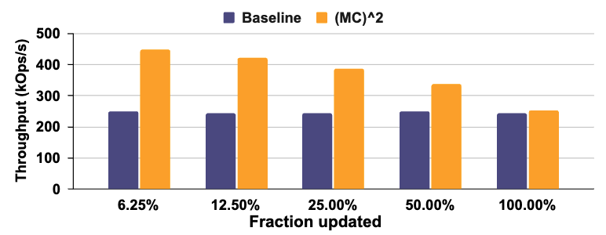
Evaluation: Cicada transaction throughput
Faster
Notes:
Moving on to the performance of applications with MCSquare, we see that many database transactions involve updating only small portions of a tuple. For example, in TPCC, decrementing the quantity of stock of an item being sold in a store may only update 1 – 2 % of the total tuple size. As we previously saw, this leads to excessive data being copied for the read-copy-update performed by MVCC databases.
With (MC)^2, we can pay only the copy overhead for the portion of the tuple updated.
To evaluate this, we enhanced the Cicada database with (MC)^2 and performed repeated operations on a table with 8KB sized rows modifying different fractions of the tuple and measuring throughput. These operations are split 50:50 between reads and updates typical of write-intensive DB workloads. We used 8 threads saturating the cores on our system.
(MC)^2 is able to provide up to 78% higher throughput, since it reduces the memory bandwidth consumed for smaller update fractions.
Our paper contains more evaluation for workloads including huge page COW faults, and kernel buffer copying.

Slide 19
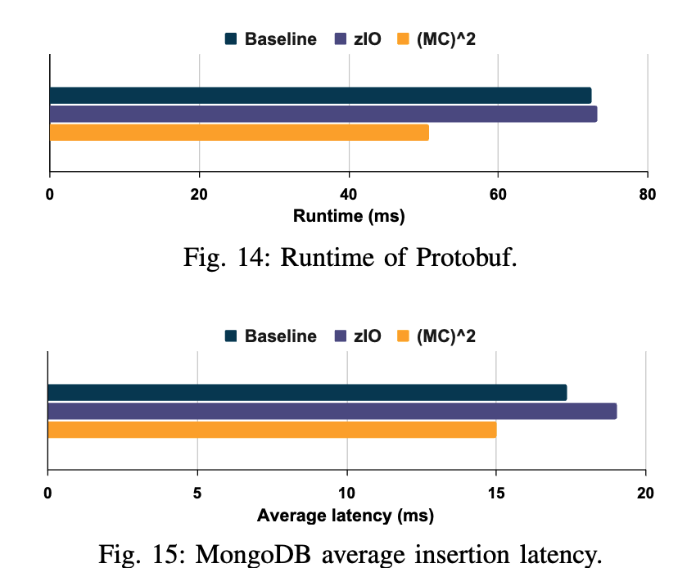
Evaluation: Protobuf and MongoDB
Faster
Faster
43% lower
15% lower
Notes:
We analyze (MC)^2 with a protobuf workload provided in Google’s Fleetbench benchmark suite. Fleetbench contains workloads dedicated to common hot library functions, constructed using traces from production servers. We find that (MC)^2 has 43% lower runtime compared to memcpy. zIO is unable to generate any performance benefit since all the copies in this benchmark were smaller than the 4 KB page size it requires to elide copies.
We also replicated an experiment from the zIO paper, where MongoDB insertions are performed using 100KB fields and 10 fields per insertion. (MC)^2 provides on average 15% lower latency for insertion, while zIO slows down by 9%. This is because copied data is later accessed, triggering page faults for zIO which (MC)^2 avoids.

Slide 20

Summary
(MC)²: a novel lazy copy mechanism at memory controller
Up to 11x faster than standard memcpy
Provides benefits across many workloads:
43% speedup in a Protobuf benchmark
15% faster insertion operations in MongoDB
Up to 78% higher throughput for MVCC databases
Our code is available: https://github.com/AKKamath/MCSquare-ISCA24
Thank you!
Notes:
To summarize: We introduce MCSquare a novel lazy copy mechanism at the memory controller, which provides up to 11x faster copying than standard memcpy. It provides benefits across workloads such as Protobuf, MongoDB, and MVCC databses. Our code is completely open-source on Github. Thanks for attending the talk.

Slide 21
Backup slides

Slide 22
Evaluation: Copy + random access runtime
Slower
Notes:
We also perform an experiment where the data is randomly accessed instead of sequentially. It’s worth noting that these types of access patterns are rare, as it reduces the efficiency of the cache.
Here, zIO incurs a heavy overhead at 12.5%, since almost every access is to a different page, forcing it to resolve page faults on every access. As the number of accesses increase, it starts seeing accesses to previously faulted pages, reducing its relative runtime.
(MC)^2 performs near the performance of memcpy. This is due to an optimization we use where we write data back to the destination on a read operation, making further reads avoid (MC)^2, further details in the paper.
Without this optimization, (MC)^2 would’ve performed 60% worse.

Slide 23
(MC)² operation: Read source
Core
Core
Core
READ SRC
Last-level $
Interconnect
BPQ
Copy Tracking Table
Copy Tracking Table
BPQ
DEST
SRC
SIZE
A
Memory controller
Memory controller
DEST
SRC
SIZE
A
Memory
Memory
SRC
DEST
SRC
Notes:
Reads to the source buffer experiences no change because of our system.

Slide 24
(MC)² operation: Write source
Core
Core
Core
WRITE SRC
Last-level $
Interconnect
BPQ
Copy Tracking Table
Copy Tracking Table
BPQ
SRC
DEST
SRC
SIZE
A
Memory controller
Memory controller
DEST
SRC
SIZE
A
SRC
ACK DEST
SRC
Memory
Memory
DEST
SRC
DEST
Notes:
Writes to the source cacheline are a bit more involved since we need to make sure that the data that should’ve been copied to the destination isn’t lost.
When the write reaches memory, the CTT is looked up.
Since the write is to the source cacheline, we hold it in the BPQ.
The memory controller then reads the SRC from memory. This data is then sent to the memory controller containing the destination.
The data is then written to the destination cacheline, and the entry is removed from the CTT. This is essentially the “lazy copy” in action.
An acknowledgement is broadcast to the other memory controllers so that they also remove the entry.
The source write is then removed from BPQ then sent to memory.

Slide 25
(MC)² operation: Write destination
Core
Core
Core
WRITE DEST
Last-level $
Interconnect
BPQ
Copy Tracking Table
Copy Tracking Table
BPQ
DEST
SRC
SIZE
A
Memory controller
Memory controller
DEST
SRC
SIZE
A
ACK DEST
DEST
Memory
Memory
SRC
DEST
SRC
Notes:
Writes to destination buffers are a bit simpler.
When the write reaches the memory controller, it causes the entry in the CTT to be removed.
The write happens to the destination as normal.
An acknowledgement is then generated and sent to the other memory controllers so that they can invalidate their entries as well.

Slide 26
(MC)² Software: memcpy_lazy()
def memcpy_lazy(dest, src, size):
# Cacheline align dest
left_fringe = ALIGN_REM(dest, CL_SIZE)
memcpy(dest, src, left_fringe)
dest += left_fringe
src += left_fringe
size -= left_fringe
while size > 0:
# Calculate remaining size in page
src_off = ALIGN_REM(src, PAGE_SIZE)
dest_off = ALIGN_REM(dest, PAGE_SIZE)
# Pick minimum size left as lazy copy size
copy_size = min(min(src_off, dest_off), size)
if copy_size < CL_SIZE:
memcpy(dest, src, copy_size)
else:
# Make copy_size a multiple of CL_SIZE
copy_size &= (CL_SIZE - 1);
MCLAZY(dest, src, copy_size)
dest += copy_size;
src += copy_size;
size -= copy_size;
Multiple of cacheline size
Destination:
Cacheline-aligned
Notes:
To remove these restrictions from the programmer, we provide a software wrapper around this instruction which internally handles all the restrictions.
It first cacheline-aligns the destination address, manually copying data needed to align it.
It then checks how much data is remaining within the source and destination pages.
It then calls the MCLAZY instruction if there is at least a cacheline size left.
It repeats this process for the entire lazy copy requested.

Slide 27
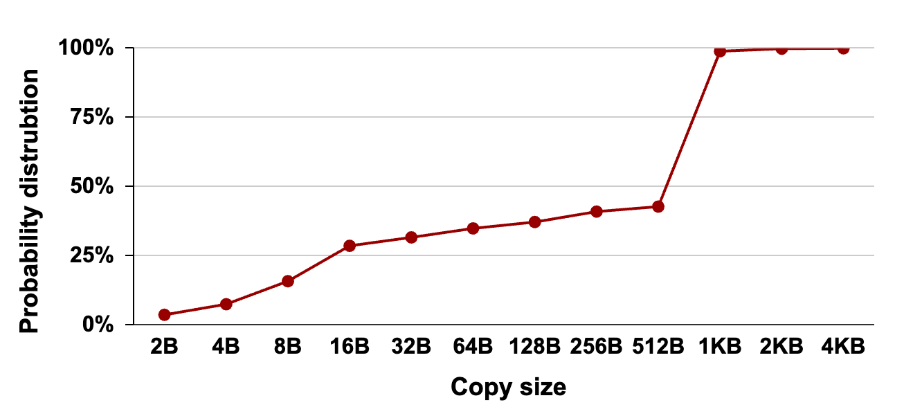
Analysis of Protobuf: Copy sizes
56% of copies >= 1KB
100% of copies <= 4 KB
Notes:
We interposed all the memcpy calls in the workload and we found that most of the copies in the range of a few KB.

Slide 28
Analysis of Protobuf: Sources of overhead
Notes:
We then used Perf a performance analysis tool in Linux to examine the sources of overheads in Protobuf.
We found that Memcpy had a 29% overhead in this application.
Of this, 28.5% of memory accesses generated by memcpy were cache misses, which means the data had to be fetched from memory.
92% of the time, there was an operation within the CPU waiting for a memory access to complete.
However, modern CPUs are able to hide memory latencies with out-of-order execution.
62.5% of the time, the CPU was stalled, waiting for a memory access to complete before it could make any progress.

