Slide 1




POD-Attention: Unlocking Full Prefill-Decode Overlap for Faster LLM Inference
Aditya K Kamath¹, Ramya Prabhu², Jayashree Mohan²,
Simon Peter¹, Ramachandran Ramjee², Ashish Panwar²
¹University of Washington
²Microsoft Research India

Slide 2
Outline
LLM Inference and Hybrid Batching
Motivation for POD-Attention
GPU microarchitectural background and kernel fusion
POD-Attention design
Evaluation
Notes:
Before we get started, I’d like to go over what we’ll be covering. We start off with a background on LLM execution covering Prefill, Decode, and Hybrid batching. We’ll then look at how GPU execution works. We’ll then look at GPU kernel fusion and POD-Attention’s design before finishing off with Evaluation.

Slide 3

LLM Prefill
Time-To-First-Token (TTFT)
Time taken by this iteration
decode
Feed-Forward Network
Prefill
Large input size
N Layers ⨉
Self-Attention
This
Is
A
Prefill
Large Language Model (LLM)
User
Notes:
Large Language models or LLMs are extremely popular today. (click) The fundamental unit of LLM architecture is the transformer block which consists of Self Attention and the Feed Forward Network. This block repeating N times makes a large language model. (click) When a user submits a prompt, the LLM processes it to produce the first token. This is called prefill. (click) The time that this takes is called the Time to first token, which is an important latency metric that modern LLM serving systems try to optimize.

Slide 4
LLM Decode
Time-Between-Token (TBT)
Time between two decodes
decode
is
happening!
Feed-Forward Network
Decode
Single token input/output size.
N Layers X
Self-Attention
This
Is
A
Prefill
decode
is
Large Language Model (LLM)
User
Notes:
After the first iteration, the output is passed back into the LLM to generate the next token. This is called a decode. (click) It is characterized by its relatively smaller input and output size. (click) This process of passing new tokens back to the LLM continues until it stops generating tokens for the request. (click) The time between two decodes is called Time between token or TBT, which is another important latency metric that serving systems optimize for.

Slide 5


LLM Hybrid Batching [Sarathi-Serve, OSDI’24]
Prefill
Prefill
LLMs
Decode
Decode
Prefill and decode inputs of multiple requests are combined as a single input
Improves throughput by reusing model weights and reducing latencies.
Notes:
Hybrid batching has emerged as the state-of-the-art method of balancing these latencies. [Click] In hybrid batching, multiple requests’ prefill and decode are combined and operated on by the same model weights. This improves overall throughput by reusing model weights and reduces latencies.

Slide 6
LLM Hybrid Batching – A Closer Look
Layer norm
Pre-projection
Post-projection
Layer norm
FFN
Prefill
Prefill
Attention
Decode Attention
Decode
Notes:
When we take a closer look at how hybrid batching is implemented in frameworks, we see that the reuse of model weights does happen for operations like Pre projection.

Slide 7
LLM Hybrid Batching – A Closer Look
Prefill
Prefill
Layer norm
Pre-projection
Decode
Post-projection
Layer norm
FFN
Decode
Prefill
Attention
Decode Attention
Prefill
Decode
Attention operates on discrete data items (no data reuse across input requests).
Kernels optimized independently for prefill or decode.
Notes:
Unfortunately, for Attention operations, each input is operated on by a separate data item called a KV-Cache which isn’t shared across the requests. GPU attention kernels are independently optimized for either prefill’s large size or decode’s small size. [Click] This means that the inputs are separated and the attention for each is performed independently, following which they are again recombined for the rest of the LLM layer.

Slide 8
Our Goal With POD-Attention
Layer norm
Pre-projection
Post-projection
Layer norm
FFN
Can we optimize this part?
Prefill
Attention
Decode Attention
Notes:
Our work tries to reduce the overhead of the attention operations to improve overall LLM serving performance.

Slide 9
Why Optimize Attention?
60% of overall time
Model: Llama-3-8B, Hardware A100 x 2, Decode Batch Size: 60
Attention is the biggest bottleneck at large context lengths.
Notes:
Our motivation lies in the fact that for larger input context lengths or number of input tokens, the attention operations end up being the biggest bottleneck, taking up to 60% of execution time - as shown in the plot here. As context lengths are ever-increasing, this problem will only increase in magnitude. For the rest of this talk we’ll focus only on Attention. We now look at the opportunities present for improving this situation.

Slide 10
Opportunity: Resource (Under)utilization
Model: Llama-3-8B, Hardware: 2 A100
Prefill saturates compute but has low memory bandwidth utilization.
Decode saturates memory bandwidth but has low compute utilization.
Notes:
We profiled the prefill and decode attention kernels to identify the compute and memory bandwidth utilization shown in the y-axis. As prefill attention operates on a large number of tokens seen in the x-axis, prefill attention kernels are optimized for large matrix multiplications which are compute-bound. For decode attention, typically 10 to 100 requests are batched together and operated on, which have a small number of tokens compared to prefill. The decode kernels are optimized for smaller matrix multiplications which are memory-bound.
[click] We notice that the utilization of memory bandwidth for prefill was below 5% and compute for decode was below 10% which is very low. From this we ask, is it possible to saturate both the compute and memory bandwidth by performing these operations together?
To answer this question, we must first look at how the GPU processes operations.

Slide 11
GPU Execution: CTA Scheduling
CTA
Launched Kernel
Stream
queue
CTA
CTA
CTA
CTA
CTA
CTA scheduler
SM
SM
SM
CTA
CTA
CTA
L1 $ / Shared mem
L1 $ / Shared mem
L1 $ / Shared mem
GPU
L2 $
DRAM
CTA scheduler in hardware assigns queued CTAs to SMs for execution.
Notes:
When a programmer launches a GPU kernel, they specify groups of a hundred to a thousand threads called Cooperative Thread Arrays or CTAs. The work to be done by the kernel is split among these different CTAs. For example, in tiled matrix multiplication, each CTA can handle a different matrix tile. [click] These wait in a stream queue until a CTA scheduler assigns these CTAs to the Streaming Multiprocessors or SMs within the GPU where execution occurs. The SM is analogous to a CPU processor. In modern GPUs, each SM holds around 1 to 8 CTAs. For the attention kernels we analyzed, each SM had up to 2 CTAs.

Slide 12
GPU Execution: Warp Scheduling
SM
CTA
CTA
Warp
Warp
Warp
Warp
Warp
Warp
Green = Prefill Warp
Orange = Decode Warp
Warp scheduler
Compute core
Compute core
Ld/st unit
Ld/st unit
L1 $ / Shared mem
Warp scheduler assigns queued warps to free resources attempting to saturate all GPU resources.
Notes:
Inside the SM, these CTAs are divided into warps, [click] which are groups of 32 threads which execute in lockstep. In the figure, we look at the warps of a decode kernel which are memory-bound, depicted with an orange color. A warp scheduler assigns queued warps to free resources every clock cycle. If possible, it attempts to saturate all the available resources. [click] For the decode attention shown, these warps are all reliant on the load/store unit to perform memory accesses. [click] As all the warps are contending for the same resource, the warp scheduler has limited opportunity to overlap execution between the warps. Conversely, prefill warps are compute bound and contend for the compute cores.
[click] If instead, we had prefill warps co-located with these decode warps within the same SM, the warp scheduler could attempt to service them all in parallel as depicted, thus improving overall throughput.

Slide 13
Fusing Prefill and Decode
Goal: Overlap compute-heavy prefill with memory-bandwidth-heavy decode to fully utilize GPU resources.
Sub Goal: Co locate prefill and decode CTAs within the same SM
Notes:
Thus, to achieve the best performance and reach our goal of overlapping compute-heavy prefill with memory-bandwidth-heavy decode. We establish a new goal of co-locating the prefill and decode CTAs within the same SM so that the warp scheduler can overlap them.

Slide 14
Known Methods of Kernel Fusion
Naïve fusion (CTA-parallel): Combined kernel for both prefill and decode.
Kernel-parallel: Launch kernels in separate CUDA Streams.
Warp-parallel: Divide warps in the CTA among ops [HFuse, CGO ‘22].
Intra-thread: Every thread performs both operations.
Cannot guarantee operation co-location within SM.
Exhibits bad load balancing within the GPU.
Excessive synchronization overhead.
Notes:
For this, we go over existing methods of kernel fusion and find that they all have limitations. (click) Naïve fusion and kernel parallel cannot guarantee operation co-location within an SM, and we shall shortly see why. Warp-parallel execution exhibits bad load balancing within the GPU. Intra-thread fusion requires excessive synchronization overheads for correctness.

Slide 15
Naïve Kernel Fusion (CTA-Parallel)
CTA
CTA
CTA
CTA
Stream
queue
CTA
CTA
Green = Prefill CTA
Orange = Decode CTA
CTA
CTA
CTA
CTA
CTA scheduler
SM
SM
SM
CTA
CTA
CTA
CTA
CTA
CTA
L1 $ / Shared mem
L1 $ / Shared mem
L1 $ / Shared mem
Cannot guarantee SM co-location, limiting speedup.
Notes:
The traditional method of kernel fusion involves combining the two kernels into one kernel, assigning the different CTAs to different operations. In the figure the green CTAs perform prefill and the orange decode. (click) The problem with this approach is that since the CTA scheduler is handled by hardware, there is no control over which CTAs get scheduled on which SMs greatly limiting the speedup. Kernel-parallel execution suffers from the same problem for the exact same reason.

Slide 16
How Can We Address This?
Goal: Overlap compute-heavy prefill with memory-bandwidth-heavy decode to fully utilize GPU resources.
Problem: CTA scheduler is handled by GPU driver/hardware.
Notes:
We see that a major problem of fusion is that the assignment of CTAs to GPU SMs is hidden from the programmer as it is handled by the GPU driver and hardware.

Slide 17
Introducing POD-Attention!
POD-Attention: Combines prefills and decodes into a single kernel with guaranteed SM co-location.
Key idea: SM-aware CTA scheduling
Guarantees each SM runs prefill and decode CTAs in parallel.
Enables the CTA scheduler to overlap the two operations.
Utilizes compute and memory bandwidth simultaneously.
Notes:
To address this, we introduce POD-Attention, which efficiently combines prefill and decode operations into a single kernel while guaranteeing SM co-location. POD-Attention uses SM-aware CTA scheduling to guarantee co-location of prefill and decode within each SM. This allows the warp scheduler to overlap the operations and properly utilize both the compute and memory bandwidth of the GPU. Unlike other approaches, we can guarantee SM co-location as well as good load balancing.

Slide 18
POD-Attention: Fused kernels
CTA
CTA
POD-Attention
stream
Green = Prefill CTA
Orange = Decode CTA
CTA
CTA
Prefill
stream
Decode
stream
CTA
CTA
CTA
CTA
CTA
CTA
CTA scheduler
SM
SM
SM
L1 $ / Shared mem
L1 $ / Shared mem
L1 $ / Shared mem
We create a new kernel with enough CTAs for both prefill and decode kernels.
Notes:
Previously, we would launch two kernels, one for prefill and one for decode, each with a certain number of CTAs depending on the inputs. (click) With POD-Attention, we instead have a new kernel which is launched with enough CTAs for both prefill and decode combined.

Slide 19
POD-Attention: SM-aware CTA scheduling
CTA
CTA
POD-Attention
stream
CTA
Green = Prefill CTA
Orange = Decode CTA
CTA
CTA
CTA scheduler
SM 0
SM 1
SM 2
CTA
CTA
CTA
CTA
CTA
L1 $ / Shared mem
L1 $ / Shared mem
L1 $ / Shared mem
2
1
2
3
2
SM counter array
Prefill counter
Decode counter
Notes:
Instead of having dedicated prefill and decode CTAs, we treat all of the CTAs the same before execution begins. Inside the kernel, we maintain three global variables shared by all the CTAs, namely (click) the SM counter array, (click) the prefill counter, and the decode counter. The SM counter array keeps track of how many CTAs have launched on each SM so far. In the figure we see that the counter array has 2, 1, and 2 which means 2 CTAs have run on SM 0, 1 on SM 1, and 2 on SM 2. The prefill and decode counters keep track of how many CTAs have executed prefill and decode respectively. In the figure we see the prefill counter contains 3, indicating 3 prefills have executed, while the decode counter has 2 matching the 2 decode CTAs. We shall now look at how these allow us to co-locate prefill and decode operations despite having no control over the hardware CTA scheduler.

Slide 20
POD-Attention: SM-aware CTA scheduling
CTA
Read SM ID hardware register
Atomically increment SM counter to find which op to perform
Atomically increment op counter to get CTA_ID
Begin operation
CTA
POD-Attention
stream
CTA
CTA
CTA
CTA scheduler
SM 0
SM 1
SM 2
CTA
CTA
CTA
CTA
CTA
CTA
CTA
L1 $ / Shared mem
L1 $ / Shared mem
L1 $ / Shared mem
1
2
2
2
3
3
2
SM counter array
Prefill counter
Decode counter
Notes:
Once a CTA is launched by the CTA scheduler onto an SM, it first determines the SM it was launched on by reading an SM ID hardware register contained within every SM. In the shown case, the newly launched CTA reads the SM ID 1. [click] It then increments the SM counter array for the respective SM, getting the value 1 from the counter array, and replacing it with 2. This informs the new CTA that it is the second CTA to launch on that SM, with an ID value of 1. We now apply a policy to decide what operation this newly launched CTA should run based on this value, for example, even numbered CTAs perform prefill, odd CTAs perform decode. [click] In the shown case, since it has a value of 1, it performs decode. [click] The CTA then atomically increments the operator counter and executes it. This allows us to ensure that we don’t run more operations that necessary. For example, if we want only 4 decode CTAs and the counter has the value 4, we can perform prefill instead. Since each CTA determines its operations based on previously launched CTAs within each SM, we guarantee co-location of the different operations. Since each SM can hold two CTAs, load balancing is not an issue as completion of an operation allows another to get scheduled on the SM.

Slide 21
Attention-specific Optimizations
Decode tiling
Smaller tiles minimize compute utilization of decode CTAs
Varying number of CTAs per SM
Enables fine-grained overlap of prefill and decode CTAs
Limited prefill splitting
Reduces memory bandwidth usage of prefill CTAs
Notes:
Our paper covers various optimizations that we perform to minimize interference between the prefill and decode operations and maximize performance. For example, we use smaller decode tiles to minimize decode CTA compute utilization. We vary the CTAs per SM to allow more fine-grained overlap, and we reduce prefill splitting which reduces the bandwidth pressure caused by prefill CTAs.

Slide 22
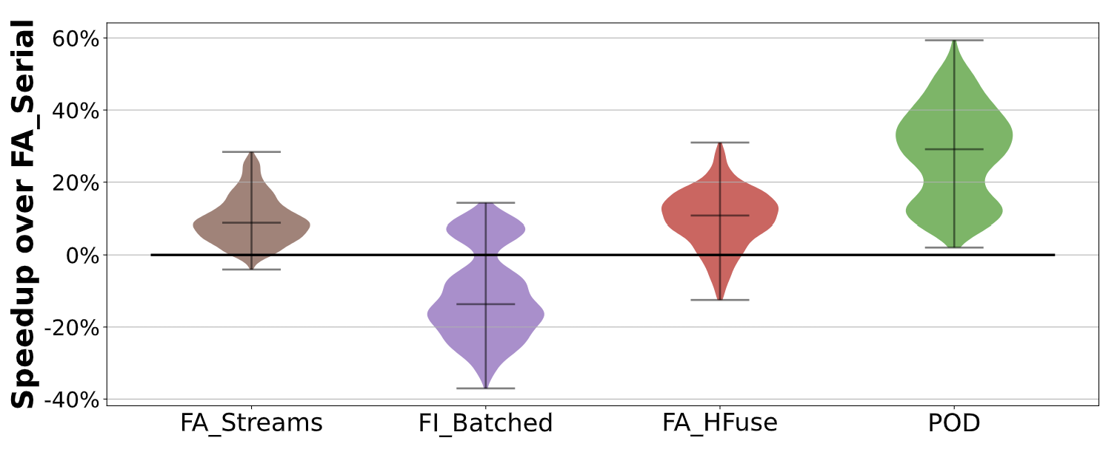
POD-Attention Performance
Streams
Batched
HFuse
POD beats all existing alternatives, with up to 61% speedup (33% average).
Notes:
To investigate POD-Attention’s performance, we ran the attention kernels sweeping over a thousand practical input configurations, varying input sizes and LLM model configurations. We compare against FlashAttention kernels, as well as state-of-the-art FlashInfer kernels. FA_Serial, our baseline, executes the two operations in serial, similar to how existing hybrid-batch frameworks run these kernels. Streams executes prefill and decode in separate CUDA streams, as we previously saw. This provides some limited speedup, as early completion of some prefill operations allows decode to start utilizing the GPU. Batched combines both prefill and decode input and runs a single prefill kernel. This ends up usually performing worse, as kernel execution is optimized for one set of inputs (in this case prefill), and adding other inputs leads to subpar execution choices, like excessively large matrix multiplication tile sizes. Hfuse is a state-of-the-art GPU kernel fusion tool that merges the warps of different kernel’s CTAs. Finally, POD performs 29% - 33% better on average, with a speedup of up to 59%.

Slide 23
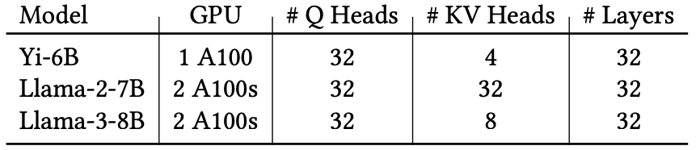
LLM Evaluation: Baselines and Workloads
Inference frameworks
Framework | Description
vLLM [SOSP ‘23] | Popular framework that prioritizes prefill latency (TTFT).
Sarathi [OSDI ‘24] | Uses hybrid-batching to improve decode latency (TBT).
Sarathi + POD | Sarathi enhanced with POD-Attention.
Models and hardware
Notes:
We also evaluate POD-Attention’s benefit on end-to-end LLM execution. We compare against state-of-the-art schedulers vLLM and Sarathi. vLLM uses prefill prioritizing scheduling which stalls ongoing decodes whenever a new prefill request arrives. Sarathi instead uses hybrid batching which combines prefills and decodes into a batch avoiding these stalls. Finally, we look at Sarathi enhanced by POD to overlap the prefill and decode attention. We evaluate on a few different models on A100 GPUs.

Slide 24
Online Inference Performance
Llama 3 8B, arXiv-Summarization, QPS = 0.95
Lower is
better
vLLM provides low TTFT but high TBT, stalling nearly all requests
Sarathi provides low TBT, but high TTFT
Sarathi + POD reduces TBT stalls with TTFT closer to vLLM
Notes:
vLLM prioritizes prefills, providing low TTFT at the expense of high TBT. Sarathi’s hybrid batching suffers from high TTFT latency as prefills and decodes are combined in a batch causing decode’s attention latency to have an impact on TTFT. POD allows both to overlap achieving an acceptable latency in comparison.

Slide 25

Summary
POD-Attention fuses prefill and decode attention to maximize GPU resource utilization
Performance improvement:
Up to 61% faster hybrid attention over current methods
Up to 22% higher end-to-end throughput
Lower latency and stalls that state-of-the-art frameworks vLLM and Sarathi
Available for FlashAttention:
https://github.com/microsoft/vattention/tree/main/pod_attn
As well as FlashInfer:
https://github.com/flashinfer-ai/flashinfer
Notes:
Our code is completely open-source on Github and has been integrated into mainline FlashInfer. Thank you.

Slide 26
Thank you

Slide 27
Backup slides

Slide 28
LLM Scheduling
Prefill-prioritizing scheduling
Prefill
Decode
Decode
Prefill
Decode
Low TTFT
High TBT
Decode-prioritizing scheduling
Decode
Decode
Prefill
Decode
Prefill
Low TBT
High TTFT
Hybrid-batching based scheduling
Prefill
1 / 3
Decode
Prefill
2 / 3
Decode
Prefill
3 / 3
Decode
Prefill
1 / 3
Decode
Prefill
2 / 3
Decode
Hybrid-batching trades off slightly higher TTFT for low TBT
Notes:
To manage this, hybrid-batching scheduling was introduced, which combines prefill and decode from different requests into a single batch. This increases the TTFT slightly, but provides lower and more stable TBT.

Slide 29
Kernel-parallel Execution with Streams
CTA
CTA
CTA
CTA
Prefill
stream
CTA
CTA
Decode
stream
CTA
CTA
CTA
CTA
CTA scheduler
SM
SM
SM
CTA
CTA
CTA
CTA
CTA
CTA
L1 $ / Shared mem
L1 $ / Shared mem
L1 $ / Shared mem
Streams cannot guarantee SM co-location, limiting potential speedup.

Slide 30
Offline Inference Performance
Up to 27% higher throughput than Sarathi and vLLM

Slide 31
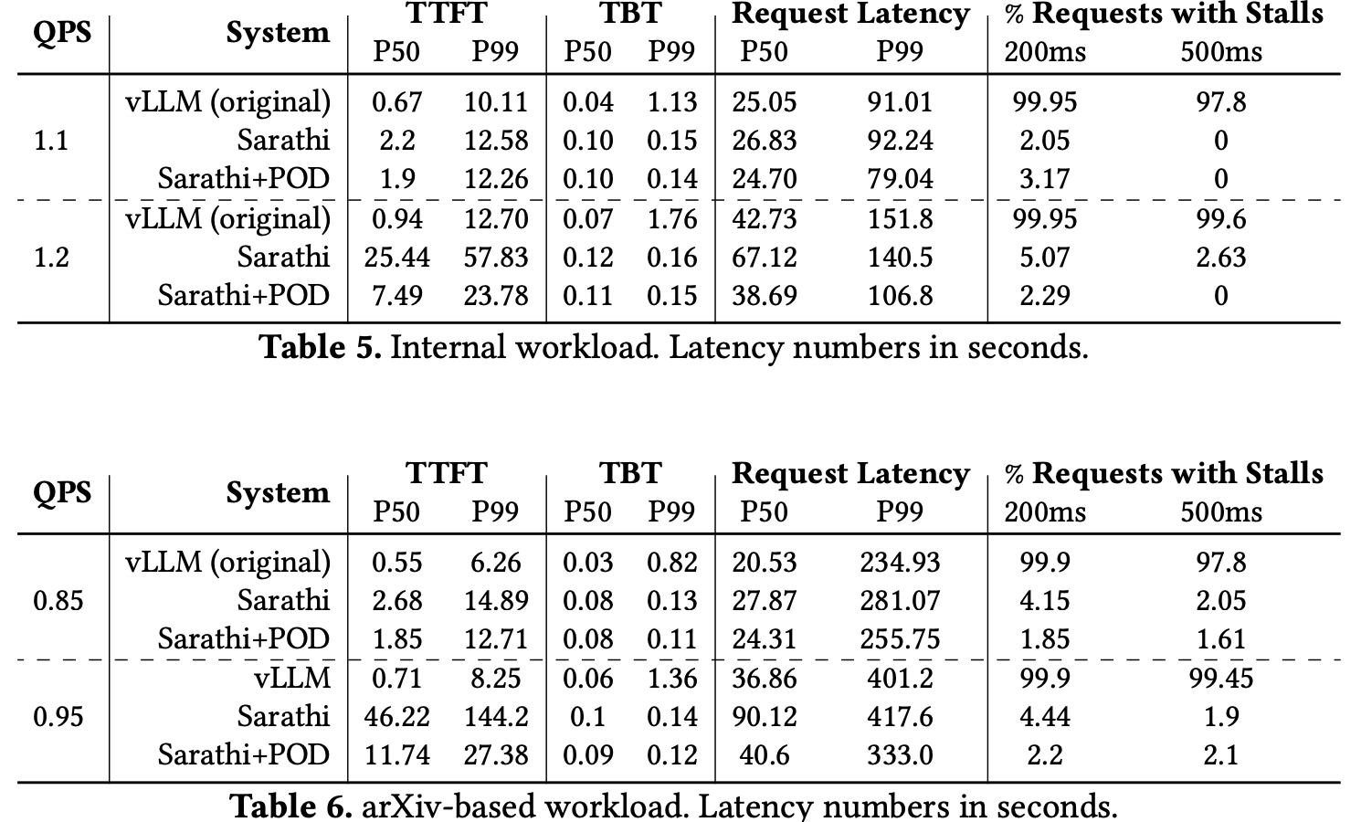
Online Inference Performance

Slide 32
Steps to integrate POD-Attention
Convert prefill/decode kernels into generic device functions.
Remove references to CTA ID within kernel, instead pass as a parameter.
__global__ void flash_fwd_kernel(…params…)
to
__device__ void flash_fwd_func(…params…, int CTA_ID)
Use SM-aware CTA scheduling to pick whether to run prefill or
decode and decide CTA ID to be passed.

Slide 33
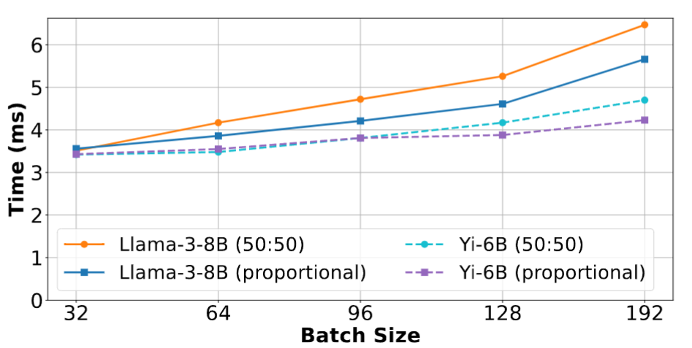
Sensitivity: Scheduling style
8K context length, tp-1

