Slide 1
Scoped Buffered Persistency Model for GPUs
Shweta Pandey*, Aditya K Kamath*, Arkaprava Basu
https://csl.csa.iisc.ac.in/
* Both authors contributed equally

Slide 2
Executive Summary
Many applications can benefit from GPU and persistent memory (PM).
Persistency models are crucial to write a program leveraging PM.
CPU persistency models do not scale well for GPUs.
We design a high-bandwidth, GPU-oriented persistency model.
Notes:
Let me start with a brief summary of our work.
Prior work has shown that many applications can benefit from GPU's parallelism and the durability provided by Persistent Memories.
However, it does not define a persistency model, which is crucial to write correct recoverable programs.
We find that traditional CPU persistency models do not scale well for GPUs.
To address this gap, we propose a persistency model which is optimized for the GPU’s highly parallel architecture.

Slide 3
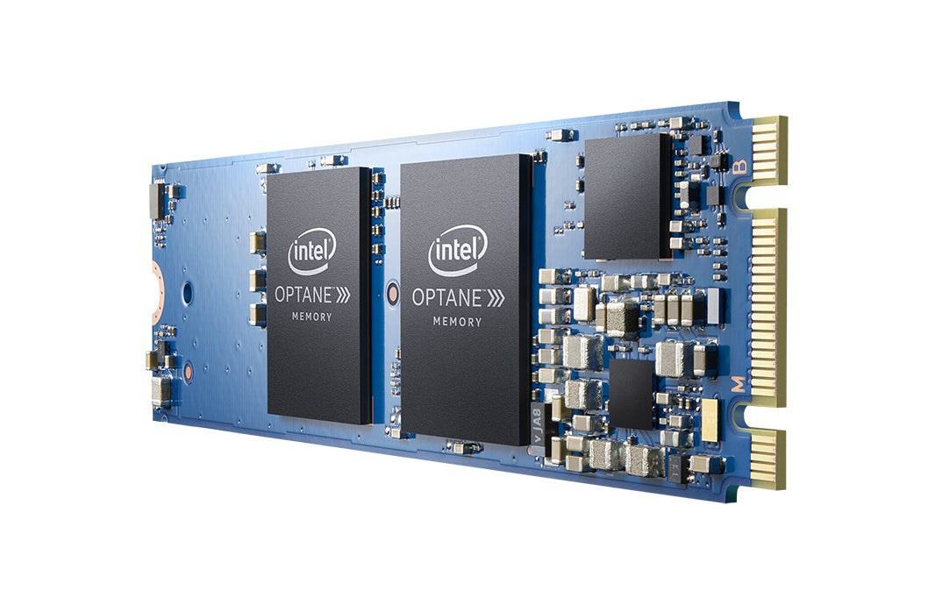
Persistent Memory (PM)
Byte-addressable Fine-grained persistence Near-DRAM performance
Image credits:
[1] https://news.samsung.com/us/samsung-electronics-introduces-industrys-first-512gb-cxl-memory-module/
Notes:
Non-volatile memory technologies such as Intel’s Optane DC memory blur the long-held distinction between memory and storage by allowing for byte-addressable, fine-grain persistence at near-dram performance.
We refer to NVM accessed via loads and stores at byte granularity as Persistent Memory or PM.

Slide 4
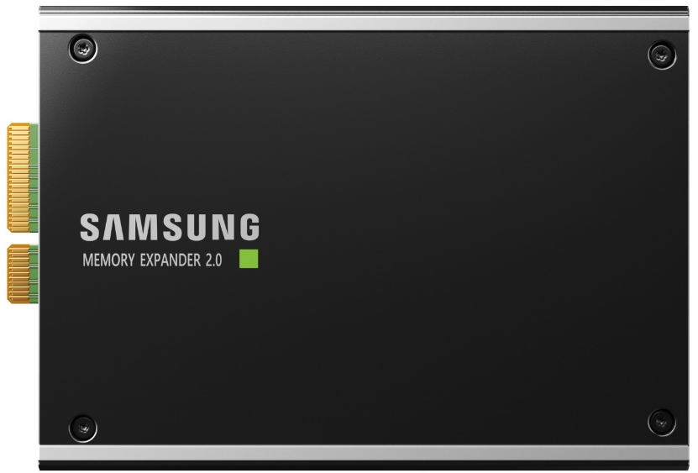

Upcoming forms of Persistent Memory
CXL 2.0 with support for PM
Memory-semantics SSD
Image credits:
[1] https://news.samsung.com/us/samsung-electronics-introduces-industrys-first-512gb-cxl-memory-module/
[2] https://news.samsung.com/us/samsung-electronics-unveils-next-generation-memory-solutions-flash-memory-summit-2022/
Notes:
Although Optane discontinued.
Compute Express Link 2.0 specification incorporated a global persistent flush operation for manipulating PM-resident data structures.
Samsung has also launched memory-semantic SSDs that can effectively act as PM
Hence, while Intel Optane was the first commercially available PM, it is unlikely to be the last.

Slide 5
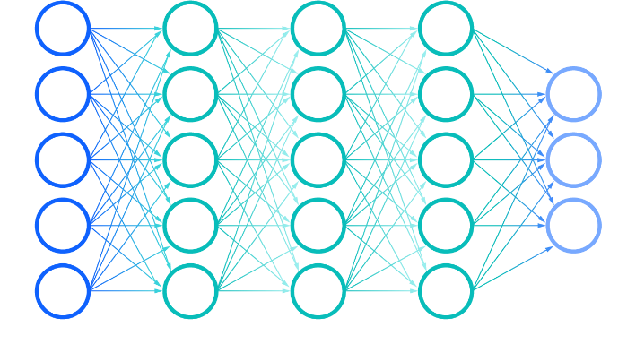
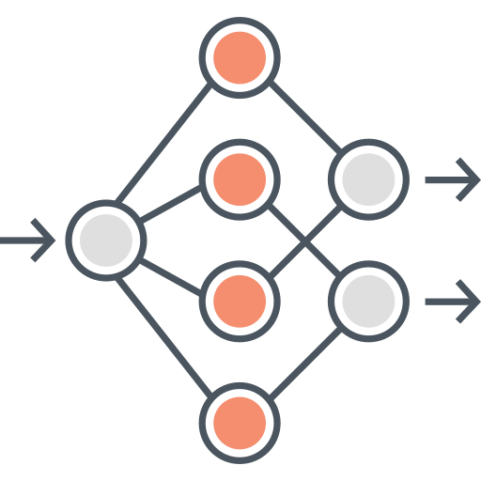
GPUs can accelerate many PM apps.
Checkpoint
GPU-accelerated persistent key-value stores (gpKVS)
Checkpointing of weights during DNN training
Graph analytics on large graphs
[ASPLOS ‘22] GPM: Leveraging Persistent Memory from a GPU
Notes:
In our previous work, GPM, we demonstrated how GPU kernels can directly access PM without requiring any hardware modification. This enables many GPU-accelerated applications to benefit from both the parallelism provided by GPUs and the persistence provided by PMs, including GPU-accelerated persistent key-value stores and faster checkpointing of long-running DNN kernels.

Slide 6
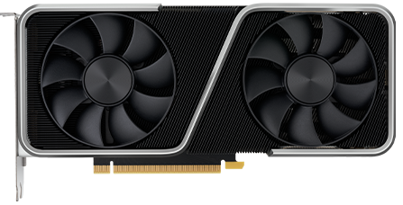
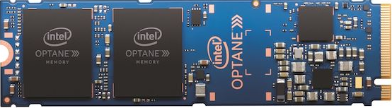
Ordering persists is necessary
SM
SM
SM
SM
Executed order of writes:
W(T₀): pX = a
W(T₁₀₂₄): pY = pX
Order of writes to PM:
W(T₁₀₂₄): pY = pX
W(T₀): pX = a
SM
SM
SM
SM
LLC
Image credits:
[1] https://www.nvidia.com/en-gb/graphics-cards/
[2] https://www.amazon.com/Intel-Optane-Memory-2280/
Notes:
Ensuring recoverability of data structures is a fundamental requirement for any PM program. Writes to PM-resident data structures from different threads can be cached in volatile caches and drained to the PM in arbitrary order.
A crash or a power failure can, thus, leave PM-resident data structures inconsistent.
While GPM demonstrated the benefits of PM for GPU programs, it does not specify a persistency model, making it difficult for programmers to reason about whether a program is correctly recoverable.

Slide 7
GPUs need a persistency model
Persistency models define the order in which writes to PM (persists) become durable, a.k.a. the Persist Memory Order (PMO).
Notes:
Persistency models define the order in which writes to PM (persists) should become persistent (durable). We refer to this order as persist memory order (PMO). A model determines how programmers can express PMOs, both within a thread (intra-thread PMO) and across threads (inter-thread PMO). While there has been a plethora of work on designing persistency models for CPUs, we focus on designing a persistency model for GPUs.

Slide 8
Goals for recoverable GPU programs
1
Formally define a GPU persistency model.
Should conform to the GPU’s current memory architecture.
Should be scalable to thousands of concurrent GPU threads.
Should bridge the gap between GPU’s bandwidth needs and PM.
2
3
4
Notes:
We propose to formally define a GPU persistency model which conforms to the GPU’s memory architecture. It should scale to thousands of concurrent GPU threads while bridging the gap between GPU's bandwidth needs and the lower bandwidth provided by PMs. We find that CPU persistency models are not well suited for these goals. We shall now look at some unique challenges in designing a GPU persistency model.

Slide 9
C1:Communicating PMO is challenging
T₀
T₁₀₂₄
SM
SM
SM
SM
Unit
Unit
Unit
Unit
Unit
Unit
Unit
Unit
SIMD
Core
SIMD
Core
SIMD
Core
SIMD
Core
pX = a
Expected PMO
L1 $
L1 $
L1 $
L1 $
?
pY = pX
NVM
Notes:
Firstly, unlike CPUs, the GPU’s hardware is not responsible for keeping its L1 caches coherent. Hence unlike CPU persistency models, we cannot rely on coherence messages for tracking inter-thread ordering dependencies.

Slide 10
C2:Global PMO in a GPU is expensive
SM
SM
SM
SM
Unit
Unit
Unit
Unit
Unit
Unit
Unit
Unit
SIMD
Core
SIMD
Core
SIMD
Core
SIMD
Core
L1 $
L1 $
L1 $
L1 $
NVM
Notes:
Secondly, CPU persistency models rely on global ordering of persists, which is not well-suited for the GPU’s highly parallel architecture. Furthermore, GPU applications may require PMO both within and across threadblocks. Hence, only globally ordering persists is not just expensive but also unnecessary.

Slide 11
C3:GPU programs need high bandwidth
SM
SM
SM
SM
Unit
Unit
Unit
Unit
Stalled write operations
Unit
Unit
Unit
Unit
SIMD
Core
SIMD
Core
SIMD
Core
SIMD
Core
L1 $
L1 $
L1 $
L1 $
Waiting to be persisted
NVM
Persisting
Buffering of persists is necessary
Notes:
Finally, GPU programs require very high bandwidth and issue persists in bursts. However, as PM offers lower bandwidth than what is demanded by GPUs, buffering of persists is necessary for GPU kernels.

Slide 12
CPU-like buffers do not scale
SM
SM
SM
SM
Unit
Unit
Unit
Unit
Unit
Unit
Unit
Unit
SIMD
Core
SIMD
Core
SIMD
Core
SIMD
Core
L1 $
L1 $
L1 $
L1 $
Global Persist Buffer
NVM
Notes:
While CPU persistency models propose buffers for performance, traditional CPU buffers are not scalable for GPUs. Sharing a single buffer among all processors is not feasible and makes it almost impossible to track ordering across persists.

Slide 13
CPU-like buffers do not scale
SM
SM
SM
SM
Unit
Unit
Unit
Unit
Unit
Unit
Unit
Unit
SIMD
Core
SIMD
Core
SIMD
Core
SIMD
Core
L1 $
L1 $
L1 $
L1 $
Per-thread
persist buffer
NVM
Notes:
Alternatively, a per-thread buffer would incur massive hardware overheads due to the hundreds of thousands of concurrent GPU threads. It would also make the detection and enforcement of inter-thread PMO difficult.

Slide 14
Challenges for GPU persistency models
C1
Describing order among persists is difficult with incoherent caches.
Globally ordering persists is ill-suited for GPU programs.
Naïve extension of CPU persist buffers is not practical for GPUs.
C2
C3
Notes:
To summarize, CPU persistency models are not suitable for GPUs. One, in the absence of coherent L1 caches, GPU models cannot easily communicate inter-thread PMO. Two, global communication of persists is expensive and often unnecessary. Three, naive extensions of CPU persist buffers are impractical for GPUs. Therefore, a formal GPU persistency model that caters to the GPU's unique architecture is essential for high-performance computing

Slide 15

Scoped Buffered Release Persistency
1
Describing order among persists is difficult with incoherent caches.
Global ordering of persists does not scale well for GPU programs.
Naïve implementation of CPU buffers is impractical
2
3
Notes:
To this end, we propose Scoped Buffered Release Persistency or SBRP.

Slide 16
Persist acquire-release
1
pAcq: persist acquire
pRel: persist release
ofence: ordering fence
dfence: durability fence
T₀
T₁₀₂₄
2
pX =a
Synchronized
pRel(var, 1)
3
Inter-thread
PMO
while(!pAcq(&var))
4
pY = pX
Notes:
We provide persist acquire-release operations, which help the programmer to explicitly define the inter-thread PMO as shown. Thus, we do not depend on coherence messages for tracking inter-thread PMO. These instructions are not foreign to GPU programmers. We borrow existing ofence and dfence operations for intra-thread order. ofence provides the basic intra-thread ordering guarantee. Dfence provides a stronger guarantee that all data prior to the operation has been persisted.

Slide 17
Scoped Buffered Release Persistency
1
Describing order among persists is difficult with incoherent caches.
-- Rely on acquire-release operations for ordering persists.
Global ordering of persists does not scale well for GPU programs.
Naïve implementation of CPU buffers is not practical.
2
3
Notes:
Next, to avoid globally ordering persists, we take cue from GPU’s memory consistency model.

Slide 18
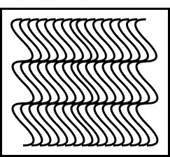
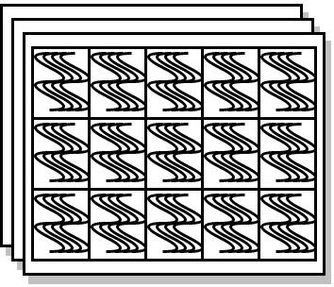
GPU scopes and thread hierarchy
Programming hierarchy
Hardware hierarchy
Thread
SIMD
lane
SM
Unit
Unit
Threadblock
SIMD core
L1$
GPU
Unit
Unit
Grid
SM
LLC
Notes:
A GPU program arranges hundreds of thousands of concurrent threads in a hierarchy. It uses scopes to allow programmers to specify the subset of threads that should participate in synchronization. Describe hardware

Slide 19
Scoped persist ordering
T₀
T₁₀₂₃
pAcq_<scope>: scoped persist acquire
pRel_<scope>: scoped persist release
pX = a
Synchronized
pRel_blk(var, 1)
Ordered
while(!pAcq_blk(&var))
pY = pX
Notes:
We posit that GPU persistency models should similarly, support scopes to specify and enforce inter-thread PMO. In the example shown, threads within a threadblock issue block-scoped acquire-release operations for ordering.

Slide 20
Scoped Buffered Release Persistency
1
Describing order among persists is difficult with incoherent caches.
-- Rely on acquire-release operations for ordering persists.
Global ordering of persists does not scale well for GPU programs.
-- Use scopes to define ordering among a subset of threads.
Naïve implementation of CPU buffers is not practical.
2
3
Notes:
We finally propose novel GPU persist buffers that allow us to bridge the gap between GPU’s bandwidth needs and the bandwidth sported by PMs.

Slide 21

Scalable buffer design
SM
SM
SM
SM
Unit
Unit
Unit
Unit
Unit
Unit
Unit
Unit
SIMD
Core
SIMD
Core
SIMD
Core
SIMD
Core
L1 $
L1 $
L1 $
L1 $
NVM
Notes:
We add a persist buffer per SM. Let us now take a deeper look to see how these unique buffers work.

Slide 22
Scalable buffer design
SM
Warp waiting queue
Type
(3 bits)
L1$ Index
(9 bits)
Warp bitmask
(32 bits)
SIMD Units
L1 $
To NVM
Notes:
The buffers are closely coupled with the L1 cache. Each buffer entry contains three fields. The first is the "type" which indicates whether the buffer entry is for a persist operation, a fence operation, or a scoped acquire/release. The second field, the "L1 cache index," is only used for persist operations and identifies the cacheline containing the data for the entry. The last field, the "warp bitmask," identifies the warp(s) that executed the operation. Further details can be found in our paper.

Slide 23
Enforcing intra-thread PMO
SM
Warp waiting queue
SIMD Units
pX = a
….
dfence()
pY = b
….
….
L1 $
To NVM
Notes:
We employ this buffer in tandem with the GPU's warp scheduler to enforce the programmer's indicated PMO. For example, the dfence operation necessitates that all previous persists be durable before execution can proceed. When a warp persists pX and then another warp persists pY, the warp is descheduled when it reaches the dfence and is not scheduled again until its dfence operation is at the buffer's head.

Slide 24
Enforcing inter-thread PMO
SM
Warp waiting queue
pX = a pRel_blk (&flag, 1)
…..
SIMD Units
while (pAcq_blk (&flag) == 0) {}
pY = pX
L1 $
Evict
To NVM
Notes:
Now, let's examine how inter-thread PMO is enforced. First, a warp persists pX and releases it. Then, another warp acquires and persists pY. Assume that the second warp tries to evict pY before pX is persisted, violating the PMO. The second warp is descheduled until the prior data is persisted, guaranteeing the PMO is ensured.

Slide 25
Flushing persists: eager flushing policy
SM
Warp waiting queue
pX = a ….
pY = b
pZ = c
….
pZ = d
SIMD Units
L1 $
Missed coalescing opportunity
To NVM
Notes:
A key performance consideration while designing the buffers is deciding when to flush dirty PM cache lines. One option is to eagerly flush all persists. While this ensures that the NVM bandwidth is utilised well, it reduces the opportunities to coalesce in the cache. GPUs coalesce writes to the same cache line to reduce the number of write packets drained from caches to memory.

Slide 26
Flushing persists: lazy flushing policy
SM
Warp waiting queue
pX = a ….
pY = b
pZ = c
….
pZ = d
SIMD Units
L1 $
To NVM
Burst of persists
Notes:
On the other hand, lazily flushing persists at an ordering operation leads to poor utilization of NVM bandwidth and leads back to our original problem of bursts of persists to NVM and stalls in GPU.

Slide 27
Optimization: window flushing policy
SM
Warp waiting queue
pX = a ….
pY = b
pZ = c
….
pZ = d
SIMD Units
L1 $
Window
To NVM
Notes:
We propose a window-based policy to get the best of both worlds. Each SM tries to maintain a fixed number of outstanding persists, creating a stream of persists and avoiding bursts, while allowing for coalescing opportunities.

Slide 28
SBRP: Meeting GPU persistency goals
1
We formally define a GPU persistency model: SBRP.
Conforms to the GPU architecture by using acquire-release semantics.
Relies on scopes to scale well across GPU’s parallel architecture.
Employs uniquely designed buffers to improve performance.
2
3
4
Notes:
To summarize, we present SBRP, which utilizes scoped-acquire-release operations to dictate PMO between threads, allowing it to scale effectively across hundreds of thousands of concurrent GPU threads while adhering to the GPU's existing memory architecture. Finally, we propose a novel persist buffer design for GPUs that efficiently implements all types of PMO.

Slide 29
Simulated hardware configuration
SMs | 30
PCIe BW | 28 GBPS
NVM BW | 84 GBPS read, 42 GBPS write
GDDR BW | 336 GBPS
NVM latency | 300 ns
PCIe latency | 300 ns
GDDR latency | 100 ns
Notes:
Let’s now look at the stimulated platform and the results we obtained. We evaluated SBRP by extending GPGPU-Sim 4.0. The following table lists the simulated configuration.

Slide 30
Benchmarks investigated
Applications | Description | Type of PMO
gpKVS | GPU-accelerated persistent key value store | Intrathread
Hashmap (HM) | GPU-accelerated persistent hashmap | Intrathread
SRAD | Image processing on persistent images | Intrathread
Reduction (Red) | Computing sum of a elements of a large array | Blk/dev-interthread
Multiqueue | Inserting and deleting in persistent queues | Intra/blk-interthread
Scan | Computing scan of a large persistent array | Blk-interthread
Notes:
We evaluate the six applications shown in the table. Each application places its key data structures in the PM for recoverability. These applications have different types of PMO – intra-thread, intra-, and inter-threadblock.

Slide 31
Persistency model of GPM
Global ordering of persists
Scope-agnostic
Does not employ a buffer for persists
Analogous to CPU’s epoch persistency model
Notes:
We compare SBRP against GPM. GPM allows GPU kernels to access PMs directly. A system-scoped thread fence is used to dictate ordering boundaries. We find that, GPM follows a scope-agnostic, unbuffered persistency model. The model is similar to CPU’s epoch persistency model as it employs system scope fences that act as an epoch barrier, and globally orders all persists.

Slide 32
Performance: GPM vs SBRP
Notes:
SBRP not only defines a persistency model that helps programmers in reasoning about the intra- and inter-thread PMO, but also improves performance. On average, SBRP improves by 2.7x over GPM. Reduction greatly benefits from SBRP because the persists can remain in the L1 cache without being flushed to the PM in intra-threadblock PMO. It speeds up by 3.5x over GPM.
In our paper we provide a more detailed evaluation with other persistency models.

Slide 33



Summary
GPUs need a persistency model.
CPU persistency models are not sufficient to support GPUs’ requirements.
Our contributions:
We formally define a GPU persistency model: SBRP.
SBRP relies on acquire-release semantics for indicating inter-thread PMO.
SBRP leverages scopes to allow order amongst a subset of threads.
We design a highly-optimized GPU persist buffer.
Reproducible artifact: https://github.com/csl-iisc/SBRP-ASPLOS23
Notes:
To summarize, we propose scoped buffered persistency model that supports scoped acquire-release operations for dictating PMO and supports buffers designed specifically for GPUs. Our artifact is open source and has received all the badges. Thank you!

