Slide 1
ScoRD: A Scoped Race
Detector for GPUs
Aditya K. Kamath, Alvin A. George, Arkaprava Basu
Notes:
Greet everyone. Introduce self. Introduce title.

Slide 2
Executive summary
Scoped synchronization is unique to GPUs
Enables synchronization within a subset of GPU threads (scope)
Scoped synchronization speeds up apps. when used appropriately
Can introduce new class of bugs
Scoped races → Insufficient scope for observing threads
Our proposal: Hardware-based Scoped Race Detector (ScoRD)
Extends happens-before and lockset for scopes
Utilizes metadata caching
Low perf. overhead race reporting for debugging and testing (~35%)
<3KB hardware state and 12.5% memory overhead for metadata
New benchmark suite (ScoR)!
Configurable to introduce scoped races
7 applications
32 microbenchmarks
Notes:
Let me start with a brief summary of what I’ll be covering. We’ll be covering scoped synchronization, and how it can be beneficial to improving performance. We’ll then see how bugs can arise because of misuse. To help mitigate some of these problems, we propose a hardware-based scoped race detector, we call scord, which uses happens-before and lockset detection to detect scoped races. We also introduce a new benchmark suite called scor which consists of 7 applications and 32 microbenchmarks. To make discussions more concrete, I’ll be borrowing terminology from NVIDIA’s CUDA, a GPU programming language.

Slide 3
Outline
Background and scoped races
ScoRD: Hardware-based scoped race detection
ScoR: Benchmark suite with scoped synchronization
Evaluation and results
Notes:
To begin with, I’ll be discussing the background of scopes and scoped races. We’ll then take a look at ScoRD and the hardware that makes it possible.
We’ll then delve into ScoR, the benchmark suite that we created.
Finally, we’ll conclude with evaluation and results.

Slide 4
Typical races in multithreaded programs
Write-write race
Read-write race
Thread A
Var = 5
Thread B
Var = 7
Thread A
Var = 5
Thread B
Foo = Var
Foo = ?
Conflicting access
Conflicting access
Write 5
Write 7
Write 5
Read Var
Var = 0
Var = 0
Var = ?
Var = 5
Notes:
[Most of us are familiar with multithreaded CPU programs. So we’ll start with a quick recap of that.]
[AB: We start with a short recap of what is a race in a multithread application]
There are two types of races that can arise in multithreaded applications. The first is when two threads concurrently write to a common memory location. As we can see, this leaves the memory location in an undefined state. The second case is when one thread is writing to a location, while another thread reads, leaving the reading thread in an undefined state. Both of these cases show what is known as a conflicting access, where two threads concurrently access a location with one of the accesses being a write.

Slide 5
Common synchronization operations
Fence
Barrier
Thread 1
A = 5
…
Thread 2
…
B = A
A = 5
B = 4
…
Race
FENCE
BARRIER
BARRIER
…
…
Atomic
Lock
Thread 1
Lock(X)
A = 5
Unlock(X)
Thread 2
Lock(X)
A = 7
Unlock(X)
Thread 1
atomicAdd(A, 5)
Thread 2
atomicAdd(A, 5)
Notes:
To avoid such situations from arising, most multithreaded languages provide a set of synchronization operations. For example, in default execution, memory accesses by a thread can appear in a different order when viewed by other threads. By adding a fence in between such accesses, we can prevent this reordering. To avoid a data race between two threads, we can place barriers between the two accesses forcing the threads to synchronize at the barrier before continuing execution, avoiding a race. [AB: Mention that
Similarly atomic and lock operations ensure that threads involved execute their internal operations sequentially, preventing concurrent accesses.

Slide 6
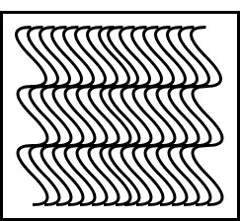
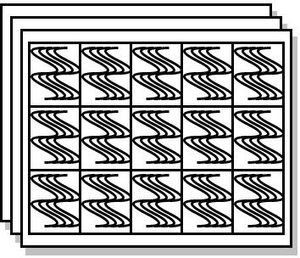
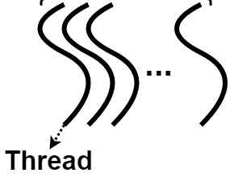
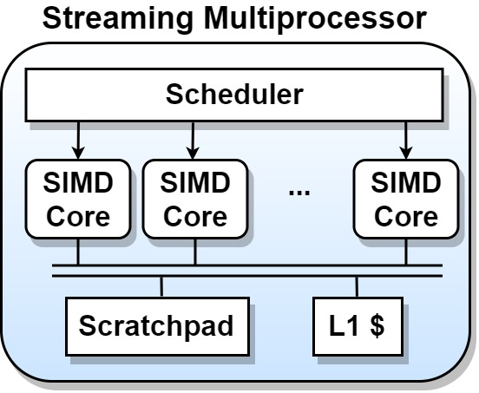
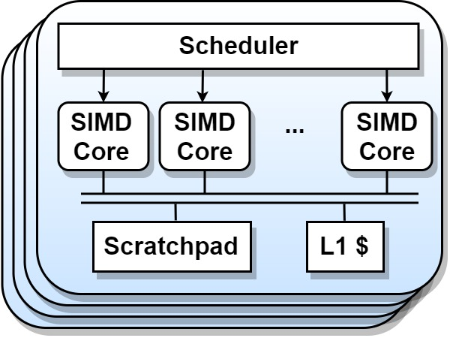
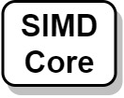
Scaling synchronizations in GPUs
Warp
32 threads
Thread block
~1000 threads
Grid
~100000 threads
Problem
Global synchronization is expensive,
and often unnecessary
Solution
Synchronize within a subset of threads
(a.k.a. a scope)
No scope
Block scope
Device scope
Notes:
GPUs designed for massive parallelism, with 100000s threads being executed, to make this massive scale tractable, they are arranged in a hierarchical fashion. Typically 32 threads are arranged. Block scope vs device scope timings. This gives you an idea of overhead you can save.
[AB: Tell why arranged in a hierarchy….. Thousands of threads, intractable otherwise]
[AB: Do not be so specific about 32. Say, in NVIDIA hardware, typically 32 threads….]
[AB: Can we quote some numbers like synchronizing across entire grid can take XX nanoseconds while that across a threadblock takes only YY nanoseconds….]
[Explain much more about the GPU architecture]
So many threads communicating across L2 would be expensive. To provide high-performance synchronization, you can instead synchronize within a subset of threads.]
In GPUs, both the hardware and software follow a hierarchical model. More recent GPUs may slightly differ, but this model still largely holds.
The smallest group of threads is known as a warp containing 32 threads, that execute in lockstep in a single SIMD Core.
A threadblock consists of many of these warps, which execute on a single streaming multiprocessor, or SM. Each of these SMs contain a scratchpad and L1 cache shared by the threads executing within the SM.
Even larger than this is the grid, which has around 100 thousand threads executing across the entire GPU.
As we can see, global synchronization across a grid can be expensive, and in many cases not needed.
To solve this, GPU languages provide what are known as scopes, which allow synchronization within a subset of threads.

Slide 7
Scoped synchronization operations in CUDA
Fence
Atomic
__threadfence_block()
__threadfence() [default, device scope]
__threadfence_system()
atomicX_block()
atomicX() [default, device scope]
atomicX_system()
Lock
Unlock
atomicCAS_block(X, 0, 1) + __threadfence_block()
atomicCAS(X, 0, 1) + __threadfence() [default, device scope]
atomicCAS_system(X, 0, 1) + __threadfence_system()
__threadfence_block() + atomicExch_block(X, 0)
__threadfence() + atomicExch(X, 0) [default, device scope]
__threadfence_system() + atomicExch_system(X, 0)
Notes:
[AB: Talk about one example, say __threadfence which is the fence in CUDA can be extended with scope qualifier. Say default is device scope]
[AB: Lock takes the scope of the narrowest constituent]
Based on these scopes, CUDA provides two variants of synchronization operations, the fence and atomic.
The barriers that we discussed earlier, called syncthreads, do not have a scopes in CUDA.
Fences and atomics can be combined to create lock and unlock operations.
The lock consists of an atomic compare-and-swap followed by a threadfence, while the unlock consists of a fence followed by an atomic exchange. The scope of such operations is the smallest scope of the constituent fence and lock operations.

Slide 8
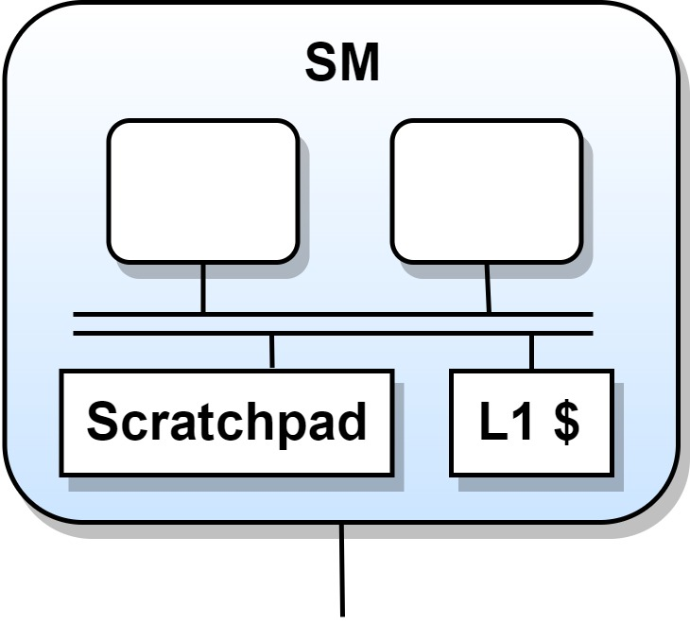
Pros and cons of scoped synch.
Scopes are useful to improve performance
Device Scope
Block Scope
Notes:
Now let us see how scoped synchronization can help improve performance when used appropriately.
Let us take two threads belonging to the same threadblock. Since they are in the same threadblock they would execute on the same SM.
The producer thread creates a data item, then synchronizes using device scope.
The consumer thread then synchronizes using device scope as well, then accesses the data item.
As the two threads are on the same SM, this is unnecessary.
Instead they can synchronize using block scope using the intermediate L1 cache, reducing the performance overhead.

Slide 9
Pros and cons of scoped synch.
Scopes are useful to improve performance, but can create scoped races
Scopes are useful to improve performance
SCOPED RACE!
Device Scope
Block Scope
Notes:
Now assume the two threads are executing in different thread blocks, meaning they may be scheduled in different SMs.
The producer threads creates a data item, then synchronizes using block scope.
Following this, the consumer synchronizes using device scope.
As they do not reside in the SM, the scope of the synchronization of the producer is insufficient, causing a scoped race.
In short, a scoped race occurs when intending communicating threads do not synchronize using scopes that include both.

Slide 10
Example of a scoped race in practice
Graph coloring on GPU with work-stealing
SCOPED RACE!
Operating
threadblocks
currHead[blockId] =
atomicAdd(
&nextHead[otherBlock],
NTHREADS);
currHead[blockId] =
atomicAdd_block(
&nextHead[blockId],
NTHREADS);
Block
scope
Steal work
Device scope
Block
scope
V
currHead[blockId] =
atomicAdd_block(
&nextHead[otherBlock],
NTHREADS);
V
V
Work
queues
V
V
V
V
V
V
Notes:
Now let us see how subtle races can arise when
Take the case of graph coloring, where a program tries to assign colors to the vertices of a graph, such that two neighbors do not end up with the same color.
The program divides the vertices among executing threads blocks, giving each their own unique work queue filled with vertices. In such a case, the thread blocks may remove items from the queue using block scope.
One thread block may exhaust its work queue, while other threadblocks still have work remaining. A common method of load balancing in such cases is to allow the thread block to steal work from other threads. Since this thread block is stealing from a different block’s queue, it uses device scope. However, this still leads to a scoped race, as the owner of the queue was using block scope operations, which are not guaranteed to be visible to the stealing thread block.
In this way, scoped races may subtly arise.

Slide 11
Example of a scoped race in practice
SCOPED RACE!
Operating
threadblocks
currHead[blockId] =
atomicAdd(
&nextHead[otherBlock],
NTHREADS);
currHead[blockId] =
atomicAdd_block(
&nextHead[blockId],
NTHREADS);
Block
scope
Steal work
Device scope
Work
queues
currHead[blockId] =
atomicAdd_block(
&nextHead[otherBlock],
NTHREADS);
V
V
Notes:
Now let us see how subtle races can arise when
Take the case of graph coloring, where a program tries to assign colors to the vertices of a graph, such that two neighbors do not end up with the same color.
The program divides the vertices among executing threads blocks, giving each their own unique work queue filled with vertices. In such a case, the thread blocks may remove items from the queue using block scope.
One thread block may exhaust its work queue, while other threadblocks still have work remaining. A common method of load balancing in such cases is to allow the thread block to steal work from other threads. Since this thread block is stealing from a different block’s queue, it uses device scope. However, this still leads to a scoped race, as the owner of the queue was using block scope operations, which are not guaranteed to be visible to the stealing thread block.
In this way, scoped races may subtly arise.

Slide 12
Flavors of scoped races
Scoped fence
Scoped atomic
// Update global array with final sum
if (tid == 0)
g_odata[blockIdx.x] = sdata[0]; __threadfence_block();
// Update global shared location
currHead[blockId] = atomicAdd_block(
&nextHead[blockId], NTHREADS);
Goal: Design low-overhead scoped race detector
Scoped lock
Scoped unlock
// Acquire global lock
while(0 != atomicCAS_block(
&globalStack[id].lock, 0, 1));
__threadfence_block();
// Release global lock
__threadfence_block();
atomicExch_block(
&globalStack[id].lock, 0);
Notes:
There are many flavors of scoped races, each one related to each of the scoped synchronization operations.
The goal of our work is to detect such scoped races at a low overhead.
Based on the available scoped synchronization operations, four types of scoped races can occur: a scoped fence race, a scoped atomic race, a race due to scoped locks, and a race due to scoped unlocks.
Our goal is to design a low-overhead detector for these scoped races.

Slide 13
Outline
Background and Scoped races
ScoRD: Hardware-based Scoped Race detection
ScoR: Benchmark suite with scoped synchronization
Evaluation and results
Notes:
This brings us to how our race detection actually works.
We’ll now be covering ScoRD, a hardware-based scoped race detector

Slide 14
ScoRD’s design philosophy
Perform quick preliminary checks to rule out definite non-races
Avoid full detection for every memory instruction
Extend happens-before detection to detect races with scoped fences and atomics
Extend lockset detection to check for races with scoped lock/unlock
Notes:
At a high level, since we wish to limit the overheads, we perform quick checks in the non-racey common case.
By extending happens-before detection with the notion of scopes, we use it to detect races in fences and atomics.
Similarly, we extend lockset detection for…
We extend happens-before detection for detecting scoped fence/atomic races by introducing the notion of, and extend lockset to detect races involving lock and unlock operations.

Slide 15
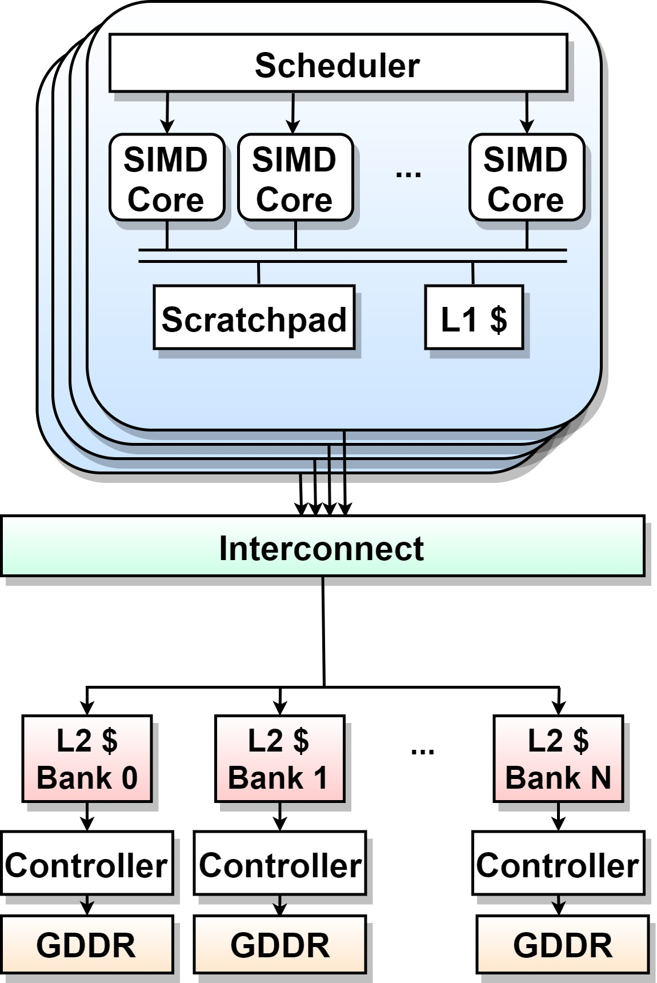
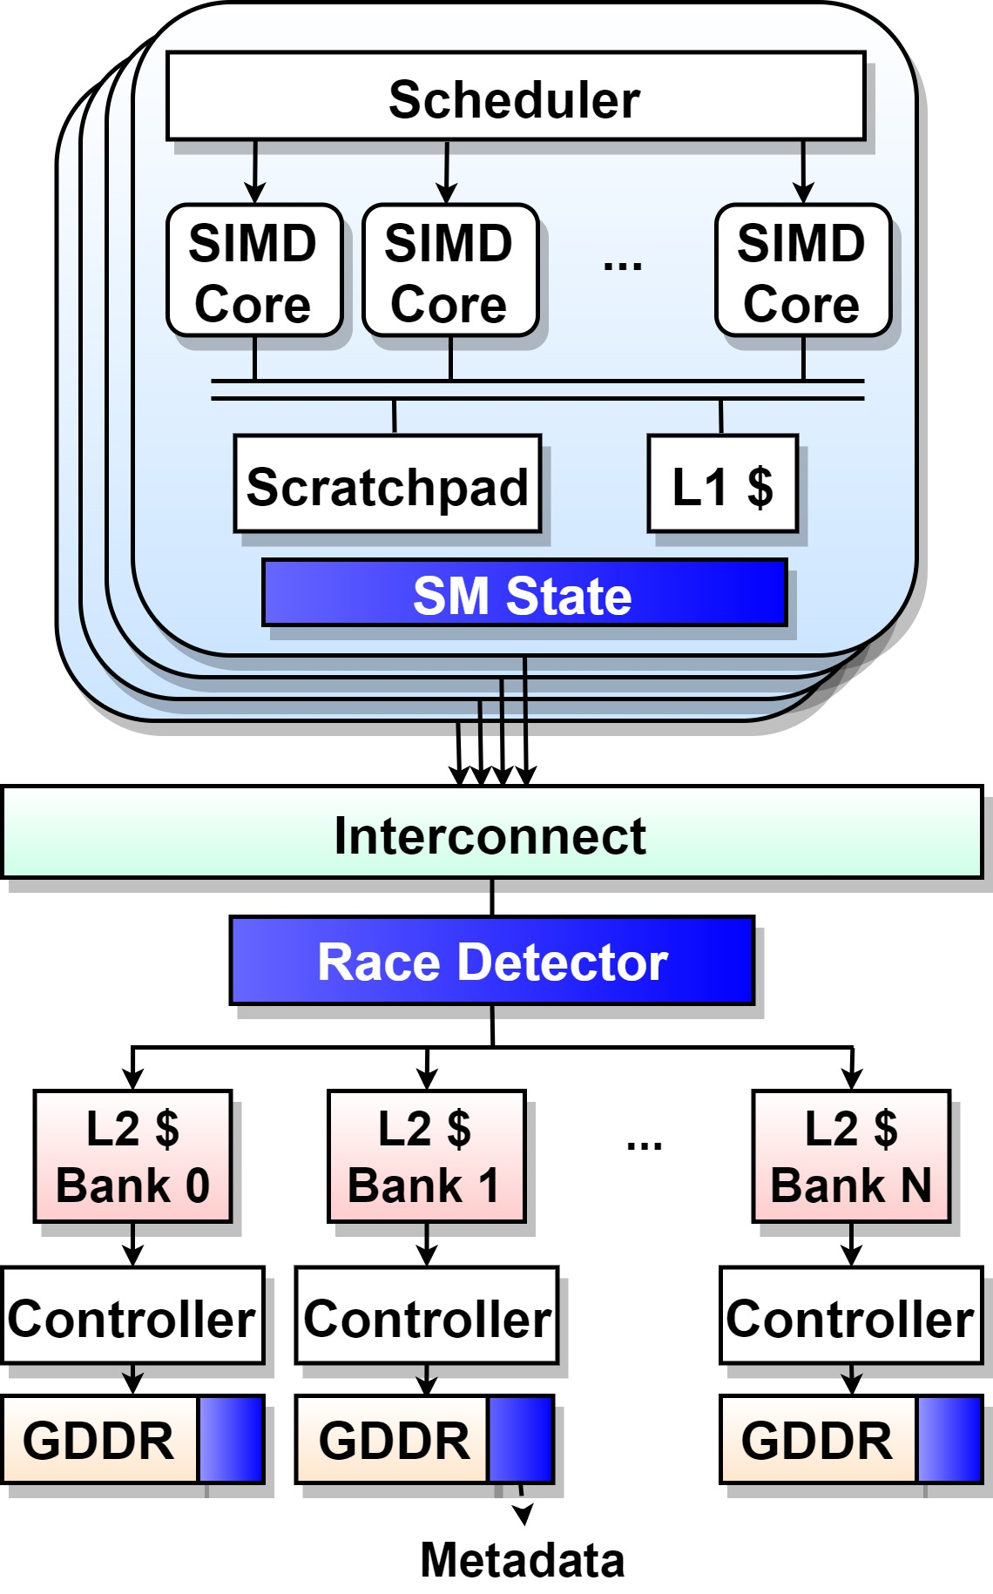
Architecture of ScoRD
Notes:
As we can see, our architecture adds three main components over a GPU’s base design.
Two of these are hardware components, the SM State and Race detector.
The SM state keeps track of locks and barriers.
The Race detector…
We also have some in-memory metadata, which is not part of the hardware state, but is allocated during race debugging.
Namely the SM State, the Race Detector, and metadata.
We’ll now see what each of these components contribute.

Slide 16
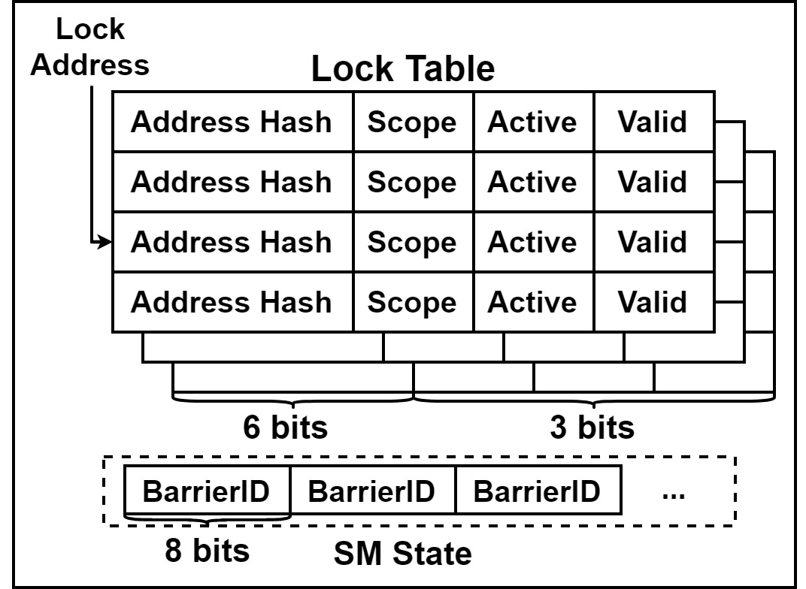
BarrierID: Maintains counter
of last barrier execution
Lock table:
Keeps track of active locks
SM State
Overhead: 144 bytes / SM
Overhead: 8 bytes / SM
Total overhead: 152 bytes / SM
Notes:
The SM state contains a barrier ID, which is a counter that keeps track of barriers executing, at an overhead of 8 bytes per SM.
Recall that locks are created by a combination of a atomic and fence. To do this, we use a 4-entry lock table to infer which locks are being held. For more details refer to the paper.
In addition, we have a lock table, which is responsible for inferring and tracking active locks held by a warp. This table incurs an overhead of 144 bytes per SM. For a total overhead of 152 bytes per SM.

Slide 17
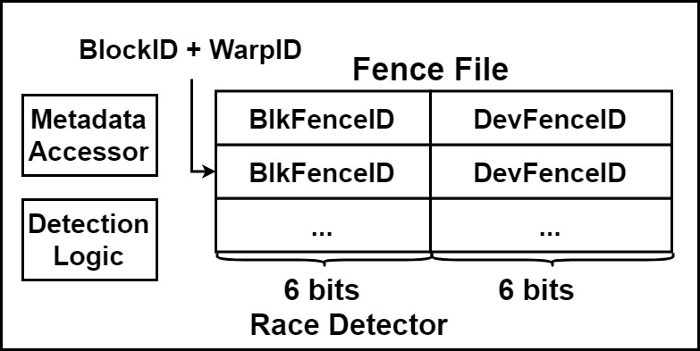
Fence file: Maintains counters
for last fence executed
Responsible for accessing GDDR and obtaining relevant metadata
Race Detector
Performs the race detection checks once metadata has been obtained
Overhead: 48 bytes / SM
Notes:
The race detector is kept across the interconnect, intercepting every global memory access that arises.
It houses the two major logic components. The metadata accessor is responsible for looking up relevant metadata associated with each memory access, while the detection logic performs the actual detection checks.
In addition to these, the race detector contains a fence file, which contains counters updated every time a thread executes a fence operation, at an overhead of 48 bytes per SM.

Slide 18
In-memory metadata
Metadata entry uses 8 bytes for every 4 bytes of global memory
200% memory overhead
We’ll later see how this can be reduced
Notes:
To store the details of every memory access, we partition the GDDR to maintain metadata entries for every data item at a 4 byte granularity. This metadata keeps track of various details of the latest memory access and are updated every access. We can see that the metadata takes up 8 bytes of memory, leading to a 200% memory overhead. We’ll see in a short while how this can be reduced.

Slide 19
Race detection in operation
Notes:
Now that we understand the three important design components, we’ll now see how these are used to do that actual race detection.

Slide 20
Preliminary race check
Observation: Majority of accesses do not participate in races
Quickly identify them with early checks
First access
Program order
Barrier
Thread A
A = 5
…
B = A
Thread A
A = 5
Barrier
…
Thread B
…
Barrier
B = A
A = 5
…
Notes:
We find that the majority of accesses are non-racey, and so, to eliminate them early, we start off with a preliminary race check.
The first check we do, is to check whether the access is the first one to that data item, by seeing if the metadata indicates no previous accesses.
The second check is whether any other thread has accessed the data being accessed. If not, we know that no race has occurred.
The final check is whether the access is coming after a barrier operation, in which case the barrier prevents a race from occurring.

Slide 21
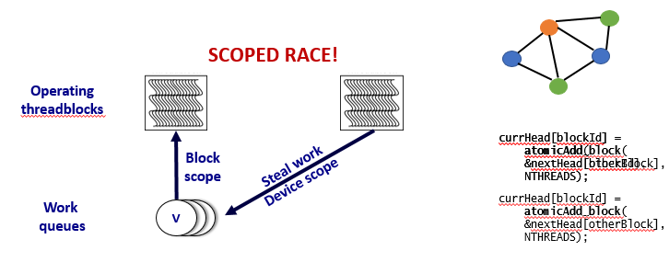
Detailed race check
If preliminary checks fail, perform in-depth checks for races
Modified | BlkShared | DevShared | Scope = Block | IsAtom = True | Strong
[63 – 58] Unused | [57 – 54] Tag | [53 – 47] BlockID = 0 | [46 - 42] WarpID | [41 – 36] DevFenceID | [35 – 30] BlkFenceID | [29 – 22] BarrierID | [21 – 16] Flags | [15 – 0] Lock Bloom Filter
Current access info: BlockID = 1, IsAtom = True, Scope = Device
Notes:
In case none of these checks pass, we proceed to more detailed checks.
We cannot delve into more details…
[Add more details to insufficient scoped atomic]
For example, if the previous access was an atomic, we check the scope of the operation, and whether the current access if coming from the same threadblock. Based on these, we can determine if a race due to insufficiently scoped atomic has arisen. Similar checks are done for fences and locking, where happens-before is used for fences and atomics, and lockset is used for locking.

Slide 22
Detailed race check
If preliminary checks fail, perform in-depth checks for races
Happens-before
Lockset
Insufficiently
scoped fence
Insufficiently
scoped atomic
Insufficiently
scoped locking
Check scope of previous atomic
Compare block IDs of accesses
Compare locksets
Ensure overlapping locks
Compare appropriate fence IDs
Notes:
In case none of these checks pass, we proceed to more detailed checks.
We cannot delve into more details…
[Add more details to insufficient scoped atomic]
For example, if the previous access was an atomic, we check the scope of the operation, and whether the current access if coming from the same threadblock. Based on these, we can determine if a race due to insufficiently scoped atomic has arisen. Similar checks are done for fences and locking, where happens-before is used for fences and atomics, and lockset is used for locking.

Slide 23
Optimization to reduce metadata overheads
Initial design requires 200% metadata overhead
Observations:
Majority of allocated data does not participate in races
Typically recently accessed/modified data create races
Optimization: A software-based direct-mapped cache of metadata
Reduce overheads to 12.5%
All metadata is not equally necessary
User data
User data
Metadata
Metadata
Unnecessary metadata
Notes:
As we previously saw, our base design requires 200% metadata, which isn’t always tractable.
We make a few interesting observations that allow us to reduce it without … that the majority of data are not involved in races, and as races require concurrent accesses, these end up happening close together in time.
Taking advantage of these operations, instead of maintaining metadata for every data item, we store the metadata in the form of a software-based cache.
We observed that a 12.5% metadata overhead gave a good balance between accuracy and performance.

Slide 24
ScoRD: In a nutshell
Memory access intercepted
Fetch metadata
Declare access race-free
Any check
passes
Perform preliminary checks
Write back metadata to memory
All checks fail
Perform in-depth race checks
All checks
pass
User
Any check fails
Declare race
Memory address
Instruction pointer
Race type
Source code available at: https://www.github.com/csl-iisc/ScoRD
Notes:
There are many moving pieces in this design, so to put this all together…
To summarize what we’ve discussed. We start our detection every time a memory access is intercepted, after which we fetch the appropriate metadata from memory.
Once we have this, we preform preliminary checks. If any of these pass, we write the updated metadata to memory, and declare that the access is race-free. If they fail, we must perform much more in-depth race checks, in which case a failure indicates a race is present.
In such a case, we send the user the memory address, instruction pointer, and race type to aid in debugging.

Slide 25
Outline
Background and Scoped races
ScoRD: Hardware-based Scoped Race detection
ScoR: Benchmark suite with scoped synchronization
Evaluation and results

Slide 26
Challenge: Few applications w/ scopes
Scoped synchronization not yet commonplace
Lack of applications to be tested for scoped races
Our contribution: An open-sourced benchmark suite
7 applications
32 microbenchmarks
Can be configured to introduce scoped races
Available at: https://www.github.com/csl-iisc/ScoR/
Notes:
One of the key challenges, is while the support for scoped synchronization is increasing with every generation of GPUs, it’s still not widespread in GPU programs.
To solve this issue, we introduce an open-sourced benchmark suite consisting of 7 applications and 32 microbenchmarks which use scopes and can exhibit scoped races.

Slide 27
ScoR benchmark suite
Applications
Microbenchmarks
Code | Benchmark | No. of races present
MM | Matrix multiplication | 4
RED | Reduction | 2
R110 | Rule 110 cellular automata | 2
GCOL | Graph coloring | 6
GCON | Graph connectivity | 5
1DC | One-dimensional convolution | 1
UTS | Unbalanced tree search | 6
 | Total | 26
Synchronization type | Racey tests | Non-racey tests
Fence | 2 | 4
Atomics | 4 | 5
Lock/unlock | 12 | 5
Total | 18 | 14
Notes:
These cover a wide variety of applications, like irregular graph algorithms, well-coalesced …
As we can see, these consist of a wide variety of GPU applications, as well as three different groups of microbenchmarks, each targeting different types of scoped races.

Slide 28
Outline
Background and Scoped races
ScoRD: Hardware-based Scoped Race detection
ScoR: Benchmark suite with scoped synchronization
Evaluation and results
Notes:
Now the important part is …

Slide 29
Methodology
Uses GPGPU-Sim for simulation
Code is compiled using CUDA 8.0 and PTX 5.0
Number of SMs | 15 | Threads per warp | 32
Max. threads per block | 1024 | Max. warps per SM | 32
Threadblocks per SM | 8 | Memory channels | 12
Private L1 cache | 16 KB, 4-way, 128B blocks, global write-evict, local write-back | Shared L2 cache | 1.5 MB, 8-way, 128B blocks, write-back
Notes:
Before to get into this, we need a brief discussion about the methodology…
To simulate the hardware required, we used GPGPU-Sim, enhanced with scoped synchronization operations. We used CUDA 8, and PTX 5 for coding the applications. The table displays the parameters of our simulation.

Slide 30
Scoped race detection accuracy
Chances of…
False positives:
Only if IDs complete exactly one cycle between metadata accesses
Highly unlikely
Non-existent in our experiment
False negatives:
Possible if lock addresses get aliased in the lock tables
Also rarely possible when optimization of metadata caching causes aliasing
Workload | Races present | Races caught
MM | 4 | 4
RED | 2 | 2
R110 | 2 | 1
GCOL | 6 | 6
GCON | 5 | 5
1DC | 1 | 1
UTS | 6 | 6
Microbenchmarks | 18 | 18
Total | 44 | 43
In our experiments, zero false positives, one false negative
Notes:
[Change workload name]
As we can see, out of 44 possible races, our detector was able to catch 43 of them.
While we did not find any cases of false positives during our evaluation. False positives can arise when the hardware counters complete exactly once cycle between accesses. For example, we use a 6-bit counter for tracking fences. This means 64 fence executions must which is an unlikely scenarios. False negatives arise due to aliasing, either when caching metdata, or when keeping track of active locks. During our experiments, we found no false positives, and only one false negative. This false negative was caused by the caching of metadata, which can be tuned. In the case when the metadata was not cached, we found no false positives.

Slide 31
Performance
Worst:
88%
Average:
35%
Code | MM | RED | R110 | GCOL | GCON | 1DC | UTS
Benchmark | Matrix multiplication | Reduction | Rule 110 automata | Graph colouring | Graph connectivity | One-dimensional convolution | Unbalanced Tree search
Notes:
In the worst case, ScoRD had an overhead of 88% (why?). In comparison graph colouring had … while on average it took 35%.

Slide 32
Conclusions
Scoped synchronization in GPU important for performance
But, introduces possibility of a new type of bug – Scoped races
ScoRD is a hardware enhancement to detect scoped races
Incurs low performance overhead (~35%)
Adds limited hardware state (~2.9 KB)
Reasonable memory overhead for metadata (~12.5%)
Open-source ScoR benchmark suite for evaluating ScoRD
Notes:
To conclude, scoped synchronization is an important development in GPU program design, but can lead to scoped races.
We propose ScoRD as a solution to detect these races when they arise,
With only around 35% performance overhead, 720 bytes… low overheads.
In the process of this work we create
ScoR provides open-source applications to further spur research in this domain.

