Slide 1
GPM: Leveraging Persistent Memory from a GPU
Shweta Pandey*, Aditya K Kamath*, Arkaprava Basu
https://csl.csa.iisc.ac.in/
* Both authors contributed equally
Notes:
Csl website link
Github link where?

Slide 2
Executive summary
Today, benefits of persistent memory (PM) limited only to CPU apps
We enable GPUs to harness PM without new hardware
We demonstrate three classes of GPU apps. that benefit from PM
We create a GPU runtime for easily writing recoverable GPU kernels

Slide 3
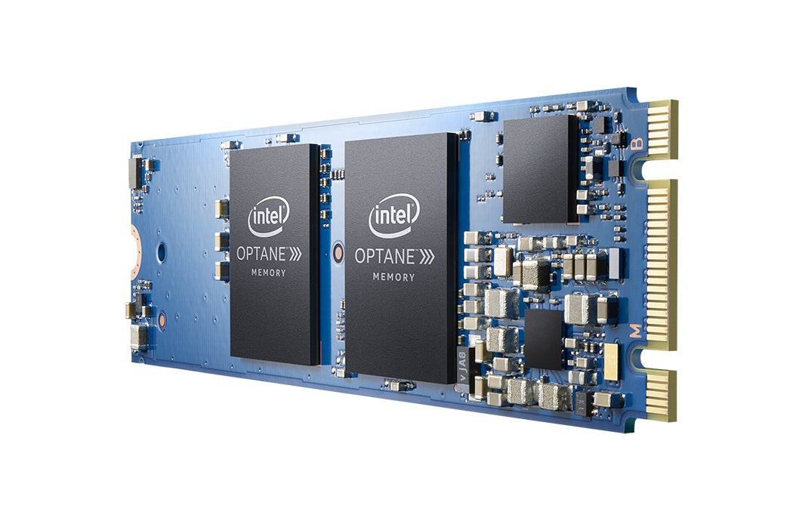
Non-volatile memory (NVM) is here!
Byte-addressable Fine-grained persistence Near-DRAM performance
Persistent Memory (PM) = Byte-addressable NVM
Notes:
No Bullet point, hz come up with byte-addressable, fine-grain persistence
Persistent Memory (PM) =

Slide 4

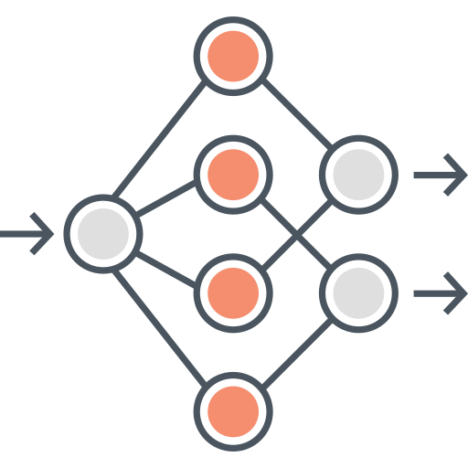



Decade of PM research for CPU apps.
Notes:
Use PM here. Don’t use NVM and PM interchangeably.
Persistent KVS + GPU-accelerated KVS : enabled when GPUs are able to perform fine-grained persistence
Pivot to gpKVS. Bring Figure 1 here itself. It brings huge throughput lift with exactly the same persistence guarantees from a pKVS.
We create a whole benchmark suite for these applications.

Slide 5
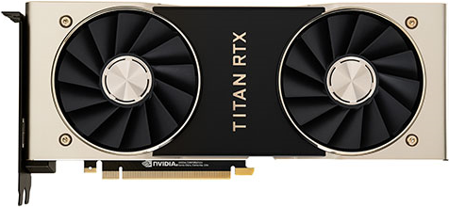
GPUs can accelerate (some) PM apps.
Persistent KVS (pKVS)
[EuroSys’21, ATC ‘20, FAST’19]
GPU-accelerated KVS (gKVS)
[VLDB ’15, SoCC’15]
gpKVS: GPU-accelerated Persistent KVS
Notes:
pKVS and gKVS and gpKVS
Use of persistent KVS and put the reference of motivation of importance of pKVS GPUs can accelerate the GET and SET operations on KVS like MegaKV
GPUs to accelerate GETs and SETs gpKVS -- can potentially

Slide 6
Multi-fold speedup with gpKVS
Throughput (Mops/s)
2.5
2.0
1.5
1.0
0.5
0
Notes:
gpKVS instead of MegaKV + GPM
Multi-fold speedup with gpKVS – heading
Later we will discuss 3 categories of applications

Slide 7

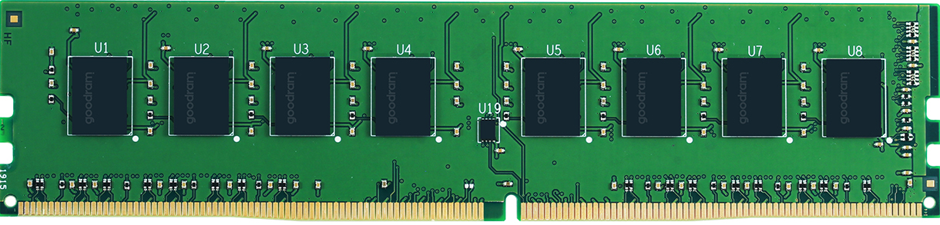
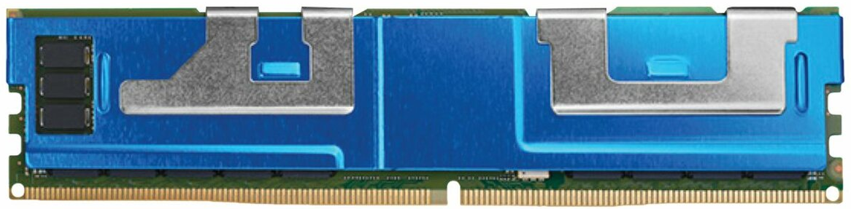
CPU Assisted Persistence (CAP)
set(key, value)
cudaMemcpy(key)
cudaMemcpy(value)
PCIe
persist(key, value)
DRAM
PMem
Notes:
GPU kernel = GPU function
Animation – Push the fourth key value pair with the other three. Then move all four to the DRAM and then Pmem. Along with copy to device and persist appearing
Naïve way of doing it – CAP
Warp on GPU and single thread on CPU
CPU thread comes and guarantees persistence
Caches are volatile

Slide 8
Our goal: in-kernel persistence
set(key, value)
persist(key, value)
PCIe
DRAM
PMem
Allow GPUs to directly store data on PM; enable fine-grained persistence
Notes:
Guarantee persistence – horizontal line shows up saying persistence guaranteed
Box/Slide with benefits of persistence – GPU parallelism for persistence CPU software overheads ignored Direct access for loads and stores to PM

Slide 9
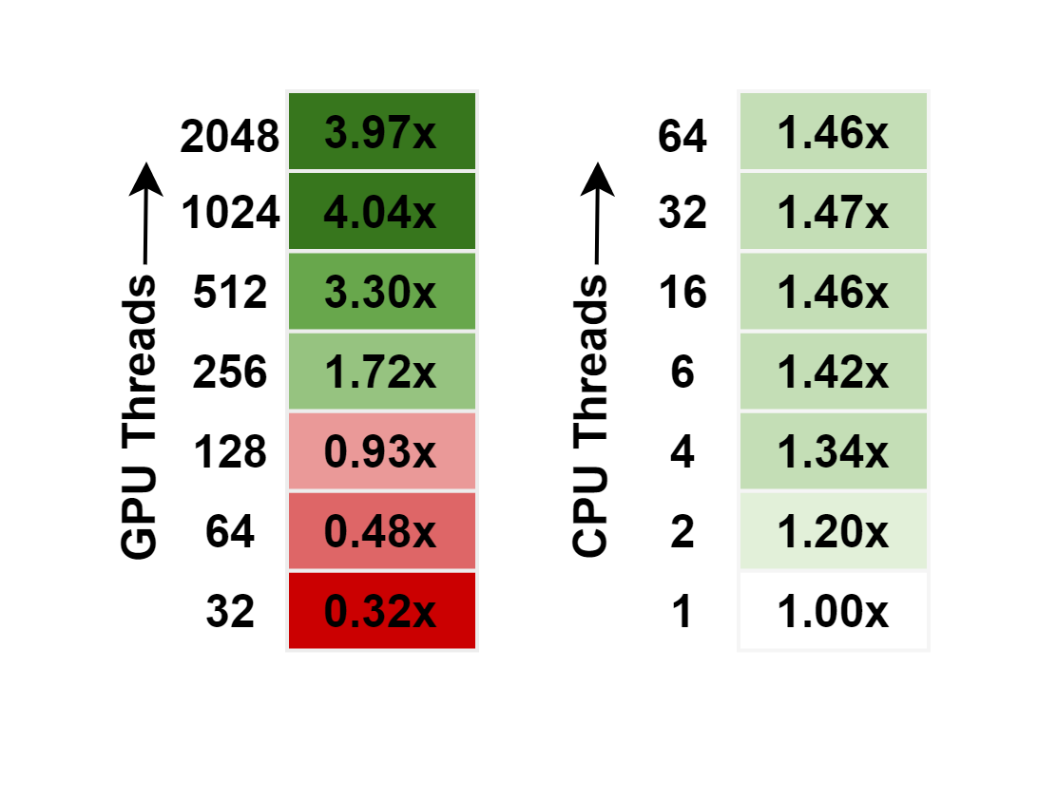
Benefits of in-kernel persistence
Ease of programmability
Parallelism in persisting data
Selective persistence
Direct access to PM
1
2
3
4
Notes:
Octagon or circle In-kernel persistence, and go to CPU
Ease of programming
Add parallelism data, wipe it, in the microbenchmark it is visible

Slide 10

GPU with Persistent Memory: GPM
1
Create GPM with current hardware
Use cases for GPM: GPMBench
Runtime library for GPM: LibGPM
2
3
Notes:
Remove the sub points
When the arrow comes
Sub points show up later with arrow
Create GPM with current hardware
IDEA slide

Slide 11
GPM system model
CPU
GPU
SM
SM
Core
SM
IO Hub
PCIe
PCIe
LLC
Interconnect
DRAM
MC
MC
PMem
L2$ Bank 0
L2$ Bank N
DRAM
NVM
GDDR
GDDR
NVM is attached to the CPU, is accessed by GPU through PCIe

Slide 12
Mapping NVM onto GPU address space
CPU
GPU
GPU page table
SM
SM
Core
SM
IO Hub
PCIe
Interconnect
LLC
L2$ Bank 0
L2$ Bank N
MC
MC
DRAM
NVM
GDDR
GDDR
Host Memory
Device Memory
Unified Virtual Address (UVA) space
Notes:
Black boxes appear with animation of UVA
DRAM and NVM = host mem
GDDR = dev mem
System mem

Slide 13
In-place updates to PM data structures
CPU
GPU
SM
set(key, value)
__threadfence_sys
SM
SM
SM
SM
Core
SM
IO Hub
IO Hub
PCIe
Interconnect
LLC
LLC
DDIO: Data Direct I/O
L2$ Bank 0
L2$ Bank N
MC
MC
DRAM
NVM
GDDR
GDDR
The system-scope threadfence pushes data from GPU to the CPU’s LLC
Notes:
Barrier comes and stops at the LLC
As DDIO off, the barrier push the data to the NVM Bring it up in DDIO
Show the barrier moving
iMC = MC
No clflush instruction. We can use system scope threadfence. It will flush it out of the GPU memory.

Slide 14
Guaranteeing persistence from GPU
CPU
DDIO
GPU
set(key, value)
__threadfence_sys
SM
SM
GPM achieved by
1. Mapping (parts of) NVM onto the GPU’s VA space with UVA. 2. Ordering data using system-scoped threadfence. 3. Guaranteeing persistence by selectively turning DDIO off.
SM
Core
SM
IO Hub
IO Hub
PCIe
Interconnect
LLC
L2$ Bank 0
L2$ Bank N
MC
MC
DRAM
NVM
NVM
GDDR
GDDR
Turn DDIO off to push the data to the persistent domain
Notes:
Octagon for 1,2,3
Overlay with the three things
Show full form of DDIO on the right bottom side of slide
Go back to our proposal – Use cases of GPM: GPMBench
Gray out others
Runtime for GPM: LibGPM

Slide 15
GPU with Persistent Memory: GPM
1
Create GPM with current hardware
Use cases for GPM: GPMBench
Runtime library for GPM: LibGPM
2
3
Notes:
Create GPM with current hardware
IDEA slide

Slide 16
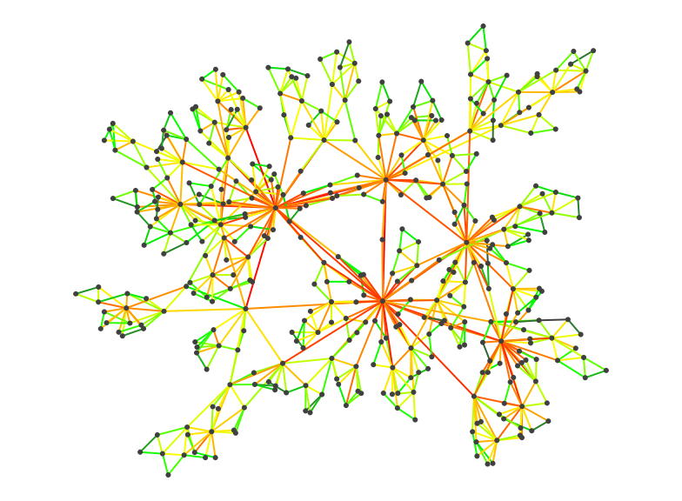
GPMBench: Three application classes
Transactional | Long-running iterative | Native
gpKVS, GPU-accelerated DB | DNN, CFD, BLK, HS | BFS, SRAD, PS
Needs logging
Needs checkpointing
In-kernel persistence
Notes:
GPU-accelerated pKVS GPU-accelerated DB on PM
Transactional needs logging, Long iterative needs checkpointing
Native does not need an explicit recovery, the recovery is in-kernel.
All of this is open-sourced

Slide 17
GPU with Persistent Memory: GPM
1
Create GPM with current hardware
Use cases for GPM: GPMBench
Runtime library for GPM: LibGPM
2
3
Notes:
Create GPM with current hardware
IDEA slide

Slide 18
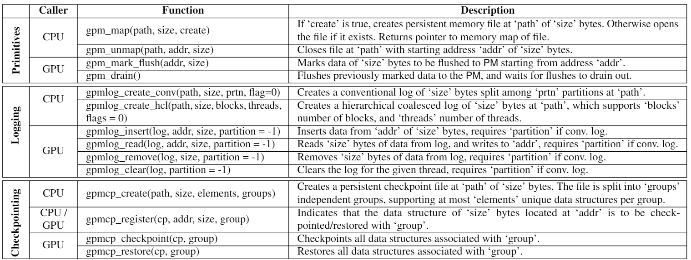



LibGPM: CUDA library for GPM
Logging | Checkpointing | Primitives
gpmlog_create_hcl, gpmlog_open, etc. | gpmcp_create, gpmcp_checkpoint, etc. | gpm_map, gpm_persist, etc.
On an average only 19 lines of code changes are needed with libGPM
Notes:
Proposal slide again.
Flash the LibGPM table with its API.
Color code them one by one

Slide 19

Conventional logging: single log
T0
T1
T31
. . .
Thread data
Shared log
Serialization while logging

Slide 20
Conventional logging: distributed log
T0
T1
T31
. . .
Thread data
Distributed log
Not suitable for GPU’s parallelism
Notes:
Due to poor data locality, the thread data is sent as multiple write operations
Not suitable for GPUs parallelism
Poor data locality, leading to multiple write operations

Slide 21
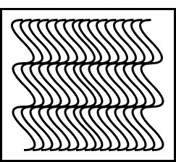
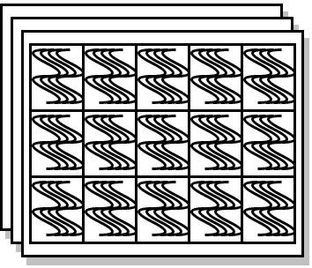
HCL: Hierarchical Coalesced Logging
Warp
Warps
Threadblock 1
Threadblock 2
Threablocks
Threadblock
Shared log
Grid
Log structure reflects thread hierarchy
Notes:
Have a backup slide for this Don’t put it here.

Slide 22
HCL: Hierarchical Coalesced Logging
T0
T1
T31
. . .
Thread data
Shared log
Data split into 4-byte chunks
Notes:
Have a backup slide for this Don’t put it here.

Slide 23
HCL: Hierarchical Coalesced Logging
T0
T1
T31
. . .
Thread data
Hardware coalescer
Shared log
128-byte
cacheline
Parallel logging GPU threads, coalesced writes to logs
Notes:
Idea bulb!
HW coalescer diff color
Parallel logging by GPU threads
Push everything to left and bring up the line graph or both or apps in a box
Move the first blocks from T0, T1.. T32 a little down Then there is HW coalescer that mashes them
And then the cacheline is moved to shared log. The cache line is marked using a thick line. Put a dotted line across it and call it 128B.

Slide 24
HCL speeds up logging
Upto 3x speedup over conventional logging!
Notes:
Remove right side picture and
Idea bulb!
HW coalescer diff color
Parallel logging by GPU threads
Push everything to left and bring up the line graph or both or apps in a box
Move the first blocks from T0, T1.. T32 a little down Then there is HW coalescer that mashes them
And then the cacheline is moved to shared log. The cache line is marked using a thick line. Put a dotted line across it and call it 128B.

Slide 25
Evaluation platform
CPU | 4 x Intel Xeon Gold 6242 (4 x 16 cores) @ 2.80GHz
GPU | NVIDIA Titan RTX (72 SMs, 24 GB GDDR6)
DRAM | 768 GB DDR4 @ 2933 MHz
NVM | 8 x 128 GB Intel Optane NVDIMM
Interconnect | PCIe 3.0 x 16
Software | Ubuntu 20.04, CUDA 11, PMDK 1.8, ext4-DAX
Notes:
No simulation

Slide 26
GPU accelerated PM applications
Type
Type | Code | Evaluated applications
Transactional | gpKVS | Key-value store
 | gpDB | GPU-accelerated DB
Checkpointing | DNN | DNN training
 | CFD | Computational fluid dynamics
 | BLK | Black-Scholes
 | HS | Hotspot
Native | BFS | Breadth-first search
 | SRAD | Speckle reducing anisotropic diffusion
 | PS | Prefix sum
Type
Notes:
Font color and font size
GPU-accelerated PM application
Speaking – GPMBench apps are used
What is the cost for persisting data?

Slide 27
Performance evaluation: CAP vs GPM
85
Notes:
We compared against our baseline – cap. On an avg x perf benefit
BFS improves so much
gpKVS or gpDB
And where and how the benefits are coming from.
Much more evaluation in the paper

Slide 28
Intel’s upcoming extended ADR (eADR)
CPU
GPU
SM
SM
Core
SM
IO Hub
IO Hub
PCIe
Interconnect
LLC
L2$ Bank 0
L2$ Bank N
MC
MC
DRAM
NVM
GDDR
GDDR
Persistence is guaranteed as soon as data reaches the caches

Slide 29
CAP under eADR
CPU
GPU
cudaMemcpy(key)
cudaMemcpy(value)
SM
SM
set(key, value)
Core
SM
IO Hub
flush(key, value)
drain()
IO Hub
PCIe
Interconnect
LLC
L2$ Bank 0
L2$ Bank N
MC
MC
DRAM
NVM
GDDR
GDDR
No need to flush the caches

Slide 30

GPM under eADR
CPU
DDIO
GPU
SM
SM
set(key, value)
__threadfence_sys
Core
SM
IO Hub
IO Hub
PCIe
Interconnect
LLC
L2$ Bank 0
L2$ Bank N
MC
MC
DRAM
NVM
GDDR
GDDR
No need to disable DDIO

Slide 31
CAP and GPM with e-ADR (projection)
110
142
Notes:
There is a lot more evaluation.
Cost of persistence?

Slide 32



Summary
GPUs can make use of persistence that NVMs provide.
We propose GPM to allow GPUs to leverage PM persistence.
Our contributions:
Create GPM with in-kernel, fine-grained persistence in current hardware.
Show the importance of PM for GPU apps with a benchmark suite GPMBench.
Build a GPM runtime, libGPM, allowing programmers to easily use GPM.
1
2
3
Reproducible artifact: https://github.com/csl-iisc/GPM-ASPLOS22
Notes:
To summarize, concurrency bugs threaten GPU applications. Newly evolving programming features also come with the possibility of new bugs.
To combat these bugs, we propose iGUARD, a race detector with relatively low overhead that requires no hardware changes and supports advanced synchronization.

