Slide 1
GPM: Leveraging Persistent Memory from a GPU
Shweta Pandey*, Aditya K Kamath*, Arkaprava Basu
https://csl.csa.iisc.ac.in/
* Both authors contributed equally
Notes:
Hello everyone, my name is Shweta Pandey. Today, I will be presenting our work, GPM: Leveraging Persistent Memory from a GPU.

Slide 2
Executive summary
Today, benefits of persistent memory (PM) limited only to CPU apps.
We enable GPUs to harness PM without new hardware
We demonstrate three classes of GPU apps. that benefit from PM
We create a GPU runtime that lets programmers write recoverable GPU kernels easily
Notes:
Let me start with a brief summary of what we will be covering in this talk. Currently, the use of persistent memory is restricted to CPUs. Our work helps enable GPUs to harness persistent memory without needing any new hardware. We demonstrate three classes of GPU applications that could benefit from the use of persistent memory. In addition, we create a GPU runtime to help make writing recoverable kernels easier.

Slide 3
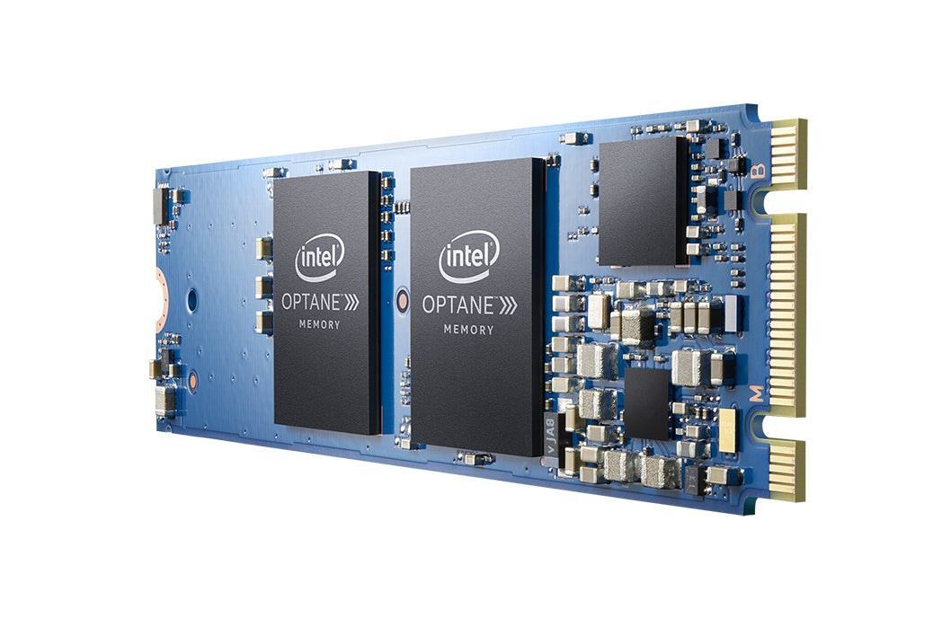
Non-volatile memory (NVM) is here!
Byte-addressable Fine-grained persistence Near-DRAM performance
Persistent Memory (PM) = Byte-addressable NVM
Notes:
Non-volatile memories or NVMs promise to blur the long-held distinction between storage and memory. Intel Optane is the first commercially available form of NVM. They offer byte-addressability and fine-grained persistence at near DRAM performance.
In this talk we will refer to byte-addressable NVM as Persistent Memory or PM.

Slide 4

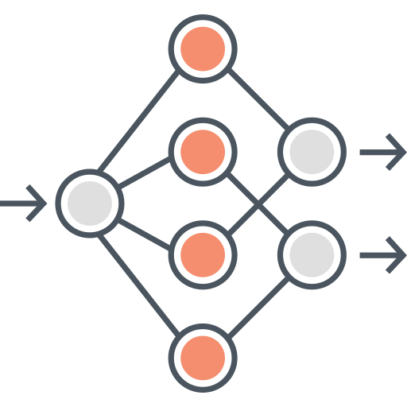



Decade of PM research for CPU apps.
Graph analytics
Persistent key-value stores
Data analytics
Persistent databases
Notes:
Years of research on persistent memory has enabled a large collection of applications that benefit from it. These include applications like persistent key-value stores and data analytics among many others. GPUs are a key compute platform today but are deprived of direct access to persistent memory. In our work, we address this by enabling fine-grained, in-kernel persistence from GPU kernels.

Slide 5
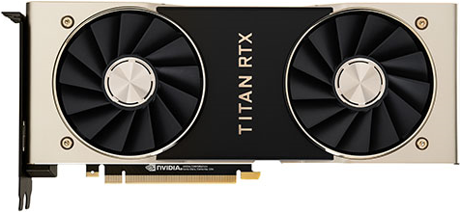
GPUs can accelerate many PM apps.
Persistent KVS (pKVS)
[EuroSys '21, ATC '20, FAST '19]
GPU-accelerated KVS (gKVS)
[VLDB '15, SoCC '15]
gpKVS: GPU-accelerated Persistent KVS
Notes:
An important question is whether there are any applications that can benefit from both the fine-grained persistence of PM, and parallelism of GPUs. We find that there are many such applications. Consider persistent key-value stores or pKVS which are the backbone of large-scale social network sites and search engines. These applications rely on persistence for fault tolerance. A significant amount of research revolves around improving the performance of persistent key value stores.
On the other hand, researchers have used GPUs to increase the throughput of get and put operations on regular key-value stores.
Enabling in-kernel GPU persistence allows us to bring these two together, allowing applications to benefit from both the persistence of PM and the parallelism of GPUs. We allow GPUs to accelerate persistent KVS for the first time and refer it as GPU-accelerated persistent KVS or gpKVS. Now the question is, what does gpKVS provide over existing pKVS?

Slide 6
Multi-fold speedup with gpKVS
Throughput (Mops/s)
2.5
2.0
1.5
1.0
0.5
0
Notes:
We find that gpKVS outperforms both commercial PM-optimized state-of-the-art pKVS like RocksDB, Intel PmemKV and academic pKVS like MatrixKV by multiple folds. We achieve this speedup while providing the same persistence guarantees as the CPU-based counterparts. Now we will take a look at what we do today on a system that has both Optane NVM and a GPU.

Slide 7
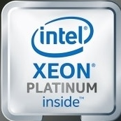
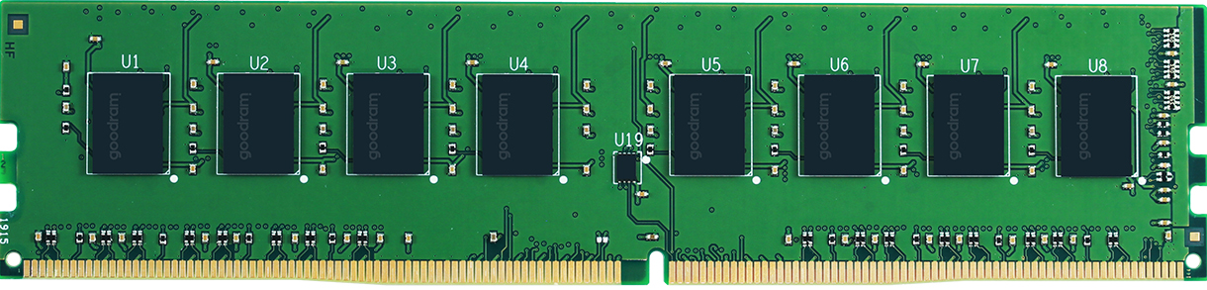
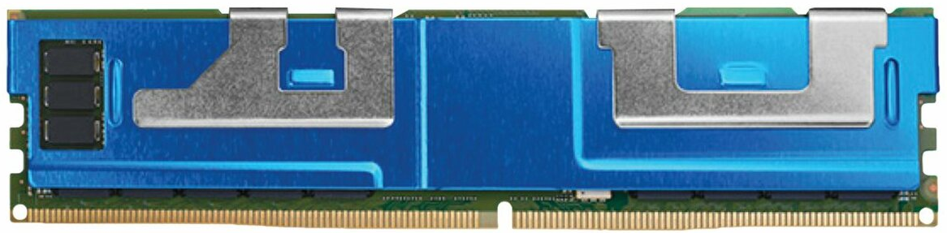
CPU Assisted Persistence (CAP)
set(key, value)
cudaMemcpy(key)
cudaMemcpy(value)
PCIe
persist(key, value)
DRAM
PMem
Issues with CAP:
Extraneous data movement
Serialization in persistence
Notes:
Today, even on a system sporting both a GPU and Persistent Memory, a GPU kernel does not persist the results of its computation directly on the PM. Instead, it relies on the CPU to do so. We call such a system CPU-assisted Persistence or CAP.
Take the example of gpKVS. The GPU performs batched SET operations.
It then transfers the entire key value store to the CPU to be persisted.
Persistence is guaranteed by the CPU flushing and fencing data from the caches. This is needed to ensure recoverability in the presence of volatile caches. However, this system exhibits unnecessary data movement and serialization by the CPU while guaranteeing persistence.

Slide 8
Our goal: in-kernel persistence
set(key, value)
persist(key, value)
PCIe
DRAM
PMem
Allow GPUs to directly store data on PM; enable fine-grained persistence
Notes:
To overcome this, our goal is to expose PM directly to GPU kernels and enable in-kernel persistence. This will allow GPU kernels to directly persist results of their computation without needing CPU assistance.
For an application like gpKVS, the GPU is able to perform both the batched set operation and guarantee persistence without relying on the CPU.

Slide 9
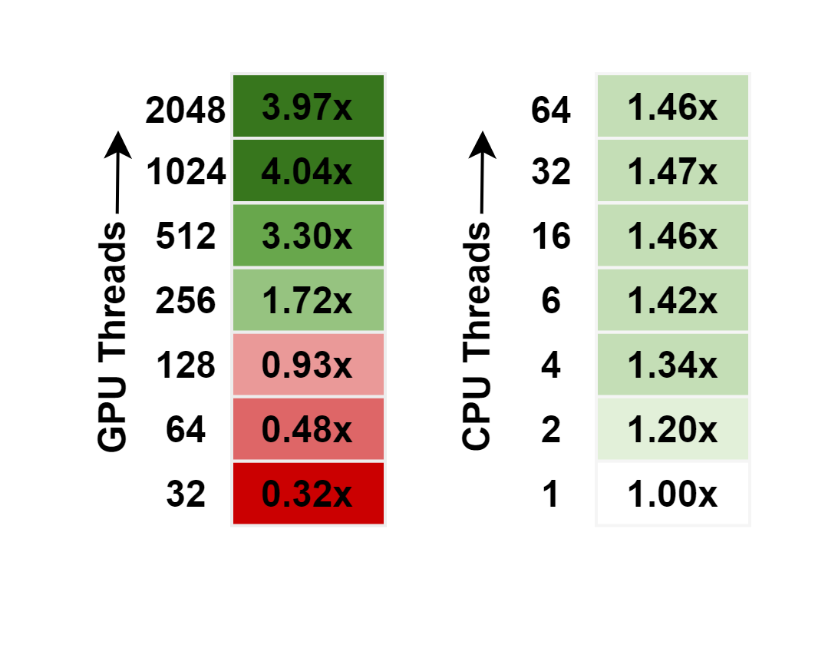
Benefits of in-kernel persistence
Ease of programmability
Parallelism in persisting data
Selective persistence
Direct access to PM
1
2
3
4
Notes:
In-kernel persistence provides several benefits. First, it eases programmability, as programmers do not have to split the kernel whenever persistence is needed and can embed the logic for persisting data in the GPU kernel itself.
Second, by relying on the CPU to persist the results of the GPU’s computation, we lose the benefit of the GPU’s massive parallelism when persisting results. To demonstrate this, we create a microbenchmark that writes and persists 1GB of data, from the GPU on the PM. We vary the number of CPU and GPU threads persisting these results and find that where multiple CPU threads could only provide 1.47x speedup over single-threaded CAP, GPUs can speed it up by up to 4x. Hence in-kernel persistence can significantly optimize data persistence from a GPU.
We also note that there are several applications in which the GPU only updates a small portion of the data, but this portion is not known until the computation on the GPU is performed. Consider the case of gpKVS, where only a few key-value pairs of a large persistent key value store may be updated. Under CAP, we will have to move the entire key value store to the CPU since the CPU is not aware of which pairs were updated. The GPU then relies on the CPU to persist it. By allowing in-kernel persistence, we can move and persist only the key-value pairs that are updated. Hence, reducing extraneous data movement.
Direct access to PM allows a GPU application to perform in-place updates through load/store instructions on the PM-resident data structures reducing the cost of updates and data movement to the PM.

Slide 10

GPU with Persistent Memory: GPM
1
Create GPM with current hardware
Use cases for GPM: GPMBench
Runtime library for GPM: LibGPM
2
3
Notes:
Towards this we make three key contributions - We create GPU with Persistent Memory or GPM in short purely in software, without any new hardware support. We create a benchmark suite GPMBench with 3 categories of applications that can leverage both GPU parallelism and PM persistence. We create a CUDA runtime library libGPM optimized for GPUs that allows GPU programs to easily leverage fine-grain persistence.
We will first discuss how we conjure GPM.

Slide 11
GPM system model
CPU
GPU
SM
SM
Core
SM
IO Hub
PCIe
PCIe
LLC
Interconnect
DRAM
MC
MC
PMem
L2$ Bank 0
L2$ Bank N
DRAM
NVM
GDDR
GDDR
NVM is attached to the CPU, is accessed by GPU through PCIe
Notes:
To understand the internals better, we’ll make use of a schematic model of our system. Note that currently no GPU hardware exists with on-board NVM. Instead, the NVM is attached to the CPU and is accessed over the PCIe bus.

Slide 12
Mapping NVM onto GPU address space
CPU
GPU
GPU page table
SM
SM
Core
SM
IO Hub
PCIe
Interconnect
LLC
L2$ Bank 0
L2$ Bank N
MC
MC
DRAM
NVM
GDDR
GDDR
Host Memory
Device Memory
Unified Virtual Address (UVA) space
Notes:
We refer to the CPU side DRAM and NVM as host memory and the GPU’s GDDR as the device memory. We will now look at the three steps needed to create GPM.
First, we map parts of the NVM to the GPU’s address space through Nvidia’s unified virtual address space, to allow GPUs direct access to PM via load/store instructions.

Slide 13
In-place updates to PM data structures
CPU
GPU
SM
set(key, value)
__threadfence_sys
SM
SM
SM
SM
Core
SM
IO Hub
IO Hub
PCIe
Interconnect
LLC
LLC
DDIO: Data Direct I/O
L2$ Bank 0
L2$ Bank N
MC
MC
DRAM
NVM
GDDR
GDDR
The system-scope threadfence pushes data from GPU to the CPU’s LLC
Notes:
Unlike CPUs, today's GPUs are not designed for use with PM and do not have instructions to flush individual cache lines.
However, system-scoped fences, originally designed for synchronization, flush data to system memory. The host memory, including the NVM, is part of the system memory, and so the fence can be used to flush writes from GPU to the NVM in the host memory to guarantee persistence. However, a system-scoped threadfence is not sufficient to guarantee persistence.
This is due to a seemingly unrelated feature on Intel servers called data direct IO or DDIO which stops writes from immediately reaching the memory. DDIO was originally designed to improve the DMA access latency of devices. When enabled, writes to the CPU memory from IO devices like network interface cards, GPUs etc. are cached in the CPU’s last level cache. This means for GPM, the fence completes as soon as the writes reach the CPU's volatile LLC and not the persistent memory.

Slide 14
Guaranteeing persistence from GPU
CPU
DDIO
GPU
set(key, value)
__threadfence_sys
SM
SM
GPM achieved by
1. Mapping (parts of) NVM onto the GPU’s VA space with UVA. 2. Ordering data using system-scoped threadfence. 3. Guaranteeing persistence by selectively turning DDIO off.
SM
Core
SM
IO Hub
IO Hub
PCIe
Interconnect
LLC
L2$ Bank 0
L2$ Bank N
MC
MC
DRAM
NVM
NVM
GDDR
GDDR
Turn DDIO off to push the data to the persistent domain
Notes:
Hence, whenever a persistence guarantee is needed from the GPU, we selectively turn off DDIO, which ensures that the threadfence completes only when the GPU’s writes reach the NVM. Thus guaranteeing persistence.
In summary: We build GPM which enables GPU kernels to perform in-place updates to PM data structures and also guarantee persistence wherever the program semantics demand by (1) Mapping parts of NVM to the GPU’s virtual address space using UVA. (2) Ordering writes to PM using system scoped threadfence and (3) Guaranteeing persistence by selectively disabling DDIO.

Slide 15
GPU with Persistent Memory: GPM
1
Create GPM with current hardware
Use cases for GPM: GPMBench
Runtime library for GPM: LibGPM
2
3
Notes:
An important aspect to consider is which applications can make use of a system like GPM. For this, we create a benchmark suite: GPMBench.

Slide 16
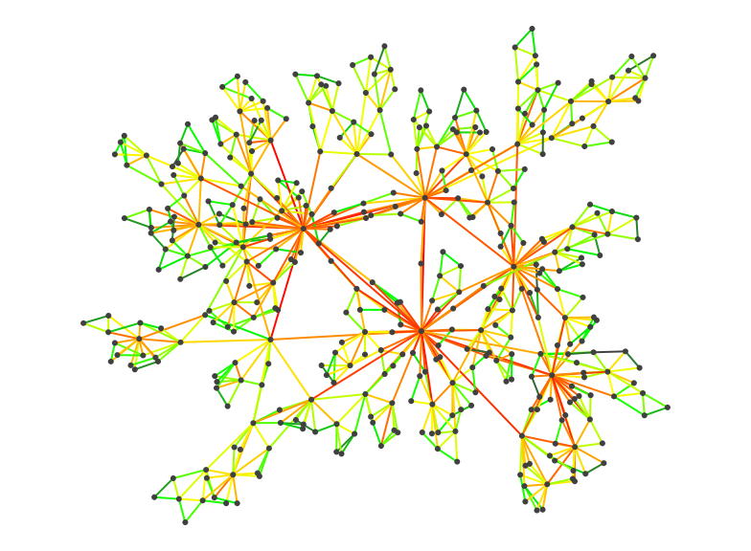
GPMBench: Three application classes
Transactional | Long-running iterative | Native
gpKVS, GPU-accelerated DB | DNN, CFD, BLK, HS | BFS, SRAD, PS
Needs logging
Needs checkpointing
In-kernel persistence
Notes:
We categorise applications that benefit from in-kernel persistence into three main classes. The first class is transactional applications like gpKVS which we have already discussed. Other applications in this class include GPU-accelerated persistent databases. For these applications the entire data structure (example the KVS or database) resides on the PM, and transactions are used for crash consistent updates. The next class consists of long-running applications like DNN training, which may run for days, which are iterative in nature. Other applications in this class are scientific simulations like computational fluid dynamics. These applications checkpoint their data regularly to avoid significant recompute following a crash or pre-mature termination. We finally enable a new class of workloads called native, that perform fine-grain, in-place updates to PM-resident data structures. These include graph processing applications operating on large PM-resident graphs.
These three classes of applications require three types of persistency support. Transactional applications require logging, long-running iterative applications need an easy way to perform checkpointing, while native applications need a basic ability to persist data at a fine grain.

Slide 17
GPU with Persistent Memory: GPM
1
Create GPM with current hardware
Use cases for GPM: GPMBench
Runtime library for GPM: LibGPM
2
3
Notes:
We'll now look at how we provide this persistency support through our runtime library libGPM.

Slide 18
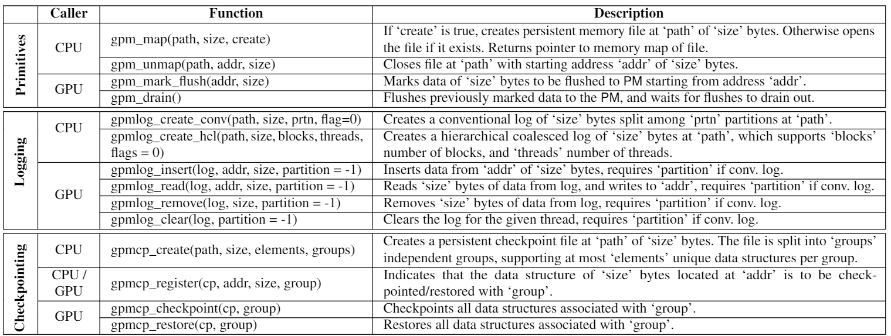



LibGPM: CUDA library for GPM
Logging | Checkpointing | Primitives
gpmlog_create_hcl, gpmlog_open, etc. | gpmcp_create, gpmcp_checkpoint, etc. | gpm_map, gpm_persist, etc.
On an average only 19 lines of code changes are needed with libGPM
Notes:
We create a detailed set of API which abstracts complex logic for persistence from GPU programmers. You don’t need to read this table as the full details are in the paper.
These API are split into three categories, reflecting the classes of applications mentioned previously. Our library provides GPU and NVM optimized interfaces for logging, checkpointing and persistency primitives.
Due to this interface, only a few lines of code changes is needed in the GPU kernel. This interface also encapsulates many GPU-optimized innovations.
In this talk we focus on GPU-optimized logging, but the rest can be found in the paper.

Slide 19

Conventional logging: single log
T0
T1
T31
. . .
Thread data
Shared log
Serialization while logging
Notes:
The cornerstone of libGPM is GPU-optimized write-ahead logging. We will first discuss how logging is conventionally performed in multi-threaded applications.
The most basic approach is to have a single log file and a single lock guarding it. Different threads that wish to perform write-ahead logging need to take the lock before inserting data. This approach doesn't scale well as it creates serialization among potentially thousands of threads that perform logging.

Slide 20
Conventional logging: distributed log
T0
T1
T31
. . .
Thread data
Distributed log
Not suitable for GPU’s parallelism
Notes:
To optimize logging for multi-threaded applications, sharded multiple logs are used, where each thread can write to their own private shard of the log without needing locks. While this works well for multi-core applications, it doesn't scale well for the GPU's architecture consisting of thousands of concurrent threads arranged in a hierarchy.

Slide 21
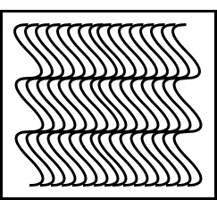
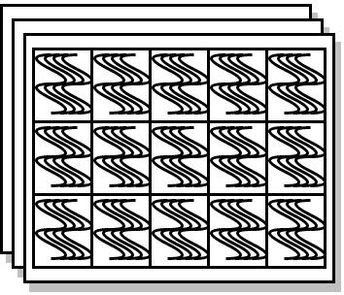
HCL: Hierarchical Coalesced Logging
Warp
Warps
Threadblock 1
Threadblock 2
Threadblocks
Threadblock
Shared log
Grid
Log structure reflects thread hierarchy
Notes:
We instead propose a GPU optimized logging that reflects the GPU's thread hierarchy in the log structure. Each grid shares a single log that all threads in the grid write to. The log is distributed among the thread hierarchy, providing a unique offset in the log where threads can insert data.
For example, each threadblock has a unique offset within the log where they can insert data.
Similarly, within this offset, each warp has a unique offset where it can insert data. In this way the hierarchy of the GPU threads is reflected in the log and data is inserted into the log without any locks. We will now look at how threads within a warp insert data.

Slide 22
HCL: Hierarchical Coalesced Logging
T0
T1
T31
. . .
Thread data
Shared log
Data split into 4-byte chunks
Notes:
Our second innovation is that we take advantage of GPUs hardware coalescing. Cachelines in GPUs are typically 128 bytes long and each warp contains 32 threads.
We split the entry being inserted into the log into 4 byte chunks.

Slide 23
HCL: Hierarchical Coalesced Logging
T0
T1
T31
. . .
Thread data
Hardware coalescer
Shared log
128-byte
cacheline
Parallel logging GPU threads, coalesced writes to logs
Notes:
These 4 byte chunks are then written into the log in parallel by all 32 threads within a warp. This allows the GPU hardware to coalesce parallel writes into a single 128-byte write operation. We refer to this GPU optimized logging as hierarchical coalesced logging or HCL. HCL makes use of two properties that allow it to bring significant performance benefit. First, as each thread has a unique position in the log to insert its data, it removes the need for locks. Second, it uses 128-byte writes to take advantage of hardware coalescing.

Slide 24
HCL speeds up logging
Upto 3x speedup over conventional logging!
Notes:
On a microbenchmark we found that HCL scales well with an increase in the number of threads compared to using a distributed log. On the x-axis we are increasing number of threads, while the Y-axis shows latency, where lower is better. The orange line shows distributed logging while the blue line shows HCL.
HCL provides around 3x speedup over conventional logging. Now we shall look at our experimental platform and the results obtained.

Slide 25
Evaluation platform
CPU | 4 x Intel Xeon Gold 6242 (4 x 16 cores) @ 2.80GHz
GPU | NVIDIA Titan RTX (72 SMs, 24 GB GDDR6)
DRAM | 768 GB DDR4 @ 2933 MHz
NVM | 8 x 128 GB Intel Optane NVDIMM
Interconnect | PCIe 3.0 x 16
Software | Ubuntu 20.04, CUDA 11, PMDK 1.8, ext4-DAX
Notes:
This table shows the details of our evaluation platform. This platform uses real hardware available on the market today. Notably, we use Intel Xeon CPU with Intel Optane and a NVIDIA Titan RTX GPU.

Slide 26
GPU-accelerated PM applications
Type
Type | Code | Evaluated applications
Transactional | gpKVS | GPU-accelerated persistent key-value store
 | gpDB | GPU-accelerated persistent DB
Checkpointing | DNN | DNN training
 | CFD | Computational fluid dynamics
 | BLK | Black-Scholes
 | HS | Hotspot
Native | BFS | Breadth-first search
 | SRAD | Speckle reducing anisotropic diffusion
 | PS | Prefix sum
Type
Notes:
These are the specific applications contained in GPMBench, divided into the three categories. In total, we performed our evaluation on 9 applications across these 3 categories.

Slide 27
Performance evaluation: CAP vs GPM
85
Transactional
Long running iterative
Native
Notes:
Our baseline is CAP, where data is transferred in bulk from the GPU to the CPU and is then persisted.
For applications like gpKVS and gpDB, the speedup mainly arises from the reduced amount of data that needs to be persisted. For example, only individual key-value pairs need be persisted instead of the entire KVS.
BFS speeds up for a similar reason as in each iteration only a sparse set of updated visited nodes need be persisted instead of the entire vertex list.
Checkpointing workloads benefit from direct access to PM removing expensive data movement through the CPU.

Slide 28



Summary
GPUs can make use of persistence that NVMs provide.
We propose GPM to allow GPUs to leverage PM persistence.
Our contributions:
Create GPM with in-kernel, fine-grained persistence in current hardware.
Show the importance of PM for GPU apps with a benchmark suite GPMBench.
Build a GPU runtime, libGPM, allowing programmers to easily use GPM.
1
2
3
Reproducible artifact: https://github.com/csl-iisc/GPM-ASPLOS22
Notes:
To summarize, we find that GPUs can make use of the persistence that NVMs provide. Towards this, we propose GPM to allow GPUs to leverage the persistence offered by PM. Our contributions include creating GPM with in-kernel, fine-grained persistence in current hardware. Showing the importance of PM for GPU apps with a benchmark suite GPMBench and Building a GPM runtime, libGPM, allowing programmers to easily use GPM. Our artifact is open-source and has received all three badges in artifact evaluation.
Thank you. I will be happy to take questions now.

Slide 29
Backup Slides

Slide 30
Intel’s upcoming extended ADR (eADR)
CPU
GPU
SM
SM
Core
SM
IO Hub
IO Hub
PCIe
Interconnect
LLC
L2$ Bank 0
L2$ Bank N
MC
MC
DRAM
NVM
GDDR
GDDR
Persistence is guaranteed as soon as data reaches the caches
Notes:
GPM is not only beneficial for applications on today’s platform, but also holds significant promise for the upcoming eADR feature.
EADR stands for extended ADR and extends the “power fail protected domain” to also include the caches. This implied that data is guaranteed to be persistent as soon as it reaches the caches.

Slide 31
CAP under eADR
CPU
GPU
cudaMemcpy(key)
cudaMemcpy(value)
SM
SM
set(key, value)
Core
SM
IO Hub
flush(key, value)
fence()
IO Hub
PCIe
Interconnect
LLC
L2$ Bank 0
L2$ Bank N
MC
MC
DRAM
NVM
GDDR
GDDR
No need to flush the caches
Notes:
For CAP systems, eADR eliminates the need to flush caches, however, the CPU still needs a fence instruction to order the data and guarantee persistence.

Slide 32

GPM under eADR
CPU
DDIO
GPU
SM
SM
set(key, value)
__threadfence_sys
Core
SM
IO Hub
IO Hub
PCIe
Interconnect
LLC
L2$ Bank 0
L2$ Bank N
MC
MC
DRAM
NVM
GDDR
GDDR
No need to disable DDIO
Notes:
For GPM, DDIO remains enabled even when persistence is required, and a threadfence operation can complete as soon as the data reaches the CPU’s LLC.

Slide 33
CAP and GPM with e-ADR (projection)
110
142
Notes:
We now show the benefits of eADR to both CAP and GPM. CAP systems see limited benefits with eADR. This is because, although eADR eliminates the need for flushing data from the CPU, most of the time in CAP is spent in transferring data from GPU to CPU and not in persisting data.
For GPM, the applications which frequently persist their data, example those due to logging, benefit the most since fences complete as soon as data reaches LLC.
In contrast, checkpointing requires a single persist after writing the entire checkpoint and, thus, is mostly agnostic to eADR. We observe that GPM with eADR is 24 times faster than CAP with eADR on average. This is because GPM's advantages of leveraging GPU's parallelism in writing to PM and avoiding extraneous data movement is unaffected by eADR. At the same time, the fact that eADR allows GPM to guarantee persistence even with DDIO enabled improves the performance significantly. Please check the full paper for more evaluation.

Slide 34
PCIe write bandwidth utilization of GPM

Slide 35
Restoration latency
Class | Workload | Restoration latency
Transactional | gpKVS | 18.96%
 | gpDB | 0.01%
Checkpointing | DNN | 0.12%
 | CFD | 0.30%
 | BLK | 0.80%
 | HS | 1.65%

Slide 36
CAP’s write amplification
Class | Workload | Restoration latency
Transactional | gpKVS | 39.98x
 | gpDB | 1.28x
Checkpointing | All workloads | 1x
Native | All workloads | 1x

Slide 37
Performance breakdown of GPM

Slide 38
GPM speeds up both CAPmm and CAPfs
16
17
11
18
85
Speedup over CAP-fs
0.1
0.7
0.1
* * * * * * * *
gpKVS gpKVS gpDB gpDB DNN CFD BLK HS BFS SRAD PS
(95:5) (I) (U)
Transactional
Checkpointing
Native

Slide 39
GPM-DNN training
8.26 milliseconds to run 10 iterations.
Whereas it takes 0.221 milliseconds to checkpoint and
0.342 milliseconds to restore from the checkpoint.

