Slide 1
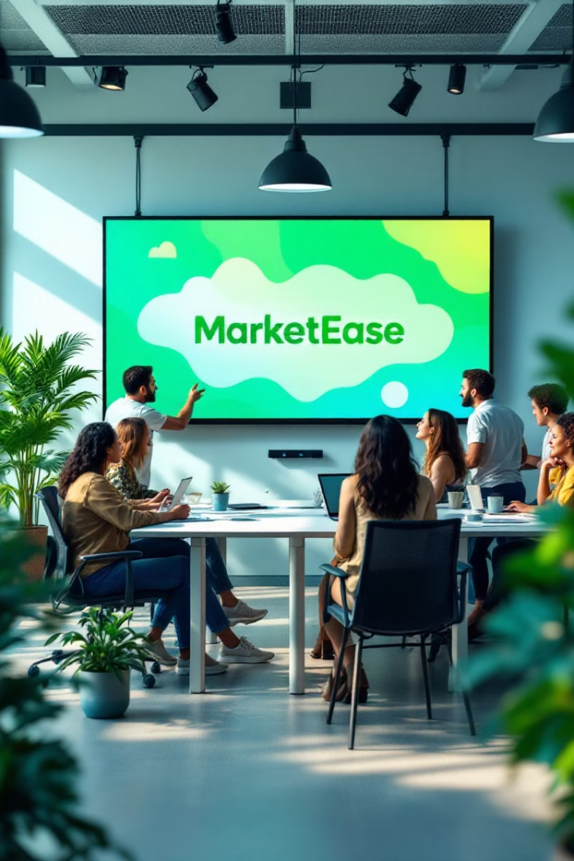
PROJECT NAME:
MarketEase – AI-Powered Marketing Partner
Focus on your Business, let AI handle your marketing.
TEAM DETAILS:
ANKITA SHARMA
AAKARSHAN
CHAHAT MADHU
VANSHIKA GUPTA
KOMAL

Slide 2
The Problem Statement
The Challenge for Business Owners
Should they focus on product development or spend time on marketing?
Hiring a Digital Marketing Agency → Costs ₹40K-₹50K per month
DIY(Do it yourself)Marketing → Time-consuming, requires expertise
Lack of Automation → Manual work, inefficient processes
Conclusion: Businesses need a cost-effective, automated, AI-driven marketing solution.

Slide 3
Our Solution – MarketEase
💡 An AI-powered platform that provides all marketing services done by agencies, plus additional automation.
✅ Reduces effort – Automates marketing, meetings, and social media.
✅ Saves time – AI manages everything, freeing up business owners.
✅ Cuts costs – Eliminates the need for expensive agencies.
MarketEase = AI-Powered Marketing + Smart Task Automation

Slide 4
Key Features & Functionality
1. Smart Meeting & Task Scheduling
2. AI-Generated Content & Auto-Posting
📩 AI scans emails → detects important meetings → one-click accept/reschedule → automatic response sent.
📝 Users line up post titles → AI creates text & images → Auto-posts to Instagram, Facebook, Blogs, & Newsletters
3. Automated Social Media Marketing
4. Chat & Voice-Enabled Task Execution
📊 Runs targeted paid ads → AI analyzes & optimizes campaigns → Generates high-converting leads.
🎙 Users can type or say:
“Reschedule my meeting with Mr. Sharma”
“Upload a post on ‘Best Marketing Strategies’” 🚀 AI instantly completes the task!

Slide 5
Architecture & Technology
📌 1: User Input & Integration
📌 2: AI Processing & Decision Making
Users connect their email, social media, and marketing accounts.
NLP-based AI scans emails for meetings.
AI generates & schedules content for social media.
AI extracts relevant tasks & meeting details.
AI analyzes ad campaigns & optimizes targeting.
📌 3: Task Execution & Automation
📌 4: Continuous Learning & Improvement
AI auto-sends emails for meetings.
AI analyzes engagement data to improve future campaigns.
AI creates & posts content on social platforms.
System learns user preferences for smarter automation.
AI runs ad campaigns & generates reports.
Technology Stack: Html / CSS/ Javascript (frontend), Python / Nodejs (backend), MySQL/MongoDB (database),NLP/TensorFlow (AI & Automation).

Slide 6
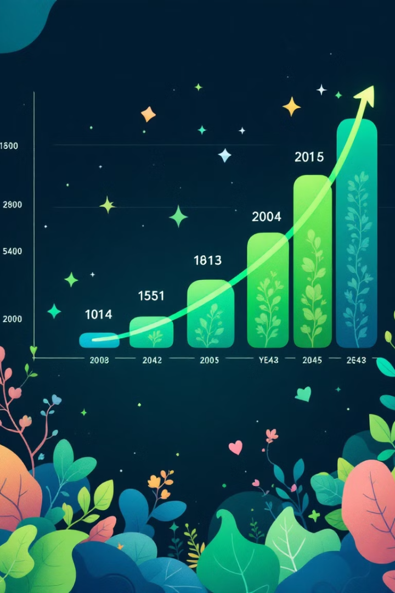
Financial Projections & Key Metrics
₹3.4 lacs
₹7.7 lacs
3 month Revenue
7 month Revenue
₹52 lacs
Year 1 Revenue
1️⃣ Subscription Plans (Monthly/Annual AI-powered marketing services) 2️⃣ Freemium Model (Basic features free, premium features paid) 3️⃣ Commission on Paid Ad Campaigns

