Slide 1
WEEK 3 · MULTI-SOURCE OPERATIONS PIPELINE
Why did throughput and reliability
swing across our depots this season?
Six Kenyan fuel depots · 5,000 fifteen-minute sensor readings · 1 Mar – 22 Apr 2026
WEATHER
SCHEDULING
DATA QUALITY
Does rainfall slow depot throughput?
Do public holidays change staffing & volume?
How much signal did we lose to bad sensor reads?

Slide 2
The Data Integration
Three independent sources, aligned on date, merged into one Master DataFrame
SOURCE 1 · INTERNAL
operational_events_5000.csv
5,000 sensor readings
(flow, pressure, temp,
incidents) rolled up to
daily KPIs per depot
MASTER
DATAFRAME
MERGE
on date
53 rows · 1 per day
14 columns
internal + API + DB
SOURCE 2 · EXTERNAL API
requests → Open-Meteo
fillna: holiday=0,
weather/staffing=mean
Daily Nairobi rainfall &
temperature; try/except
falls back to a seeded
synthetic series
SOURCE 3 · DATABASE
SQLite via SQLAlchemy
Holiday_Calendar JOIN
Employee_Shifts, SQL
GROUP BY → daily
staffing + holiday flag
All three sources share a daily date key — sensor readings are aggregated up to daily grain before the merge.

Slide 3
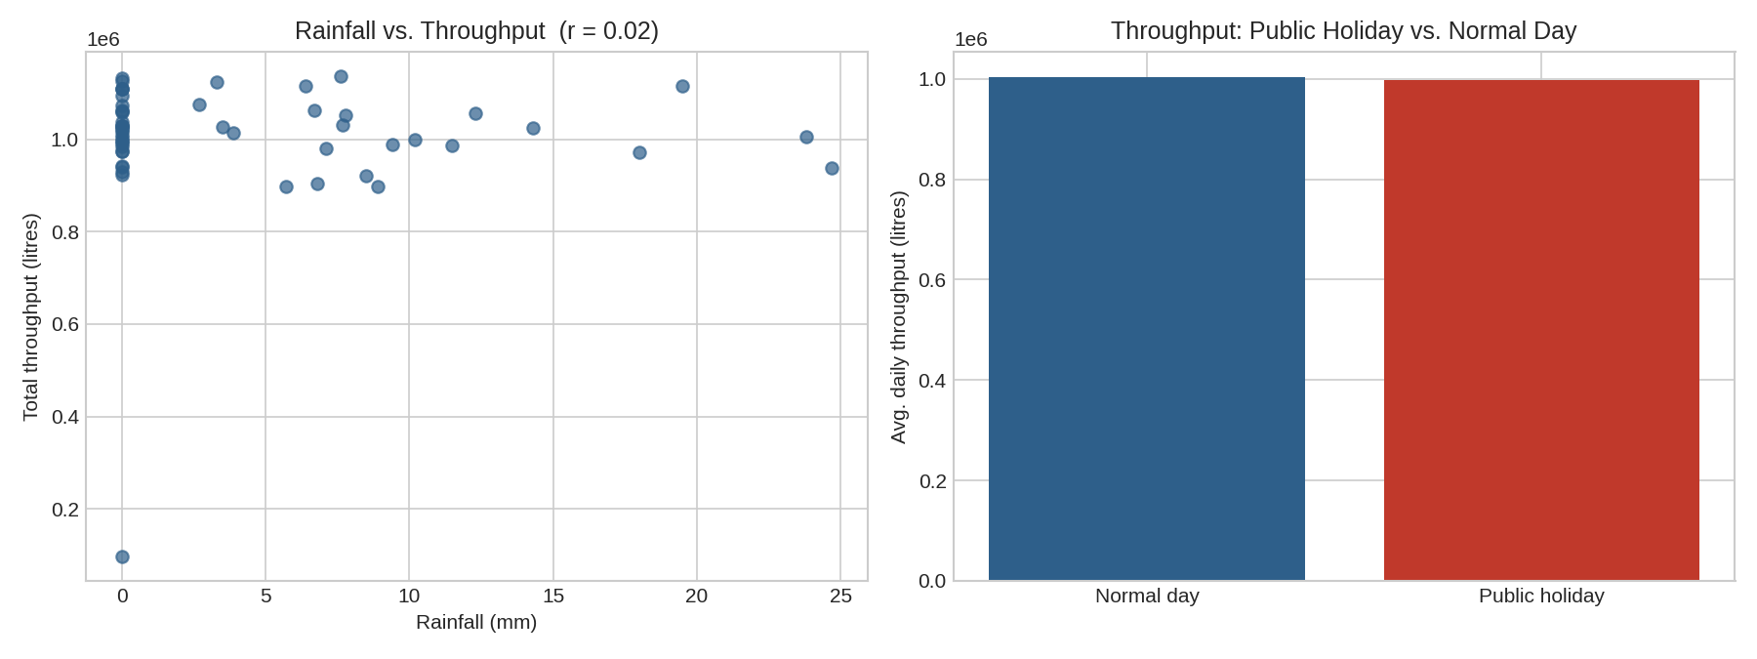
The Insight & Recommendation
What the merged data revealed once weather and staffing were joined to the sensor feed
r = 0.02
Rainfall vs. daily throughput — no meaningful linear correlation in this window (p = 0.90)
-0.5%
Throughput on gazetted public holidays vs. normal days — a small dip, not a large swing
RECOMMENDATION
20%
Look past weather and the holiday calendar. Neither explains last week's efficiency swings in this dataset — the stronger lead is data quality: 1 in 5 readings were dropped as missing/null. Prioritize fixing sensor drop-outs at the depot with the highest MISSING_RECORD rate before drawing further conclusions from throughput trends.
Of all sensor readings were MISSING/NULL records dropped before this analysis

