Slide 1
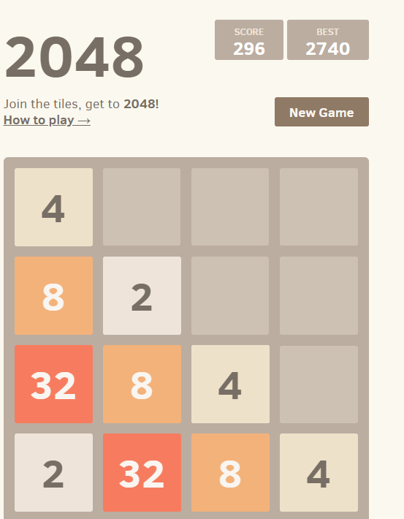
Cell (with no tile)
Rows
Numbered Tile
Columns

