Slide 1
Virtual Guide
Virtual Guide For Visually Impaired People
A Machine-Learning and Sensing based project

Slide 2
Problem Statement
This project is associated with the development of system to provide an aid to visually impaired people. It is a visual based project consisting of few main components such as camera, arduino and earphones mounted together and additional working technologies of the internet interlinked. The input of the project will be an image/video (multiple frames), the image captured and analyzed with the help of the camera interfaced to the arduino/ IOT technology.
Hence the object is detected and audio information is conveyed to the blind person through earphones.

Slide 3
Introduction
Visually impaired people face difficulties in everydays' traffic. A white rod can detect certain obstacles on the ground level in
a close proximity, however there are a lot more traffic situations its user should be aware of: quickly moving objects, public transportation, hanging objects, traffic lamps without audio aid, or the speed of other passerbys.
Guide dogs are trained for these purposes, but that is not the ideal solution as the training is expensive and time consuming, hence there is a need for a simple, quickly deployable and language independent tool. According to WHO there are about 39 million blind people and another 246 million visually impaired, so the potential market for such a tool is about 3% of the population of the world.

Slide 4
Aims and Objectives
OBJECT DETECTION: First step is to detect the obstacles in the frame.
RECOGNIZATION: Second step is recognising the object.
CONVERSION: Convert the data into audio.

Slide 5
Work details
We propose a virtual eye tool for the practical requirement of blind people. Our prototype tool consists of a camera mounted on a helmet, its image is processed with a portable computer carried by the user in real time. Earlier research prototypes were limited to 32*32 images and depth maps of similar size which results in heavy information loss making for instance traffic lamp detection impossible.
In our work, we use full scale images, and yet process them automatically in real time. Our image processing algorithms cover the
classification of hanging obstacles, road crossings, stairs, traffic lamps, which is much a broader spectrum than in previous virtual eye solutions could provide.

Slide 6
Scope
Around 3% of the world’s population is visually impaired.
There exist a few projects to help them but are not very
efficient and compatible to many people. Additionally we are
thinking to add a GPS Tracking feature in our model which can
send emergency signals whenever a visually impaired person
met an accident.

Slide 7
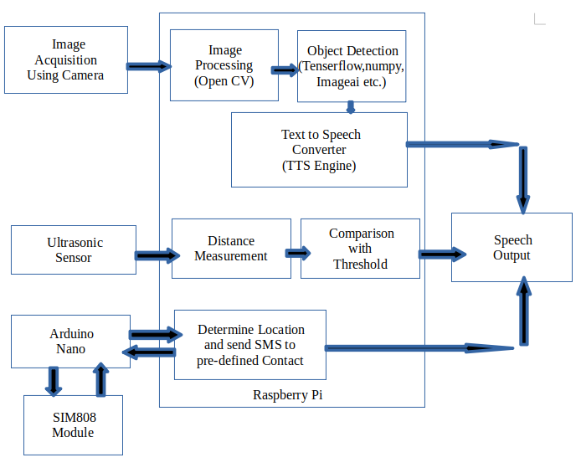
Block Diagram

Slide 8
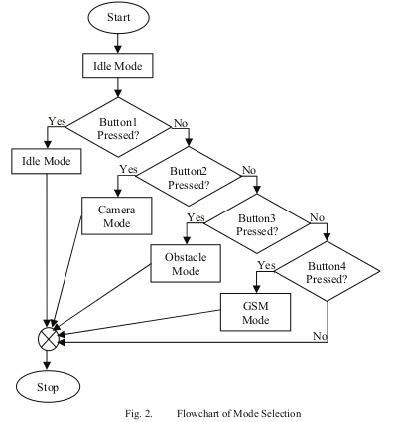
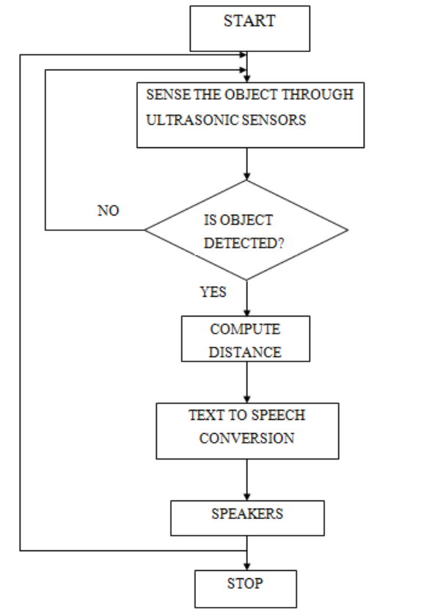
Development Methodology

Slide 9
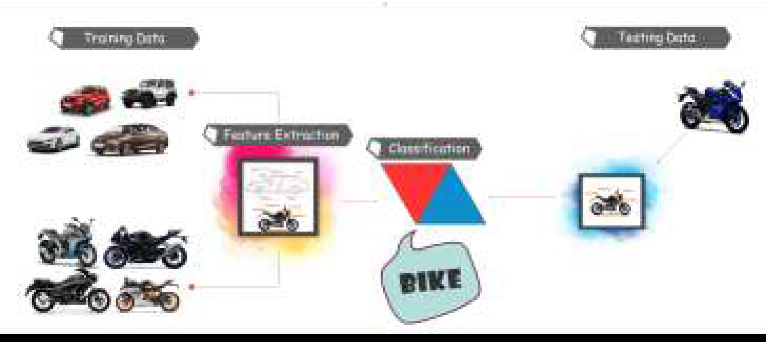
Working Modules
Object Detection:
In this phase we detect the real world objects. Like humans in still images or Videos. Diagram shows the examples of the how to object are detected easily.

Slide 10
Working Modules
Obstacle Detection:
In the proposed method, an ultrasonic sensor is used for obstacle detection in front of the users. Another ultrasonic
sensor is used to detect humps on the ground or on the road. A PIR motion sensor is used for detecting the moving
objects in front of the user.
The user will be notified if there is an obstacle or a hump or a moving object in front of him/her by speech instructions from buzzer. If the user falls down, the guardian will be instantly notified by the smartphone module

Slide 11
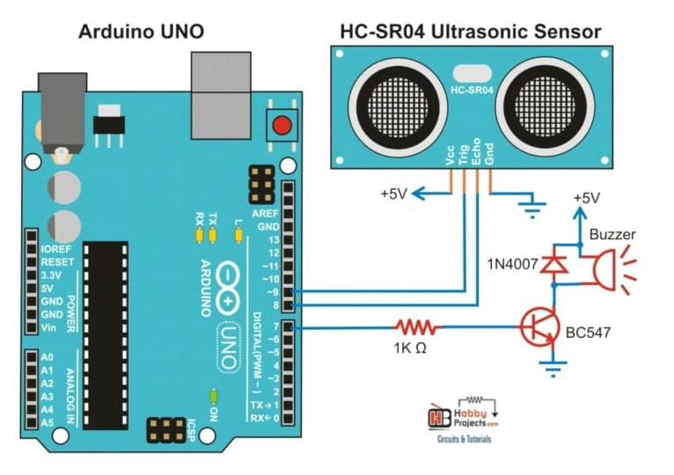
Circuit Diagram
Obstacle detection with sensor

Slide 12
Working Modules
Sending emergency message:
Virtual guide sends an emergency message in the form of mail with the help of arduino
The GPS receiver obtains the data as a whole NMEA format text. Only the latitude and longitude coordinates are taken from it; using the Arduino TinyGPS library. Then the GSM module sends Mail to the mailid specified in the code

Slide 13
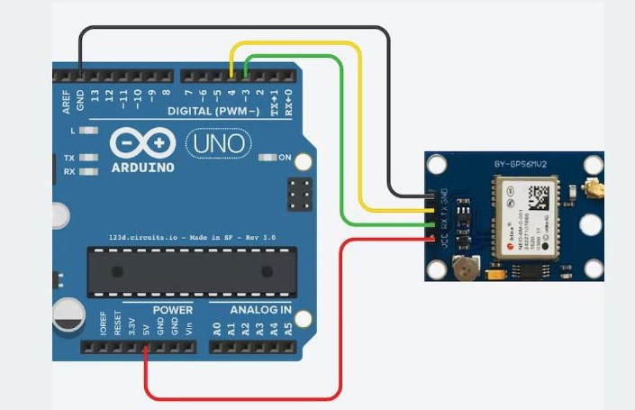
Circuit Diagram
Gps module for detecting current location

Slide 14
OpenCv
Tool for image processing and performing computer vision tasks. It is an open-source library that can be used to perform tasks like face detection, objection tracking, landmark detection, and much more.
Supports multiple languages including python, java C++.
First, we imported the OpenCV (as cv2) library into the program to use their functions in the code. After that, we have opened the image file using the imread() function of cv2.
Then, defined the properties for the image we opened in the program using the cv2 functions. Then, we subplot the image using the subplot() function of plt and giving parameters in it. In last, we have used the imshow() and show() function of the plt module to show the image in the output.

Slide 15
pyttsx
pyttsx is a cross-platform text to speech library which is platform independent. The major advantage of using this library for text-to-speech conversion is that it works offline.
Rather than saving the text as audio file, pyttsx actually speaks it there. This makes it more reliable to use for voice-based projects.

Slide 16
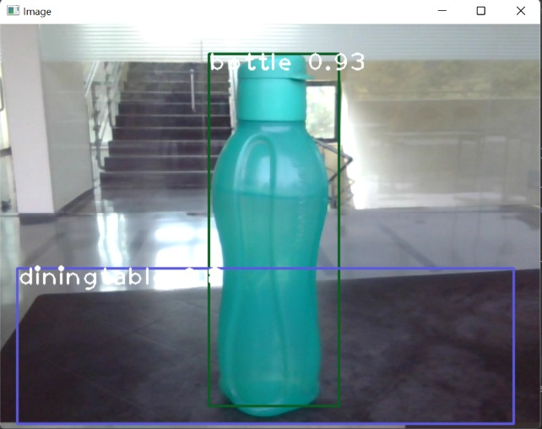
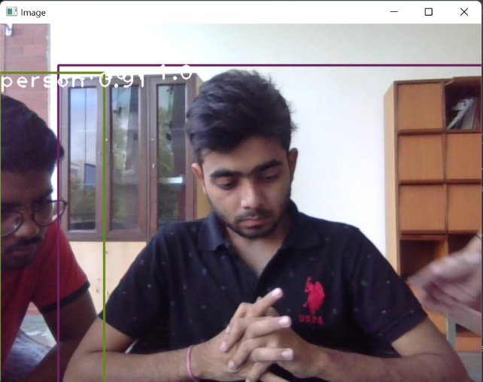
Result & Evaluation

Slide 17
Advantages of system
The system is used in the real time object detection.
It helps Blind person away from dangerous location.
This project is to provide cost effective way to allow path planning for blind people.

Slide 18
Conclusion
In this project we present a visual system for blind people based on
object like images and video scene. This system uses Deep Learning
for object identification. In order to detect some objects with
different conditions. Object detection deals with detecting objects of
inside a certain image or video.
The TensorFlow Object Detection API easily create or use an object
detection model Blind peoples they have a very little information on
self-velocity objects, direction which is essential for travel. The
navigation systems is costly which is not affordable by the common
blind people. So this project main aim is to the help of blind people.

Slide 19
Thanks!
Any questions ?

