Slide 1
Team DREAM

Slide 2
01.
Kindergarten project

Slide 3
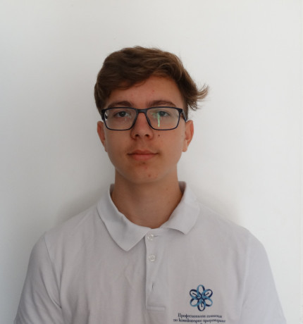
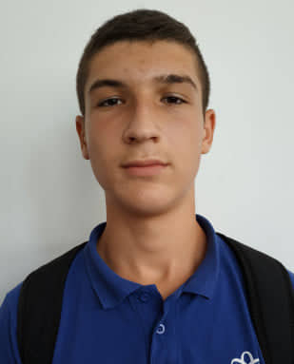
Our team
Georgi Koradov
Aleksander Pratshkov
Back End developer
Front End developer

Slide 4
Our Project
Our project is about kindergarten management application.
It allows candidacies to be sorted and searched for by parents according to certain criteria.
The parent needs to make a registration in order to submit a candidacy. According to point sets for each of the districts of the city, points can be given, which form a score for applying to a kindergarten.

Slide 5
Project stages
Stage 2
Stage 3
Stage 1
Start working on the program
Make presentation and documentation
We made plan
Distributing roles
We discussed our program functionality
We made everything clear about the presentation

Slide 6





Used Technologies
C++ is the programming language we used
Visual Studio – our development environment
We used Word for our documentation
We used Git Hub to monitor our progress
We used Power Point for our presentation

Slide 7
DEMONSTRATION

Slide 8


Thank you for your attention!
Do you have any questions?

