Slide 1
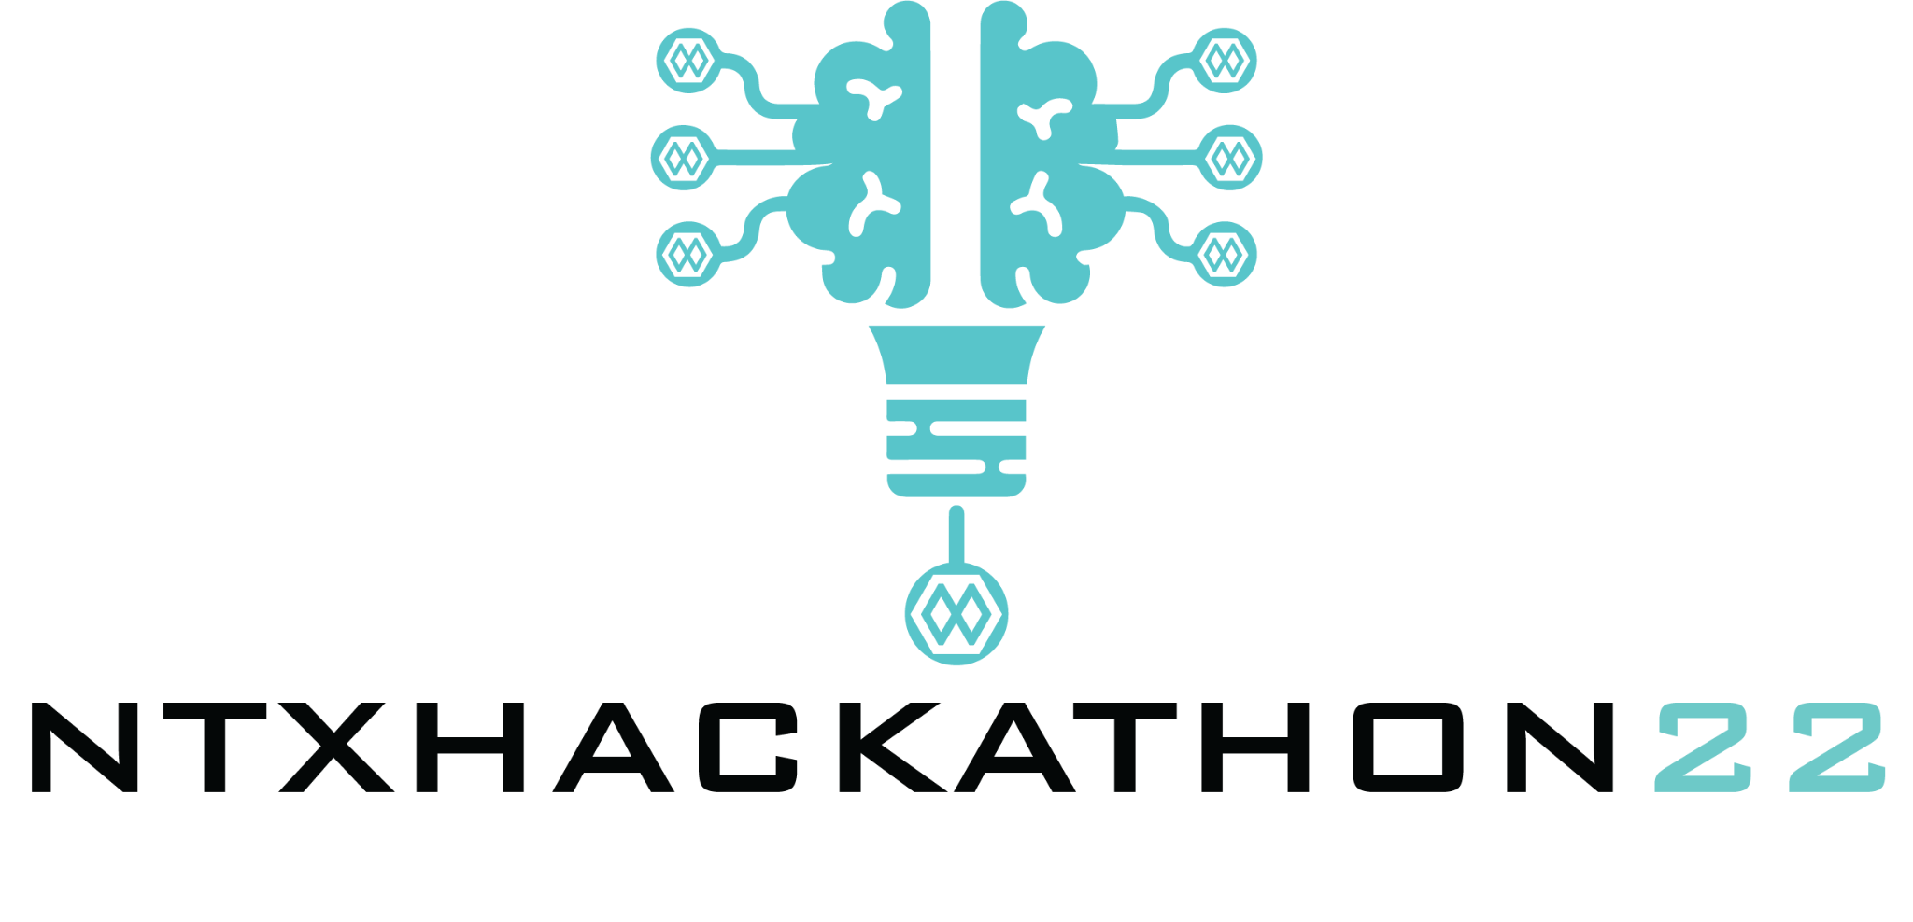

Unveiling Hand Kinematics: Classification and Mapping through EMG
Team ID: Team-54
Team Name: Ner2APE
Team Members:
Aditya Kameswara Rao Nandula, Eashita Chowdhury, Pallab Das

Slide 2
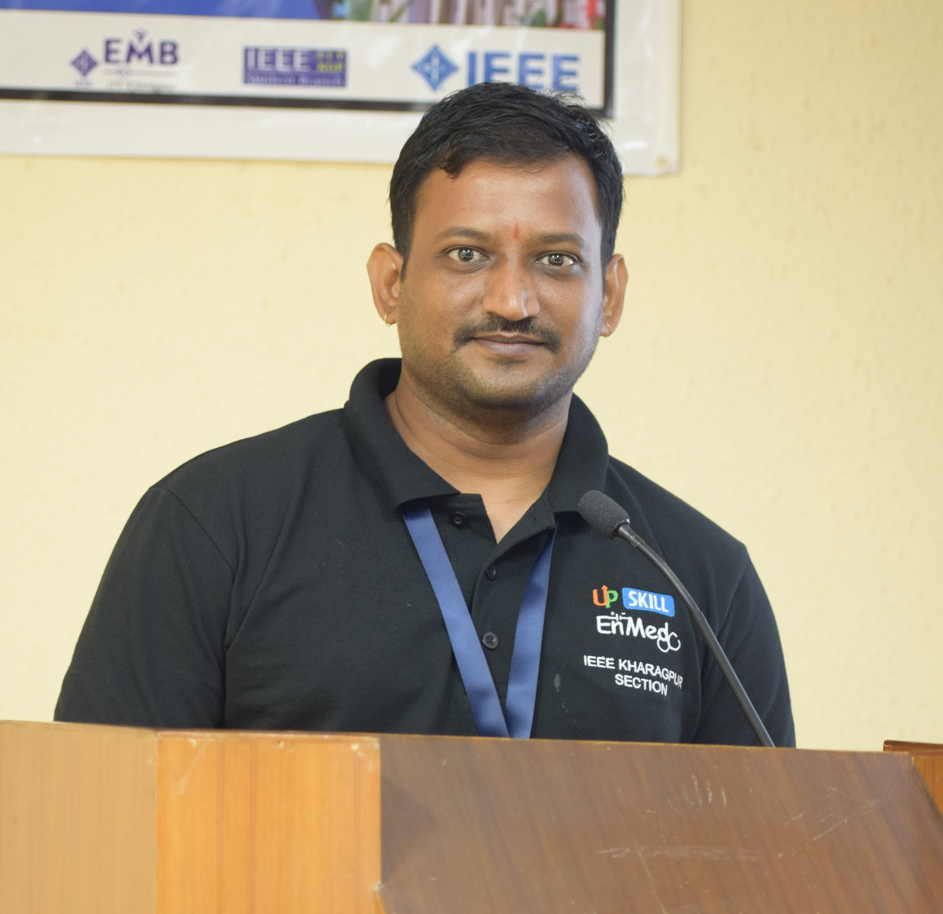
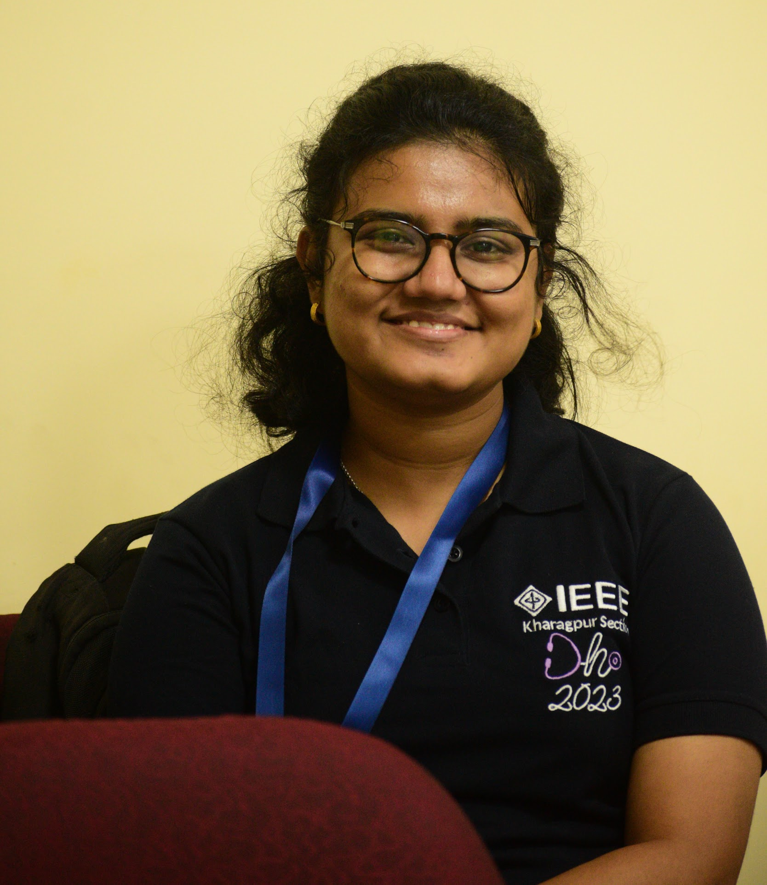
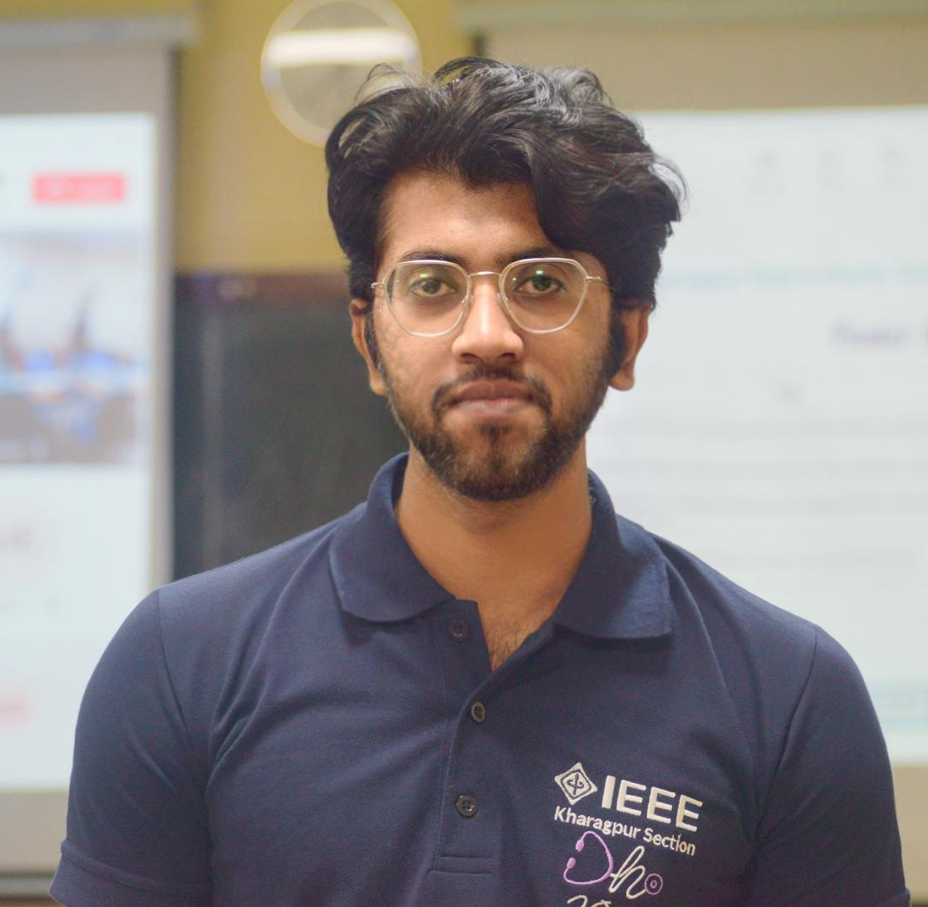
Team Members:
Aditya Kameswara Rao Nandula
Eashita Chowdhury
Pallab Das

Slide 3
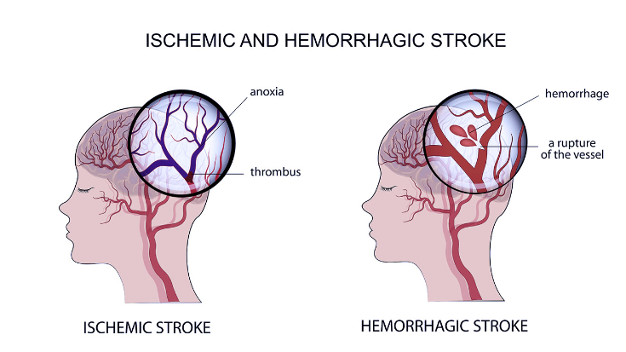
Introduction:
•Stroke is a condition where blood supply to some part of the brain is obstructed or there is leakage of blood.
•It leads to disabilities like limb motor function loss, speech impairment, etc.
•WHO reports 15 million people suffer worldwide; 5 million die and another 5 million are permanently disabled.
•145.3 per 100 000 persons/year in India with death rate of 37.1%.

Slide 4
The Problem :
The stroke patients need a physiotherapy for the limbs to get the reactivation of the dead muscles
Basic daily hand motion requirements are vital for stroke patients
A wide range of physical therapies are used.
EMG is one of the electrophysiological which can help in the restoration of muscle movements.

Slide 5
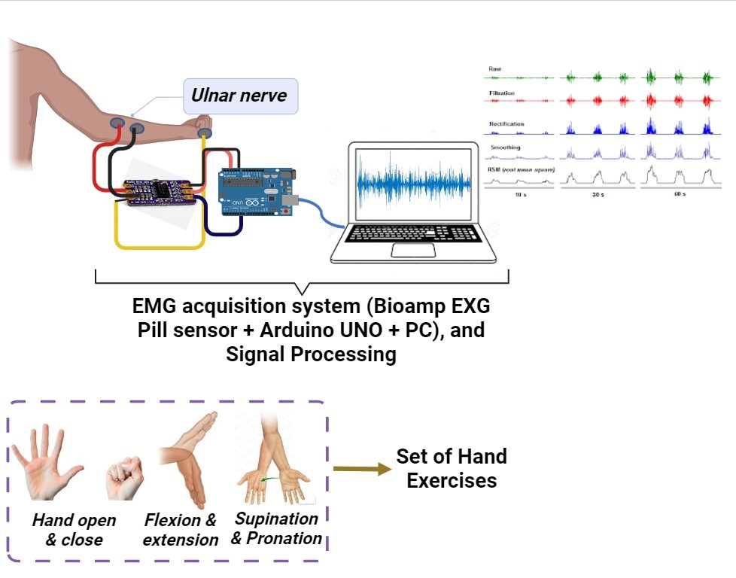
Workflow
1
Thresholding & Mapping of movements showing in the imminent slide
2
3

Slide 6
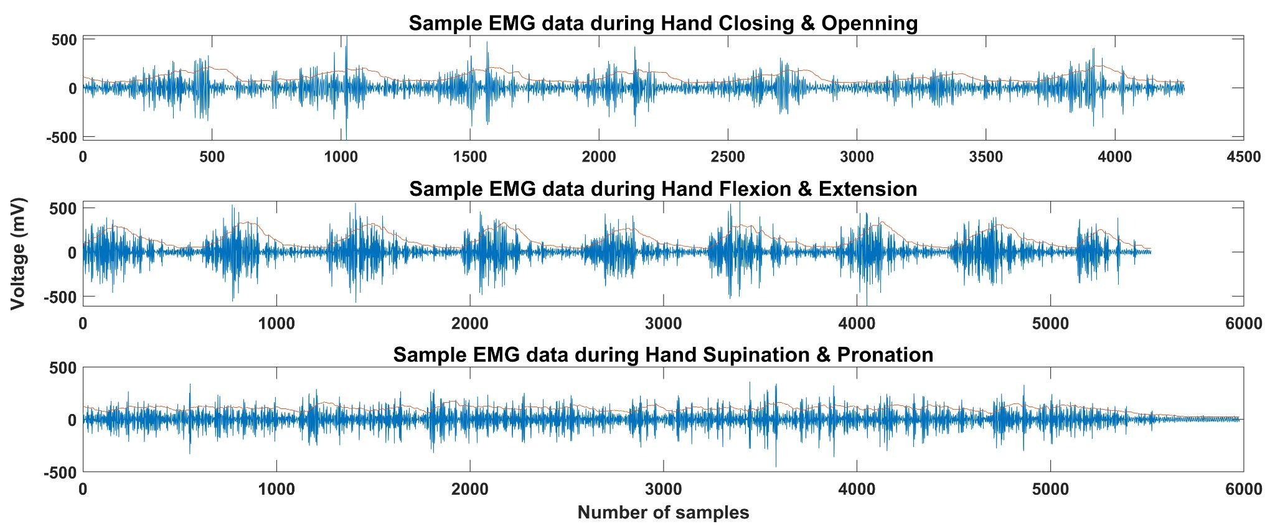

Slide 7
Hand
Close
1
Hand
Open
Hand
Flexion
Hand
Extension
2
Hand Supination
Hand Pronation
3

Slide 8
The Solution
Initial data acquisition has been done
Processing of the signals has been done
Threshold limits for the hand actions has been identified for 3 subjects
We tried to simulate the actions of hand movements
Online control of the simulation with EMG signals is yet to work.

Slide 9
Documentation
https://github.com/AKRNANDULA/Ner2APE_Hackathon2023

Slide 10
Thank You

