Slide 1
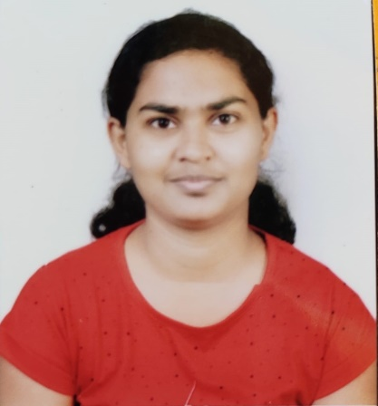

Aishwarya Krushnakumar More
Analyst/Software Engineer
Bachelor of Civil Engineering and Technology : 2016 - 2020
Skills
Java​ | Java Basics, OOPS, Generics,​ Collections, Array, Loops​
Spring | Spring Boot, Spring Rest Services, Spring Restful Services
React​ | Components, Hooks, Routing, Forms & Validation​
Database​ | Postgre SQL
UI Tech​ | HTML 5 & CSS, Bootstrap 4, JavaScript, ES6
Tools | Eclipse, STS, GitHub, Postman, Swagger, Visual Studio Code, Pg Admin 4, SQL Shell
Add On skills​ ​ | Immersive Learning​, Team management
Mumbai
Aishwarya.krushnakumar-more@capgemini.com
7057330220
A4
Full Stack Developer
Hands on experience on Core Java, Postgre-Sql, Spring Restful Services
Proficient in creating Single page Web Application in React with Authentication with routing
Has working knowledge on React and Java Development using Spring framework on an intermediate level.
Ready to learn new technologies and implement them for the future knowledge improvement.
E-Vehicle User dashboard and Admin
Case study of e- Vehicle showroom for user dashboard and admin pages along with API Gateway, Swagger, responsive UI with HTML5, CSS, Bootstrap and React used as User Interface.
Check out my work on GitHub

