Slide 1


AI-Enabled Smart Library Management System
Arnav Agarwal-1024160010
Aradhya Goyal-1024160135
Amanjot Kaur Sidhu-1024160025

Slide 2

Why current systems fall short
Search is slow and imprecise — keyword-only, limited context
Manual tracking of loans and due dates causes delays and errors
Notifications are generic or absent, increasing late returns
Administrative workflows are repetitive and time-consuming

Slide 3



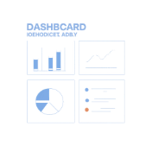
Project Objectives
Intelligent Search
Efficient Management
Automated Reminders
AI Analytics & Recommendations
Context-aware search and conversational assistance for students
Streamlined handling of books, loans, fines, and student records
Smart due-date alerts, renewals, and overdue notices via multiple channels
Personalized reading suggestions and usage insights for librarians

Slide 4

Methodology — System Workflow
Student/Admin
Frontend
Backend
Database
Key AI components: • Campus Intelligence Agent — campus-wide context and catalog indexing. • Student Onboarding Agent — profile setup, preferences, and access control. • Smart Monitoring & Notification Agent — due-date tracking and alerts.

Slide 5
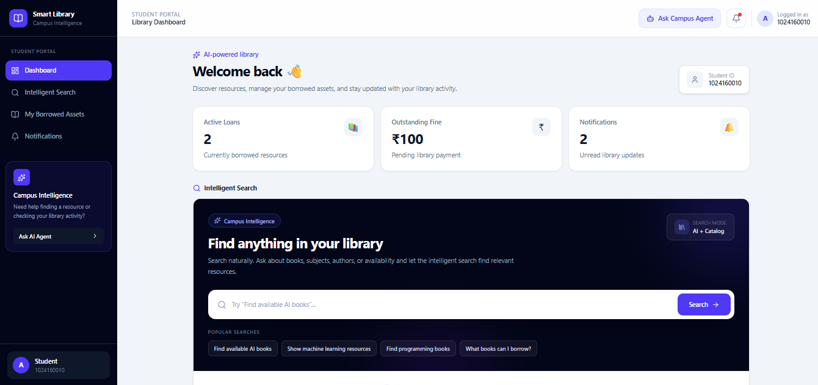
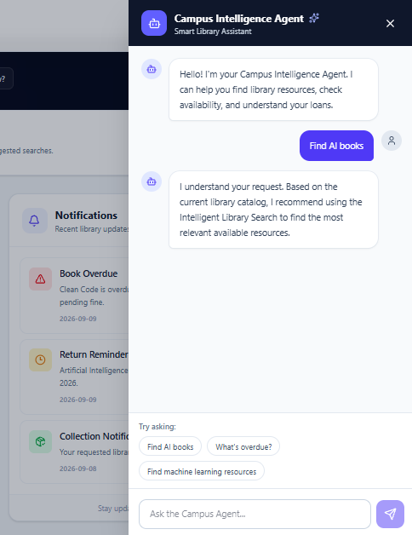

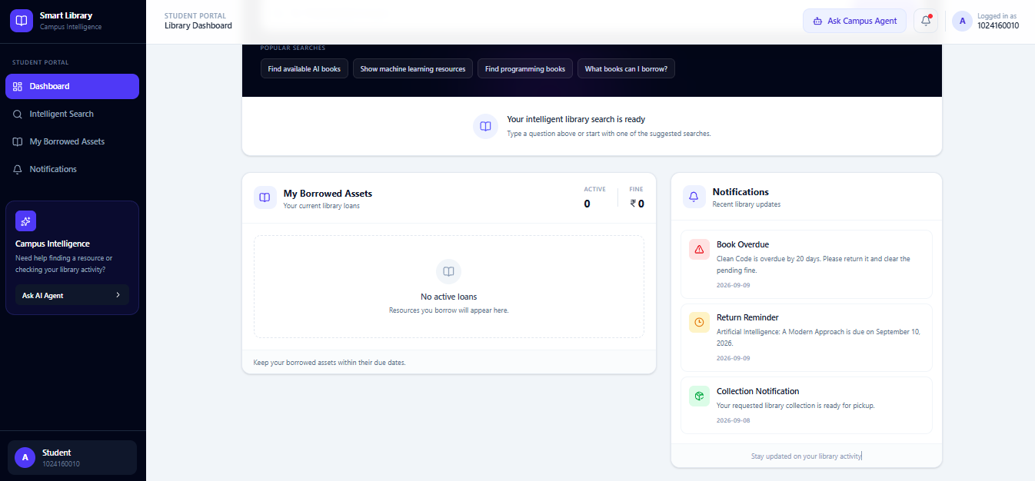
Implementation & Early Results
Use case diagrams and DFDs designed
React frontend prototype built — student dashboard ready
Features: Search, Loan Tracking, Notifications, AI Assistance
Prototype demo uses mock data; SQL schema under review
Documentation (MkDocs) published via GitHub Pages

Slide 6
Conclusion & Next Steps
Conclusion
Next Steps
Prototype and architecture foundations are complete. Frontend and DB foundations are in place for integration with backend and AI agents.
1) Connect frontend to SQL database
2) Implement backend APIs and authentication
3) Integrate and test AI agents (search, monitoring, recommendations)
4)End-to-end testing and user evaluation in campus environment

