Slide 1
Online Note Taker (TODO)
Name :- Akshay Kumar Shukla
Batch Code :- 2021-7127
Trainer :- Ruby Mehra Bindra

Slide 2
INTRODUCTION :-
A Note Taker list is a simple list of tasks that allows you to visually see what you need to accomplish It’s all in ONE place for easy reference. Grows and shortens as you work through items Posted in a common place so you don’t FORGET your tasks ORGANIZATIONAL scheduling too.

Slide 3
Tools and technologies used :-
JSP
JSTL
Hibernate
Servlet API
IDE – STS
MySQL - mysql-connector- java
JDK
Apache Tomcat

Slide 4
REQUIREMENTS :-
Remind yourself of what’s important and what needs to get done It can be fun
Playing with the list can help you think outside of the box for solutions

Slide 5
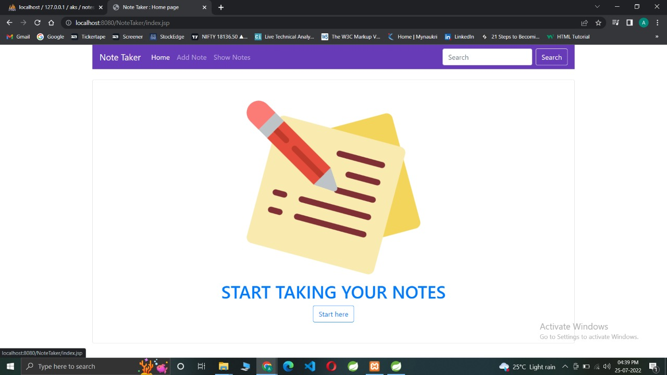
Main Screen :- (Home screen)

Slide 6
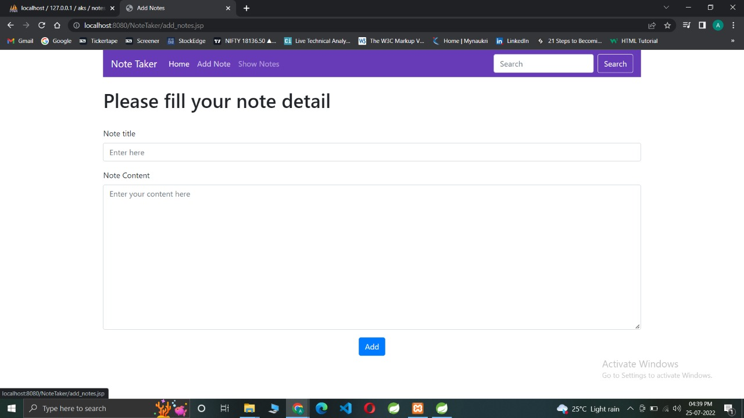
Add a Slide Title - 1
Add Note screen

Slide 7
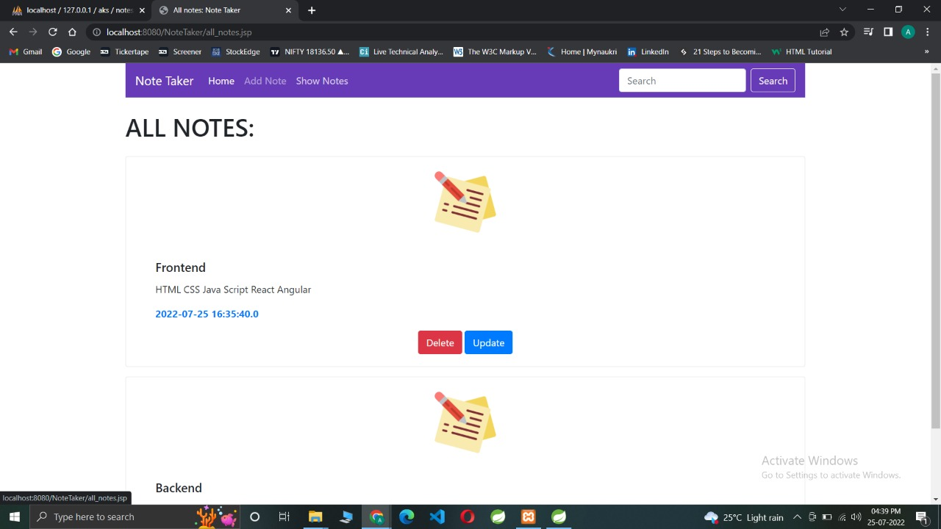
Show notes screen

Slide 8
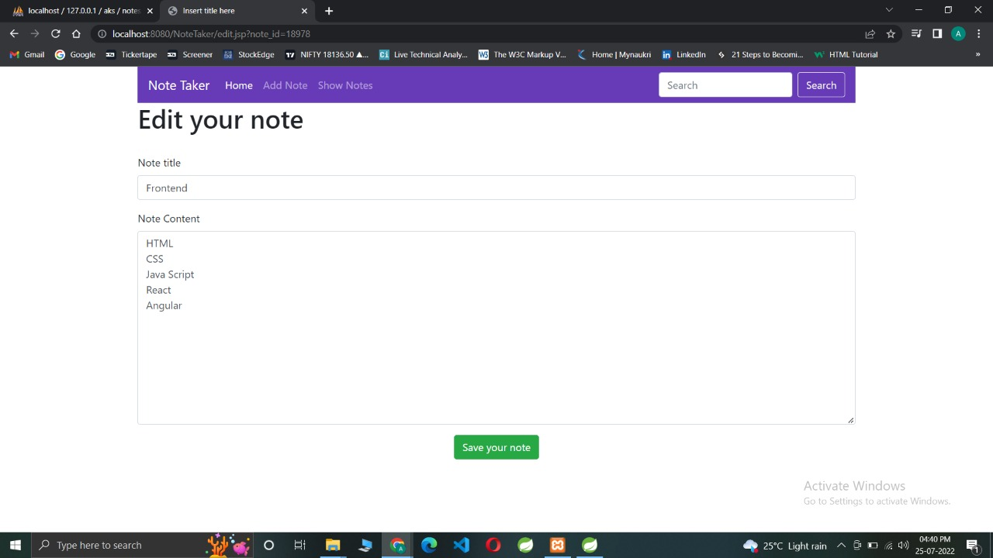
Update button screen

Slide 9
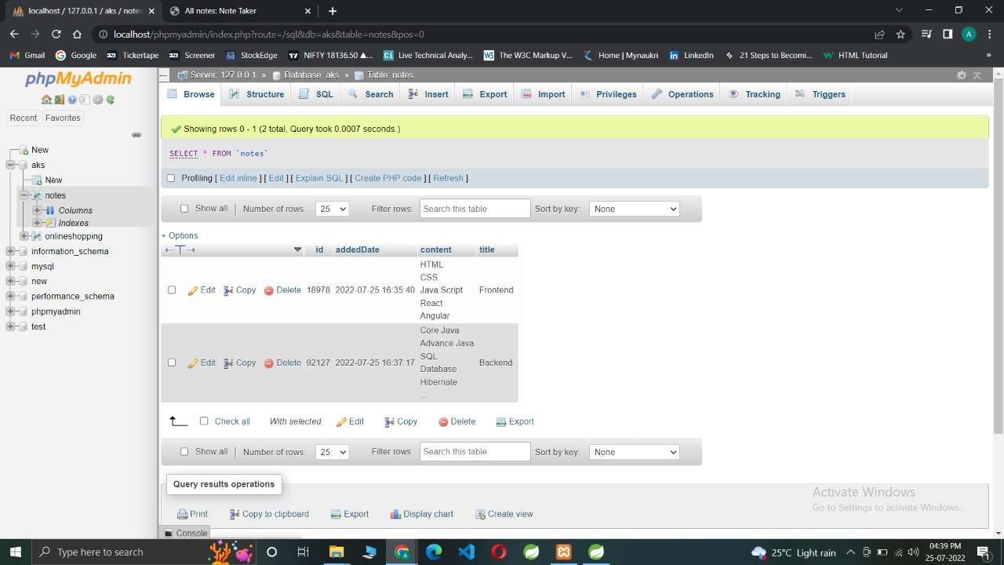
Table in SQL

Slide 10
THANKYOU Github Account :- https://github.com/AKS2996

