Slide 1
Minihackathon-1
Presented by
AKSHAIYA.M

Slide 2
EMPLOYEE DATASET
Predict the Attrition Rate

Slide 3
BUSINESS UNDERSTANDING
Employees are the most important asset of an organization
Successful employees meet deadlines and will be playing a major part in organization’s growth
However , it is important to get in track of the Attrition rate of employees as the organization can develop their policies
Here the aim is predict the employee attrition rate.

Slide 4
DATASET
Feature | Description | Data Type
Employee_ID | Unique ID of each employee | object
Age | Age of each employee | float64
Unit | Department under which the employee work | object
Education_level | Rating of Qualification of an employee (1-5) | int64
Gender | Male-0 or Female-1 | object
Decision_skill_possess | Decision skill that an employee possesses | object
Post_Level | Level of the post in an organization (1-5) | int64
Relationship_Status | Categorical Married or Single | object
Pay_Scale | Rate in between 1 to 10 | float64
Time_of_service | Years in the organization | float64
growth_rate | Growth rate in percentage of an employee | int64
Time_since_promotion | Time in years since the last promotion | int64
Work_Life_balance | Rating for work-life balance given by an employee | float64
Travel_Rate | Rating based on travel history(1-3) | int64
Hometown | Name of the city | object
Compensation_and_Benefits | Categorical Variable | object
VAR1 - VAR7 | Anominised variables | float64
Attrition_rate(TARGET VARIABLE) | Attrition rate of each employee | float64

Slide 5
DESCRIPTIVE ANALYSIS
The data set contains three CSV files
Train.csv
Test.csv
sample_submission.csv
The predicted data should be in the form of CSV file with Employee_ID and Attrition_rate as columns

Slide 6
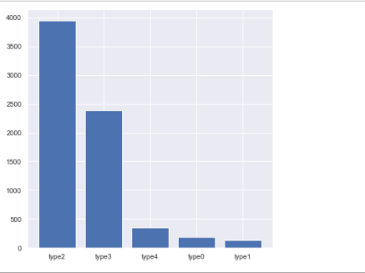
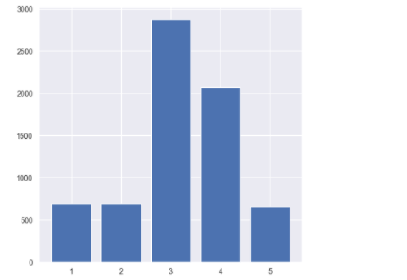
DESCRIPTIVE ANALYSIS USING EDA
The plot shows the distribution of Compensation & Benefits category
The plot shows the distribution of
Education Level

Slide 7
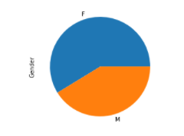
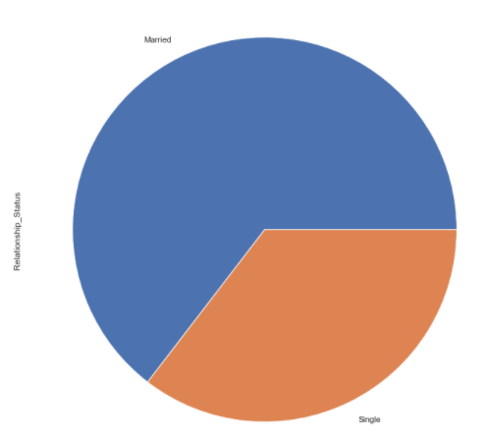
DESCRIPTIVE ANALYSIS USING EDA
The plot shows the number of male and female employees
The plot shows the Relationship status of employees

Slide 8
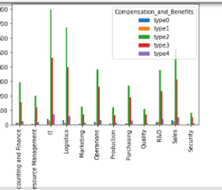
Unit Vs Compensation Benefits

Slide 9
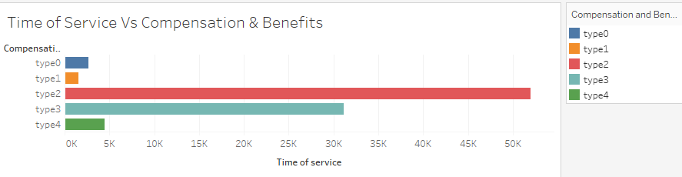
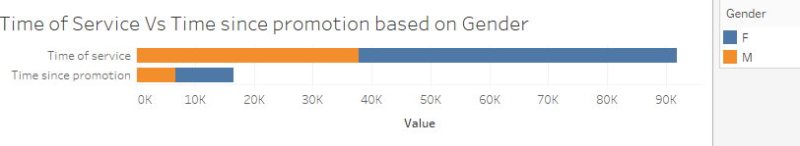
The plot shows how the promotion , compensation and benefits vary with Time of service

Slide 10
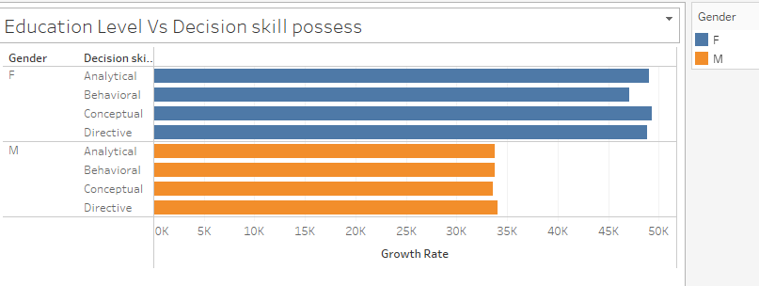

Slide 11
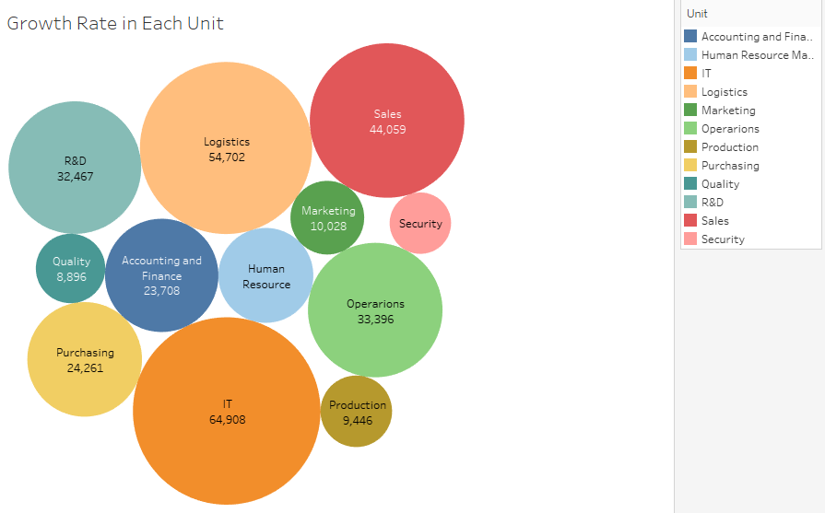

Slide 12
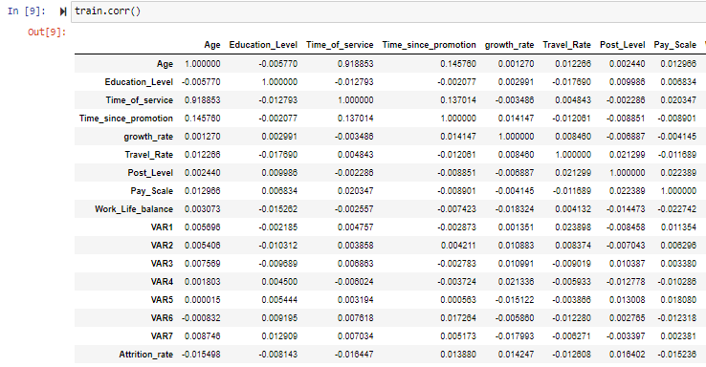
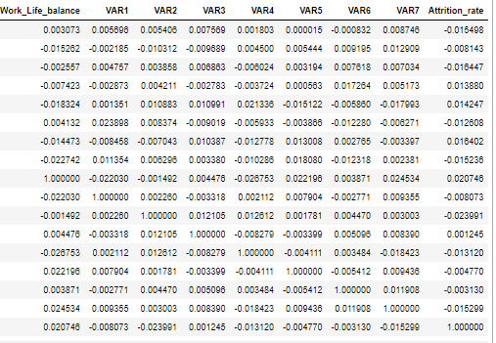
CORRELATION BETWEEN FEATURES

Slide 13
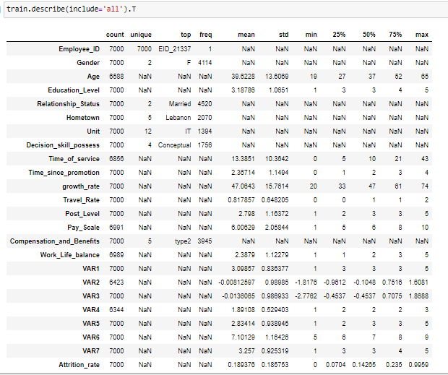
STATISTCAL ANALYSIS

Slide 14
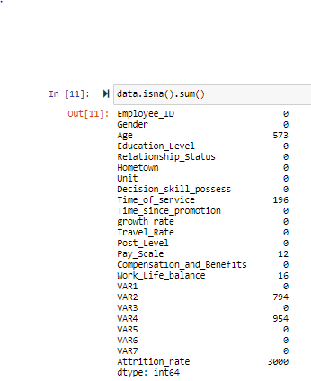
STEPS IN PREPROCESSING
For the processing purpose , train and test data has been concatenated
There are nulls in some columns such as Age ,Time_of_service,Pay_Scale,Work_Life_balance,VAR2 and VAR4
In Gender column , M is replaced as 0 and F is replaced as 1
The nulls in Age column is filled with mean values
In Relationship_Status , married is replaced as 0 and single is replaced as 1
Label encoding is done in Decision_skill_process feature

Slide 15
Time_of_service is filled with mean values
Pay_Scale is also filled with mean values
Work_Life_balance is filled with mean values
VAR2 is filled with mean values
VAR4 is filled with median values as the data seems to have outliers
Segregated the numerical and categorical columns
Scaled the numerical columns using Standard Scaler except the target data and few features and scaling is not required for them.
Processed the categorical data by adding dummies except the Employee_ID.
Concatenated both the processed numerical and categorical data with the Employee_ID.
Separated the train and test columns and made it into a CSV file

Slide 16
ALGORITHM USED
Linear Regression
Lasso Regression
Ridge Regression
Elastic Net Regression
KNN Regression

Slide 17
Hyper Parameter Tuning in Algorithm
In KNN Regression, substituted different values of K and analysed the RMSE values
While analysing the values , k=2 has the good score compared to other values present below
K-value | MSE value | Score = 100 * max(0,1-rmse(actual_values,predicted_values)
KNN(k-value=1) | 0 | 15.77575
KNN(k-value=2) | 0.129618 | 15.53388
KNN(k-value=3) | 0.150289 | 15.77575
KNN(k-value=4) | 0.159594 | 15.90385
KNN(k-value=6) | 0.168358 | 16.0217

Slide 18
Algorithm and their Scores
Algorithm | MSE value | Score = 100 * max(0,1-rmse(actual_values,predicted_values)
Linear Regression | 0.1851014 | 16.30517
Lasso Regression | 0.18574 | 16.30929
Ridge Regression | 0.1851 | 16.30551
Elastic Regression | 0.18574 | 16.30929
KNN Regresssion | 0.164779 | 15.97066

Slide 19
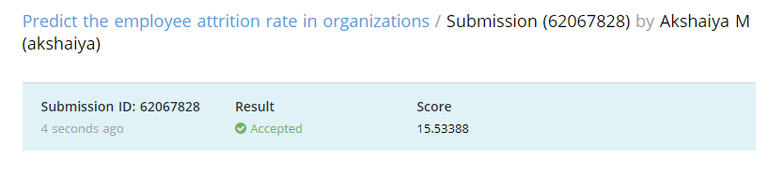
Score
Efficient Algorithm :K-Neighbour Regression (K-value=2)

Slide 20
THANK YOU

