Slide 1
Exploring the Wisdom of Crowds
Sharad Goel
Stanford University
February 13, 2015

Slide 2
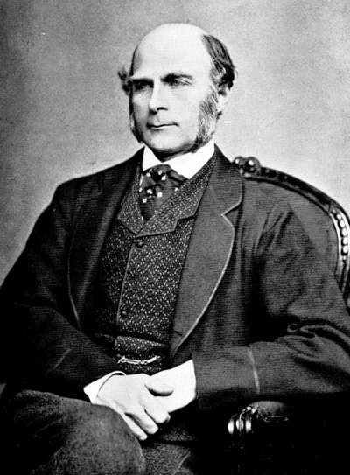
Francis Galton

Slide 3
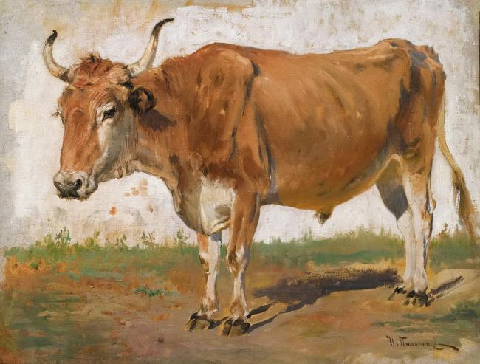
1906 Plymouth County Fair
What is the weight of the ox?

Slide 4
1906 Plymouth County Fair
What is the weight of the ox?
800 guesses
median guess was 1207 lbs.

Slide 5
1906 Plymouth County Fair
What is the weight of the ox?
800 guesses
median guess was 1207 lbs.
actual weight was 1198 lbs.

Slide 6
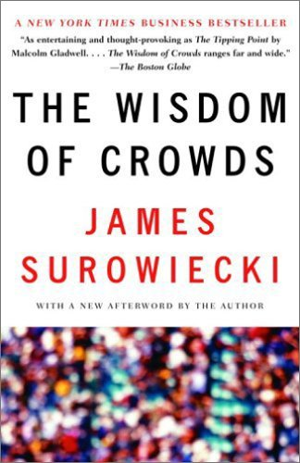

Slide 7
Wisdom of the crowd
The collective opinion of a crowd
can outperform the judgments
of any one individual

Slide 8
Madness of crowds
Charles Mackay
riots
economic bubbles
mass hysteria
herding

Slide 9
Research question
When are crowds “wise”?

Slide 10
Research question
How best to aggregate opinions?
How big a crowd do you need?
What is the effect of social influence?

Slide 11
Research question
What is the underlying mechanism?

Slide 12
Experimental design
1. Systematically construct thousands of tasks
2. Recruit a crowd to complete the tasks
3. Analyze the responses

Slide 13
Studying crowds, with crowds

Slide 14
A mini-experiment
in “collective intelligence”
http://goo.gl/forms/WG1kWgYjke
Give your best guess
Do not look up the answer
Do not talk to anyone
Don’t worry if you don’t know the answers!

Slide 15
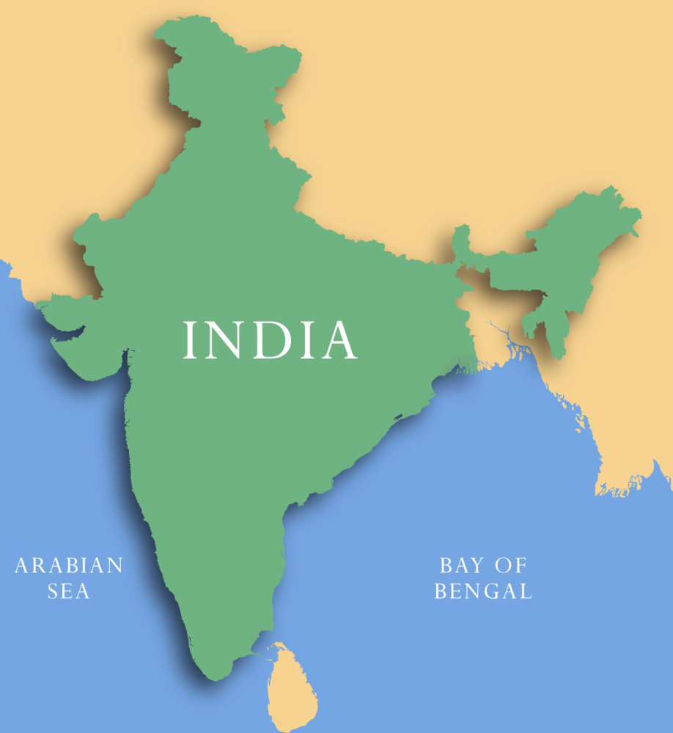
What is the total area of India? (km²)

Slide 16
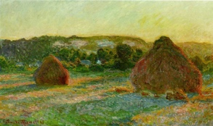
In what year was this painting made?
Notes:
Answer: 1890

Slide 17
How many dots are in the figure?

Slide 18
India vs. Pakistan
Cricket World Cup, Game 4
How many runs do you think
each team will score?

Slide 19
Assignment
literature review
Document past studies
on the wisdom of crowds

Slide 20
Assignment
brainstorm tasks
be creative, but realistic

Slide 21
Assignment [ optional ]
apply to design experiment platform
teams should have experience with
HTML, CSS, PHP, JavaScript, and MySQL

Slide 22
Course materials
Piazza, GitHub

Slide 23
Course Staff
Sharad Goel
Imanol Arrieta Ibarra
Camelia Simoiu
Rajan Vaish
Notes:
3,287,590; 1890; 1149

