Slide 1
IMDB Movie Analysis Final Project-1
By Akshat Mittal

Slide 2
PROJECT DESCRIPTION
The project is about finding out the various insights in IMDB Movies dataset .
We analyze this data and answer the questions that follows:
Cleaning the data: This is one of the most important step to perform before moving forward with the analysis.
Movies with Highest Profit: Create a new column called profit which contains the difference of the two columns: gross and budget.
Top 250: Create a new column IMDb_Top_250 and store the top 250 movies with the highest IMDb Rating. Also make sure that for all of these movies, the num_voted_users is greater than 25,000. Extract all the movies in the IMDb_Top_250 column which are not in the English language and store them in a new column named Top_Foreign_Lang_Film.

Slide 3
Best Directors: Group the column using the director_name column. Find out the top 10 directors for whom the mean of imdb_score is the highest and store them in a new column top10director.
Popular Genres: Find popular genres. Perform this step using the knowledge gained while performing previous steps.
Charts: Create three new columns namely, Meryl_Streep, Leo_Caprio, and Brad_Pitt which contain the movies in which the actors: 'Meryl Streep', 'Leonardo DiCaprio', and 'Brad Pitt' are the lead actors. Append the rows of all these columns and group the combined column. Find the mean of the num_critic_for_reviews and num_users_for_review and identify the actors which have the highest mean. Observe the change in number of voted users over decades using a bar chart. Create a column called decade which represents the decade to which every movie belongs to. For example, the title_year year 1923, 1925 should be stored as 1920s. Sort the column based on the column decade, group it by decade and find the sum of users voted in each decade. Store this in a new data frame called df_by_decade. Find the critic-favorite and audience-favorite actors

Slide 4
APPROACH
First thing is to accessing the dataset carefully using Excel and understanding that what’s happening in the data.
Applying functions to remove the null values and the duplicate data.
Categorizing the data into different tables to gain insights asked in the project.
Creating the graphs and other visualization methods to get more descriptive analysis for easy representation.

Slide 5
TECH-STACK Used
I have used Microsoft Excel to perform statistical analysis on this dataset because allows users to edit, organize, and analyze different types of information.
It allows collaborations, and multiple users can edit and format files in real-time, and any changes made to the spreadsheet can be tracked by a revision history.
This tool is used to create graphical representation of the results and to understand the result set better.
Microsoft Excel enables us to format, organize, data analyses, and calculate data in a spread sheet, and users can make information easier to view as data is added or changed.
Microsoft PowerPoint used to make the report to represent the project report clearly.

Slide 6
INSIGHTS
There were several function present in Excel which was quite unknown to me.
The data set was quite large and working with such dataset in real time was fun and more over easy learnable.
There was critical analysis was involved in this whole process.
Creating tables and using charts to analyze something is quite useful and we have also seen its practical approach.

Slide 7
1) Cleaning the Data:
This is the most difficult and crucial step of any Data analysis project.
The process included in this step varies from question to question and Dataset to Dataset.
To clean the dataset we will be:-
First dropping the columns which have no use for the analysis that we will be doing.
Columns like ‘Color’, ‘director_facebook_likes’, ‘actor_3_facebook_likes, ‘actor_2_name’, ‘actor_1_facebook_likes’, ‘cast_total_facebook_likes, ‘actor_3_name’, ‘facenumber_in_posts’, ‘plot_keywords’, ‘movie_imdb_link’, ‘content_rating’ ,’actor_2_facebook_likes’, ‘aspect_ratio’, ‘movie_facebook_likes’ are the columns containing irrelevant data for the analysis tasks provided. So, these columns needs to be dropped.
After dropping the irrelevant columns now we need to remove the rows from the dataset having anyone of its column value as blank/NULL.
Then we need to get rid off the duplicate values in the dataset which can be achieved by using the ‘Remove Duplicate Values/Cells’ available in the ‘Data’ tab.

Slide 8
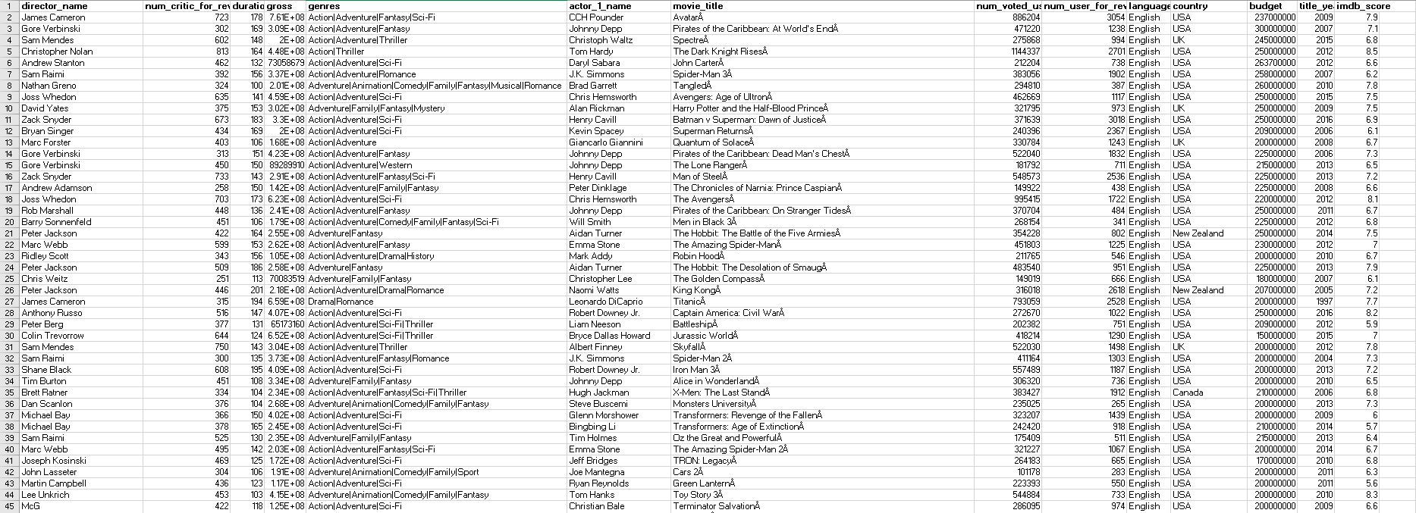
Cleaned Data:
Cleaned Dataset Link: https://docs.google.com/spreadsheets

Slide 9
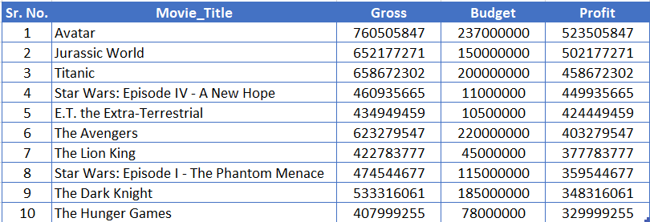
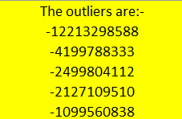
2) Movies with the Highest Profit:

Slide 10
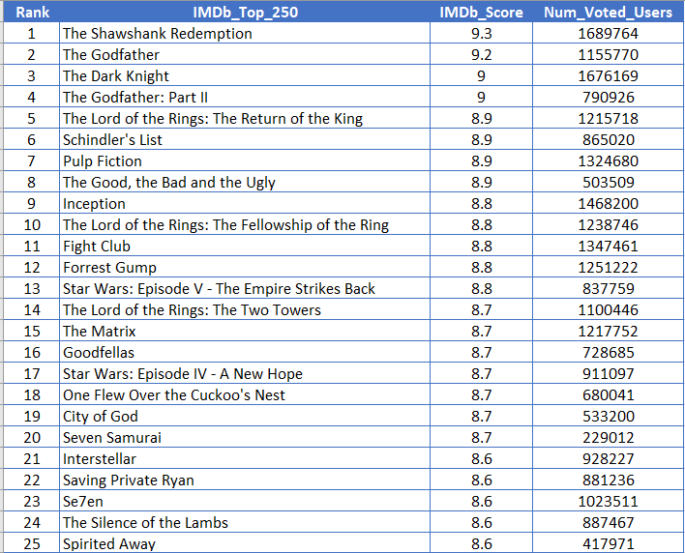
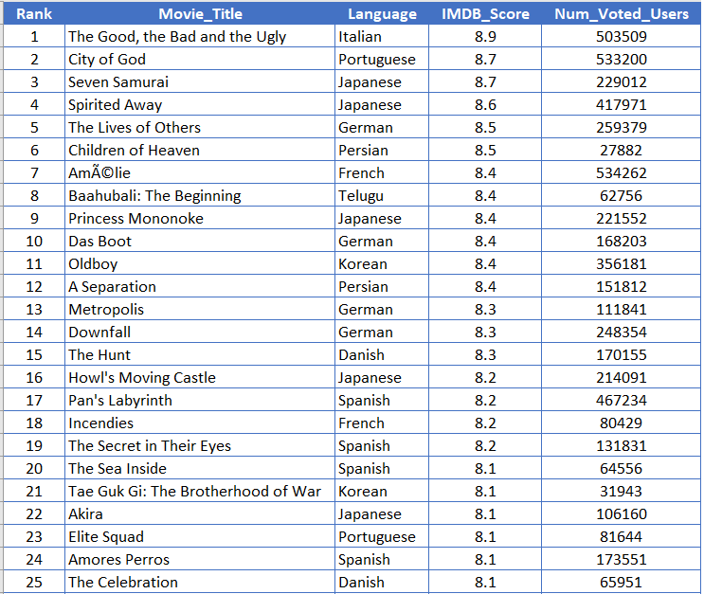
3) Top 250: Find IMDB Top 250
Top 25 Movies in all Languages:
Top 25 Movies not in English Language:
IMDB Top 250 Dataset Link: https://docs.google.com/spreadsheets/

Slide 11
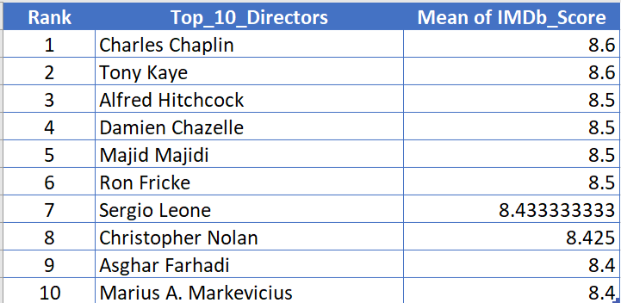
4) Best Directors:
Top10 Best Directors:
One of the best director is Charles Chaplin as seen from the observations.

Slide 12
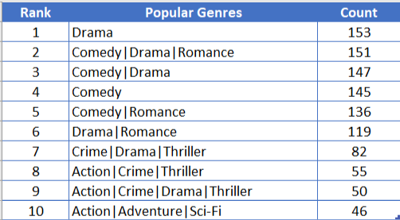
5) Popular Genres:
Here are the top 10 popular genres-
Most popular genre is Drama followed by Comedy.

Slide 13
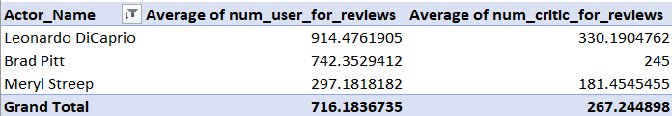
6) Charts: Find the critic-favorite and audience-favorite actors
As we can see clearly from the results,
Leonardo DiCaprio is the critic-favorite and audience-favorite actor.

Slide 14
Change in Number of Voted Users Over Decades

Slide 15
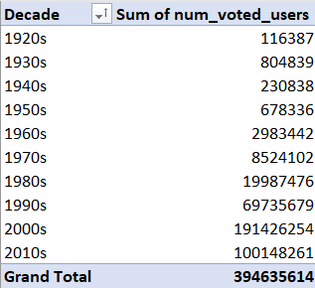
Change in Number of Voted Users Over Decades using Bar Chart

Slide 16
Working file Containing all the Analysis of IMDB Movie Dataset:
Link: https://docs.google.com/spreadsheets/IMDB_Movies_Dataset
These are the required insights and the result which were asked.
Hence, all the questions given as a part of Data Analytics IMDB Movie Analysis (Final Project -1) have been provided with answers along with graphs.

Slide 17
RESULT
In this task all the concepts regarding to Excel and statistics like sort, filter, pivot- table, etc. have been implemented using Microsoft Excel.
This project has helped me to understand the concept of exploratory data analysis.
From this project, I learnt the need of data filtration and how to generate deeper insights for a problem mentioned.
I have gained knowledge of various excel sheet functions which helped me to solve the questions asked in this project.
I have achieved how to analyze the project, as this helped me to gain more knowledge about Excel to perform better.

Slide 18
THANK YOU

