Slide 1
Catching Silent Failures in Data Pipelines
Self-supervised deep learning that finds a broken pipeline run, and points at the task that broke it
B.Tech Deep Learning Project
Akshat
Notes:
Open with the one-line version: data pipelines break quietly, and when they break every downstream step looks broken too. This project finds the one that actually caused it, without needing labelled examples.

Slide 2
Data pipelines fail without telling you
The job finishes, the report loads, and the numbers are wrong
What people expect
What actually happens
The cost
A job crashes.
Somebody gets an alert within minutes.
It gets fixed the same day.
The job finishes successfully.
A price field switched from rupees to paise upstream.
Every number is 100x too big.
Nobody notices for weeks.
Every report built on that table is wrong for the whole period.
It is found by a human squinting at a dashboard.
Notes:
Give a concrete example. A currency convention changes upstream and amounts silently become 100x too large. Nothing crashes, so nothing alerts. This is the class of failure the project targets.

Slide 3
Two reasons this is hard
1
2
There are no labels
Symptoms are not causes
Failures are rare and recorded badly. A team that has just spent a night fixing one is not going to sit down and annotate it.
So the model has to learn what normal looks like on its own.
When one step breaks, every step after it looks broken too.
Often the damage grows as it travels, so the biggest warning sign is furthest from the actual problem.
Notes:
Reason two is the interesting one and the whole reason the project exists. Telling someone that nine of nine tasks look unhealthy is not help. Land this before moving on.

Slide 4
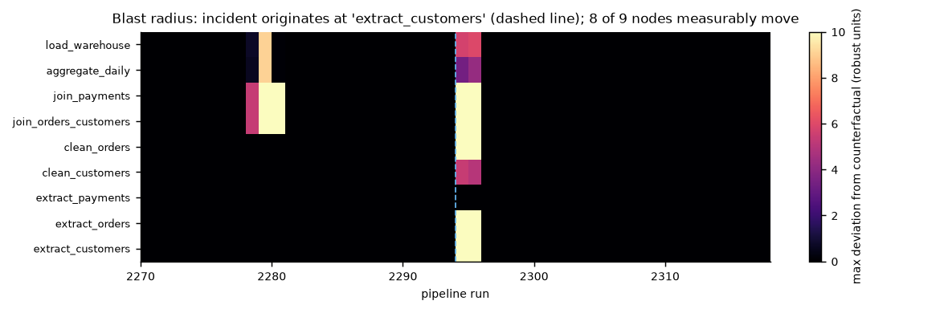
One fault, nine suspects
The problem starts at one task, but almost everything lights up
The fault was injected in one task only.
8 of 9 tasks move.
Several move harder than the one that caused it.
This is why you cannot simply blame whichever task looks worst.
Notes:
Point at the bright band. Every one of those tasks would trip an ordinary alarm. Only one of them is the cause. Ranking by 'how bad does it look' picks the wrong one.

Slide 5
There was no dataset, so I built one
No public benchmark of pipeline failures with cause labels exists
Existing work is tested on server and sensor data.
8,000
9
Those datasets have no pipeline, so there is no 'which step' to ask about.
pipeline runs simulated
tasks per run
So the question cannot even be posed on them, let alone measured.
15
273
Building the benchmark is part of the contribution, not a shortcut around a missing one.
types of failure
incidents labelled
Notes:
Be ready for 'why not real data'. Answer: no public dataset labels which step caused a failure, and company pipeline data is not released. Building one is the only way to measure localization.

Slide 6
The pipeline I simulated
Nine tasks, each doing real work on real rows
extract
customers
clean
customers
join orders +
customers
extract
orders
clean
orders
join
payments
aggregate
daily
load
warehouse
extract
payments
Faults are injected into the actual rows, not into the statistics. The next task then reads those broken rows, so the damage spreads on its own instead of being scripted by me.
Notes:
The point of the orange box: a fault injected at extract_customers flows downstream because later tasks genuinely read the corrupted rows. I did not write rules for how damage spreads.

Slide 7
Fifteen ways a pipeline breaks
Grouped into six families, all taken from real failure modes
Schema
Completeness
Values
a column vanishes, a column appears,
numbers arrive as text
nulls spike, keys go missing,
rows duplicated or truncated
units change, values corrupt,
categories get mangled
Time
Integrity
Operational
timezone shifts, data arrives late
keys stop matching,
joins explode
the task runs slow but the
data is perfectly fine
The last one is deliberately awkward: the task misses its deadline but its output is correct, so it must not be treated as data corruption.
Notes:
If asked why 15: they cover the taxonomy that Google's and Amazon's data validation tools describe in their papers. Operational is the trap case, included on purpose.

Slide 8
I measured the damage instead of guessing it
The obvious labelling turns out to be wrong
So I run every broken batch a second time with the fault removed, everything else kept identical, and compare.
The easy assumption
If a task breaks, call every task after it broken too.
2.48
3.94
Why that is wrong
An extra unused column changes nothing downstream. A slow task still produces correct data.
tasks actually affected
tasks the assumption claims
The labels are a measurement, not a guess. That matters, because the model is graded against them.
Notes:
This is a methods point examiners like. I did not assume how far damage spreads, I measured it by re-running each broken batch clean with the same random seeds.

Slide 9
How the model learns with no labels
Hide part of the picture, then make it guess what was hidden
1
2
3
4
Watch normal runs
Hide something
Guess it back
Watch for surprise
Look at thousands of ordinary pipeline runs. No one says which are good or bad.
Cover up part of a run: one task's numbers, or one kind of measurement.
Predict what was hidden using the other tasks and the recent history.
Once it is good at guessing, whatever it cannot guess is something unusual.
This is the same idea as covering words in a sentence and predicting them, which is how language models are trained.
Notes:
The sentence analogy is the one that lands with non-specialists. Hide a word, predict it, and to do that well you have to learn how language works. Same here with pipeline behaviour.

Slide 10
How I find the culprit, not just the victims
Ask each task: are you surprising, given what you were fed?
A victim
One catch I got wrong at first
Its output looks wrong, but it follows perfectly from the bad input it was given. Nothing surprising here.
My first version hid only the task being tested. But the model could still see that task's own downstream steps, which were also broken, and quietly read the answer off them.
Hiding the task and everything downstream of it fixed this.
Accuracy went from 63% to 77%.
The culprit
Its input was perfectly healthy and its output is wrong anyway. That is where the trouble started.
Notes:
Be honest that the first version leaked. It shows you tested your own idea rather than trusting it. The jump from 63 to 77 percent is the evidence the fix was real.

Slide 11
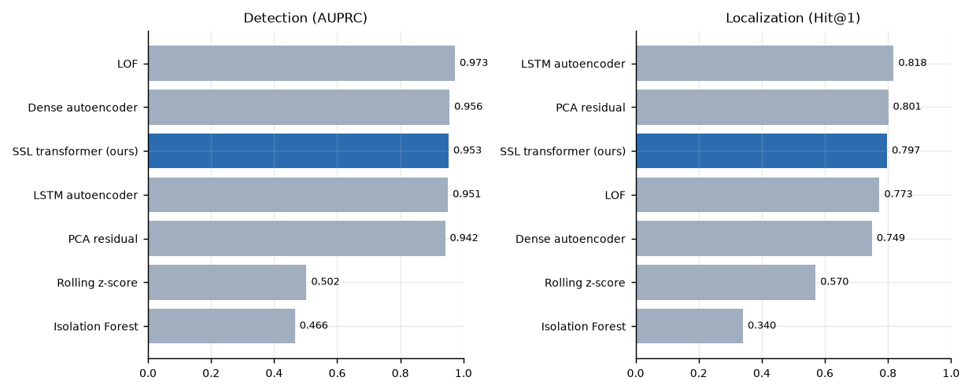
Results
Tested on the last quarter of the timeline, never seen during training
My model does not win.
A simpler method detects slightly better, another localizes slightly better.
All four leaders are within measurement error of each other.
Saying so is the honest result. The interesting finding turned out to be about how you score the tasks, not which model you use.
Notes:
Do not hide this. If an examiner asks 'so did your model win', the answer is no, and the reason is that this data is small and simple enough that classic methods do well. What I found instead is on the next slide.

Slide 12
The main finding
Two completely different fixes turned out to be worth exactly the same
Rank tasks by how bad they look
58.8%
Rows 2 and 3 are identical.
One is a statistics trick. One is a structural idea about cause and effect.
They are worth the same, and doing both barely helps.
Compare each task to its own normal
77.3%
Ask if it is surprising given its input
77.3%
Do both
79.7%
An earlier version of my write-up claimed the structural idea was worth far more. It was being compared against an unfair baseline.
Notes:
This is the single best slide to be asked about. Different tasks are naturally harder to predict than others, so raw scores are not comparable. Both fixes correct for that in different ways, and it turns out that is where nearly all the gain comes from.

Slide 13
What did not work
I removed each design idea and measured the damage
Telling the model the pipeline shape
no change
It works out the shape from the data by itself.
Giving it a clock
no change
A 32-hour window already contains a full day.
Adding contrastive learning
no change
Cost four times as much and helped nothing.
Training on perfectly clean data
no change
It tolerates messy history, which was the claim.
Four ideas, four null results. Reporting them is part of the work.
Notes:
Examiners respect null results that are reported. Each one has a reason, not a shrug. The DAG hint is redundant because the model recovers the structure on its own, which I checked directly.

Slide 14
The one thing that did change something
And it was the opposite of what I expected
I trained the model for longer. It got better at its training task.
Why
The model relies on being surprised by broken data. Train it long enough and it gets good at predicting the broken data too, so the surprise disappears.
And it got worse at finding the culprit. 80% down to 76%.
This is awkward for me: I chose when to stop training using a measure that turns out not to track what I actually care about. It is written up as an open problem rather than hidden.
Notes:
If they ask 'what would you do differently', this is the answer. I need a stopping rule that tracks localization and still needs no labels. I do not have one yet.

Slide 15
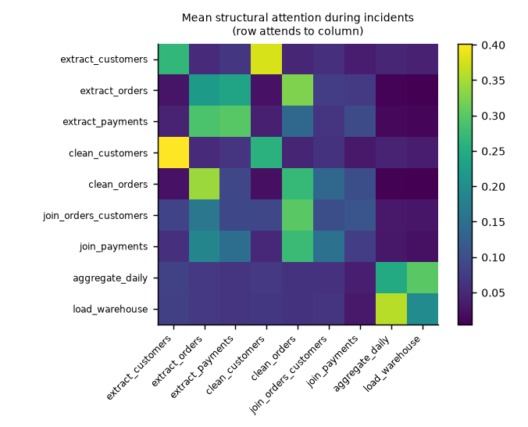
Explaining the answer
Not just which task, but what kind of problem
It learned the pipeline on its own
The bright squares are the real connections between tasks. Nobody told it which tasks feed which.
It names the right symptom 93% of the time
A unit change is reported as a value problem, a timezone shift as a timing problem. This is scored, not just displayed.
Notes:
Most papers show an explanation picture and never check it. Because my simulator knows what each fault should look like, I can score whether the explanation is correct. 93 percent.

Slide 16
What this cannot do yet
The honest list
The data is simulated
Two failure types localize badly
I chose how often faults happen and how severe they are. The ranking of methods is more trustworthy than any single number.
Both involve row counts changing. I know exactly why, and the fix is a missing measurement rather than a better model.
Detection is too easy here
Only one pipeline shape
Five of seven methods land within a hair of each other, so the benchmark does not separate them well on that half of the problem.
Everything is measured on one nine-task pipeline.
Notes:
Volunteering limitations before being asked is the strongest move available. Each one here has a specific reason and, where relevant, a named fix.

Slide 17
What I would do next
1
Measure how well join keys match
This is the exact missing piece behind the two failure types that localize badly. My error analysis predicts it should fix them.
2
Find a better stopping rule
One that needs no labels but still tracks the thing I care about. This is the most interesting open problem the project turned up.
3
Test against a real pipeline
Even a few weeks of real telemetry would let me check the simulator's assumptions instead of choosing them.
Notes:
Item one is the strongest, because it is a prediction made by my own error analysis. If they ask what you would test first, say that.

Slide 18
What I built
A benchmark
8,000 pipeline runs, 15 failure types, cause labels measured rather than assumed
A model
learns normal behaviour with no labels, finds the run that broke and the task that broke it
An honest evaluation
including four null results, one bug I found in my own work, and a claim I had to correct
Live demo next
Notes:
Close on the honesty point, then run the demo. It takes about thirty seconds and shows a real broken run being diagnosed.

