Slide 1
Self-Supervised AI for ETL Error Detection
and Root-Cause Localization
Review 2
Finding the one task that broke a data pipeline, without any labelled failures
Akshat Sparsh (23BDS0149) · Anuprakash Dubey (23BDS0162)
B.Tech Deep Learning Project · October 2026
Notes:
Open with the one-line version: pipelines break quietly, every step downstream looks broken, and this finds the one that actually caused it.

Slide 2
What this review covers
The three things Review 2 is assessed on, and where each one sits
Clear objectives
1
Slide 4
Four objectives, each with the criterion used to judge it, fixed before any experiment was run.
Dataset selection and understanding
2
Slides 6 and 7
Why no existing dataset could answer the question, what was built instead, and the four properties of the data that drove later decisions.
Complete methodology
3
Slides 8 to 11
The model, how it learns without labels, how it separates a cause from its victims, and the protocol used to evaluate it.
Results are included because the work is complete, but they are not what this review is marked on.
Notes:
Say explicitly that you know what the review is assessed on. It costs twenty seconds and it frames everything after it.

Slide 3
The problem
The job finishes successfully and the data is wrong
What people expect
What actually happens
The cost
A job crashes. Someone is alerted within minutes. It is fixed the same day.
The job succeeds. A price field switched from rupees to paise upstream. Every number is now a hundred times too big.
Nobody notices for weeks. Every report built on that table is wrong for the whole period.
Nothing failed, so nothing alerted. That is the class of failure this project targets.
Notes:
Give the concrete example. A currency convention changes and amounts become 100x too large. No exception is raised anywhere.

Slide 4
Objectives, and whether they were met
Success criteria were fixed before the experiments ran
Objective
Criterion set in advance
Result
1
Detect broken runs using no labels in training
AUPRC above 0.90
0.953
2
Identify the task that originated the incident
Top-1 above 0.50, top-3 above 0.90
0.797 / 0.973
3
Explain each finding as a named symptom
Correct symptom family above 0.80
0.935
4
Evaluate honestly against real baselines
Chronological splits, intervals, six baselines
Met
Objective 2 is the one that defines the project. The other three are achievable by existing methods.
Notes:
This is the slide a review panel most wants. Criteria were set before running anything, so success could not be redefined afterwards.

Slide 5
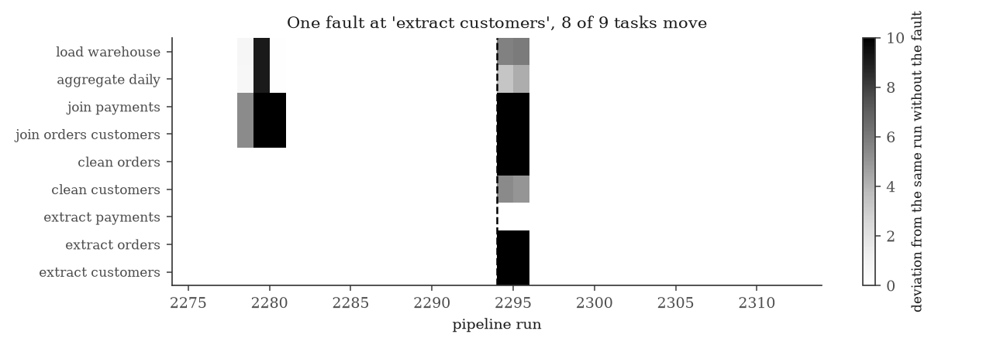
Why locating the cause is hard
One fault, and almost every task looks broken
The fault was injected into one task only.
Eight of nine tasks move.
Several move harder than the one that caused it.
The damage grows as it travels, so the loudest signal is usually furthest from the fault.
Notes:
Every one of those tasks would trip an ordinary alarm. Only one is the cause. Ranking by severity picks the wrong one.

Slide 6
Dataset: built, because none exists
No public benchmark labels which pipeline task caused a failure
Existing datasets are server and sensor readings. They contain no pipeline, so the question cannot be asked of them.
Research using real pipeline data uses company data that is never released.
8,000
9
pipeline runs
tasks each
15
273
Constructing the benchmark is part of the contribution, not a shortcut around a missing one.
fault types
labelled incidents
Notes:
Expect 'why not real data'. Answer: no public dataset labels the causing step, and company pipeline data is not released.

Slide 7
What the data looks like
Four properties that drove decisions later in the method
92.6% healthy, 7.4% broken
Training history is 3% contaminated
Answering 'healthy' every time scores 92.6% accuracy and is useless, so accuracy is never reported.
Real history contains failures nobody noticed. The method must tolerate that rather than assume a clean training set.
22 of 38 features are heavily skewed
Volume swings 9.6x, and none of it is a fault
Row counts and runtimes are long tailed, which is why normalisation uses median and IQR rather than mean and standard deviation.
311 rows at the quietest, 2984 at the busiest. Any threshold on row count fires constantly.
Notes:
These are not decorative statistics. Each one forced a specific design choice, and the slide says which.

Slide 8
Method: the model
A transformer that attends along time and across the pipeline
Input
Embed
Attend
along time
Attend
across the DAG
Predict
›
›
›
›
32 runs x 9 tasks
x 38 measurements
project each task
profile to 128 dims
each task sees
its own history
each moment sees
the other tasks
fill in what
was hidden
these two repeat, four layers
Why two directions
Why the DAG is in the model
Attending over all 288 positions at once costs far more and mixes two kinds of structure. Time is long, the pipeline is short, and they behave differently.
Each pair of tasks is labelled parent, child, ancestor, descendant or unrelated, and the model learns how much to weight each. Section 8 shows it finds the structure even without being told.
1.1 million parameters, trained in 18 minutes on a laptop GPU.
Notes:
A methodology review wants the structure, not just the idea. The two dark boxes are the part that repeats, and they are the reason the model can reason about the pipeline at all.

Slide 9
Method: learning without labels
Hide part of a run, then predict what was hidden
1
2
3
4
Watch normal runs
Hide something
Predict it back
Measure surprise
Thousands of ordinary runs. Nobody says which are good or bad.
Cover one task's numbers, or one family of measurements.
Fill the gap using the other tasks and the recent history.
Once it predicts well, whatever it cannot predict is unusual.
The same idea as covering a word in a sentence and predicting it. Doing that well requires learning how the thing behaves.
Notes:
The sentence analogy is what lands with non-specialists.

Slide 10
Method: separating the cause from the victims
Ask each task whether it is surprising given what it was fed
A victim
A mistake worth reporting
Bad output, but it follows exactly from the bad input it was given. Nothing surprising.
The first version hid only the task being tested. The model could still see that task's own downstream steps, which were also broken, and read the answer off them.
Hiding the task and everything downstream fixed it.
Accuracy went from 63% to 77%.
The cause
Healthy input, and bad output anyway. That is where it began.
Notes:
Be honest about the leak. It shows the idea was tested rather than trusted, and the 63 to 77 jump is the evidence.

Slide 11
Experimental setup
Chosen so the numbers mean something
Chronological splits
Train on the past, test on the future. A random split over a time series leaks tomorrow into today.
Contaminated training set
3% of training runs carry real incidents, as real history does.
Label-free model selection
Checkpoints chosen on reconstruction loss. Choosing on accuracy would make the method weakly supervised.
Six baselines
Rolling z-score, PCA, Isolation Forest, LOF, dense autoencoder, LSTM autoencoder, all given the same calibration.
No point-adjusted F1 as a headline
Published work shows random scores beat real models under that metric.
Notes:
A review panel checks protocol as much as results. Each line here closes a specific way of accidentally cheating.

Slide 12
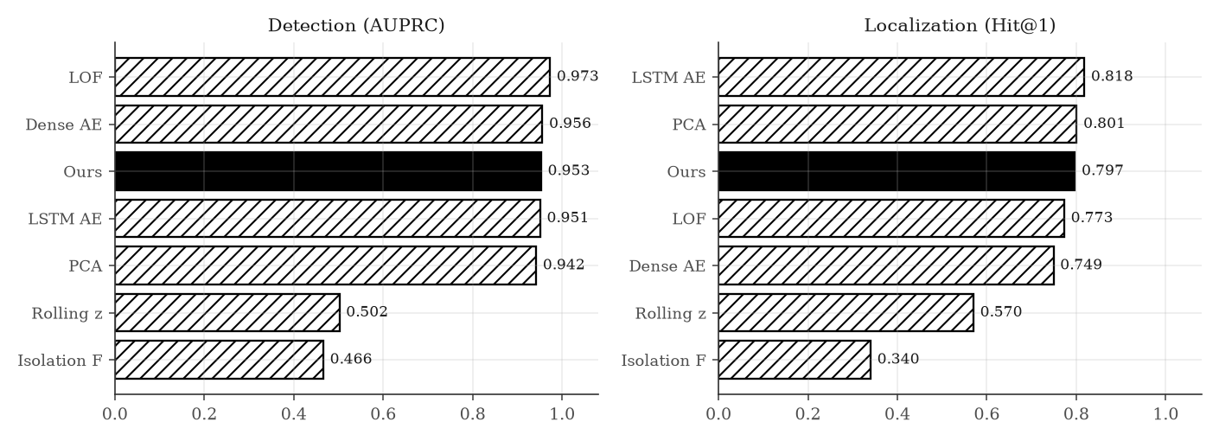
Results
Test split: 2000 runs, 291 of them broken, never seen in training
Our model does not win.
One method detects better, another localizes better.
The top four are within measurement error.
Saying so is the honest result. The useful finding turned out to be about how tasks are scored, not which model produces the score.
Notes:
Do not soften this. The reason is that the data is small and simple enough that classical methods do well. The next slide is the finding.

Slide 13
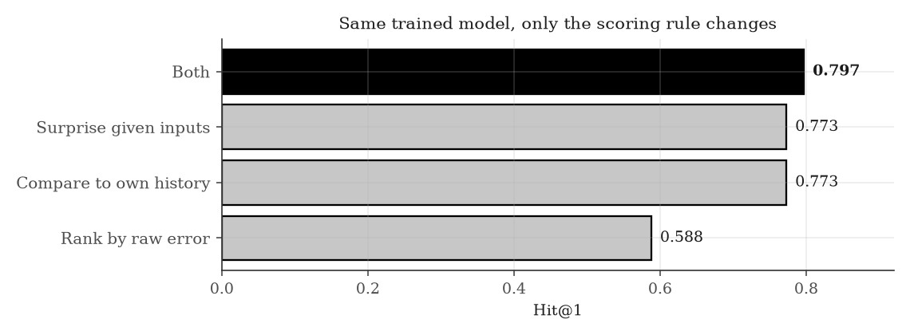
The main finding
Two different fixes for the same problem, worth exactly the same
Rows two and three are identical.
One compares a task to its own history. The other asks whether it is surprising given its inputs.
Doing both adds almost nothing.
That 18 point gain is larger than the whole spread between the seven methods, which is about 4 points. How you score matters more than which model you use.
Notes:
Different tasks are naturally harder to predict, so raw scores are not comparable. Both fixes correct for that, in different ways.

Slide 14
What did not work
Each design idea removed, then measured
Telling the model the pipeline shape
no change
It works the shape out from the data by itself.
Giving it a clock
no change
A 32-hour window already contains a full day.
Adding contrastive learning
no change
Four times the compute, no benefit.
Training on perfectly clean data
no change
It tolerates messy history, which was the claim.
Training for longer
WORSE
80% down to 76%, and the reason matters.
Four null results, reported rather than buried.
Notes:
Null results with reasons, not shrugs. The DAG hint is redundant because the model recovers the structure anyway, which we checked.

Slide 15
Training longer made it worse
And it undermines our own stopping rule
Trained for longer, the model got better at its training task.
Why
The model works by being surprised by broken data. Train it long enough and it learns to predict the broken data too, so the surprise disappears.
And worse at finding the cause. 80% down to 76%.
We chose when to stop training using a measure that turns out not to track what we care about. It is written up as an open problem rather than hidden.
Notes:
If asked what you would do differently, this is the answer. We need a stopping rule that is label-free but tracks localization.

Slide 16
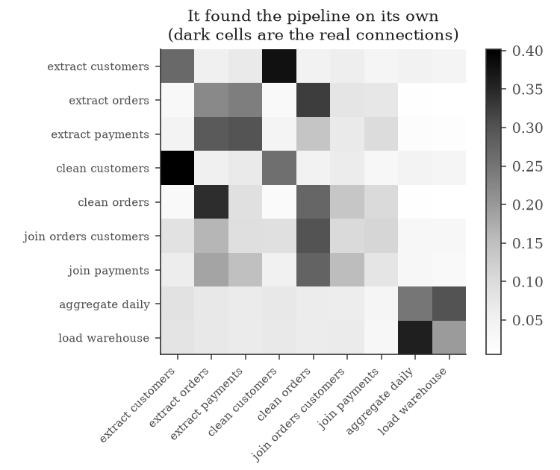
Explaining the answer
Not just which task, but what kind of problem
It found the pipeline on its own
The dark cells are the real connections between tasks. Nobody told it which task feeds which.
It names the right symptom 93% of the time
Scored against what each fault should look like, not just displayed as a picture.
Notes:
Most papers show an explanation and never check it. Our simulator knows what each fault should look like, so we can score it.

Slide 17
Limitations
Stated before being asked
The data is simulated
Two fault types localize badly
We chose how often and how severely faults occur. The ranking of methods is more trustworthy than any single number.
Both involve row counts. A join's row count depends on key overlap, which we never measure, so the model lacks the information.
Detection is too easy here
One pipeline shape
Five of seven methods land within 0.03, so the benchmark barely separates them on that half of the problem.
Everything is measured on a single nine-task pipeline.
Notes:
Volunteering limitations is stronger than conceding them. Each has a specific reason and, where relevant, a named fix.

Slide 18
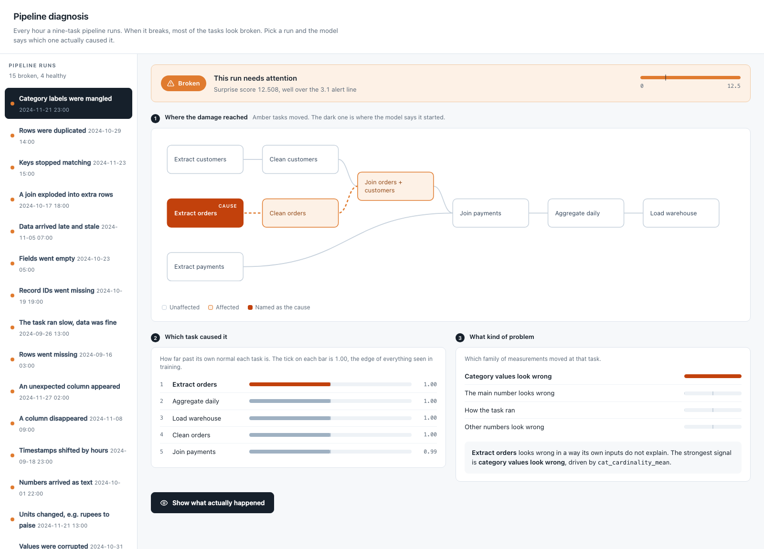
The system, running
One hour of a pipeline it had never seen, diagnosed end to end
1
Is it broken
2
Which task
3
What kind of problem
The answer stays hidden until you ask for it.
One file, no server and no internet. The ground truth is revealed on a click, so the answer can be checked rather than believed.
Notes:
This is a real screenshot, so it keeps its own colour while the rest of the deck is monochrome. Offer to run it live if there is time.

Slide 19
What was delivered
A benchmark
8,000 runs, 15 fault types, cause labels measured by re-running each faulty batch without the fault
A method
Learns normal behaviour with no labels, finds the broken run and the task that caused it, 0.953 and 0.797
An explanation layer
Names the symptom family correctly 93.5% of the time, scored rather than displayed
An honest evaluation
Six baselines, four null results, one bug found in our own scoring, one claim corrected
Demonstration follows
Notes:
Close on the honesty point, then run the demo. About two minutes.

