Slide 1


NEXT GEN EMPLOYABILITY PROGRAM
CREATING A FUTURE-READY WORKFORCE
Student Name :
Akshat Vaish
Student ID :
STU65cd2af657d9b1707944694
Mobile No:
7052885229
Mail ID:
akshatvaish192003@gmail.com
College Name :
IMS Engineering College, Ghaziabad

Slide 2
CAPSTONE PROJECT SHOWCASE
Project Title
Power BI Enabled Comprehensive Analysis on Unicorn Businesses
Abstract | Problem Statement | Project Overview | Proposed Solution | Technology Used | Modelling & Results | Conclusion | Q&A

Slide 3
Abstract
1
Objective: Aims to utilize Power BI for in-depth analysis of unicorn businesses, exploring their financial performance, market trends, geographical distribution, and key success factors.
2
Methodology: Aggregate and visualize data using Power BI's tools to uncover insights into unicorn companies’ valuation, funding, industry, and investor.
3
Insights: Identify patterns and challenges in unicorn success through data visualization, offering valuable information for investors, industry, country, and in which year.
4
Impact: Inform strategic decisions, investment strategies, and contributing to a deeper understanding of unicorns' economic significance.

Slide 4


Problem Statement
Which company is having highest ROI.
Which Country is having most Unicorns.
Which Year produced most Unicorns.
What is the Count of Company, Count of Continents, Count of Country, Count of City, Count of Industry, Sum of Funding, Sum of Valuation and, Average Years to become Unicorn.
What is the Number of Unicorns for each Industry.
Which Investor founded most of the Unicorns.

Slide 5

Project Overview
Data Collection, Data Cleaning and Pre Processing
DAX functions and Basic Visualization
Analysis/Visualization
Formatting and Testing
Story Telling, Sharing

Slide 6
Proposed Solution
I have analyzed the project using Power BI Dashboard.
Firstly create Slicers for the selection of the Year, Continent, Country, Company, Industry and, City.
Identifying which Company is having highest ROI by Matrix Chart.
Using the Map Chart to get to know about which country is having most Unicorn.
I have identified Year in which most Unicorn were produced using Stacked Column Chart.
Finding the number of Unicorns for each Industry by creating a Stacked Bar Chart.
By creating Cards for showing the Count of Company, Count of Continents, Count of Country, Count of City, Count of Industry, Sum of Funding, Sum of Valuation and, Average Years to become Unicorn.
I have identified the investor who funded most of the Unicorn using Stacked Bar Chart.
Formatting all the Visuals/Charts by their colour, fonts, etc.

Slide 7

Technology used
Power BI
Power BI refers to a business intelligence (BI) platform developed by Microsoft. It allows users to connect to various data sources, analyze it, create interactive visualizations, and share their findings with others. Power BI offers both a desktop application for detailed analysis and a cloud-based service for sharing and collaboration.
In this Project the data source is of CSV type. After Importing the data into Power BI, we will Pre Process and write DAX which is useful for the analysis of the data and sorting of various columns will be done. Visualization will be implemented and formatted. Finally functionality of the project will be tested and submitted.

Slide 8
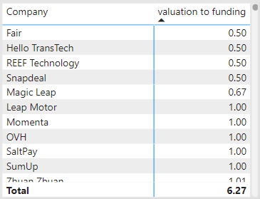
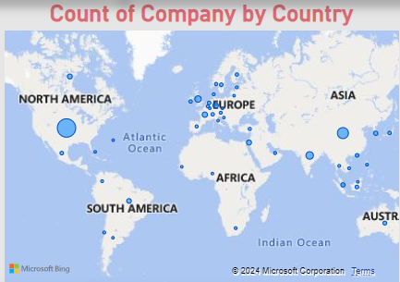
Modelling & Result
By the Matrix Chart we use to identify which Company is having highest ROI.
By the Map Chart we use to visualize which Country is having most Unicorn.

Slide 9
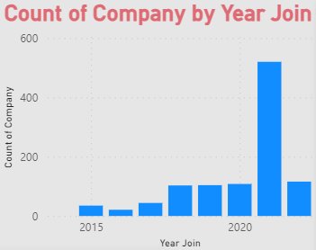
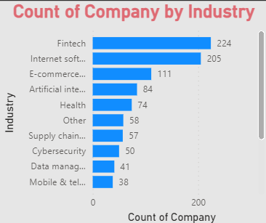
Modelling & Result
Identified the Year in which most Unicorn were produced using Stacked Column Chart.
Stacked Bar Chart is created to find the number of Unicorns for each Industry.

Slide 10
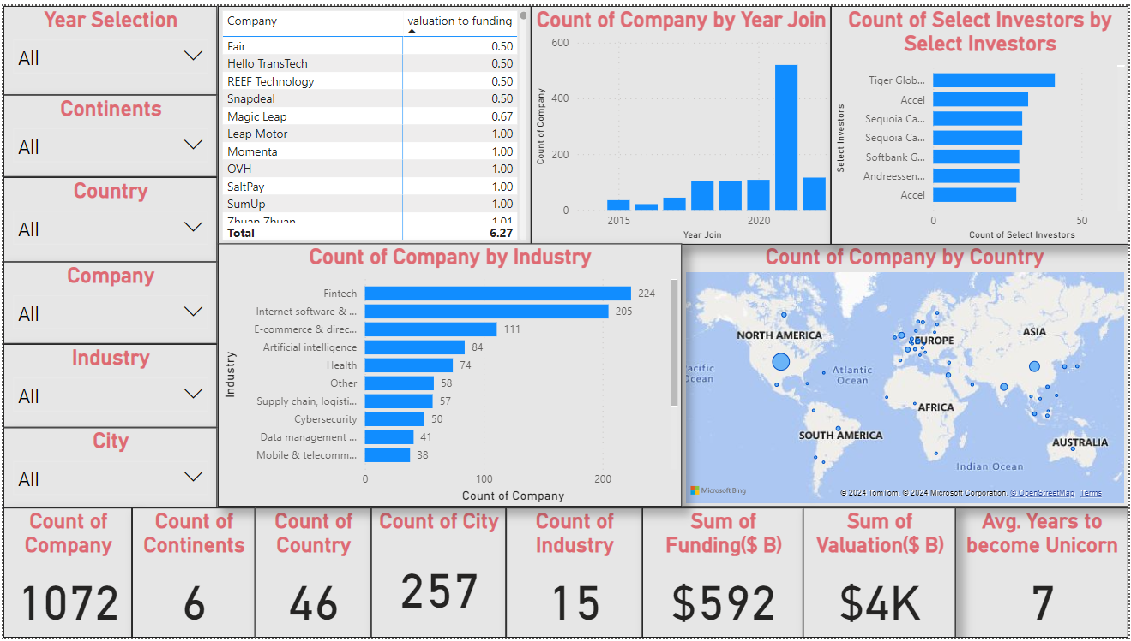
DASHBOARD:

Slide 11

Conclusion
Thorough examination of unicorn enterprises is now possible thanks to Power BI. We learned about ROI, geographic dispersion, industry trends, financing sources, and more through dynamic dashboards and interactive infographics. Leading businesses, the distribution of unicorns by nation, market trends, and significant investors were all displayed visually. Important data such as the number of companies, the amount of capital, and the average time reaching unicorn status were displayed on summary cards. This project demonstrates how powerful Power BI is at supporting in-depth analysis, directing strategic choices, and improving user experiences with eye-catching visuals.

Slide 12


Notes:
Thank You !!

