Slide 1
Web application vulnerability exploiter
Submitted in the partial fulfillment for the award of the degree of
BACHELOR OF ENGINEERING
IN
INFORMATION SECURITY
Submitted by:
Akshay
Under the Supervision of:
MR.krishnendu Rarhi
Department of AIT-CSE
DISCOVER . LEARN . EMPOWER

Slide 2
Outline
Introduction to Project
Problem Formulation
Objectives of the work
Methodology used
Results and Outputs
Conclusion
Future Scope
References

Slide 3
Introduction to Project
Web Application Vulnerability Exploiter (WAVE) is basically a vulnerability scanner which scans for Secuirity Vulnerabilities in web applications.
Vulnerability scanners are automated tools that scan web applications to look for security vulnerabilities. They test web applications for common security problems such as cross-site scripting (XSS), SQL injection,
and cross-site request forgery (CSRF).

Slide 4
Problem Formulation
WAVE automates the task of scanning web sites for content and vulnerabilities. Depending on configuration, the Scanner can crawl the application to discover its content and functionality, and audit the application to discover vulnerabilities. Importing full login sequences even enables the tool to handle more complex login mechanisms, including single sign-on.

Slide 5
Objectives
Web application security testing aims to determine whether or not a web app is vulnerable to attack. It covers both automated and manual techniques across a number of different methodologies.
Testing every type of web technology
Penetration testing
Secure development
Protect Users from risk of a data breach by finding Vulnerabilities
Scanning for Vulnerabilities.

Slide 6
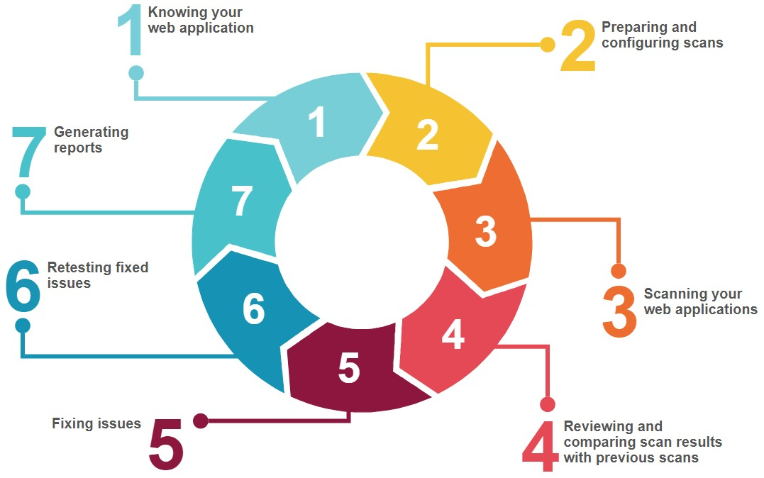
Methodology Used

Slide 7
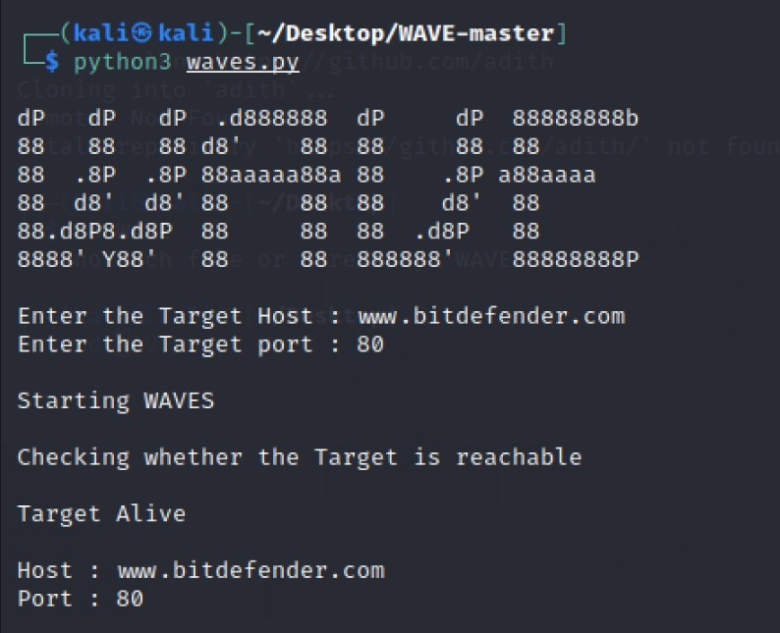
outlook

Slide 8
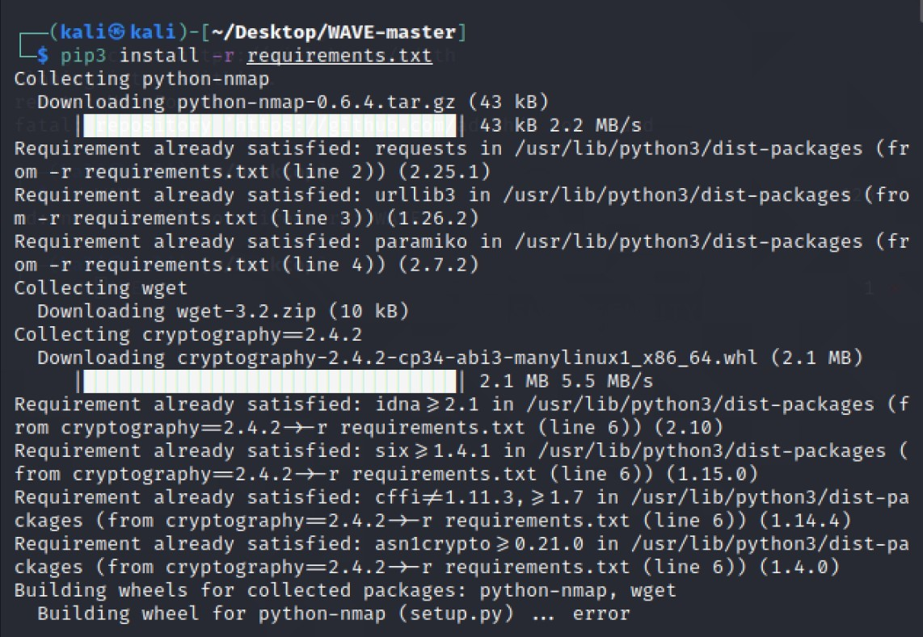
INSTALLING PREREQUIREMENTS

Slide 9
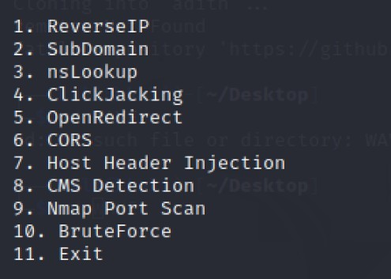
PROJECT CONSISTS OF

Slide 10
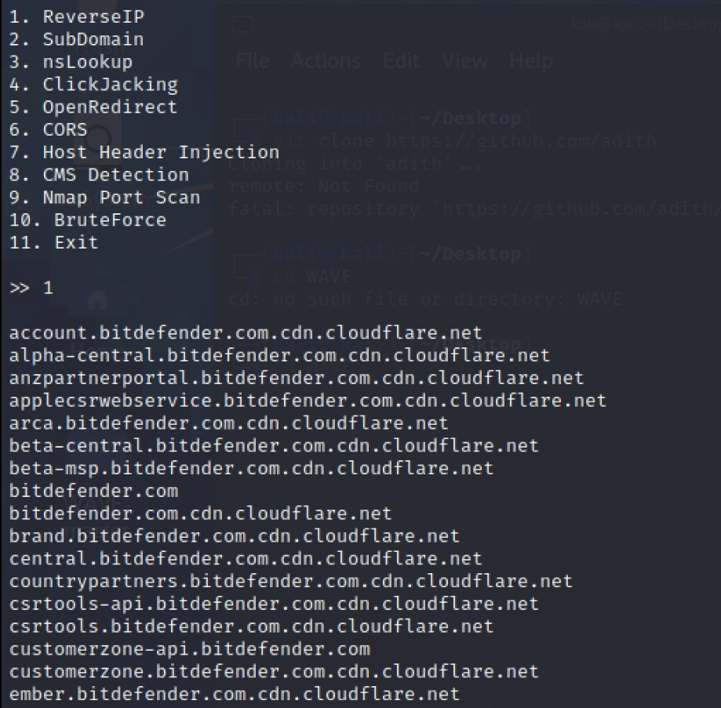
REVERSE IP:

Slide 11
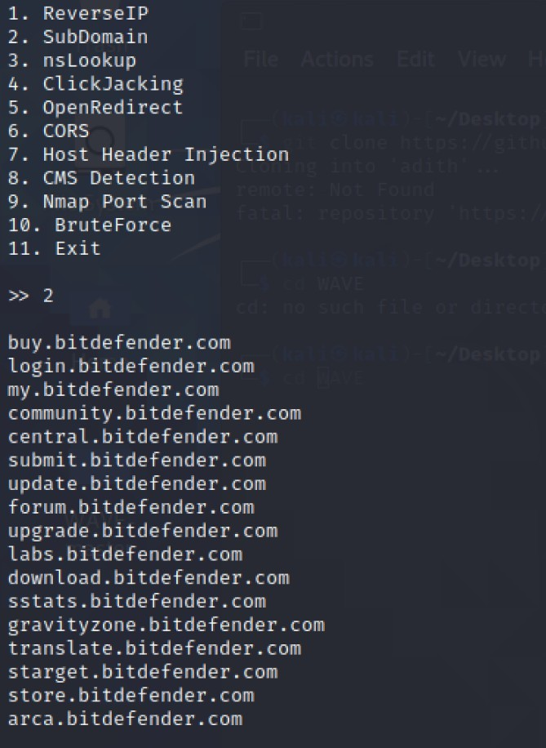
SUBDOMAIN

Slide 12
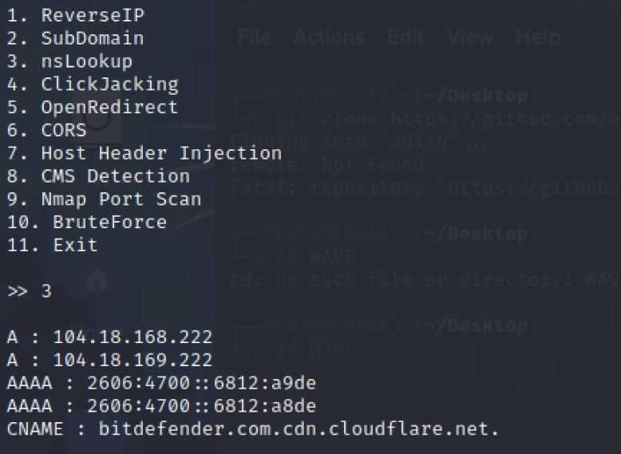
NSLOOKUP

Slide 13
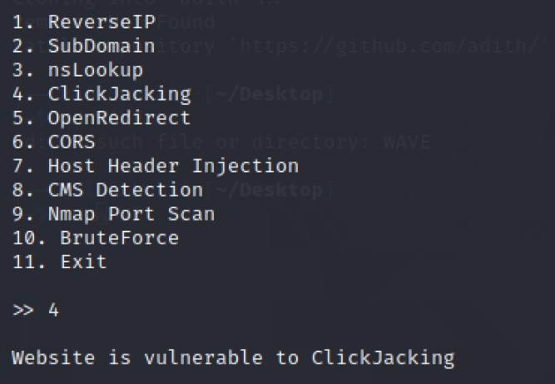
CLICKJACKING

Slide 14
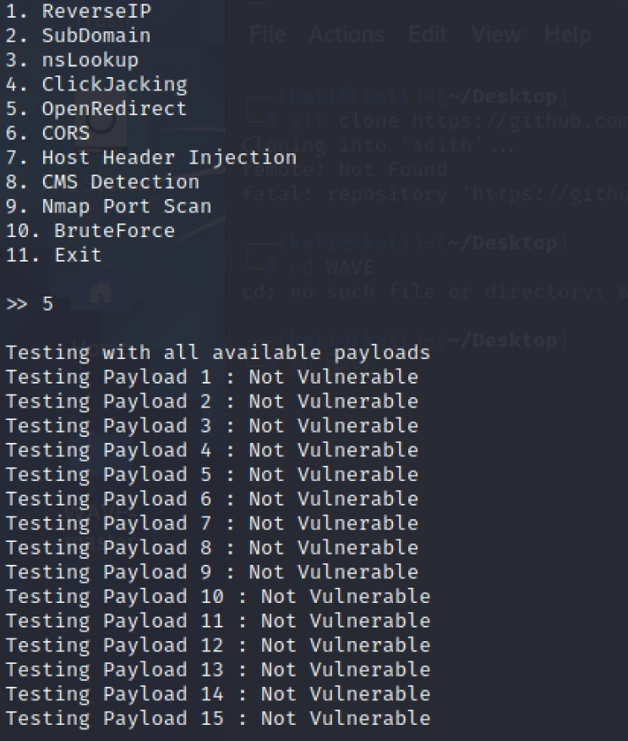
OPENREDIRECT

Slide 15
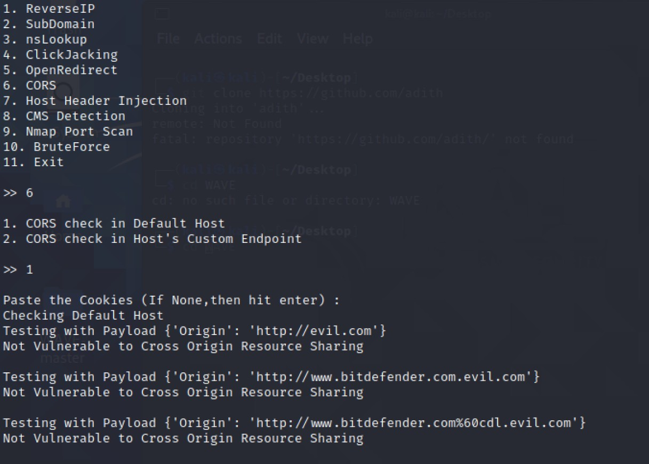
CORS(Cross-Origin Resource Sharing)

Slide 16
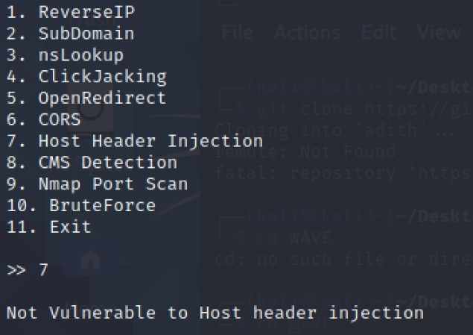
HOST HEADER INJECTION

Slide 17
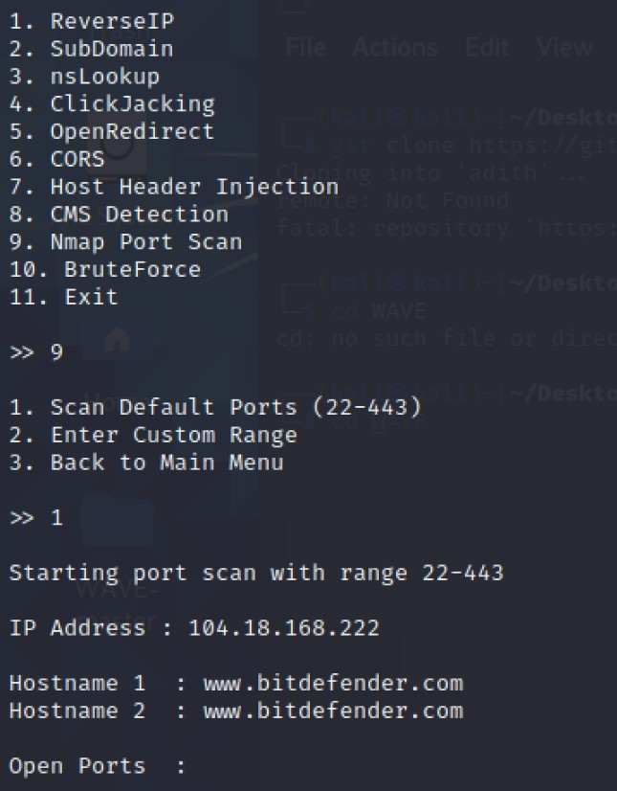
NMAP PORT SCAN

Slide 18
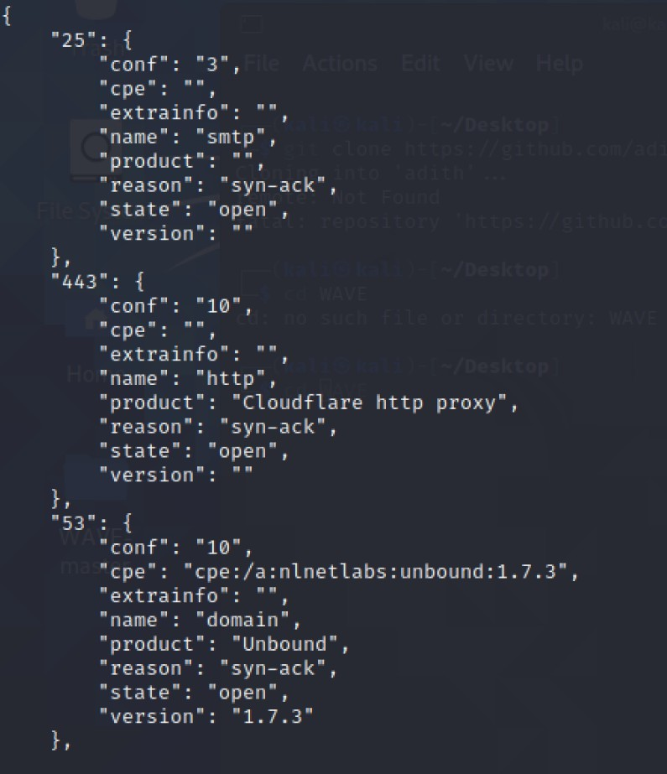
OPEN PORTS

Slide 20
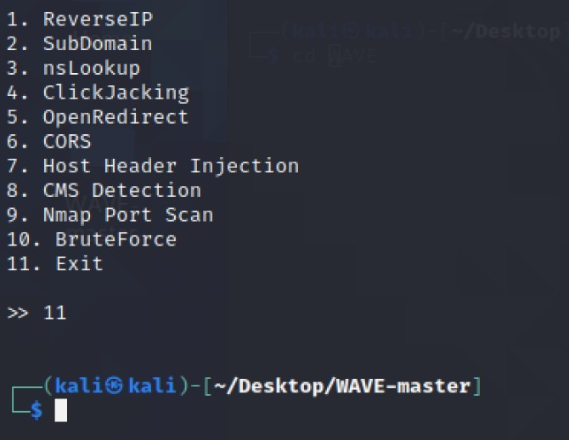
EXIT

Slide 21
Conclusion
Make Web applications more secured and flexible to use ,detect and report issues to the company.
It makes difficult for Blackhat hackers to exploit the application and make the cyber space more safe.
Web Application Vulnerability Exploiter (WAVE) is basically a vulnerability scanner which scans for Secuirity Vulnerabilities in web applications.
The web applications are tested for common security problems such as Host header injection, SQL injection, and Clickjacking, CORS. And many more.

Slide 22
Future Scope
Mention what advancements are possible with respect to your work in future.
Various other vulnerabilities will be added in this project.
OS Command Injection
Cross Site Scripting
Configuration. Management Issues like Session Hijacking.
IDOR vulnerabilities.

Slide 23
References
https://owasp.org/www-community/Vulnerability_Scanning_Tools
https://www.acunetix.com/websitesecurity/the-importance-of-web-a pplication-scanning/
https://portswigger.net/burp/vulnerability-scanner

Slide 24


THANK YOU
MADE BY:- DEEPAK JINDAL (18BCS3572) KALYAN RAM (18BCS3576)
RAMAN SUHAG (18BCS3586) ABHINANDAN (18BCS3555) AKSHAY MAHALA (18BCS3556)
24

