Slide 1

GESTURE RECOGNITION
SYSTEM

Slide 2
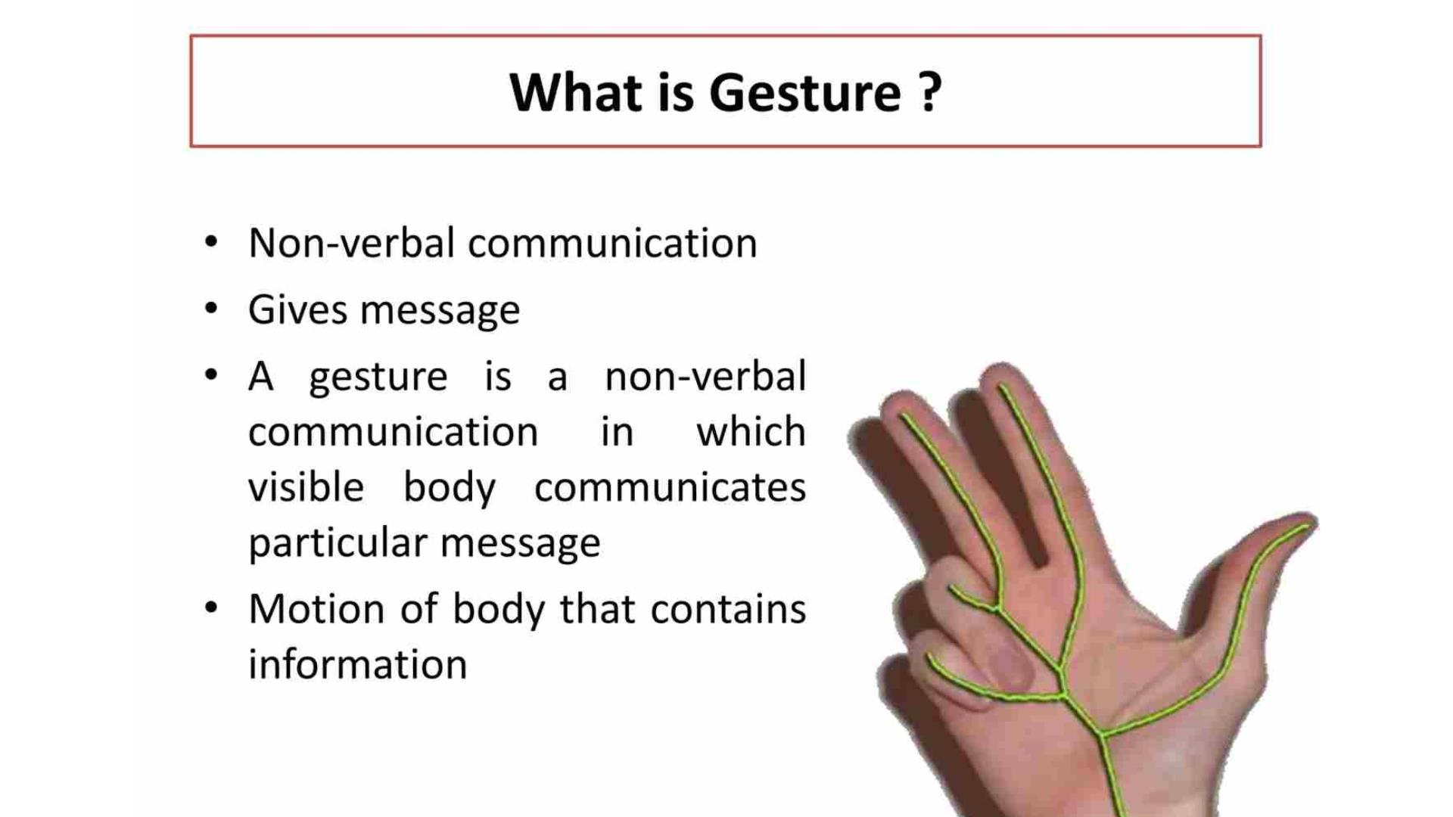

Slide 3
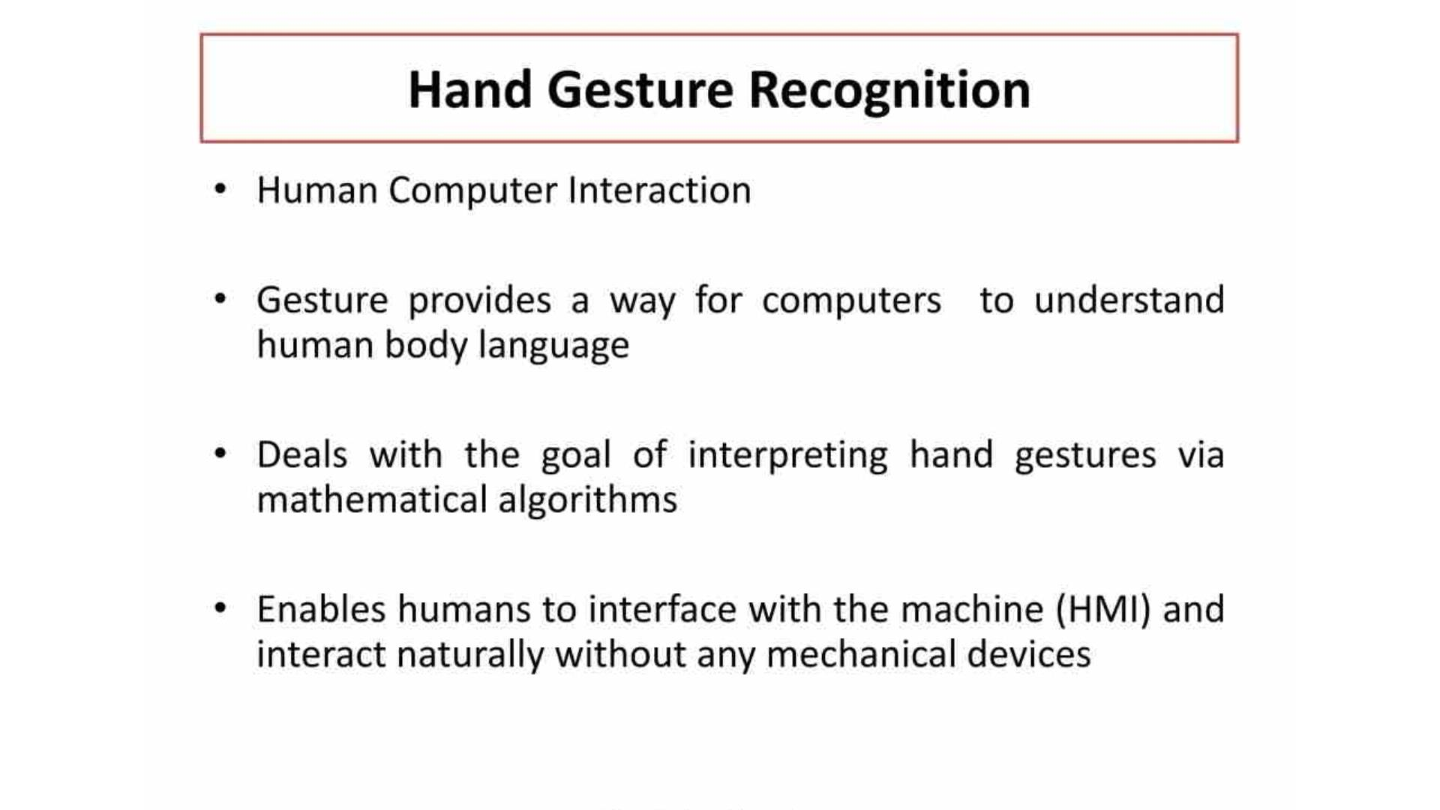

Slide 4
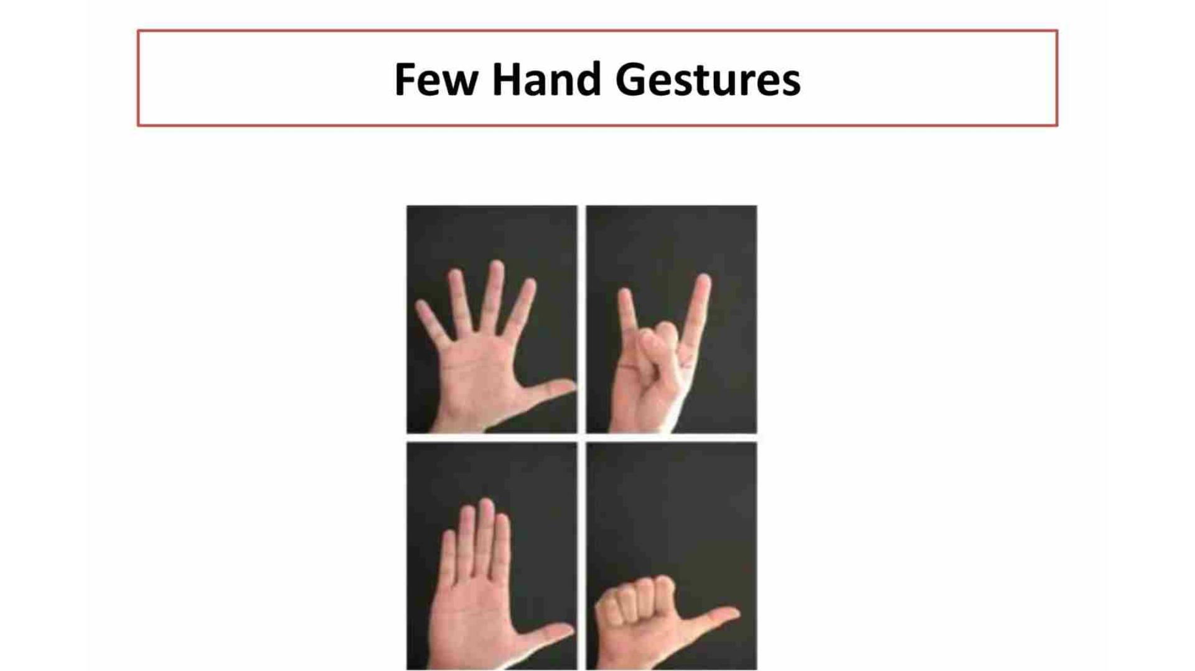

Slide 5
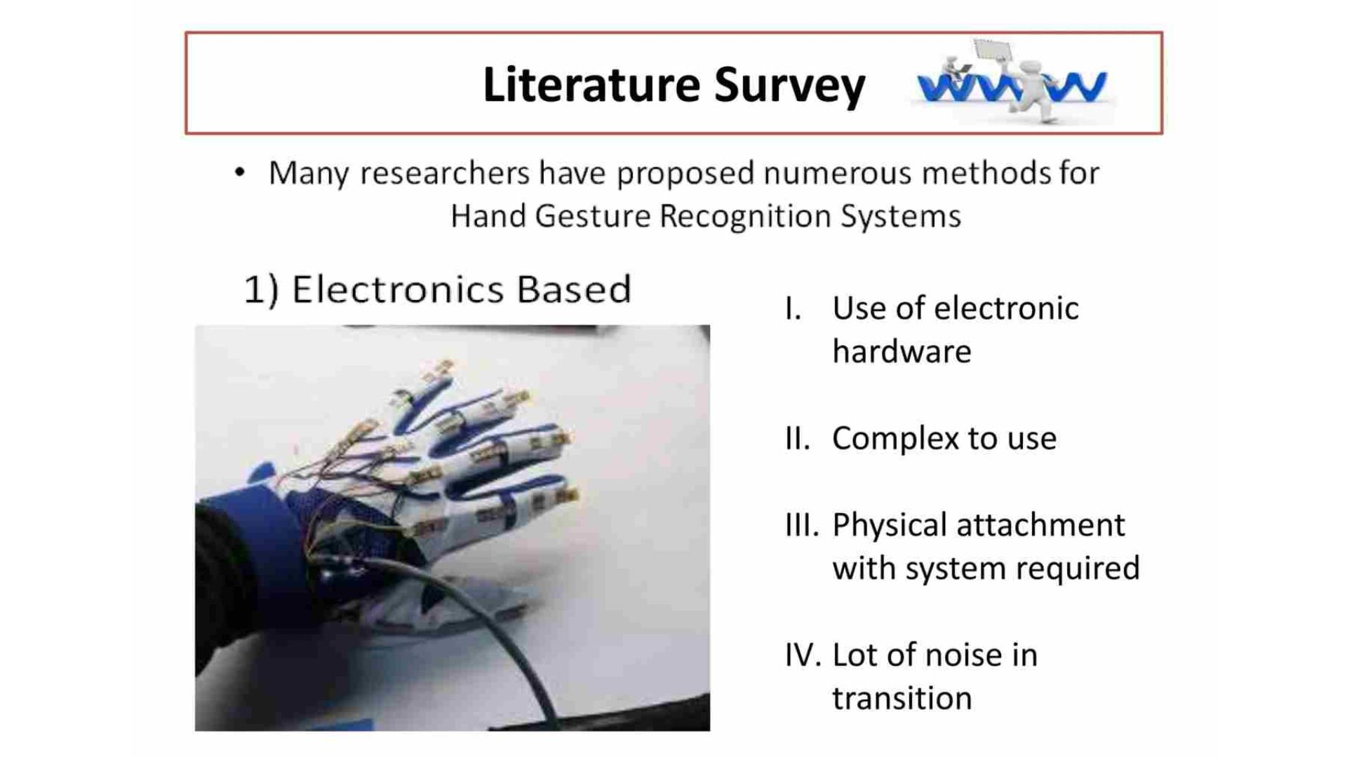

Slide 6
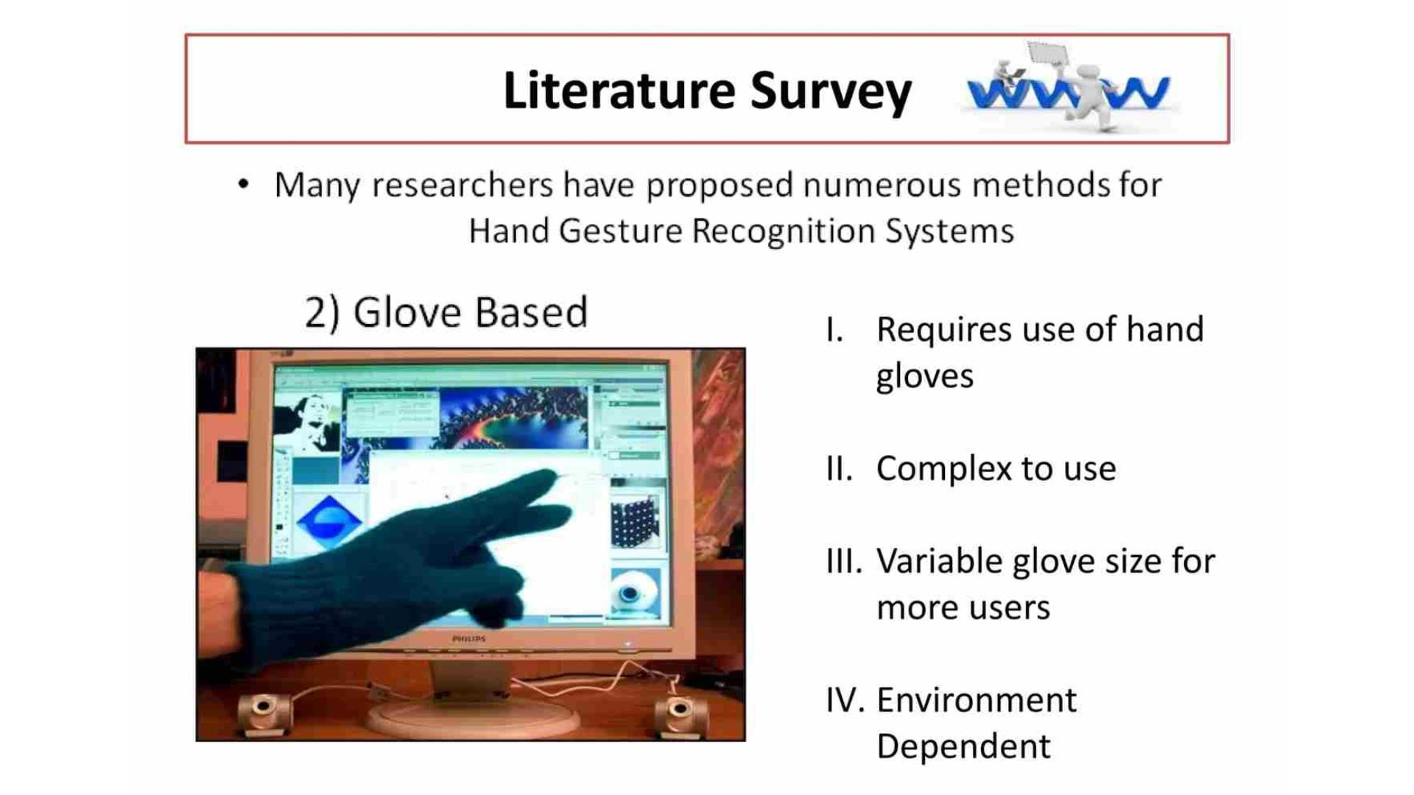

Slide 7
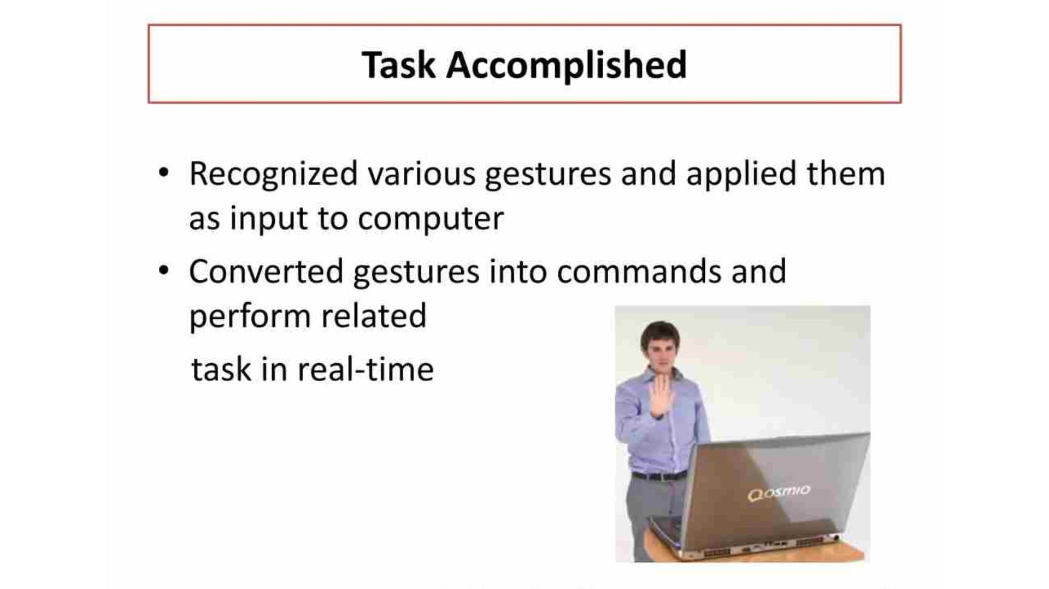

Slide 8
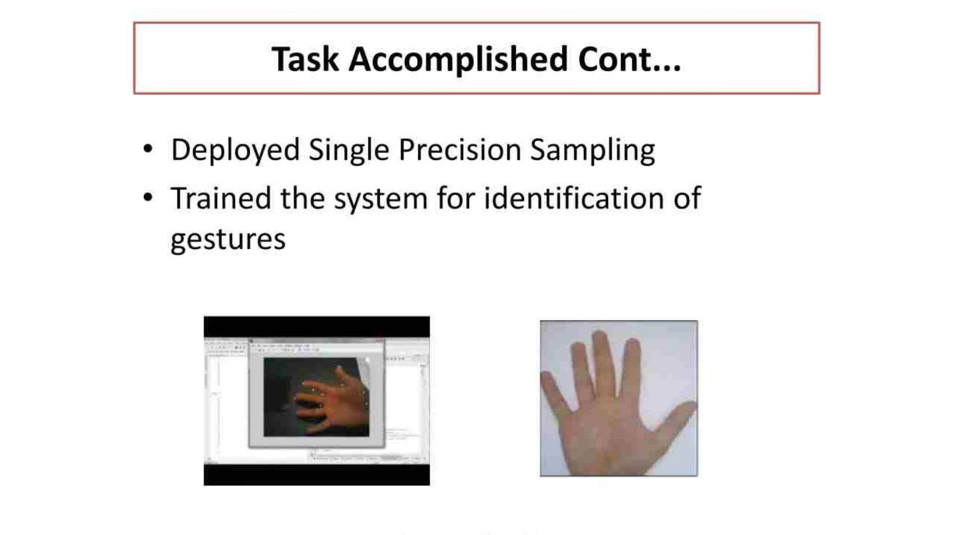

Slide 9
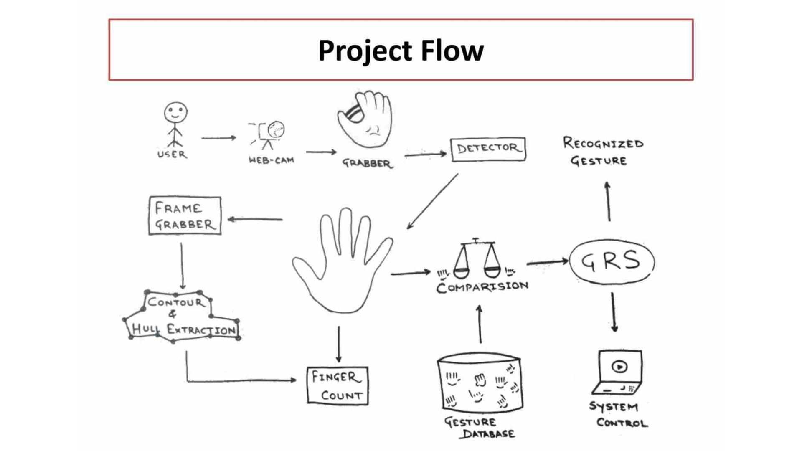

Slide 10
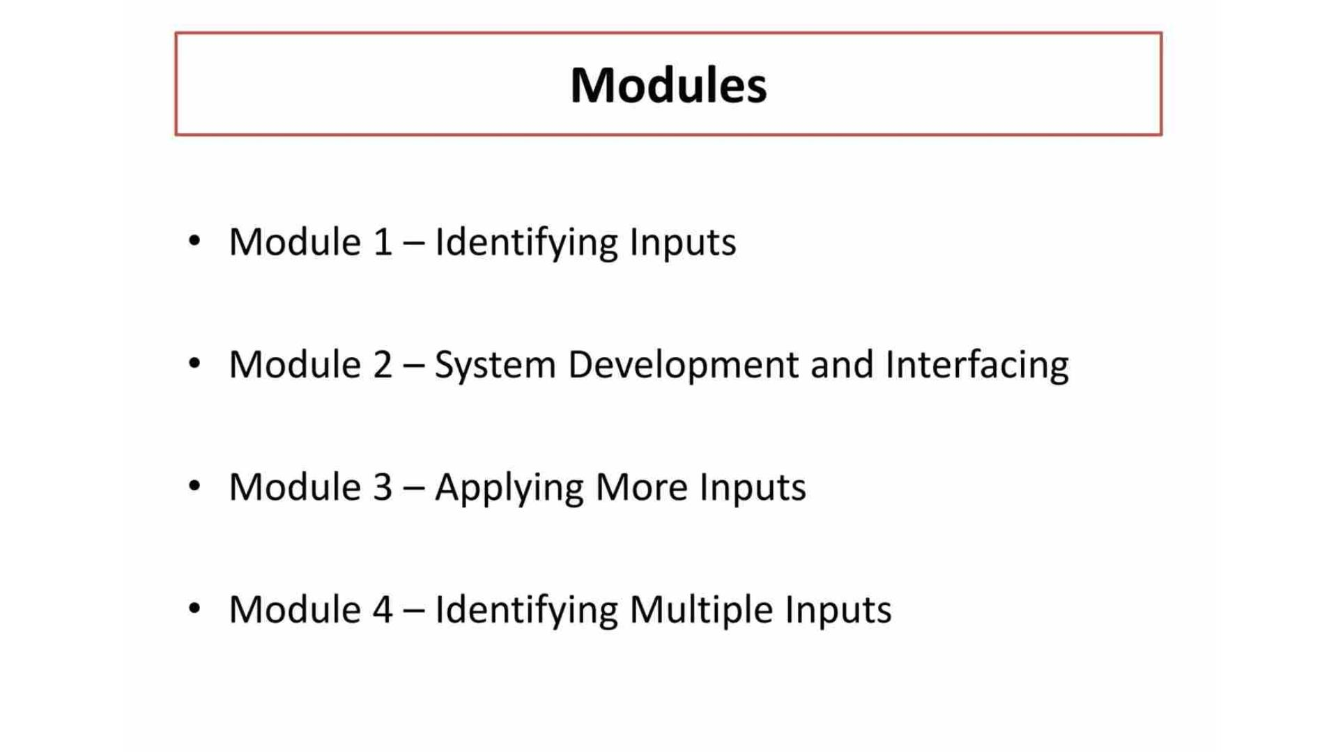

Slide 11
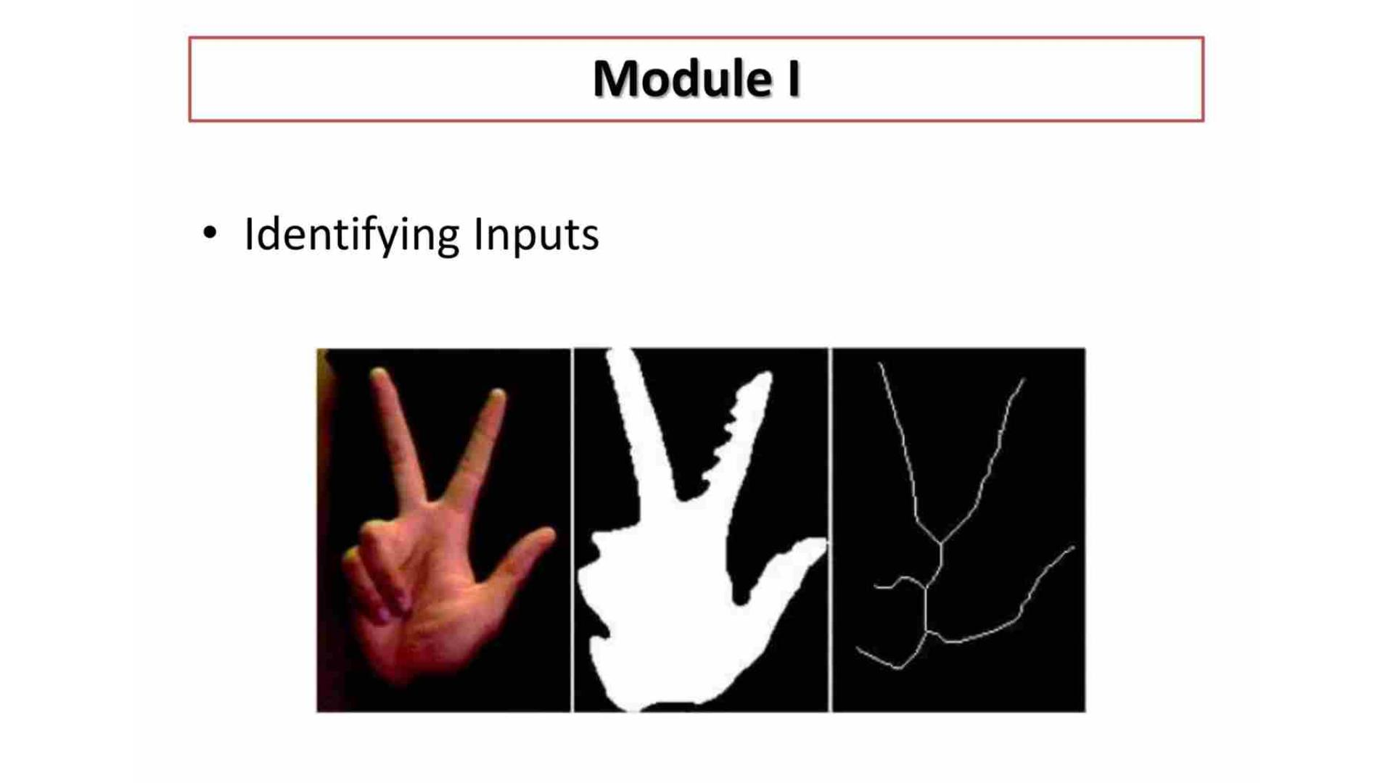

Slide 12
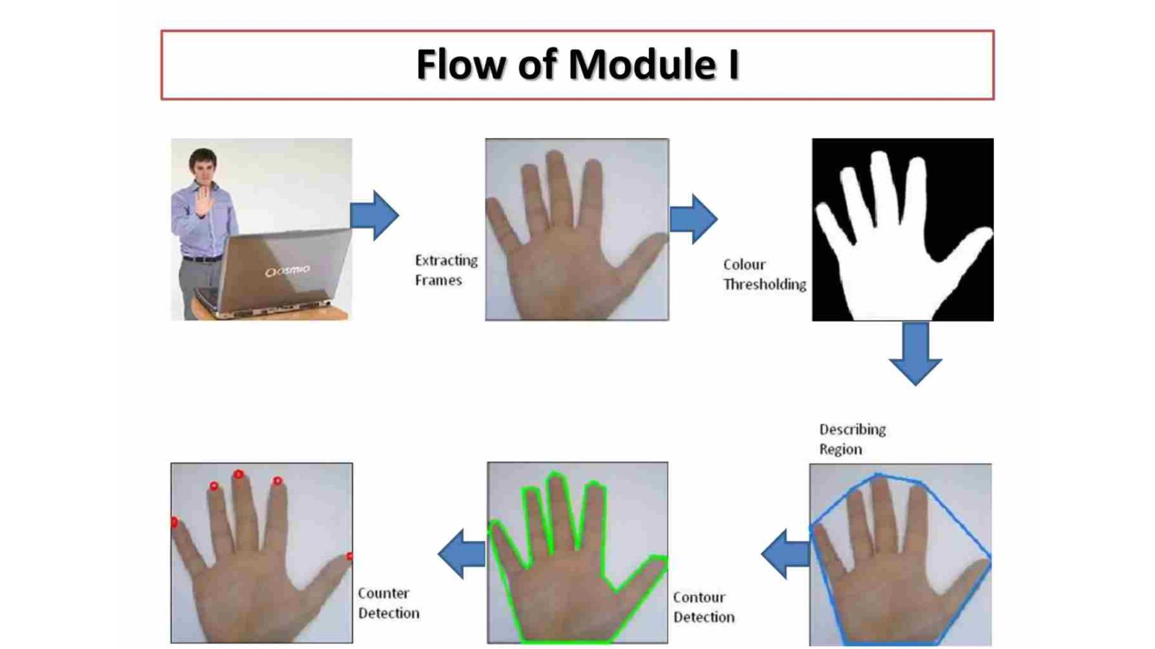

Slide 13
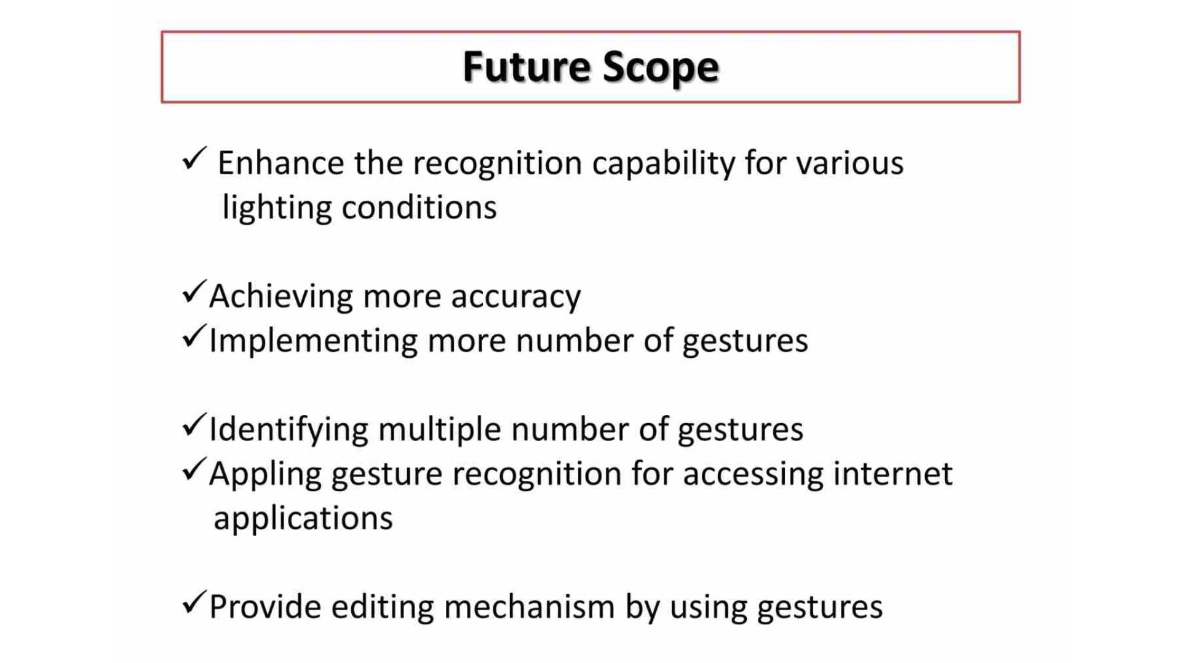

Slide 14
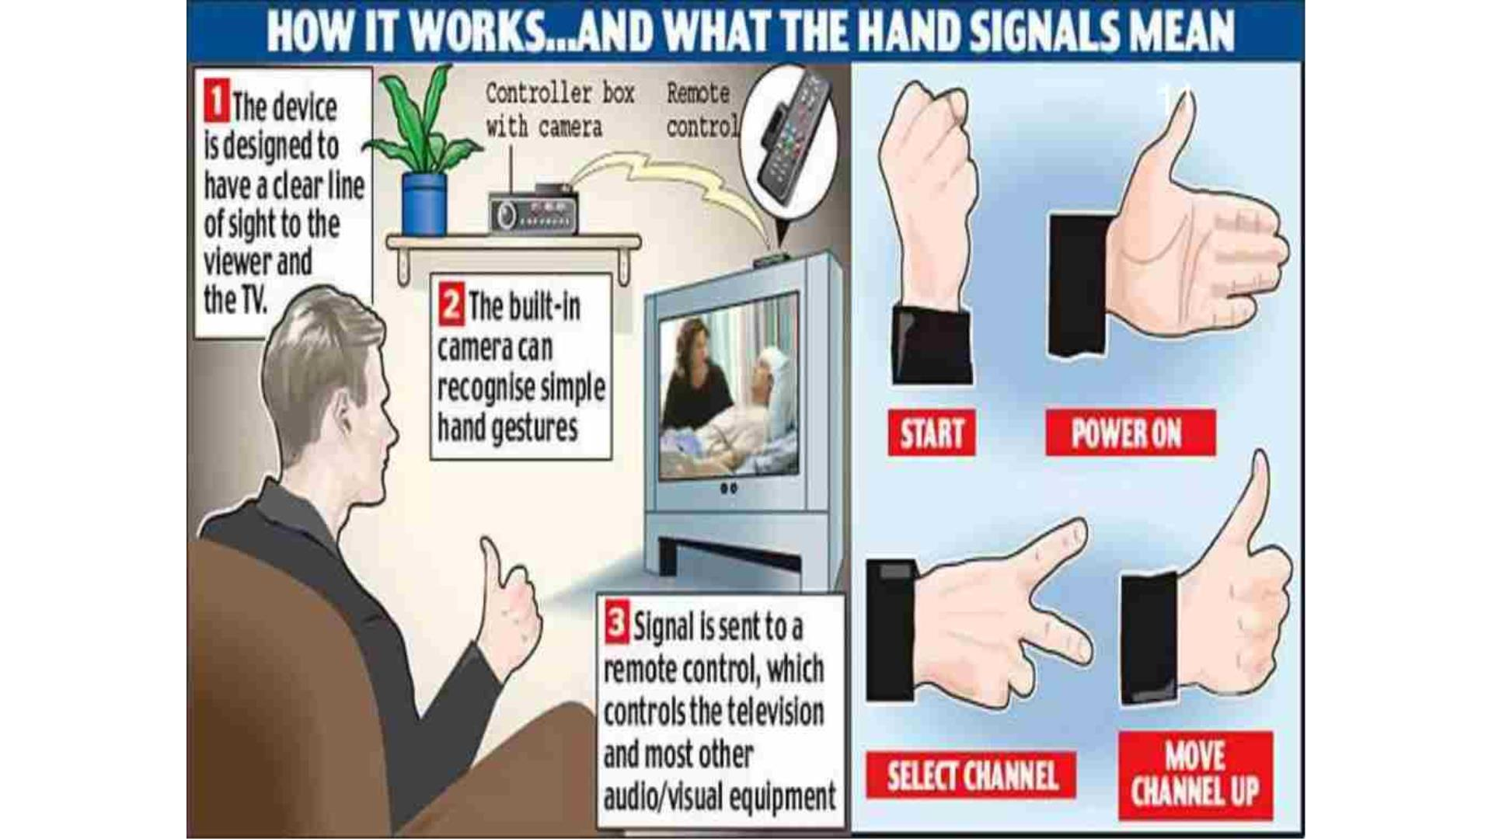

Slide 15
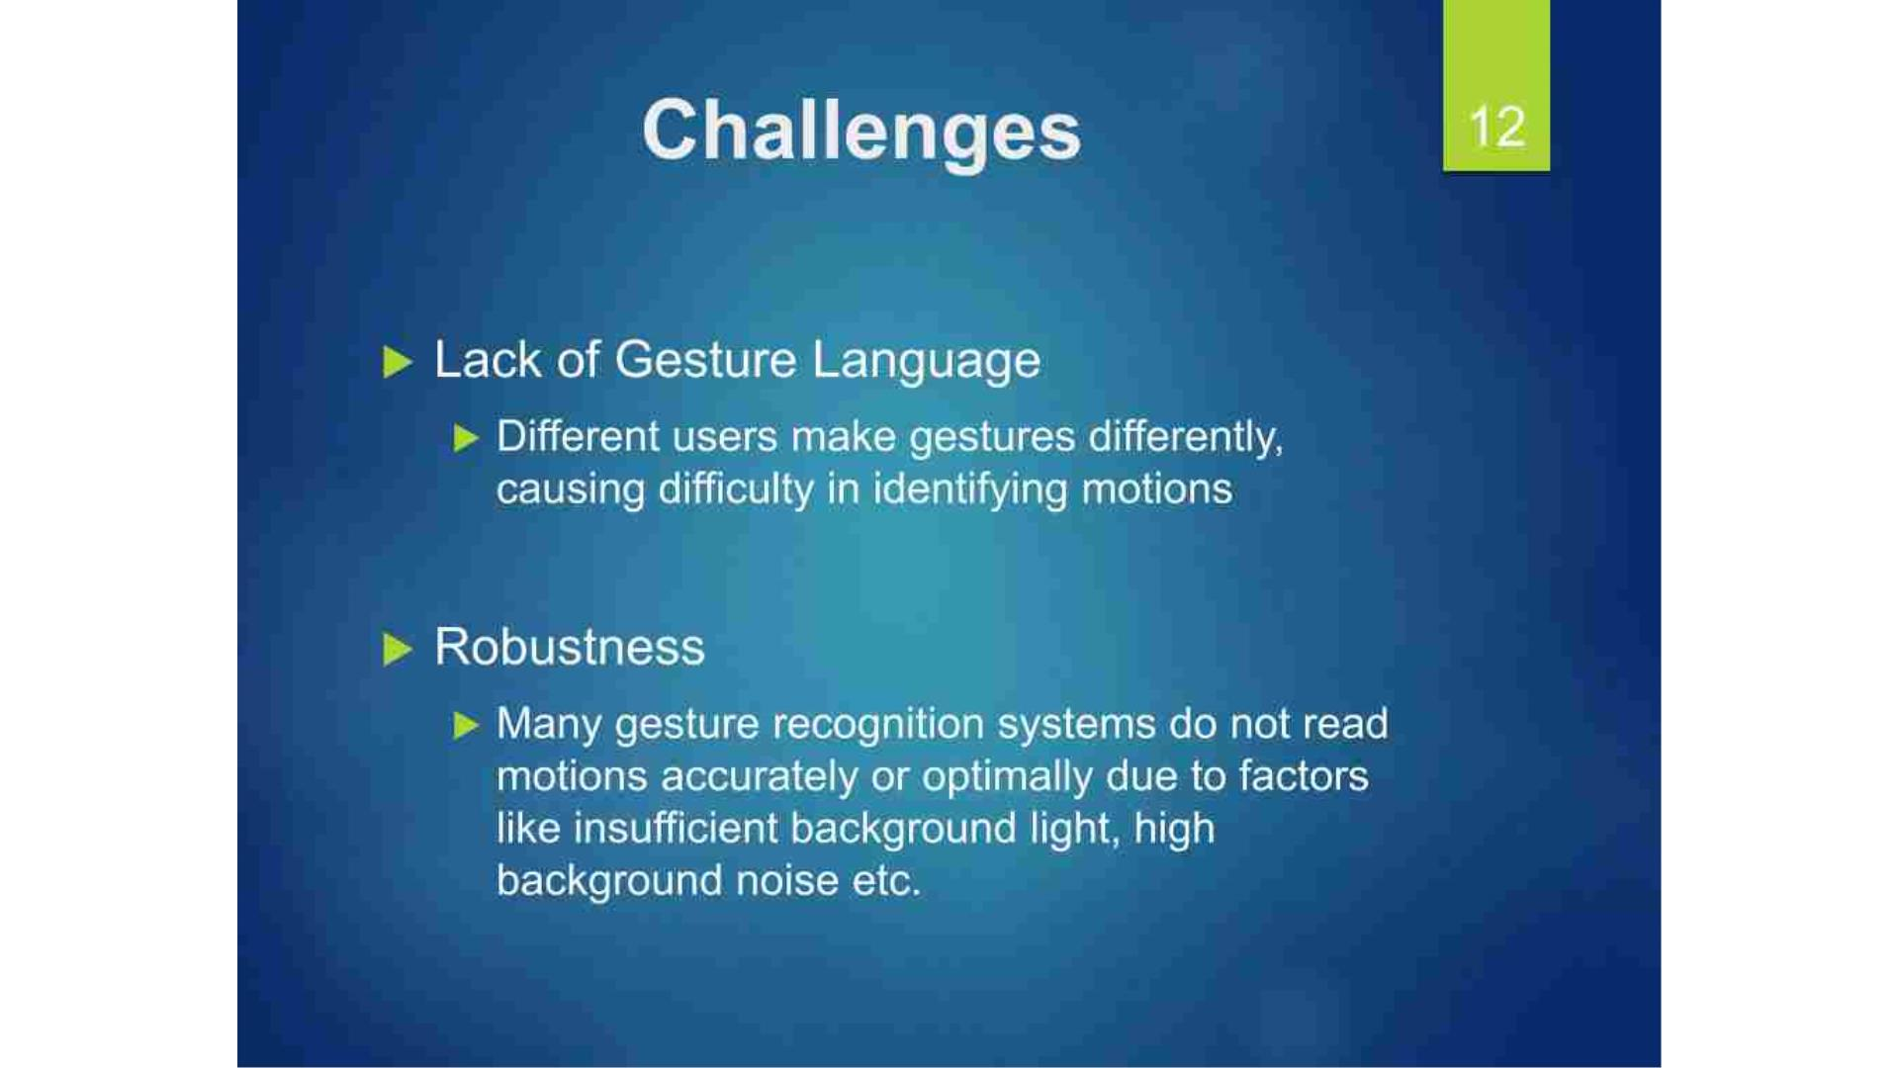

Slide 16
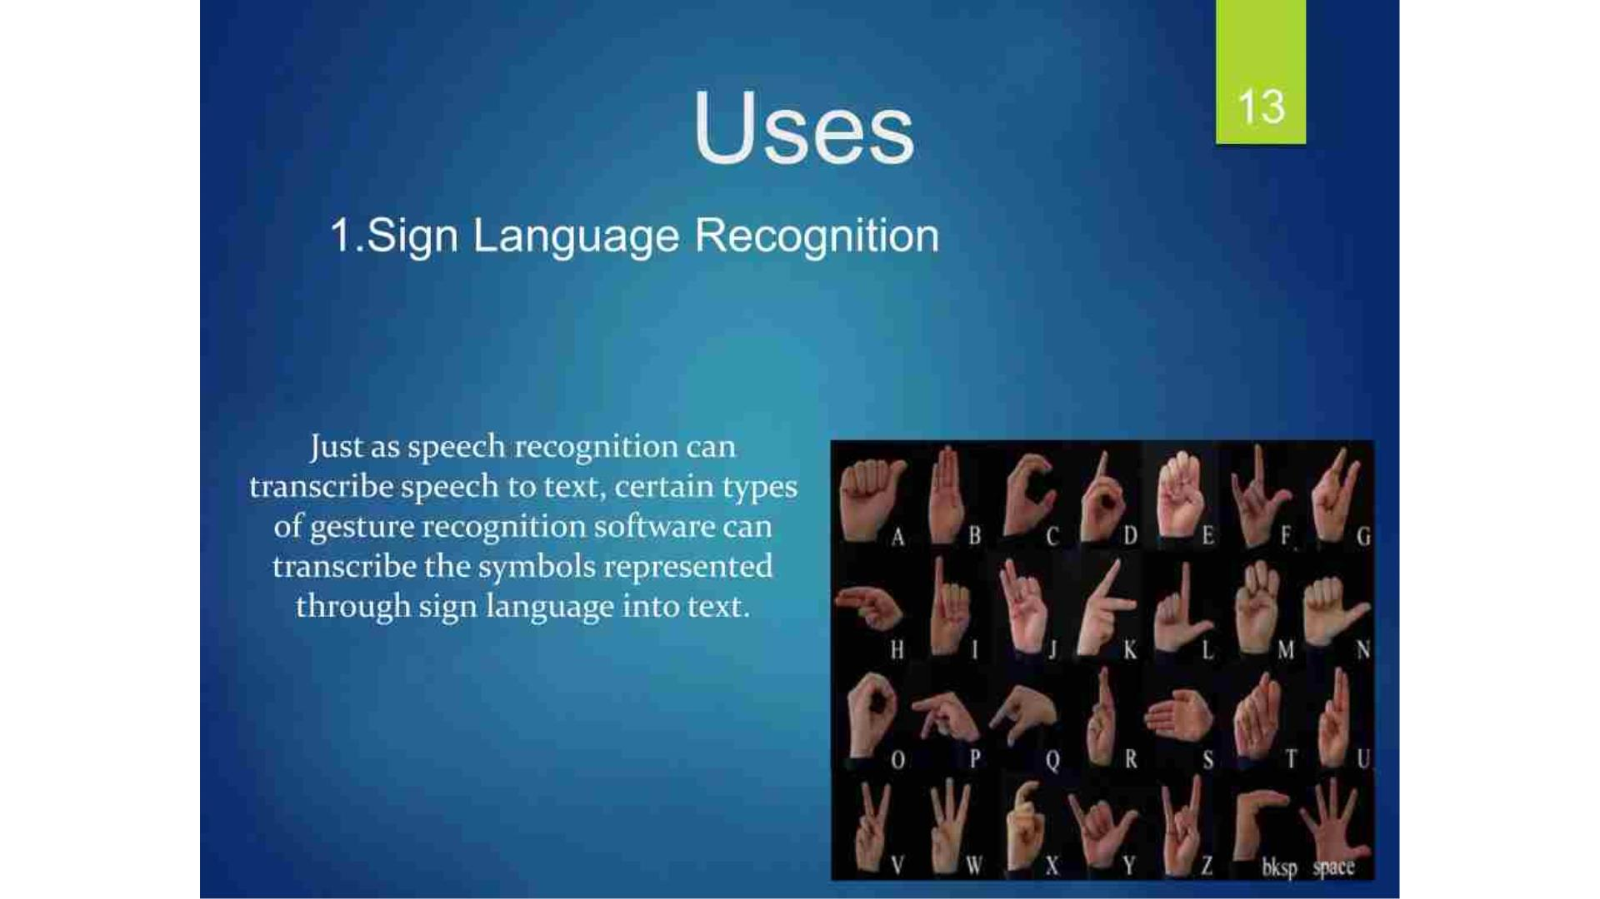

Slide 17
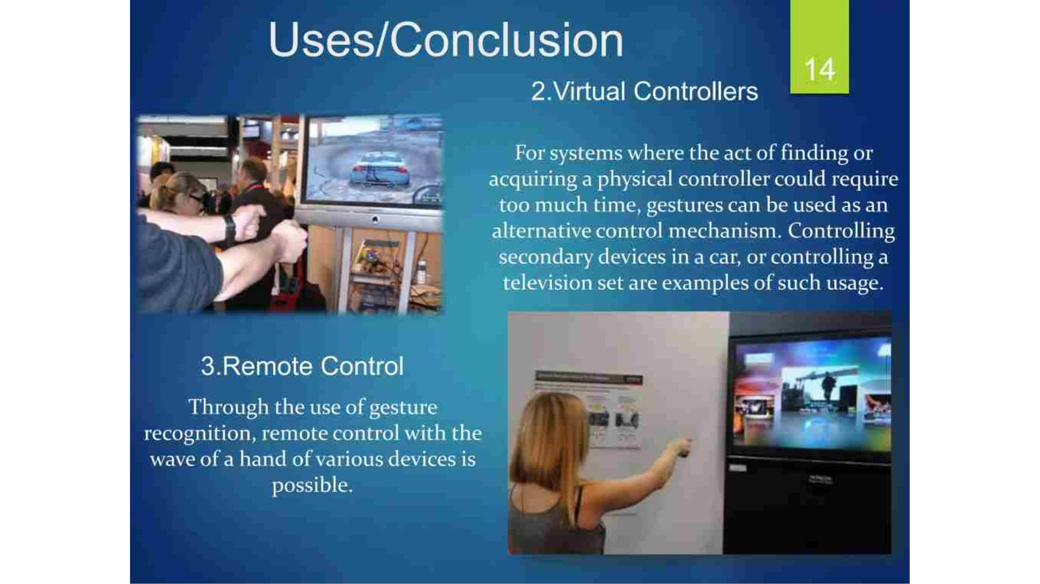

Slide 18
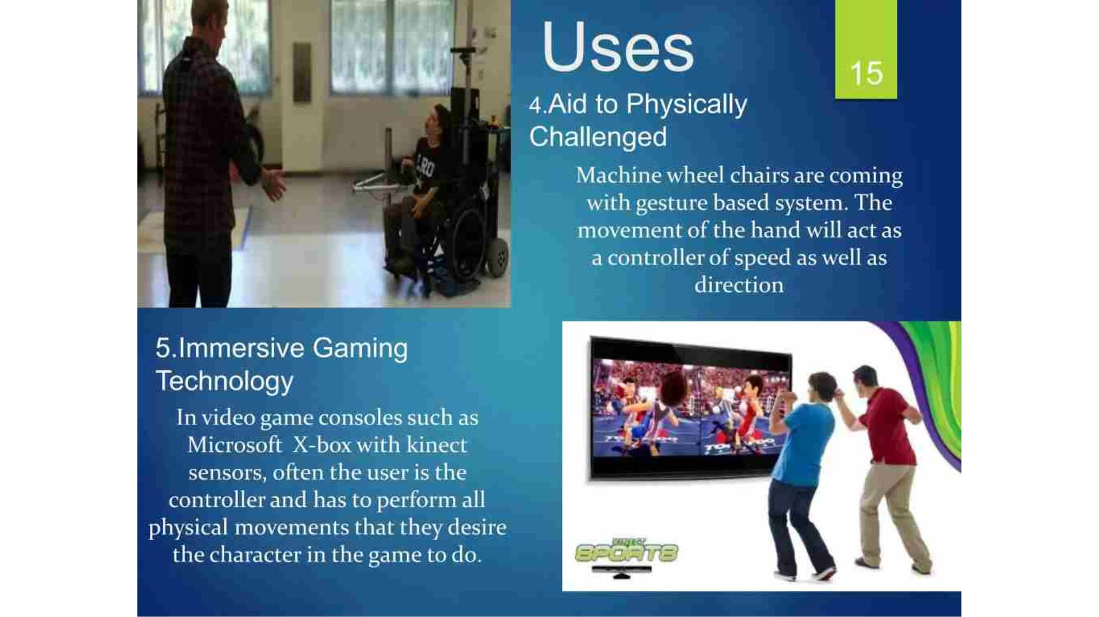

Slide 19
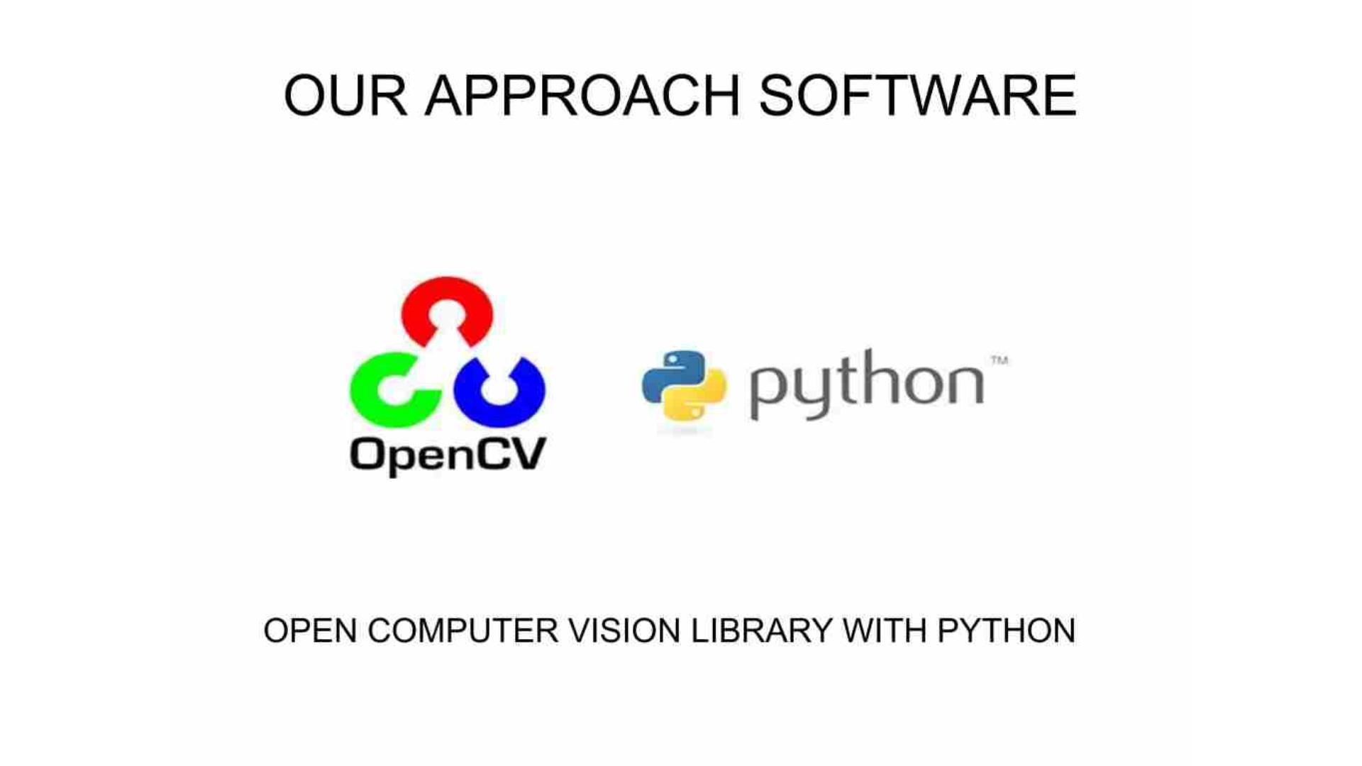

Slide 20
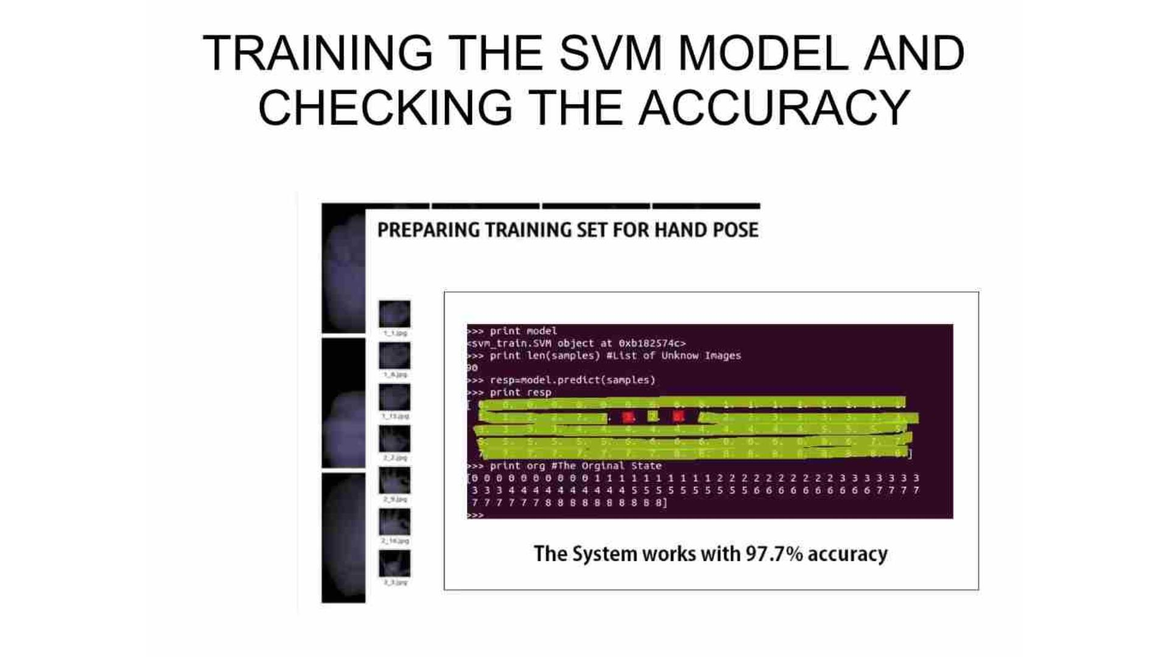

Slide 21
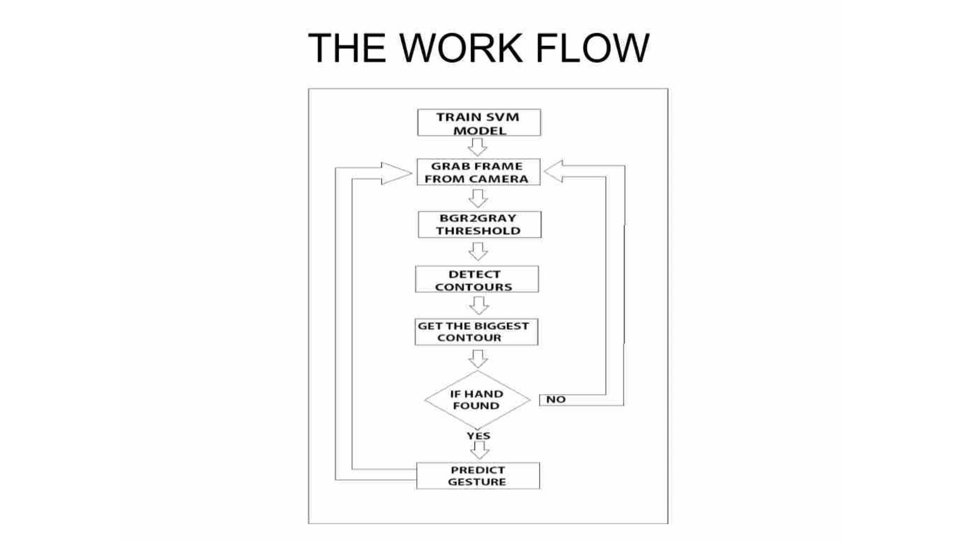

Slide 22

1. INTRODUCTION PROJECT
This project (Hand Gesture Volume Controller) is developed
using Python programming language, In this Python Project
we are going to Building a Volume Controller with our Hand
Gesture detection , To change the volume of a computer.
We first look into hand tracking and then we will use the hand
landmarks to find gesture of our hand to change the volume.
This project is module based which means we will be using a
previously created hand module which makes the hand tracking
very easy.

Slide 23
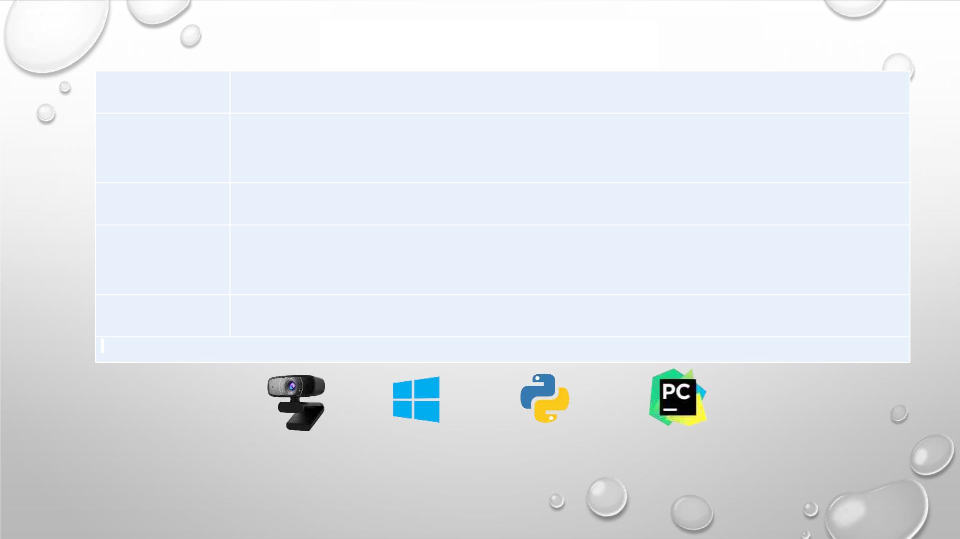
•SOFTWARE/APPARATUS REQUIREMENT
S.NO
1
Software/Apparatus Required
A Laptop with Webcam or an external Webcam device for Desktop PC.
2
3
Windows 7/8/8.1/10 installed operating System.
Python 3.9.4 or earlier version installed. (To run in Windows Terminal)
4
PyCharm IDE installed in PC.
Fig.1 Webcam
Fig.2 Windows OS
Fig.3 Python
Fig.4 PyCharm

Slide 24
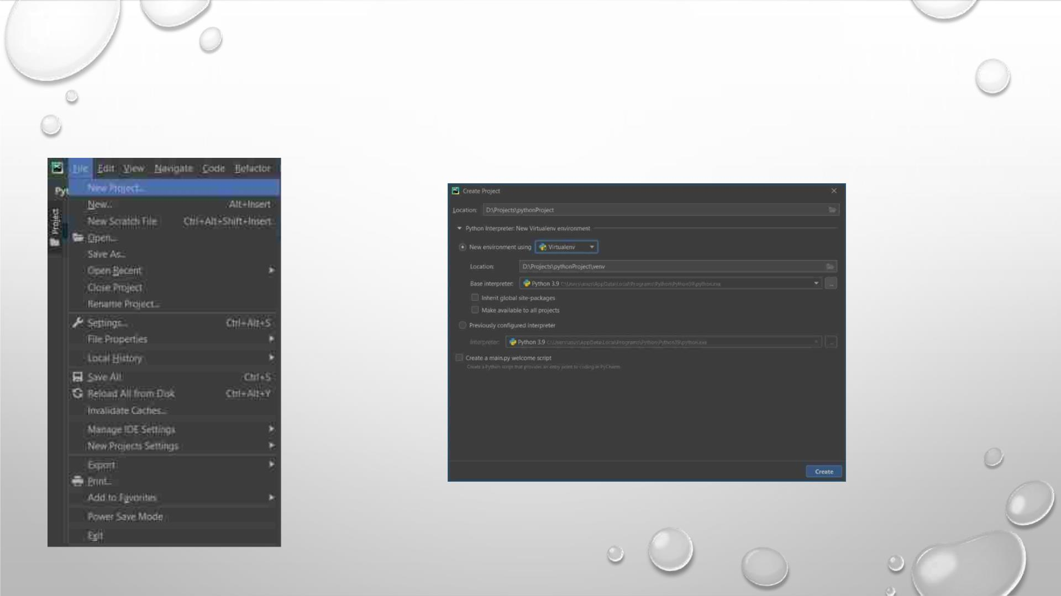
•
PROCEDURE
These are the following steps to create a Hand Gesture Volume Controller Project: -
Step 1: Open PyCharm Application located on your desktop or open from desired located folder.
Step 2: Click on File option and then click on new project.
Step 3: Select the location where you want to create your project and the click on create.

Slide 25
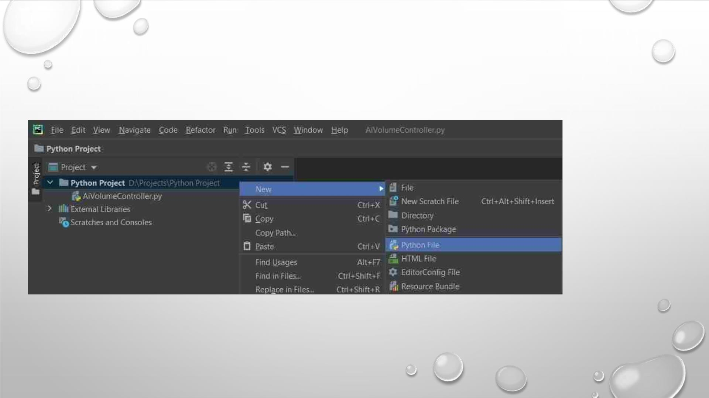
Step 4: Right Click on Project Folder → New → Python File. Name your Python file anything you
want or it is main.py by default. Click on OK, New Python file will be created.

Slide 26
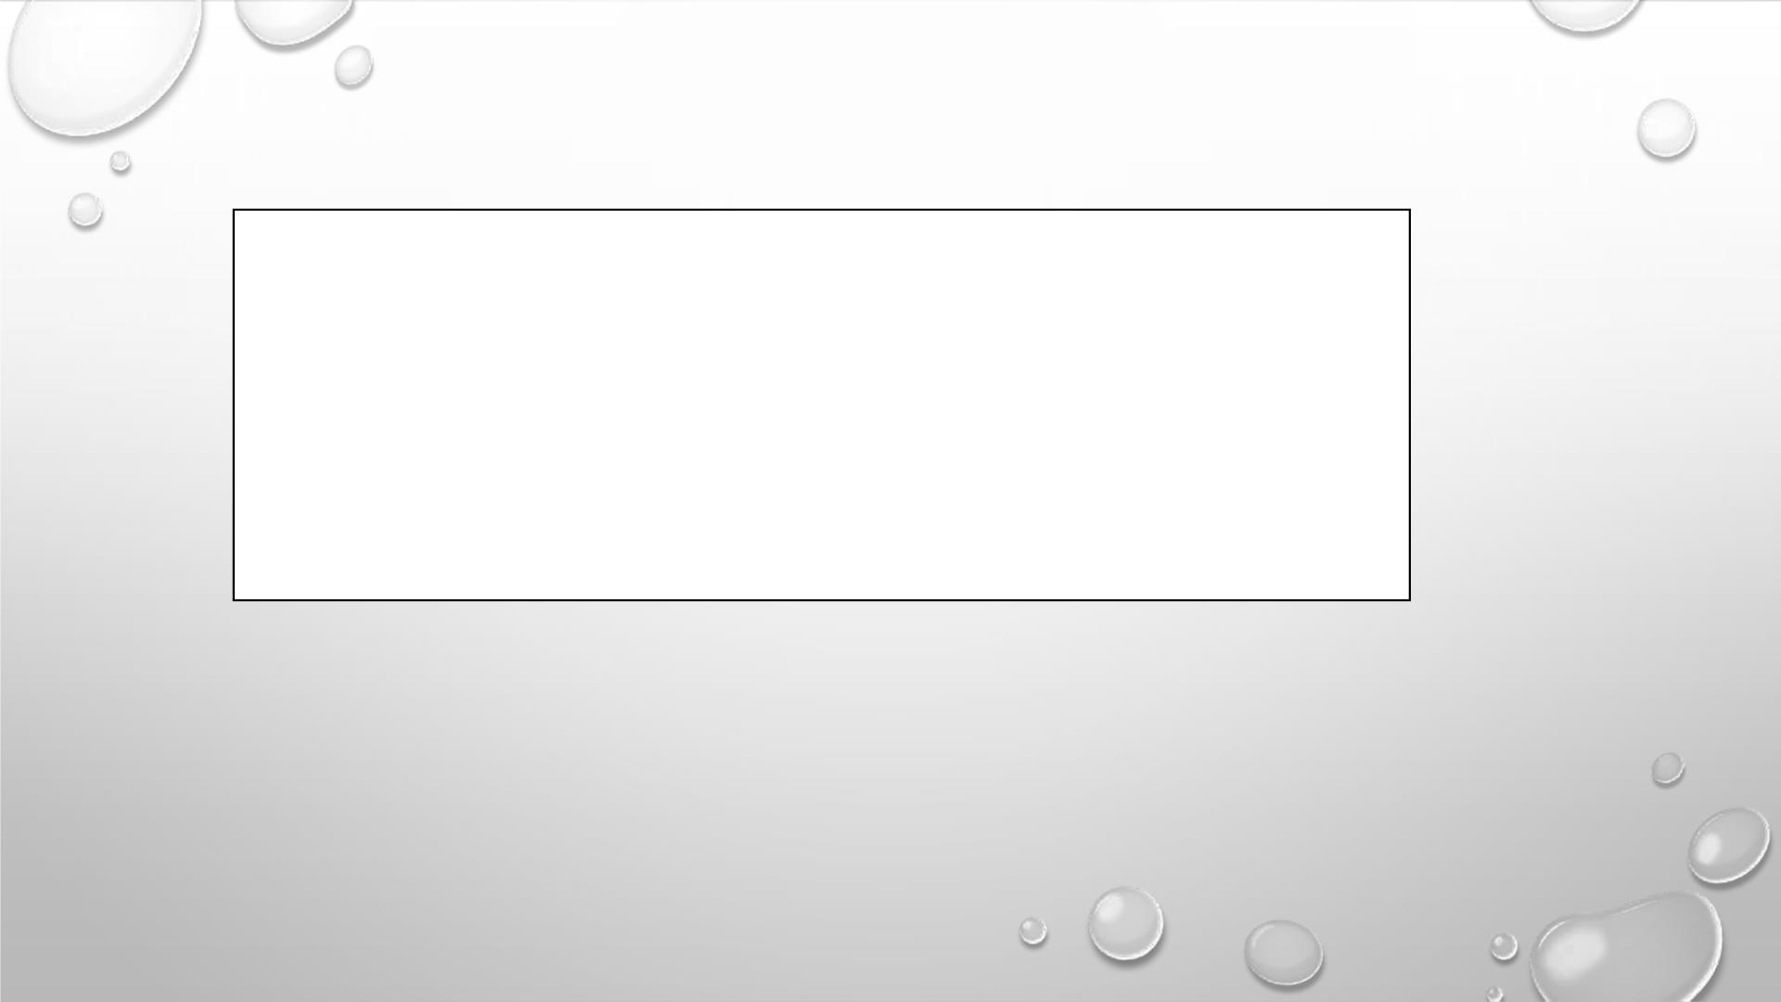
You have to import and install some Libraries to run this program: -
import cv2
import mediapipe as mp
from math import hypot
from ctypes import cast, POINTER
from comtypes import CLSCTX_ALL
from pycaw.pycaw import AudioUtilities, IAudioEndpointVolume
import numpy as np

Slide 27

Following are the Libraries/Interpreter of Python Language: -
OpenCV- OpenCV is a cross-platform library using which we can develop real-time computer vision
applications. It mainly focuses on image processing, video capture and analysis including features like
face detection and object detection.
MediaPipe: - MediaPipe is a cross-platform framework for building multimodal applied machine
learning pipelines. MediaPipe is a framework for building multimodal (eg. video, audio, any time series
data), cross platform (i.e Android, iOS, web, edge devices) applied ML pipelines.
NumPy: - NumPy is a basic level external library in Python used for complex mathematical operations.
NumPy overcomes slower executions with the use of multi-dimensional array objects.

Slide 28

Step 7: Save the Project. File → Save All (Ctrl + S)
Step 8: Run the Program {You can debug and run or directly run
the program into the PyCharm, Run → Run/Debug (Alt + Shift+ F10 /
Alt + Shift + F9)}
You can also run the program into Windows Terminal (Command Prompt).
+ R → Type ‘cmd’ and Click on OK. Go to the specific project path and run the
main file by the Command: py<space>file_name.py ↵
For Example: py main.py ↵

Slide 29
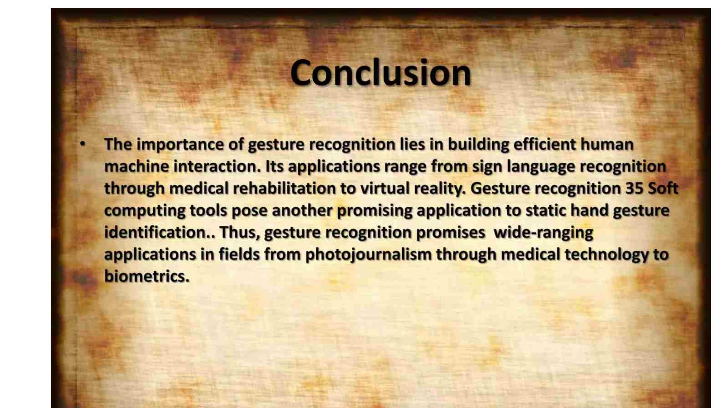

Slide 30
THANK YOU

