Slide 1
19AIE211 Introduction to Computer Networks
PROJECT PRESENTATION
TEAM-06

Slide 2
Driver Drowsiness Detection System for Accident Prevention

Slide 3
Abstract
In Real Time Driver Drowsiness System using Image Processing, capturing the driver’s eye state using computer vision-based drowsiness detection systems has been done by analyzing the interval of eye closure and developing an algorithm to detect the driver’s drowsiness in advance and to warn the driver by in vehicles alarm. This section motivates how the face is detected and how eye detection is performed for automotive applications and their detection is necessary for assessing driver drowsiness.
For detection of drowsiness the per closure value of eye is considered. So when the closure of eye exceeds a certain amount then the driver is identified to be sleepy. For implementing this system several OpenCV libraries are used including Haar-cascade. The entire system is implemented using Raspberry-Pi.

Slide 4
Team - 06
Menta Sai Akshay - 20040
Rachure Charith Sai - 20055
Sajja Bala Karthikeya - 20065
Penaka Vishnu Reddy - 20048

Slide 5
Table Of Contents
01.
02.
03.
INTRODUCTION
DROWSINESS
DETECTION
04.
05.
06.
APPROACH
IMPLEMENTATION
CONCLUSION

Slide 6
01.
INTRODUCTION

Slide 7
The attention level of driver degrade because of less sleep, long continuous driving, or any other medical condition like brain disorders, etc. Several surveys on road accidents say that around 30 percent of accidents are caused by the fatigue of the driver. When a driver drives for more than a normal period for humans then excessive fatigue is caused and also results in tiredness which drives the driver to a sleepy condition or loss of consciousness.
In Real Time Driver Drowsiness System using Image Processing, capturing the driver’s eye state using computer vision-based drowsiness detection systems has been done by analyzing the interval of eye closure and developing an algorithm to detect the driver’s drowsiness in advance and to warn the driver by in vehicles alarm. This section motivates how the face is detected and how eye detection is performed for automotive applications and their detection is necessary for assessing driver drowsiness.

Slide 8

DROWSINESS

Slide 9
Drowsiness is defined as a decreased level of awareness portrayed by sleepiness and trouble in staying alarmed but the person awakes with simple excitement by stimuli. It might be caused by an absence of rest, medicine, substance misuse, or a cerebral issue. It is mostly the result of fatigue which can be both mental and physical. Physical fatigue, or muscle weariness, is the temporary physical failure of a muscle to perform ideally.
Mental fatigue is a temporary failure to keep up with ideal psychological execution. The onset of mental exhaustion amid any intellectual action is progressive and relies on an individual's psychological capacity, furthermore upon different elements, for example, lack of sleep and general well-being.
Mental exhaustion has additionally appeared to diminish physical performance. It can show as sleepiness, dormancy, or coordinated consideration weakness.

Slide 10
Measures for detection of Drowsiness
The study states that the reason for a mishap can be categorized as one of the accompanying primary classes: (1) human, (2) vehicular, and (3) surrounding factor. The driver's error represented 91% of the accidents. The other two classes of causative elements were referred to as 4% for the type of vehicle used and 5% for surrounding factors.
Several measures are available for the measurement of drowsiness which includes the following:
Vehicle-based measures
Physiological measures
Behavioural measures

Slide 11
Vehicle-based measures
Vehicle-based measures survey path position, which monitors the vehicle's position as it identifies with path markings, to determine driver weakness, and accumulate steering wheel movement information to characterize the fatigue from low level to high level.
Physiological measures
Physiological measures are the objective measures of the physical changes that occur in our body because of fatigue. These physiological changes can be simply measured by their respective instruments as follows: ECG (electrocardiogram) EMG (electromyogram) EOG (electro oscillogram) EEG (electroencephalogram)
Behavioral measures
Certain behavioral changes take place during drowsing like
1. Yawning 2. Amount of eye closure
3. Eye blinking 4. Head position

Slide 12
03.
DETECTION

Slide 13

Dividing into
frames
Haarcascade
samples for face detection
Face Detection
Camera
Haarcascade
samples for face, yawn detection
Eye, Yawn Detection
Drowsiness Detection
Alarm

Slide 14
Algorithm Stages:
Image Capture:
Utilizing a web camera introduced inside the automobile we can get a picture of the driver. Despite the fact that the camera creates a video clip, we have to apply the developed algorithm on each edge of the video stream.
Dividing into Frames:
We are dealing with a real-time situation where the video is recorded and has to be processed. But the processing or application of the algorithm can be done only on an image. Hence the captured video has to be divided into frames for analysis.

Slide 15
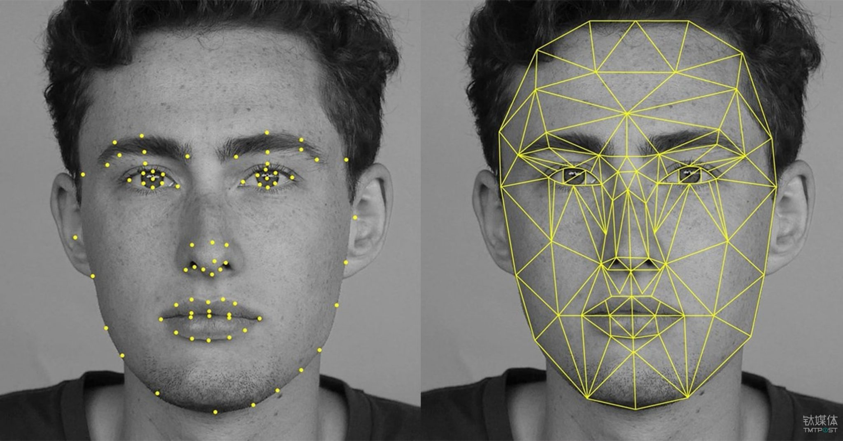
Face Detection:
In this stage, we detect the region containing the face of the driver. A specified algorithm is for the detection of a face in every frame.
By face detection, we mean locating the face in a frame or in other words finding the location of facial characters through a type of technology with the use of the computer.
The frame may be any random frame. Only facial related structures or features are detected and all other types of objects like buildings, trees, and bodies are ignored

Slide 16
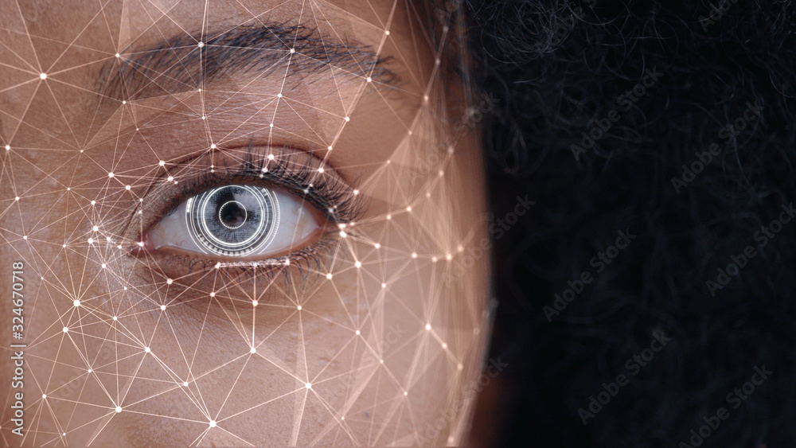
Eye Detection:
After successful detection of the face, the eye needs to be detected for further processing.
In our method eye is the decision parameter for finding the state of the driver. Though detection of the eye may be easier to locate, it’s really quite complicated. At this point, it performs the detection of the eye in the required particular region with the use of detection of several features. Generally, the Eigen approach is used for this process. It is a time taking process. When eye detection is done then the result is matched with the reference or threshold value for deciding the state of the driver.

Slide 17
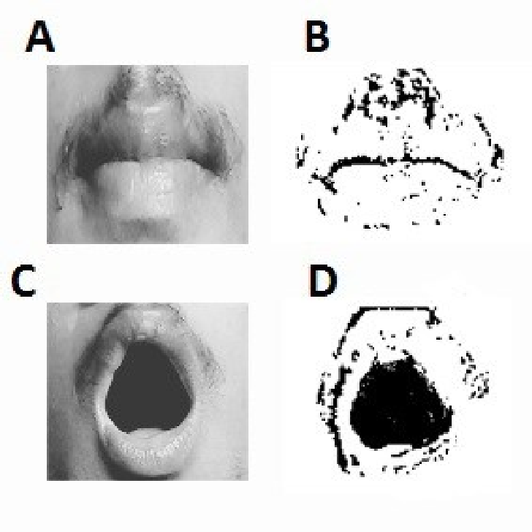
Yawn Detection:
To detect the yawn, we need to find out the distance between the user's upper lip and lower lip. So, when a person is talking this distance will be within a limit, but when the person takes yawns, the distance will be much higher than the limit or threshold.
Now to find out the distance between two lips, we need to find out the landmarks of the lips and again we will use the DLIB's facial landmark model here.

Slide 18
State of the eye:
In this stage, we find the actual state of the eye that it is closed or open or semi-closed or open.
The identification of eye status is the most important requirement. It is achieved by an algorithm which will be clarified in the later parts.
We channelize a warning message if we obtain that the eyes are in the open state or semi-open state up to a particular threshold value. If the system detects that the eyes are open then the steps are repeated again and again until it finds a closed eye

Slide 19

APPROACH

Slide 20
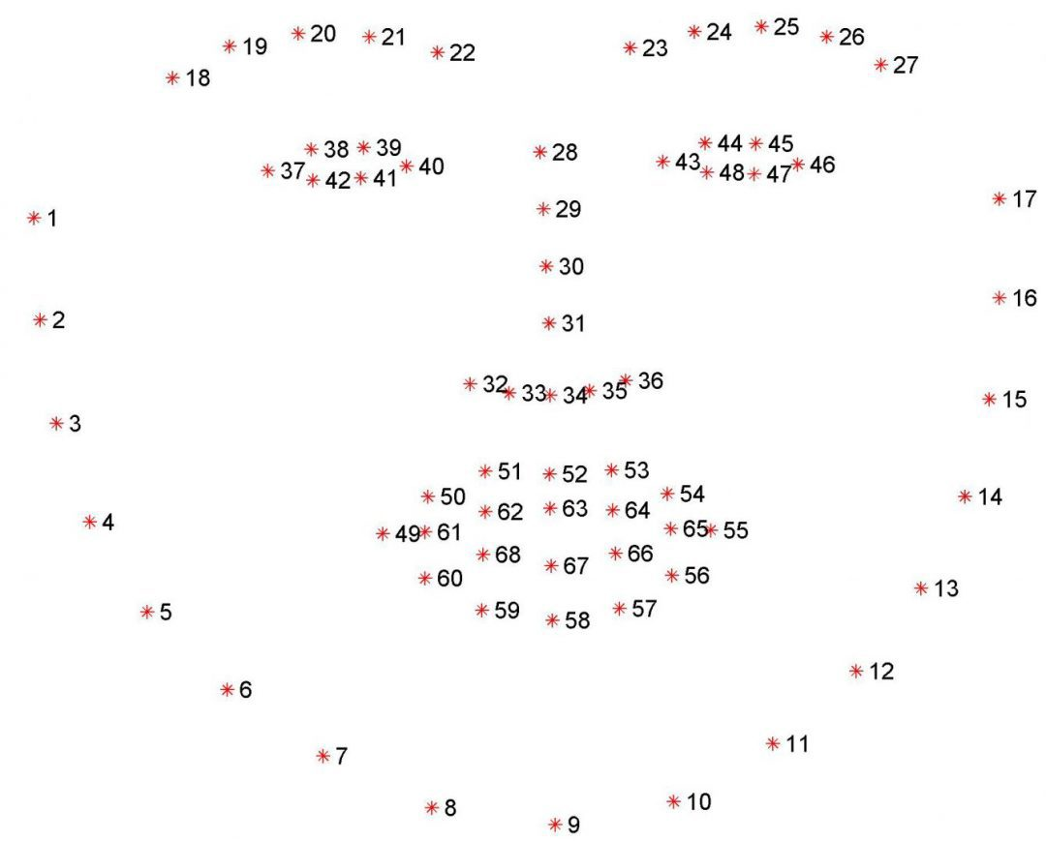
To start, we will apply OpenCV’s Haar cascades to detect the face in an image, which boils down to finding the bounding box (x, y)-coordinates of the face in the frame.
Given the bounding box of the face we can apply dlib’s facial landmark predictor to obtain 68 salient points used to localize the eyes, eyebrows, nose, mouth, and jawline:
Visualizing the 68 facial landmark coordinates from the iBUG 300-W dataset.

Slide 21
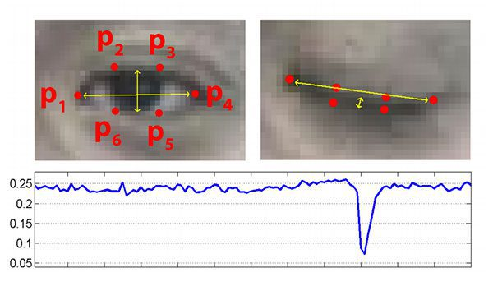
As we discussed, dlib’s 68 facial landmarks are indexable which enables us to extract the various facial structures using simple Python array slices.
Given the facial landmarks associated with an eye, we can apply the Eye Aspect Ratio (EAR) algorithm which was introduced by Soukupová and Čech in their 2017 paper,
On the top-left, we have an eye that is fully open and the eye’s facial landmarks plotted. Then on the top-right, we have an eye that is closed. The bottom then plots the eye aspect ratio over time. As we can see, the eye aspect ratio is constant (indicating that the eye is open), then rapidly drops to close to zero, then increases again, indicating a blink has taken place.

Slide 22

Finally, after obtaining the points, we can find the EAR, using the formula.
$$EAR=\frac{(\left|P_{2}−P_{6}\right|+\left|P_{1}−P_{5}\right|)}{(2∗|P_{1}−P_{4}|)}$$
Next, we will check if this EAR value is within the threshold or not, and based on that the system will alert the user.

Slide 23
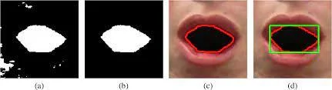
To detect the yawn, we need to find out the distance between the user's upper lip and lower lip. So, when a person is talking this distance will be within a limit, but when the person takes yawns, the distance will be much higher than the limit or threshold.
Now to find out the distance between two lips, we need to find out the landmarks of the lips and again we will use the DLIB's facial landmark model here.
Then we will simply calculate the distance between the midpoint of the upper lip to the midpoint of the lower lip. And if this distance is more than the threshold, the system will give a yawn alert to the user.

Slide 24
05.
IMPLEMENTATION

Slide 25
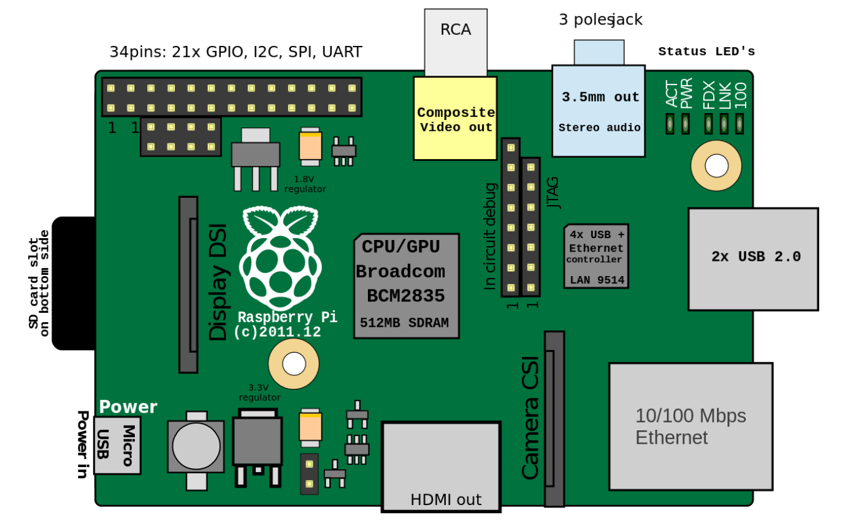
About Raspberry Pi
It is a low cost, credit-card sized computer which is used for implementing small projects. A monitor or TV has to be connected with it externally to visualize its operating system and operate it.
An external memory has to be used to load its operating system. We can program it with several languages like C++, Python etc.

Slide 26
We have implemented Face detection with the help of
1) Raspberry pi.
2) Web Cam.
3) Raspbian operating system.
4) Python IDLE.
5) OpenCV
(Open source Computer Vision) for python
with Harr object detection trainer.
6) Program code for face detection written in
Python Programming language.
Now for the remaining libraries, you need to install the following libraries in python 3:
imutils
scipy
numpy
argparse

Slide 27
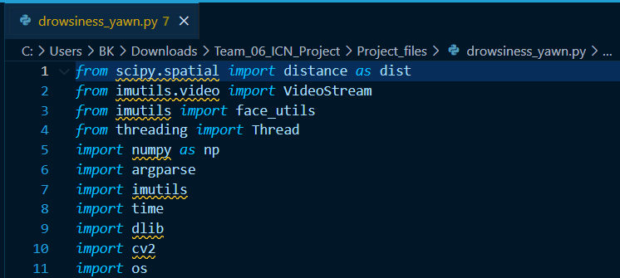
Code
Firstly, we need to import all the required libraries,

Slide 28
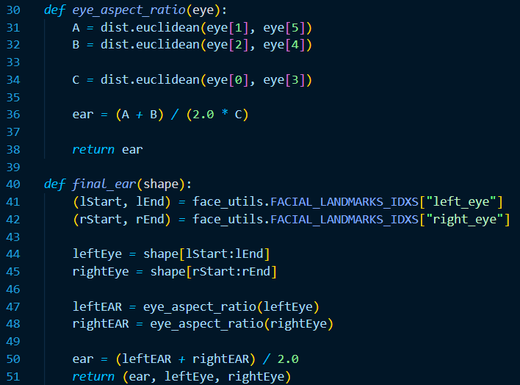
This function will calculate the average EAR for both of the eys, using the previous function "eye_aspect_ratio". It will take the landmarks list as the input, which the DLIB's shape predictor will return. It will also return left eye and right eye coordinates so that we can draw lines around the eyes in the output video feed.

Slide 29
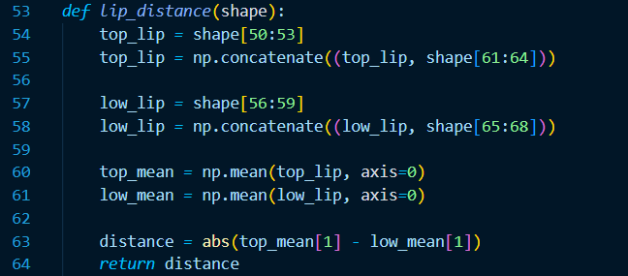
Next, we have a function named "lip_distance" to calculate the distance between lips. It will also take the DLIB's shape predictor's output as input:

Slide 30
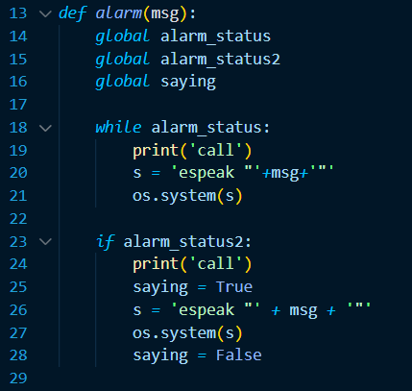
After detecting that the user is drowsy, to alert the user, we have an alarm function. Here we have used espeak, so that our system can say the user "Wake Up" in a robotics voice.

Slide 31

Finally, we have the main code where we have a lot of things, so we will only explain the important parts:
We have a small part, where we have used argparse to ensure that if the user is using a secondary webcam, he/she can do that simply by passing the webcam number as the command-line argument.

Slide 32
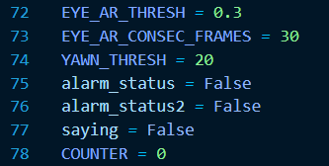
Next, we have some global threshold values, which we may need to change according to the distance of the user from the camera (especially the threshold values to detect the yawn, YAWN_THRESH).
By changing the value of EYE_AR_CONSEC_FRAMES, we can set the number of frames for which the system will wait before giving the alert to a user when the user has closed the eyes. Depending on the FPS of your camera and how much time you want to wait before giving an alert, you need to set the value of EYE_AR_CONSEC_FRAMES variable.

Slide 33

Next, we will load the models for face detection and landmarks prediction on the face.
Finally, we will start capturing video from the webcam or pi camera. Here, we will try to find faces in each of the frame and if we can find any face, then we will pass that face in the shape predictor, which will give us the face landmarks.

Slide 34
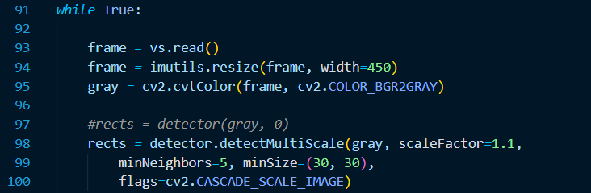
Using the landmarks we will call the earlier defined functions to calculate the EAR and distance between lips. If the lip distance is more than the threshold, the system will call the alarm function immediately to alert the user.
If the EAR value is not in the limit, the system will wait for a pre-defined amount of time and if after the time also the EAR value is not in the limit, then it will call the alarm function and will alert the user.
We will show us the live feed and also how accurately it is detecting the eyes and lips. Also, it will show the calculated EAR value and lip distance.

Slide 35
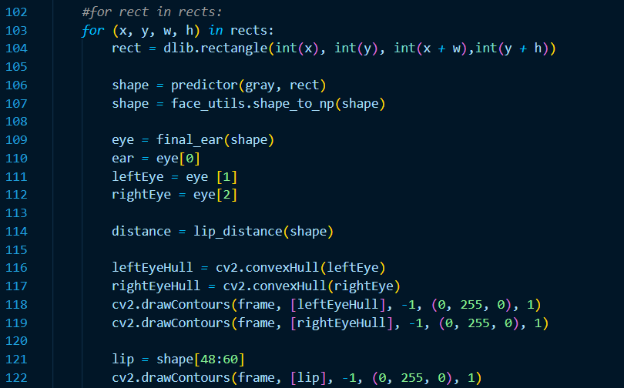

Slide 36
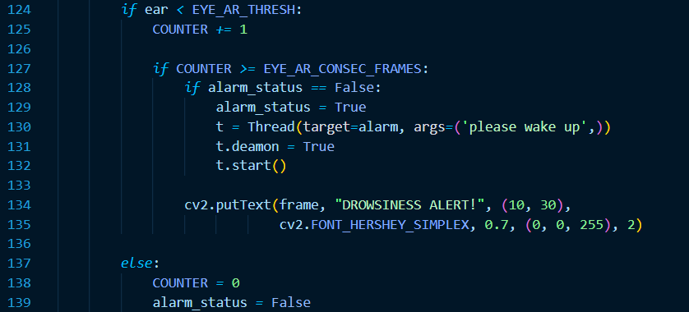

Slide 37
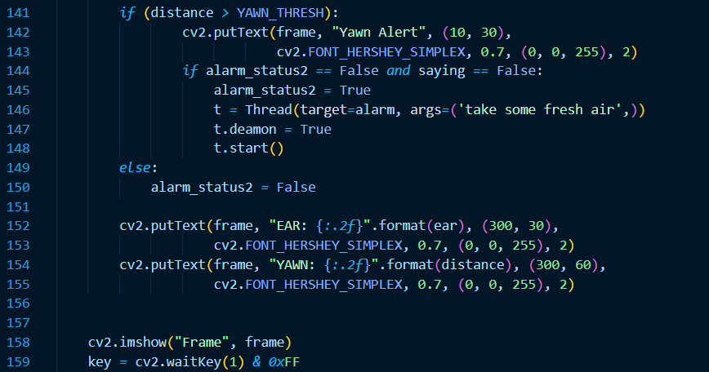

Slide 38

Demo Video

Slide 39
06.
CONCLUSION

Slide 40
Implementation of drowsiness detection with RaspberryPi was done which includes the following steps: Successful runtime capturing of video with the camera.
Captured video was divided into frames and each frame was analyzed. Successful detection of the face followed by detection of the eye. If closure of the eye for successive frames were detected then it is classified as a drowsy condition else it is regarded as a normal blink and the loop of capturing the image and analyzing the state of the driver is carried out again and again.
In this implementation during the drowsy state, the eye is not surrounded by a circle or it is not detected and the corresponding message is shown. If the driver is not drowsy then the eye is identified by a circle and it prints 1 for every successful detection of an open eye.

