Slide 1
19MAT204
MATHEMATICS FOR INTELLIGENT SYSTEMS 3
PROJECT
Group 06

Slide 2
TEAM Members
M.VISWESWARAN [CB.EN.U4AIE20075]
VISHNU RADHAKRISHNAN [CB.EN.U4AIE20074]
THUSHIT KUMAR R [CB.EN.U4AIE20072]
MENTA SAI AKSHAY [CB.EN.U4AIE20040]
KRISHNAN K M [CB.EN.U4AIE20031]

Slide 3
Emoji Predictor
😮
😒
😋
😀
😔
😂

Slide 4
Research and Analysis
Dataset Collection from Kaggle
Filtering the dataset
Dataset Training
Tuning the model
Output

Slide 5
SVM It's Implementation

Slide 6
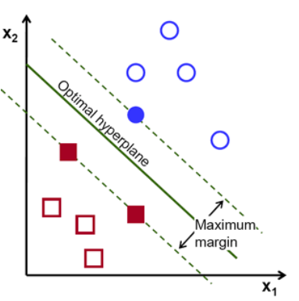
SVM (Support Vector Machines) :
A Support Vector Machine(SVM) is a discriminative classifier which intakes training data and the algorithm outputs an optimal hyperplane which categorizes the data.
Support vectors are data points that are closer to the hyperplane and influence the position and orientation of the hyperplane. Using these support vectors, we maximize the margin of the classifier. Deleting the support vectors will change the position of the hyperplane. These are the points that help us build our SVM.

Slide 7
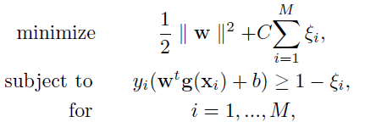
L1 SVM
Support vector machines with linear sum of slack variables, which are commonly used are called L1-SVM's.
Let training data be x_{i} (i = 1, ...,M) and its label be y_{i} =1, if xi belongs to Class 1, and y_{i} = −1 if Class 2.
To obtain the optimal separating hyperplane of the L1-SVM in the feature space,
we consider the following optimization problem:

Slide 8
Where w is a weight vector,
C is the margin parameter that determines the tradeoff between the maximization of
the margin and the minimization of the classification error,
ξ_{i} (i = 1, ...,M) are the non-negative slack variables
And,
b is the bias term.

Slide 9
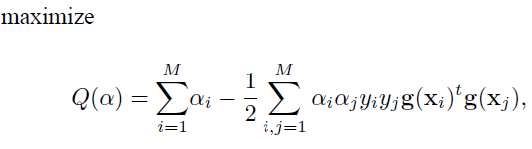




On Introducing the Lagrange multipliers αi, we obtain the following dual problem,
We use the mapping function that satisfies
Kernel Function
Solving the above dual problem, we obtain the decision function:

Slide 10
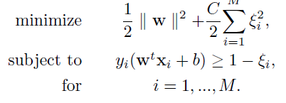
L2 SVM
L2-SVMs use the square sum of the slack variables ξi in the objective function instead of the
linear sum of the slack variables.
we consider optimization problem as

Slide 11
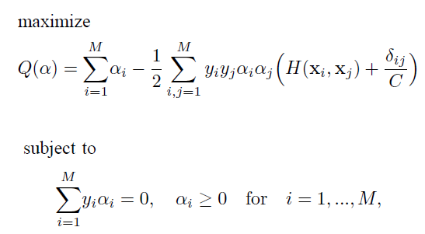
Introducing the Lagrange multipliers αi, we obtain the dual problem:
δij is Kronecker’s delta function, in which δij = 1 for
i = j and 0, otherwise

Slide 12
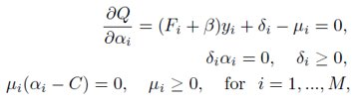

DIFFERENCES
L1 SVM | L2 SVM
Support vector machines with linear sum of slack variables, which are commonly used, are called L1-SVMs | Support Vector Machines with the square sum of slack variables are called L2-SVMs.
The objective for an L1-SVM is: | The objective of an L2-SVM is:
KKT Conditions: | KKT Conditions:

Slide 13
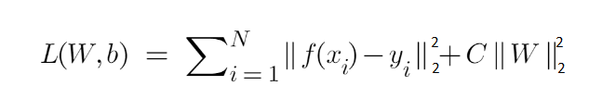
Least Square SVM:
Least Square Support vector machines (LS-SVM) are least square versions of support vector machines(SVM)
The main objective of LS-SVM is to apply minimization of sum of squared errors to the objective function.
LS-SVM are used for classification and regression analysis and are also class of Kernel-based learning methods.

Slide 14


Least squares version to the SVM classifier by formulating the classification problem as
Subject to the equality constraints.

Slide 15

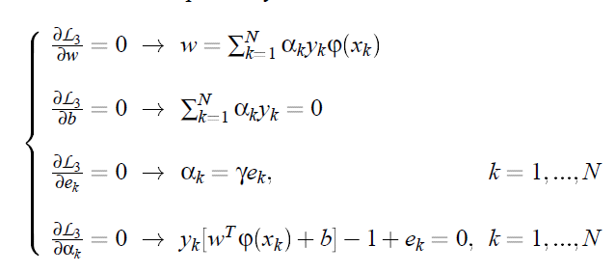
Lagrangian is defined as
Conditions for optimality

Slide 16
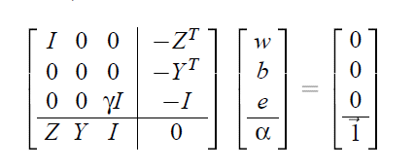
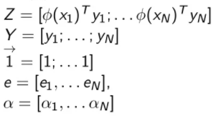
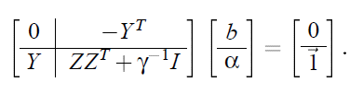
The above equations can be written as the solution for the following set of Linear Equations
The solution is given by,

Slide 17

After applying Mercer's Solution to the matrix Ω = ZZ^T
Hence the classifier is found by solving the linear set of equations instead of quadratic programming and The support values αk are proportional to the errors at the data points

Slide 18
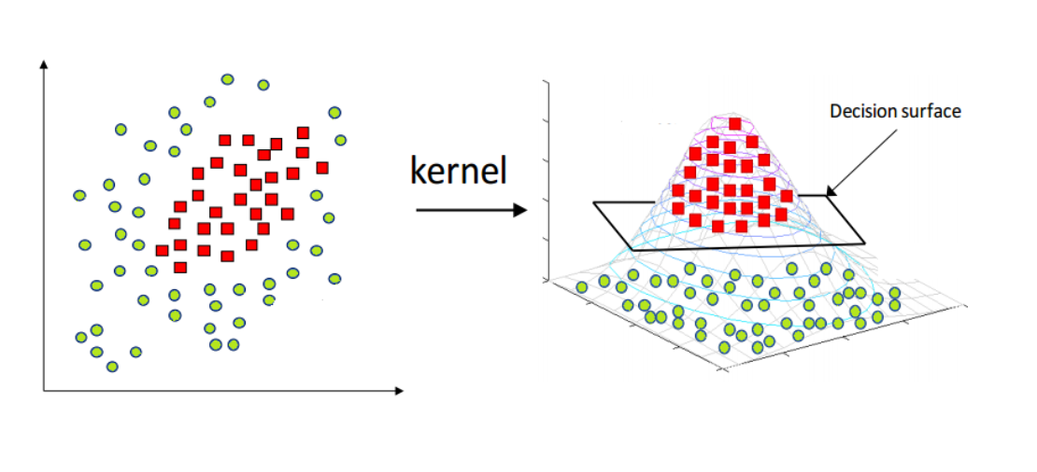
What is Kernel trick !?
Major part of SVM, Kernel trick
Kernel is a way of computing the dot product of two vectors x and y in higher dimensional feature space.
Applying Kernel means to replace the dot product of two vectors by Kernel function.

Slide 19
There are basically 3 types of Kernel Linear, Polynomial, RBF here we are mainly using RBF.
Radial basis function Kernel is a popular Kernel method.
Here the value depends on the distance from the origin or from some point.
Using the distance in the original space we calculate the dot product.

Slide 20
Kernel Functions
SVM can map the input vector into a high dimensional feature space.
This can be done when a linear boundary is inappropriate.
Here by selecting the non-linear mapping as a priori, SVM constructs an optimal separating
hyperplane in this higher dimension.
So basically, the kernel function helps to enable operations to be done in input space rather
than the higher dimensional space.

Slide 21


So here some theory suggest that inner product in feature space has an equivalent Kernel in input space provided certain conditions in hold.
From this Gaussian radial basis function (G-RBF) has received significant attention and it is given by:

Slide 22
Here generally, using RBF it helps in some method of determining a subset of centers,
where usually we use a method of clustering to select a subset of centers.
So the process of SVM in this implicit selection process is its main focusing feature where
each support vectors contributing on local Gaussian functions and it is centered at that data point.
And also principle of SRM can be used to select global basis function width.

Slide 23
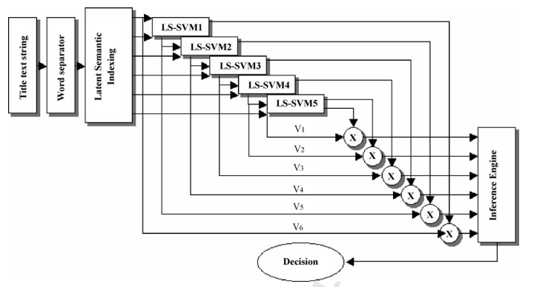
BASIC IDEA

Slide 24
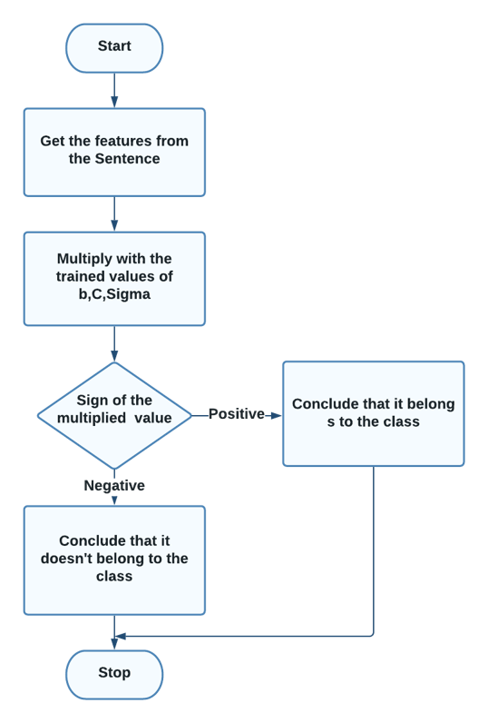

Slide 25
ALGORITHMS

Slide 26
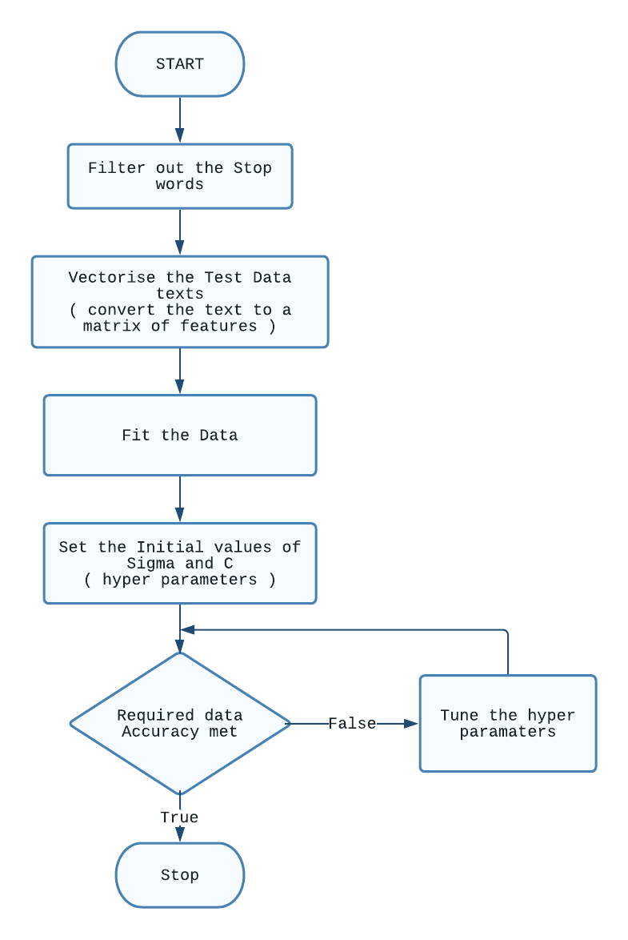
TRAINING

Slide 27
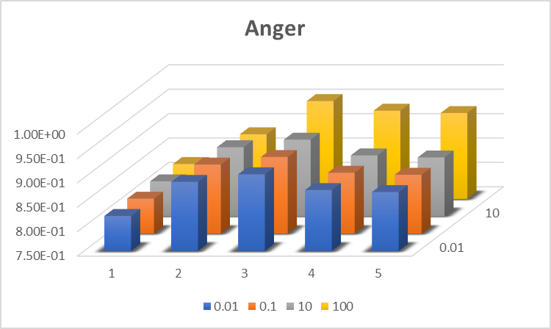
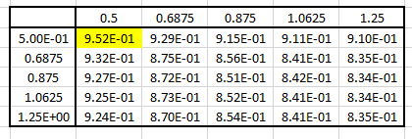
Plots in Parameter Tuning
The accuracy of the model was plotted for corresponding C and Sigma values pair
Z
Y
X
X axis : Sigma value
Y series : corresponding to the given C values in the bottom
Z axis : accuracy of the Model

Slide 28
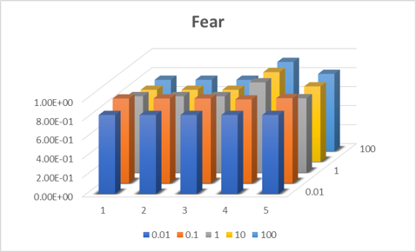
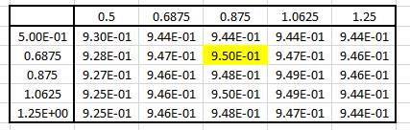
Fear

Slide 29
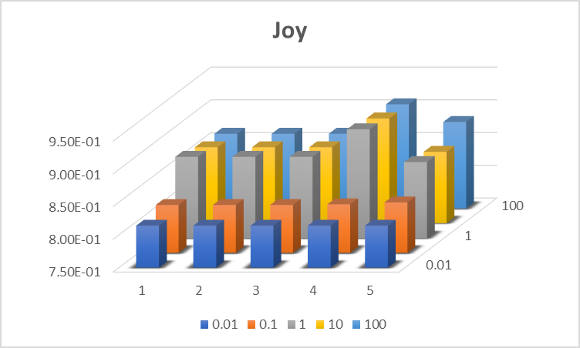
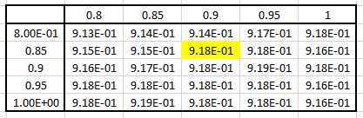
Joy

Slide 30
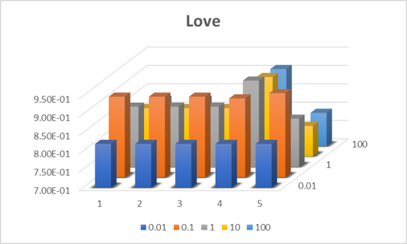
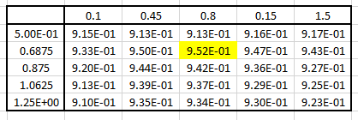
Love

Slide 31
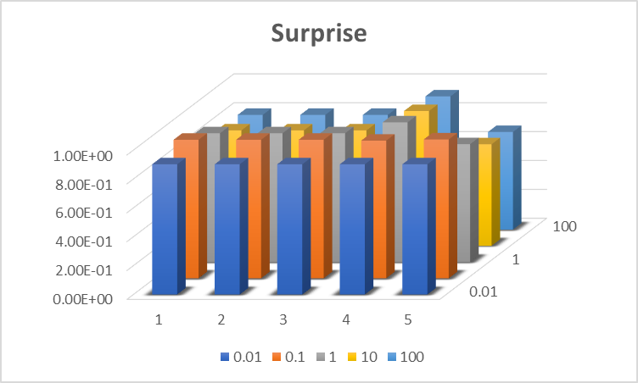
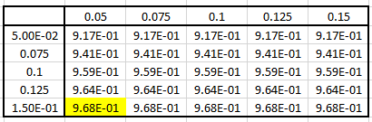
Surprise

Slide 32
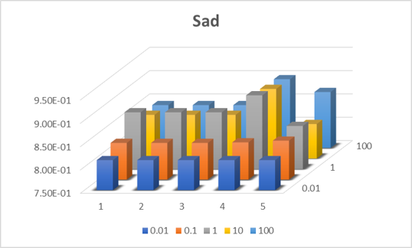
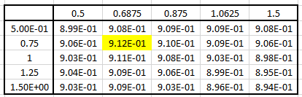
Sad

Slide 33

CLASSIFIER

Slide 34
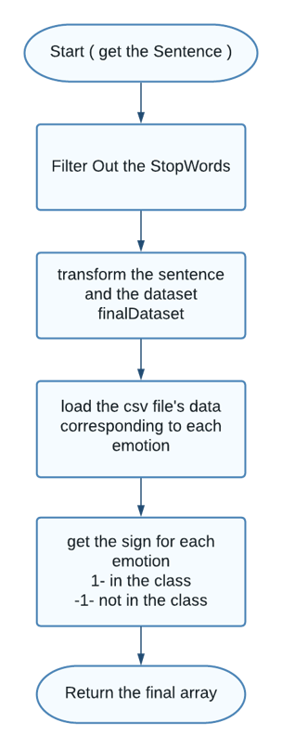

Slide 35

BACKEND

Slide 36
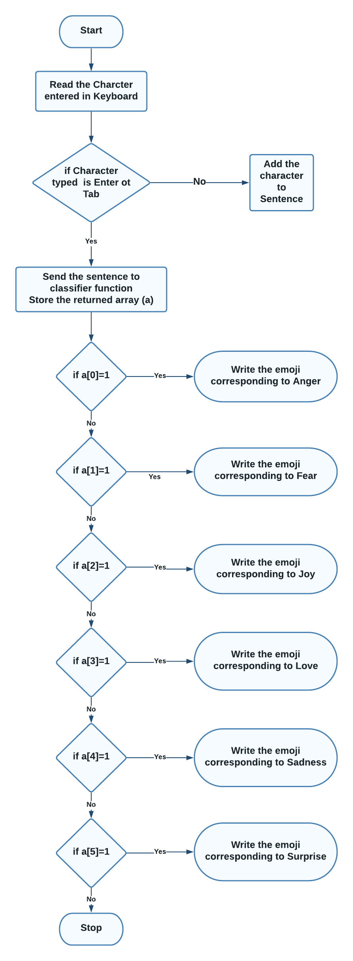

Slide 37
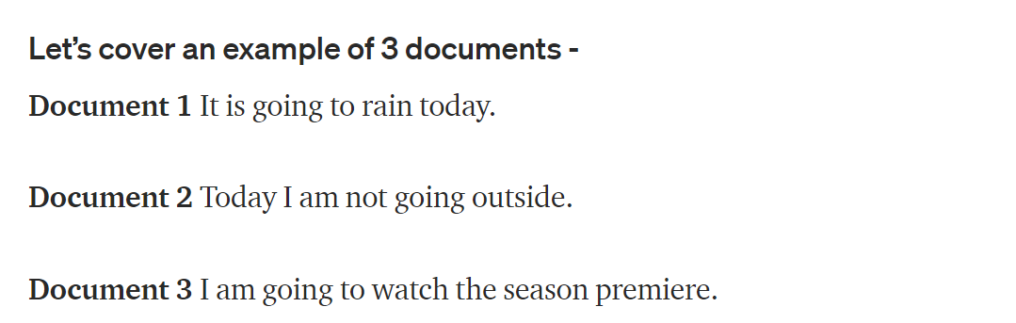
TF-IDF Vectorization

Slide 38
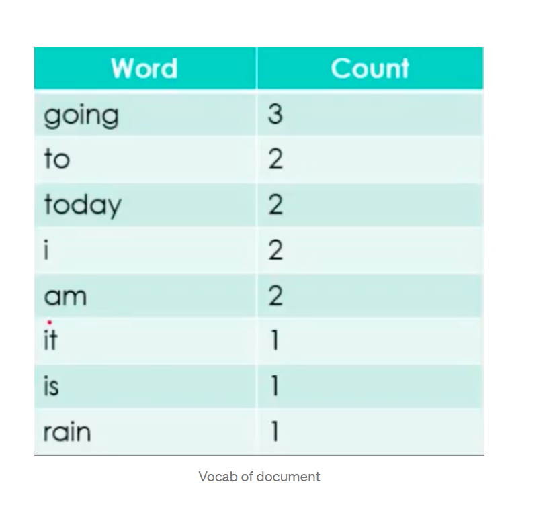
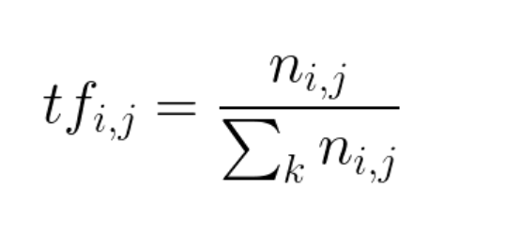

Slide 39
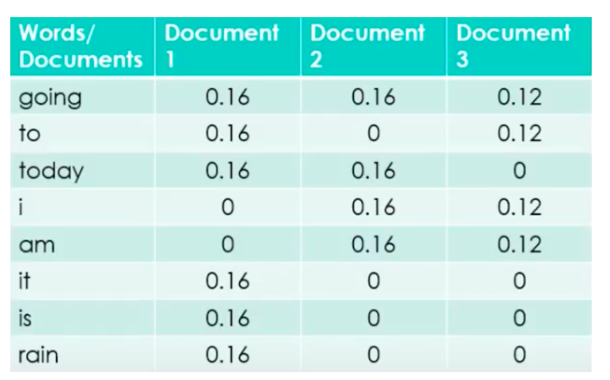

Slide 40
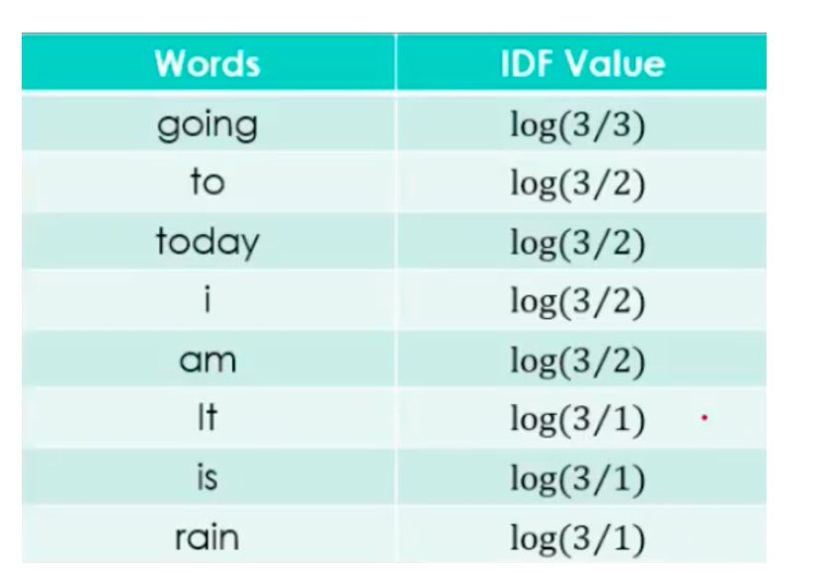
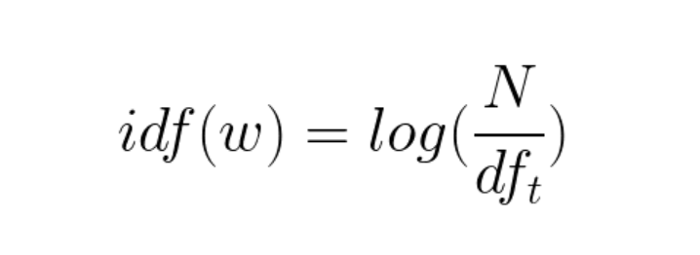

Slide 41
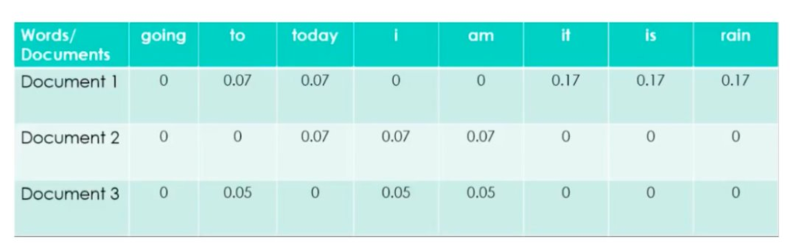
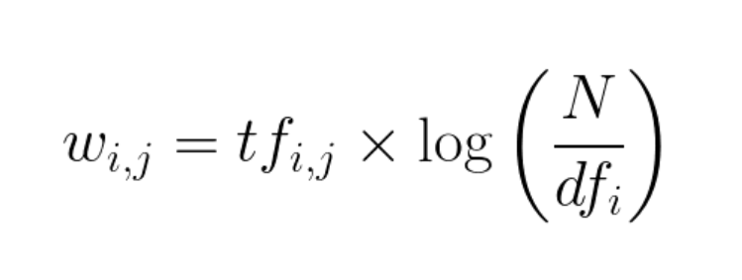

Slide 42
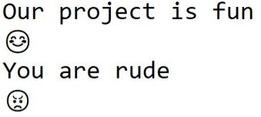
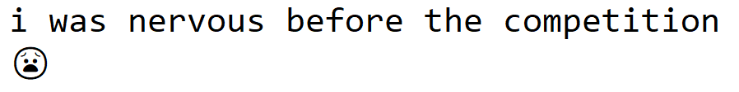
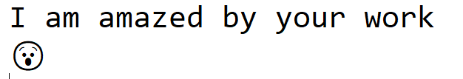

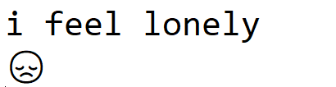
OUTPUT Samples

Slide 43

GUI

Slide 44
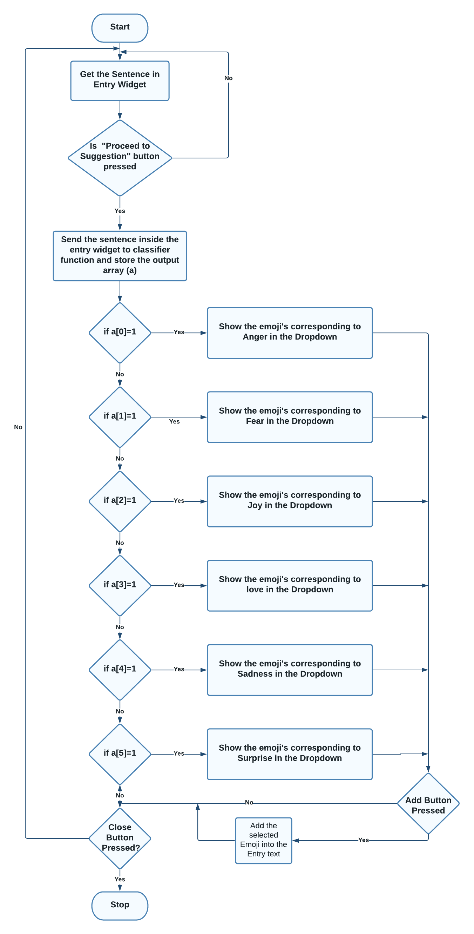

Slide 45
REFERENCES
1. Least Squares Support Vector Machine Classifiers -https://www.researchgate.net/publication/220578095_Least_Squares_Support_Vector_Machine_Classifiers
2. Comparison of L1 and L2 Support Vector Machines -https://www.researchgate.net/publication/4030193_Comparison_of_L1_and_L2_Support_Vector_Machines
3. Text classification: A least square support vector machine approach -https://www.researchgate.net/publication/222420760_Text_classification_A_least_square_support_vector_machine_approach

Slide 46
THANK YOU

