Slide 1
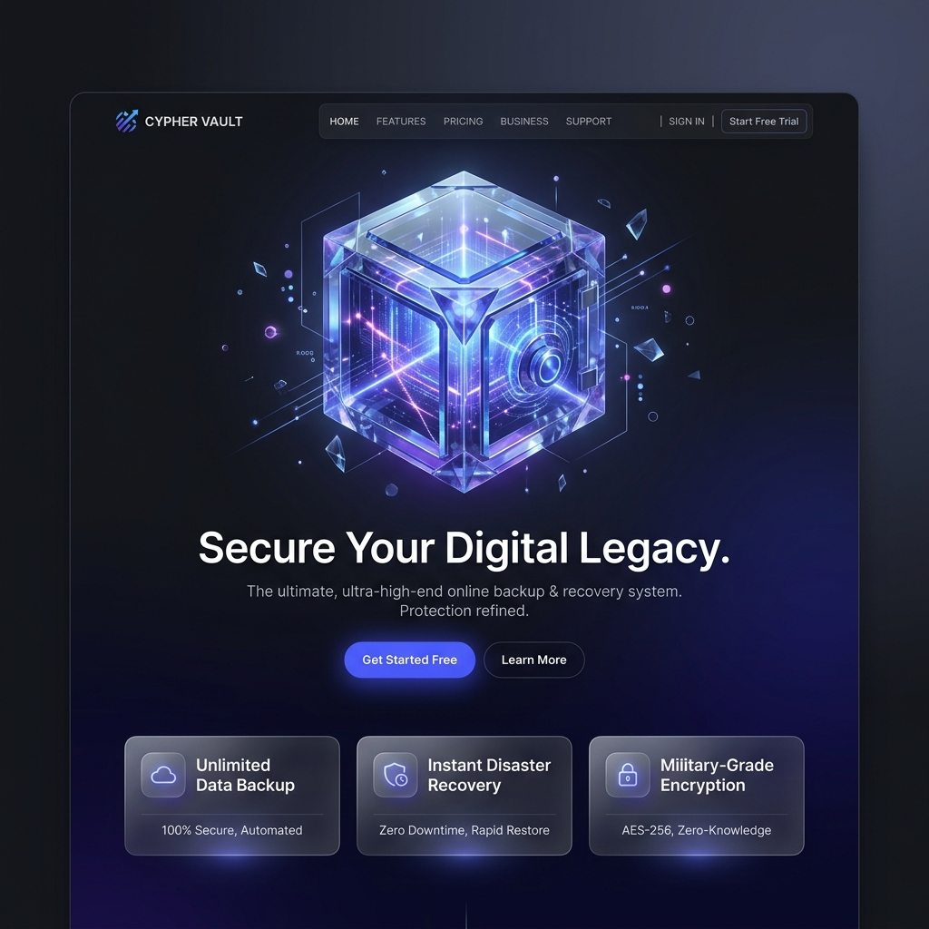
NEXT-GEN UI/UX
Designing the Future of Data Recovery

Slide 2
Design Philosophy: Glassmorphism
• Visual Depth: Layers of frosted glass for hierarchy
• Minimalism: Removing friction from data management
• Feedback: Micro-animations for system health
• Accessibility: High-contrast typography (Outfit/Inter)

Slide 3
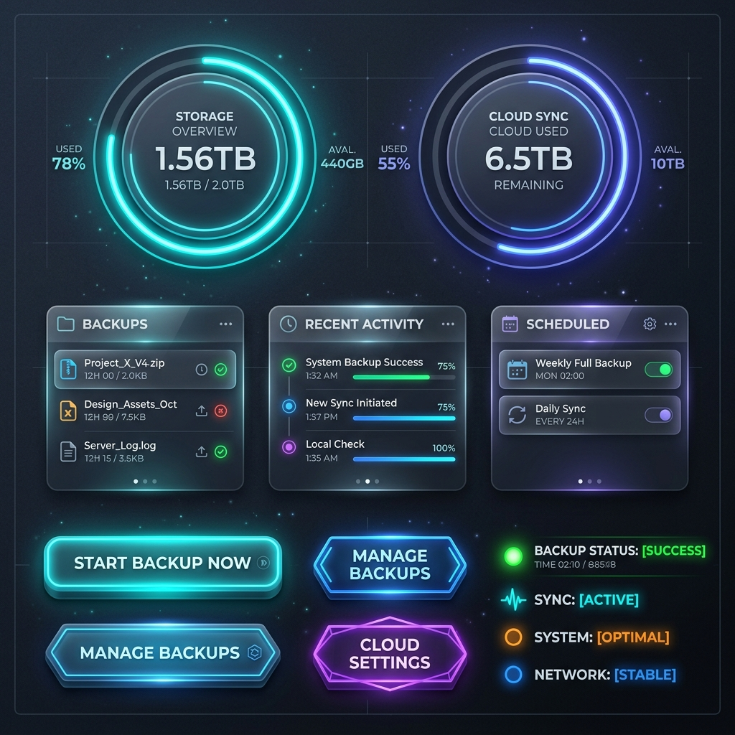
Atomic Components
• Neural Gauges
• Shard List Cards
• Dynamic Buttons
• Status Badges

Slide 4
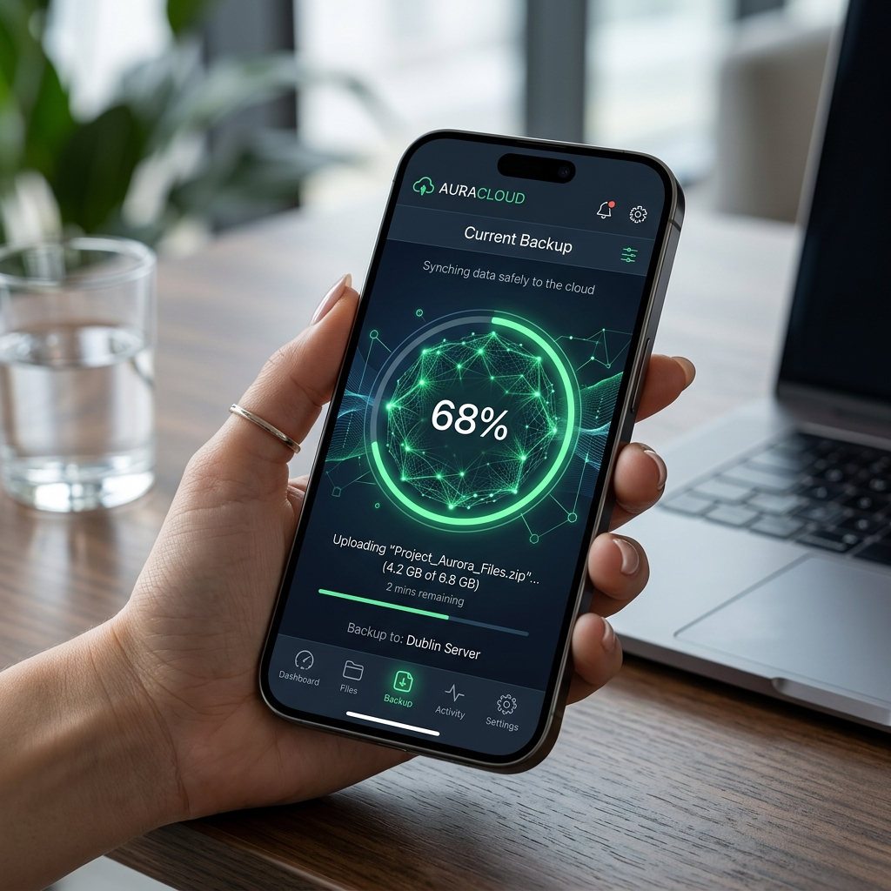
Mobile Nodes
• Capacitor-Powered
• Touch-Optimized Sharding
• Instant Cloud Sync
• Native-Feel Interactions

Slide 5
The Visual Identity
Colors: Vault Blue, Slate Dark, Emerald Green
Typography: 'Outfit' for headings, 'Inter' for body
Motion: Neural-Pulse & Float animations

Slide 6
The User Journey
• One-Click Sync: Automated mesh sharding
• Live Monitoring: Real-time efficiency gauges
• Temporal Recovery: Selecting snapshots from timeline
• Cognitive Parity: Secure reassembly of data

Slide 7
WHERE SECURITY MEETS DESIGN

